Slide 1
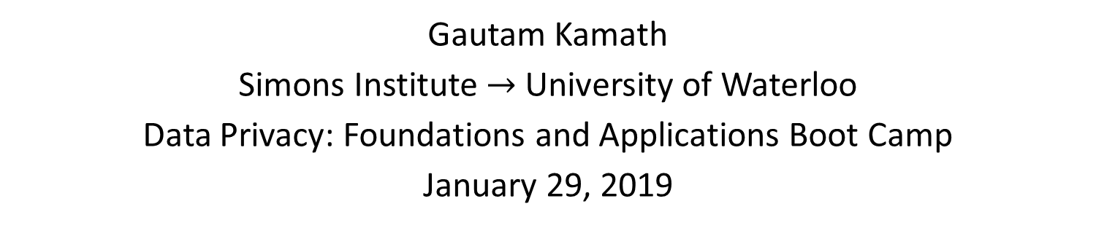
Private Statistics:
A TCS Perspective
Gautam Kamath
Simons Institute $→$ University of Waterloo
Data Privacy: Foundations and Applications Boot Camp
January 29, 2019

Slide 2
Outline
Setting and Goals
Hypothesis Testing
Distribution Estimation
(Some) Other Statistical Tasks

Slide 3
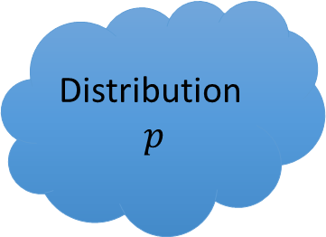

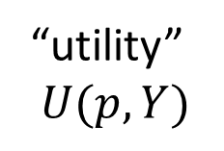
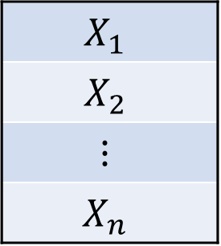

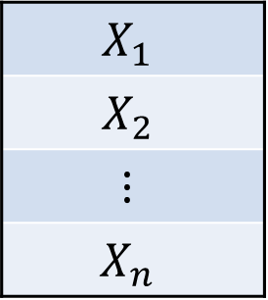
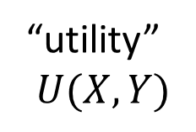
Algorithms vs. Statistics
Algorithms
$$X_{1}$$
$$X_{2}$$
$$⋮$$
$$X_{n}$$
M
$$Y$$
“utility”
$$U(X,Y)$$
Statistics
$$X_{1}$$
$$X_{2}$$
$$⋮$$
$$X_{n}$$
Distribution
$p$
M
$$Y$$
random
sampling
“utility”
$$U(p,Y)$$

Slide 4
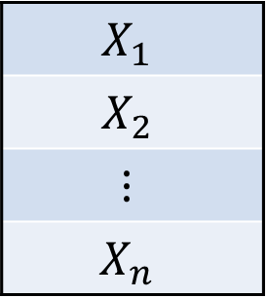
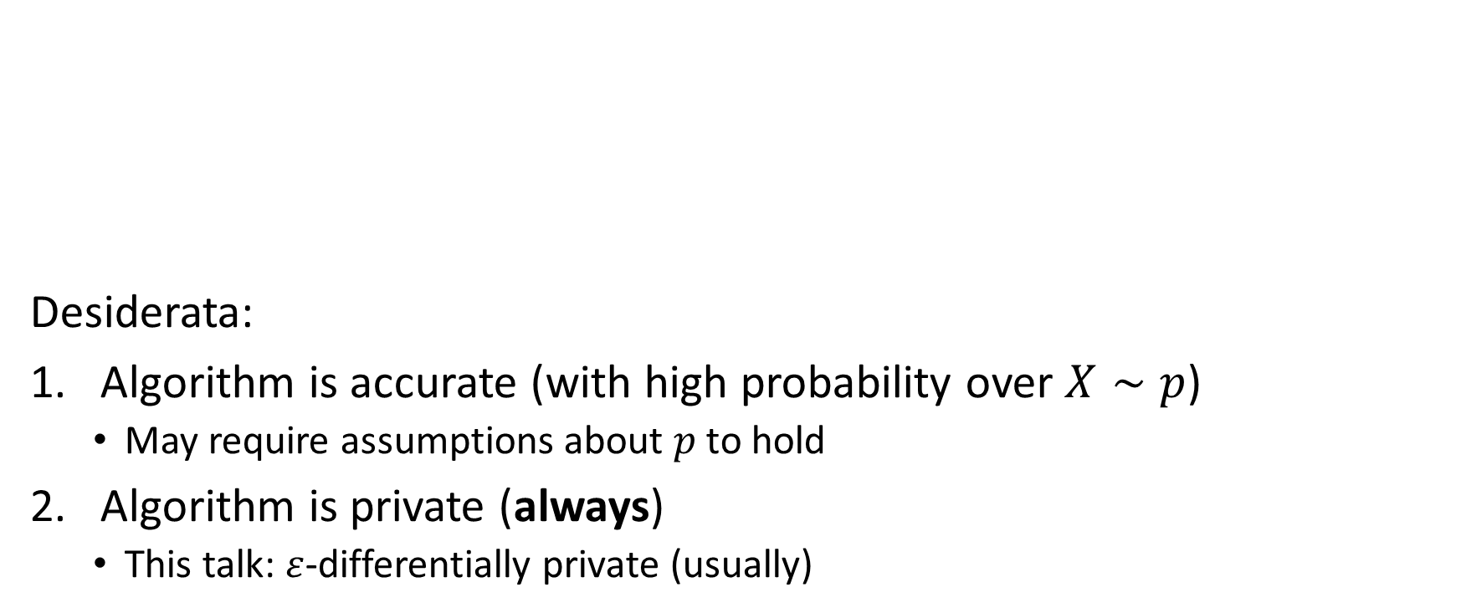
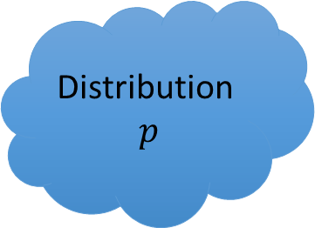
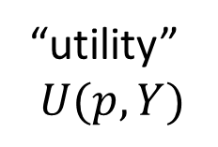

Privacy in Statistics
Statistics
$$X_{1}$$
$$X_{2}$$
$$⋮$$
$$X_{n}$$
Desiderata:
Algorithm is accurate (with high probability over $X∼p$)
  May require assumptions about $p$ to hold
Algorithm is private (always)
  This talk: $ε$-differentially private (usually)
Distribution
$p$
M
$$Y$$
random
sampling
“utility”
$$U(p,Y)$$

Slide 5
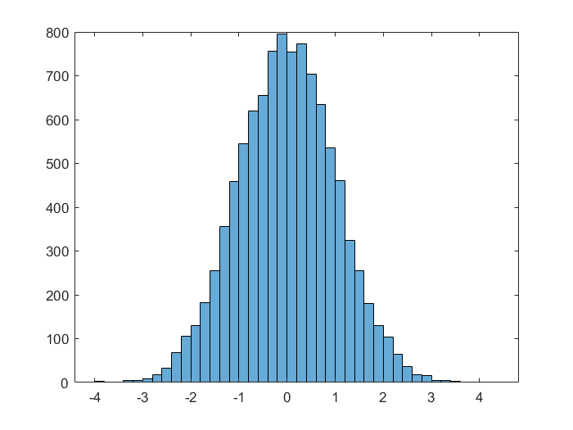
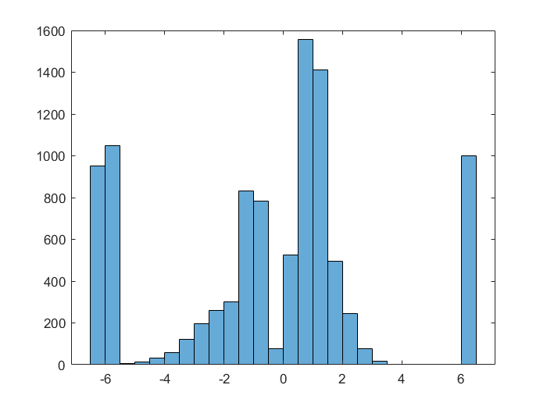
Privacy and Utility
Privacy ✓
Utility ✓
Privacy ✓
Utility ✗
Notes:
histogram(normrnd(0,1, 10000, 1))
X= [normrnd(-2,1,1400,1); normrnd(-1,0.2,1300,1); 4*betarnd(2,5,3000,1); normrnd(1, 0.2, 1300, 1); normrnd(6.5,0,1000,1); normrnd(-6, 0.1, 2000, 1);]; histogram(X)

Slide 6
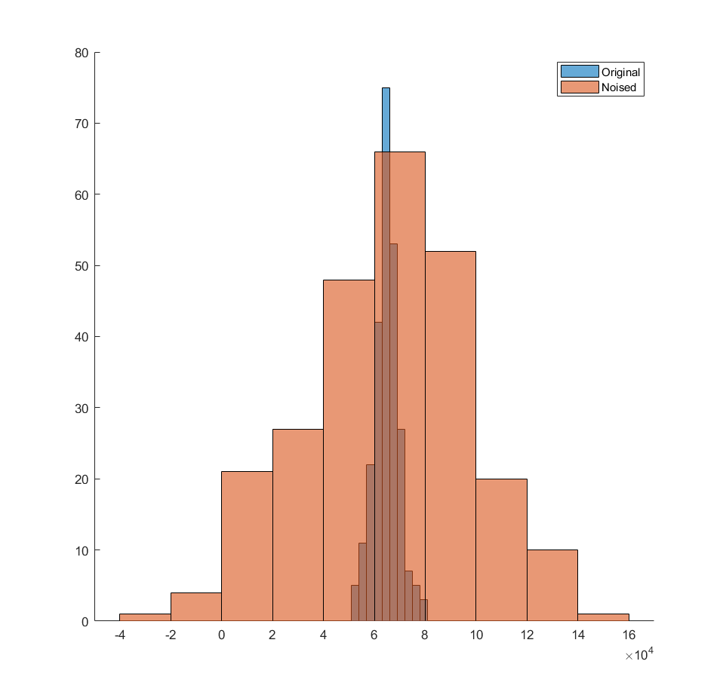
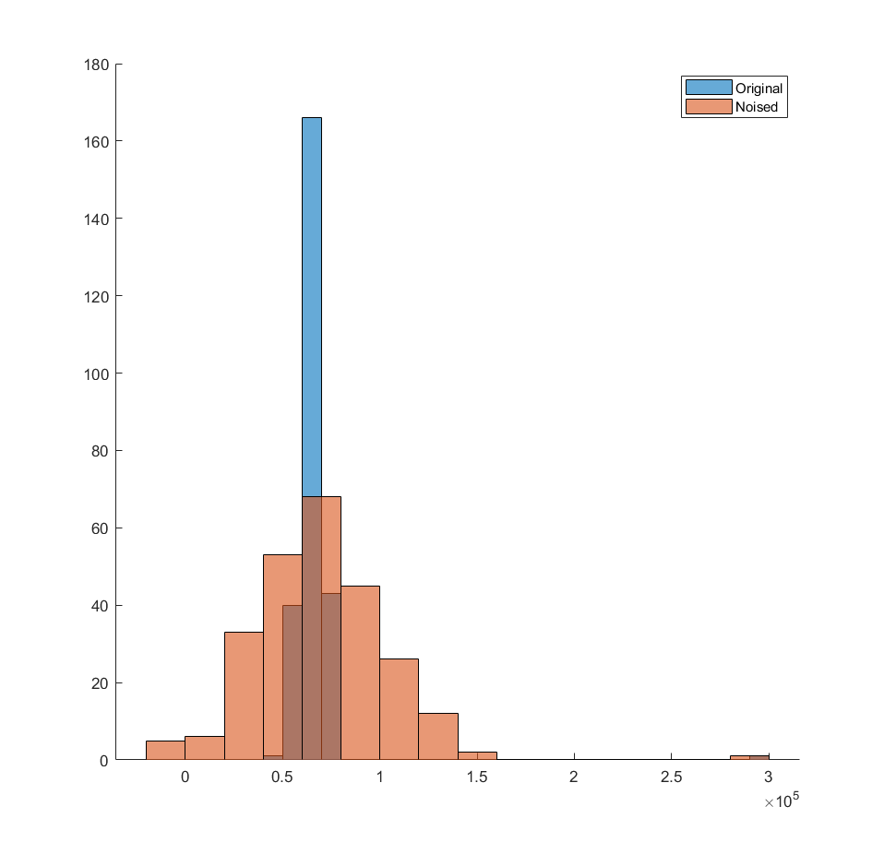
Why Worst-Case Privacy?
Can violate privacy of outliers
  Salaries: Noise, then release dataset
Notes:
X = [normrnd(65000,5000,250,1)]; Y = X + normrnd(0,30000,size(X)); figure(1); hold on; histogram(X);histogram(Y); legend( 'Original', 'Noised');
X = [normrnd(65000,5000,250,1); 300000]; Y = X + normrnd(0,30000,size(X)); figure(2); hold on; histogram(X);histogram(Y); legend( 'Original', 'Noised');

Slide 7
Why Worst-Case Privacy?
Can violate privacy of outliers
Statistics can be retracted, private information can’t
Notes:
X = [normrnd(65000,5000,250,1)]; Y = X + normrnd(0,30000,size(X)); figure(1); hold on; histogram(X);histogram(Y); legend( 'Original', 'Noised');
X = [normrnd(65000,5000,250,1); 300000]; Y = X + normrnd(0,30000,size(X)); figure(2); hold on; histogram(X);histogram(Y); legend( 'Original', 'Noised');

Slide 8
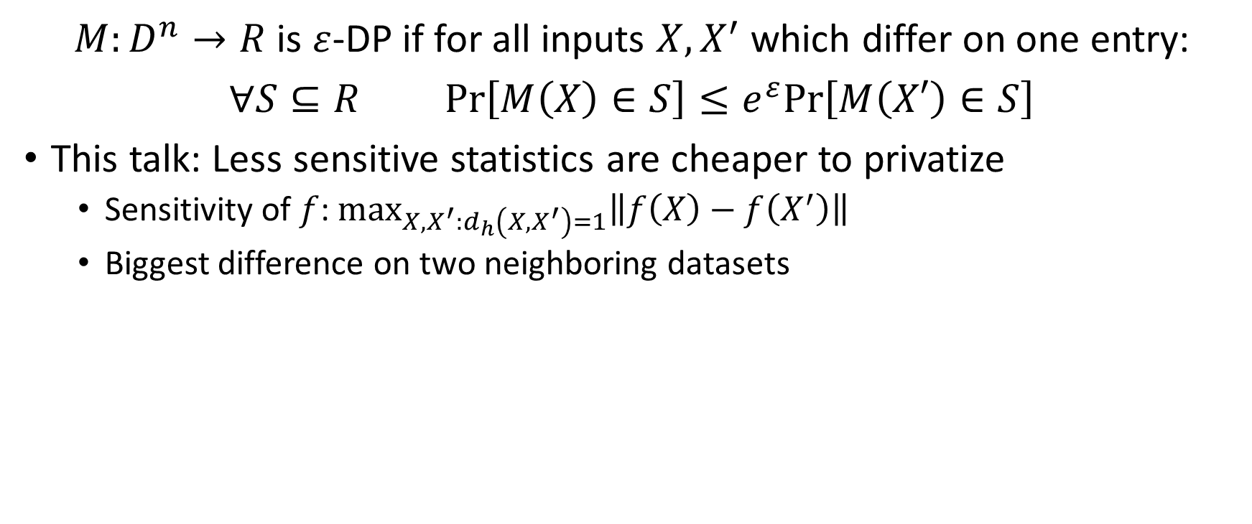
Privacy?
$M:D^{n}→R$ is $ε$-DP if for all inputs $X, X^{′}$ which differ on one entry:
$∀S⊆R$ $Pr\left[M\left(X\right)∈S\right]≤e^{ε}Pr\left[M\left(X′\right)∈S\right]$
This talk: Less sensitive statistics are cheaper to privatize
  Sensitivity of $f$: $\max_{X,X^{′}:d_{h}\left(X,X^{′}\right)=1}\left\|f\left(X\right)−f\left(X^{′}\right)\right\|$
  Biggest difference on two neighboring datasets

Slide 9
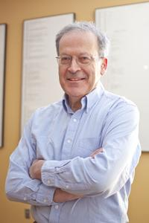
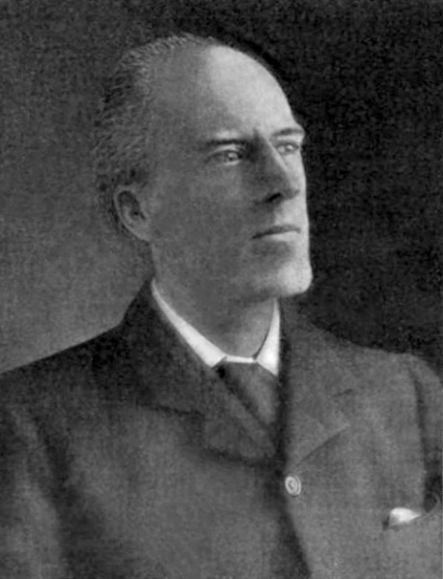
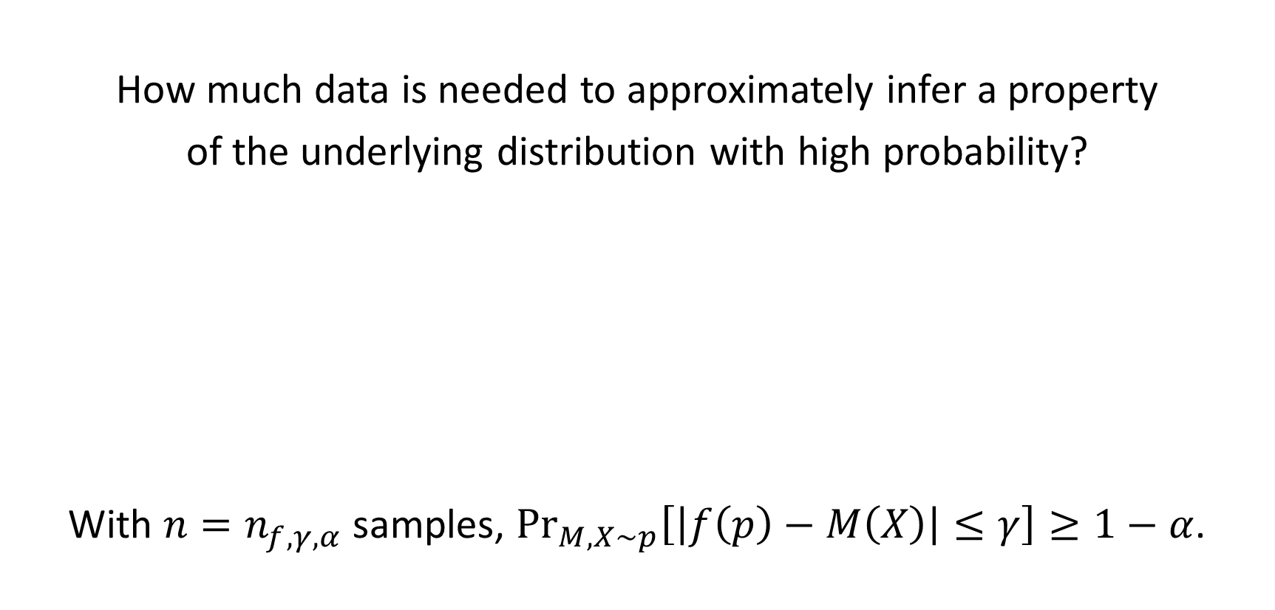
“Utility”?
How much data is needed to approximately infer a property
of the underlying distribution with high probability?
With $n=n_{f,γ,α}$ samples, $\underset{M, X∼p}{Pr}\left[\left|f\left(p\right)−M\left(X\right)\right|≤γ\right]≥1−α$.
Probably Approximately Correct (PAC) Learning
[L. Valiant ’84]

Slide 10
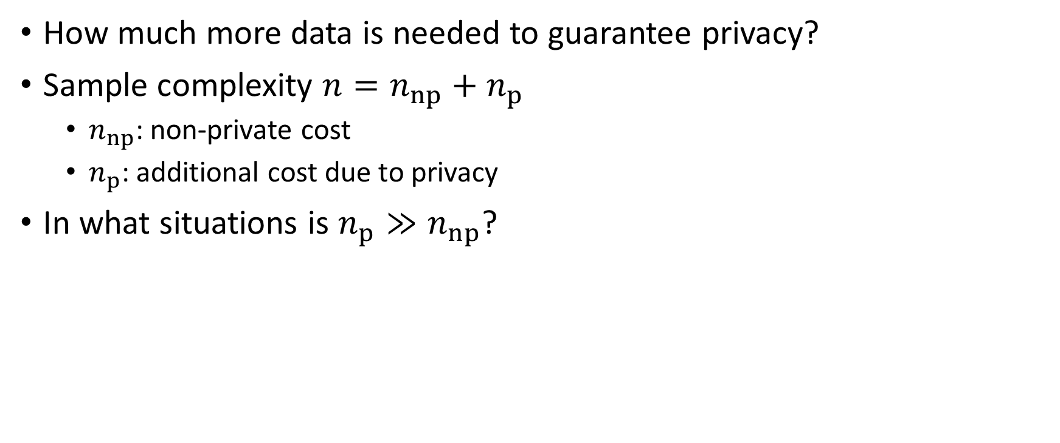
The Cost of Privacy
How much more data is needed to guarantee privacy?
Sample complexity $n=n_{np}+n_{p}$
  $n_{np}$: non-private cost
  $n_{p}$: additional cost due to privacy
In what situations is $n_{p}≫n_{np}$?

Slide 11
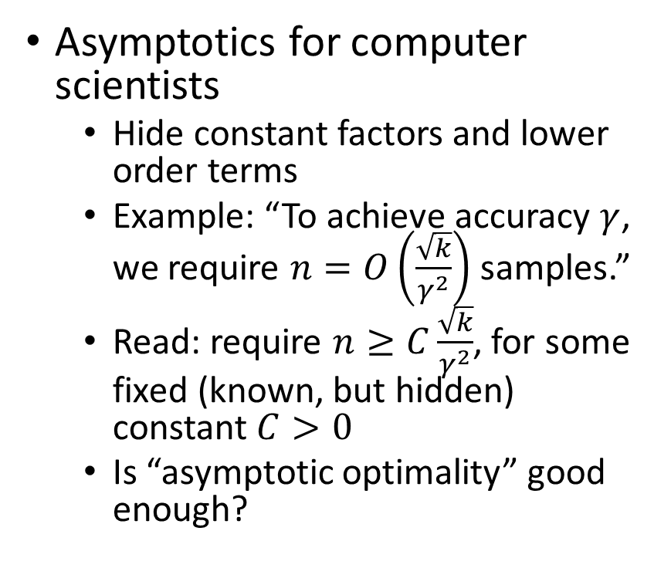
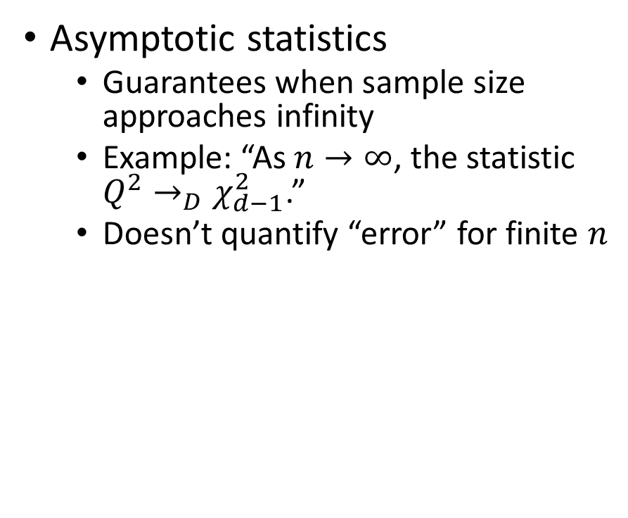
Asymptotic: One word, two meanings
Asymptotic statistics
  Guarantees when sample size approaches infinity
  Example: “As $n→∞$, the statistic $Q^{2}→_{D}χ_{d−1}^{2}$.”
  Doesn’t quantify “error” for finite $n$
Asymptotics for computer scientists
  Hide constant factors and lower order terms
  Example: “To achieve accuracy $γ$, we require $n=O\left(\frac{\sqrt{k}}{γ^{2}}\right)$ samples.”
  Read: require $n≥C\frac{\sqrt{k}}{γ^{2}}$, for some fixed (known, but hidden) constant $C>0$
  Is “asymptotic optimality” good enough?

Slide 12
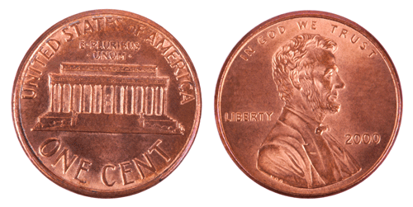
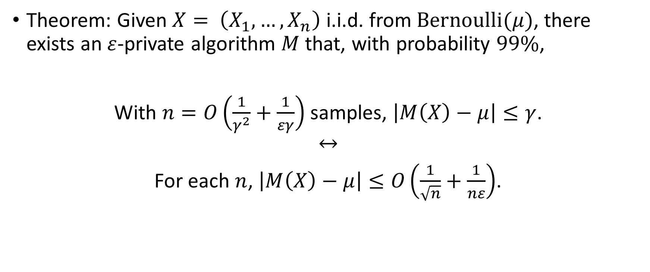
“Sample Complexity” versus “Rates”
Theorem: Given $X= \left(X_{1}, …, X_{n}\right)$ i.i.d. from $Bernoulli(μ)$, there exists an $ε$-private algorithm $M$ that, with probability $99\%$,
With $n=O\left(\frac{1}{γ^{2}}+\frac{1}{εγ}\right)$ samples, $\left|M\left(X\right)−μ\right|≤γ$.
$$↔$$
For each $n$, $\left|M\left(X\right)−μ\right|≤O\left(\frac{1}{\sqrt{n}}+\frac{1}{nε}\right)$.

Slide 13
Hypothesis Testing

Slide 14
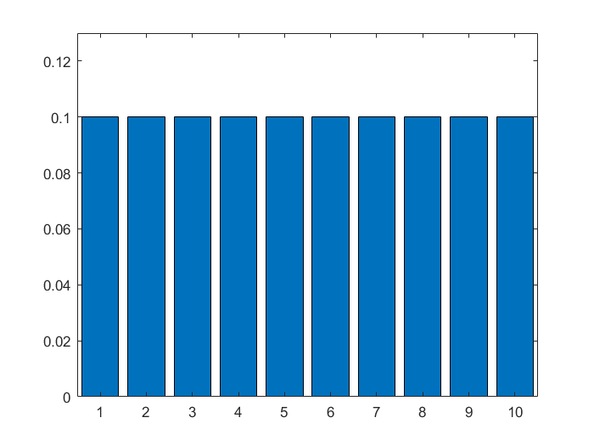
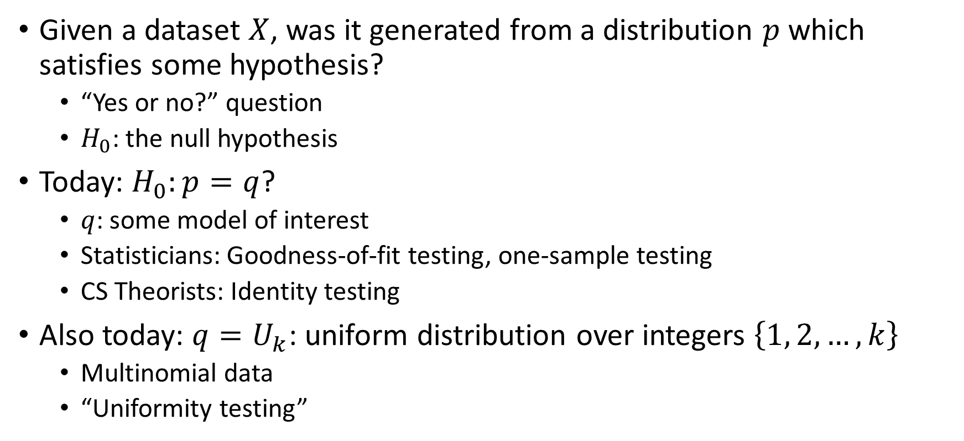
Hypothesis Testing
Given a dataset $X$, was it generated from a distribution $p$ which satisfies some hypothesis?
  “Yes or no?” question
  $H_{0}$: the null hypothesis
Today: $H_{0}:p=q$?
  $q$: some model of interest
  Statisticians: Goodness-of-fit testing, one-sample testing
  CS Theorists: Identity testing
Also today: $q=U_{k}$: uniform distribution over integers $\left\{1, 2, …, k\right\}$
  Multinomial data
  “Uniformity testing”
Notes:
n = 10; eps = 0.03; p1 = (1/n) * ones(1, n); figure(1); bar(p1); axis([0.5 n + 0.5 0 (1/n + eps)]);

Slide 15
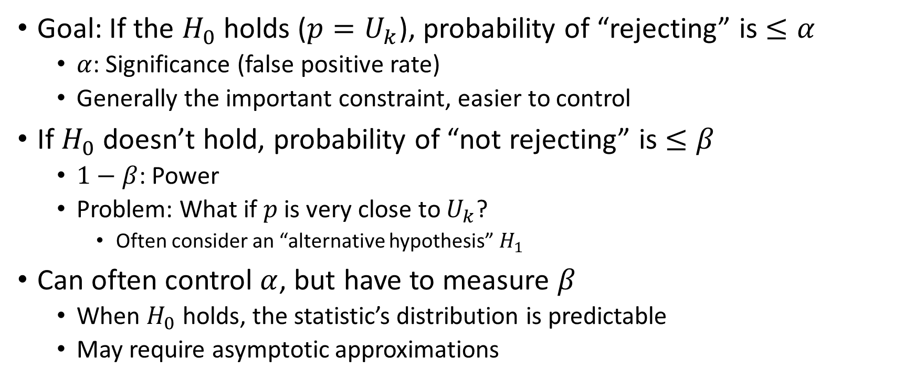
Classical Hypothesis Testing
Goal: If the $H_{0}$ holds ($p=U_{k}$), probability of “rejecting” is $≤α$
  $α$: Significance (false positive rate)
  Generally the important constraint, easier to control
If $H_{0}$ doesn’t hold, probability of “not rejecting” is $≤β$
  $1−β$: Power
  Problem: What if $p$ is very close to $U_{k}$?
    Often consider an “alternative hypothesis” $H_{1}$
Can often control $α$, but have to measure $β$
  When $H_{0}$ holds, the statistic’s distribution is predictable
  May require asymptotic approximations
Notes:
Type-I error, false positive rate
Type-II, false negative rate

Slide 16
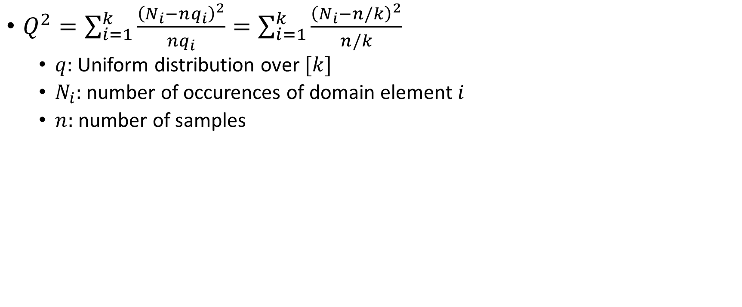
Non-private: Pearson’s Chi-squared Test
$Q^{2}=\sum_{i=1}^{k}{\frac{{\left(N_{i}−nq_{i}\right)}^{2}}{nq_{i}}}=\sum_{i=1}^{k}{\frac{{\left(N_{i}−n/k\right)}^{2}}{n/k}}$
  $q$: Uniform distribution over $[k]$
  $N_{i}$: number of occurences of domain element $i$
  $n$: number of samples
Notes:
Rescaled difference between real and expected counts

Slide 17

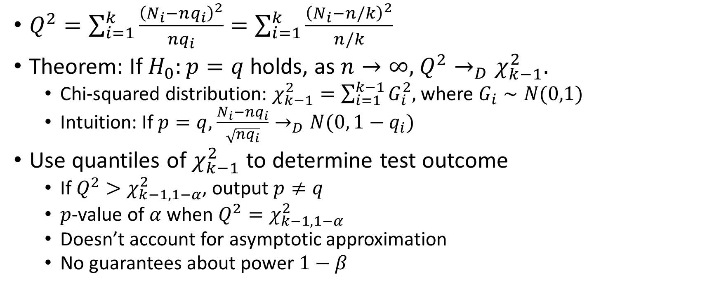
Non-private: Pearson’s Chi-squared Test
$Q^{2}=\sum_{i=1}^{k}{\frac{{\left(N_{i}−nq_{i}\right)}^{2}}{nq_{i}}}=\sum_{i=1}^{k}{\frac{{\left(N_{i}−n/k\right)}^{2}}{n/k}}$
Theorem: If $H_{0}:p=q$ holds, as $n→∞$, $Q^{2}→_{D}χ_{k−1}^{2}$.
  Chi-squared distribution: $χ_{k−1}^{2}=\sum_{i=1}^{k−1}{G_{i}^{2}}$, where $G_{i}∼N(0,1)$
  Intuition: If $p=q$, $\frac{N_{i}−nq_{i}}{\sqrt{nq_{i}}}→_{D}N(0, 1−q_{i})$
Use quantiles of $χ_{k−1}^{2}$ to determine test outcome
  If $Q^{2}>χ_{k−1, 1−α}^{2}$, output $p≠q$
  $p$-value of $α$ when $Q^{2}=χ_{k−1, 1−α}^{2}$
  Doesn’t account for asymptotic approximation
  No guarantees about power $1−β$
$$α=0.05$$
Notes:
x = 0:0.2:15;
y = chi2pdf(x,4);
plot(x,y)

Slide 18
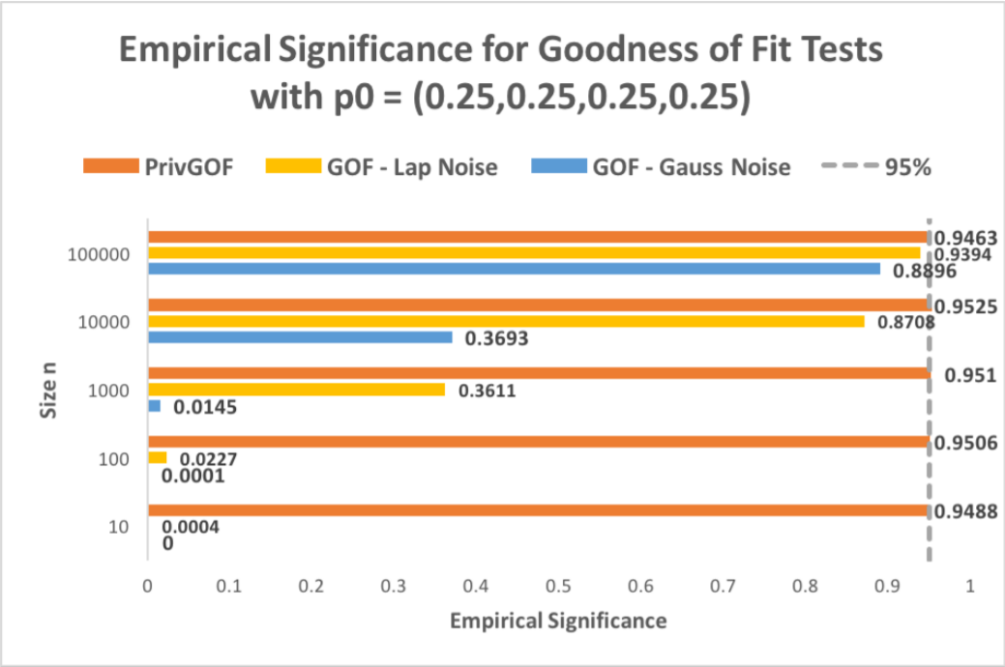
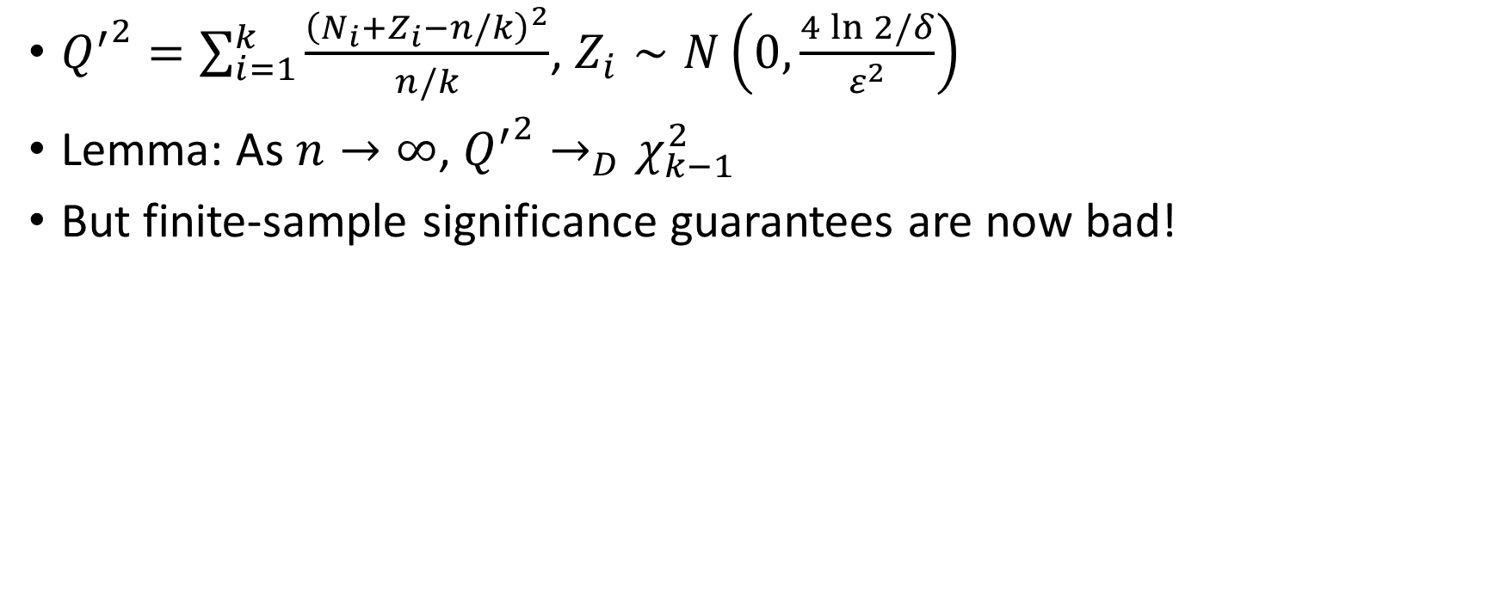
Privatizing the Chi-Squared Testing
[Gaboardi-Lim-Rogers-Vadhan ’16]
${Q^{′}}^{2}=\sum_{i=1}^{k}{\frac{{\left(N_{i}+Z_{i}−n/k\right)}^{2}}{n/k}}$, $Z_{i}∼N\left(0,\frac{4\ln{2/δ}}{ε^{2}}\right)$
Lemma: As $n→∞$, ${Q^{′}}^{2}→_{D}χ_{k−1}^{2}$
But finite-sample significance guarantees are now bad!

Slide 19
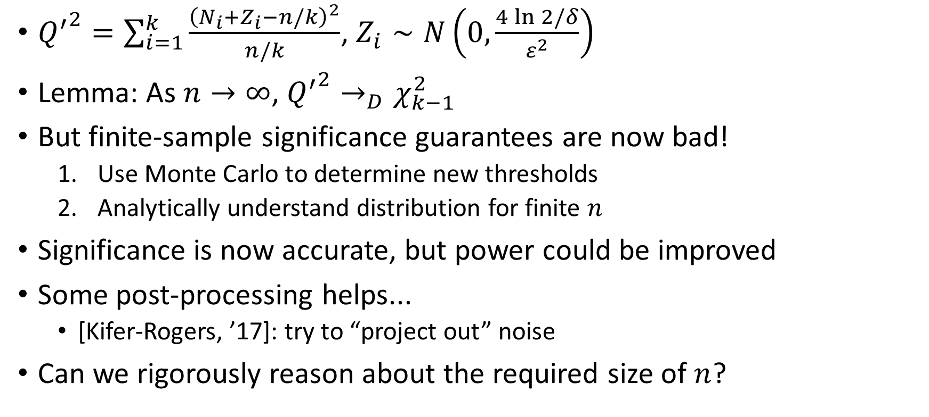
Privatizing the Chi-Squared Testing
[Gaboardi-Lim-Rogers-Vadhan ’16]
${Q^{′}}^{2}=\sum_{i=1}^{k}{\frac{{\left(N_{i}+Z_{i}−n/k\right)}^{2}}{n/k}}$, $Z_{i}∼N\left(0,\frac{4\ln{2/δ}}{ε^{2}}\right)$
Lemma: As $n→∞$, ${Q^{′}}^{2}→_{D}χ_{k−1}^{2}$
But finite-sample significance guarantees are now bad!
  Use Monte Carlo to determine new thresholds
  Analytically understand distribution for finite $n$
Significance is now accurate, but power could be improved
Some post-processing helps...
  [Kifer-Rogers, ’17]: try to “project out” noise
Can we rigorously reason about the required size of $n$?

Slide 20
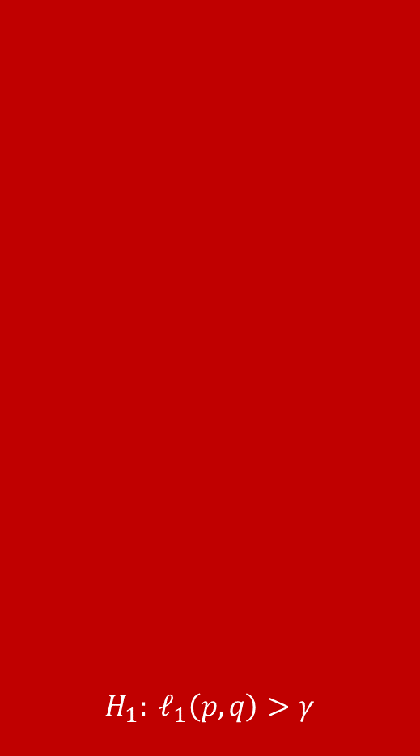
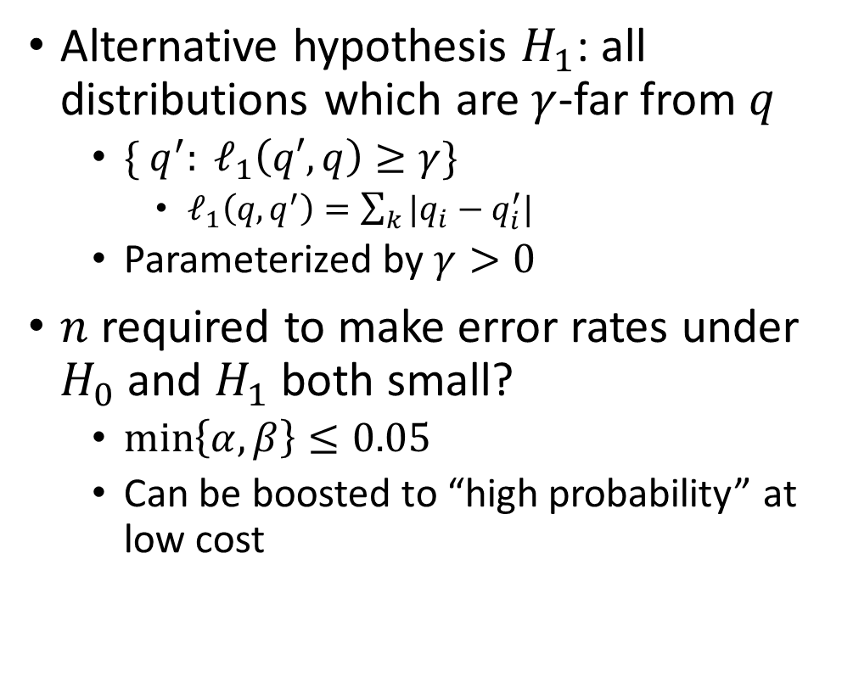

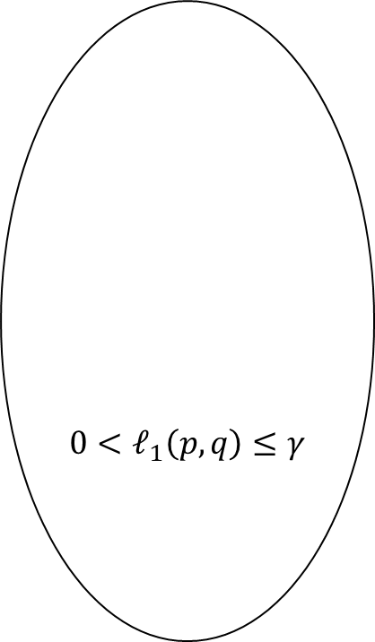
Minimax Hypothesis Testing
$$H_{1}: ℓ_{1}\left(p,q\right)>γ$$
Alternative hypothesis $H_{1}$: all distributions which are $γ$-far from $q$
  $\{ q^{′}: ℓ_{1}\left(q′, q\right)≥γ\}$
    $ℓ_{1}\left(q, q^{′}\right)=\sum_{k}{|q_{i}−q_{i}^{′}|}$
  Parameterized by $γ>0$
$n$ required to make error rates under $H_{0}$ and $H_{1}$ both small?
  $\min\left\{α,β\right\}≤0.05$
  Can be boosted to “high probability” at low cost
$$0<ℓ_{1}\left(p,q\right)≤γ$$
$$H_{0}: p=q$$

Slide 21
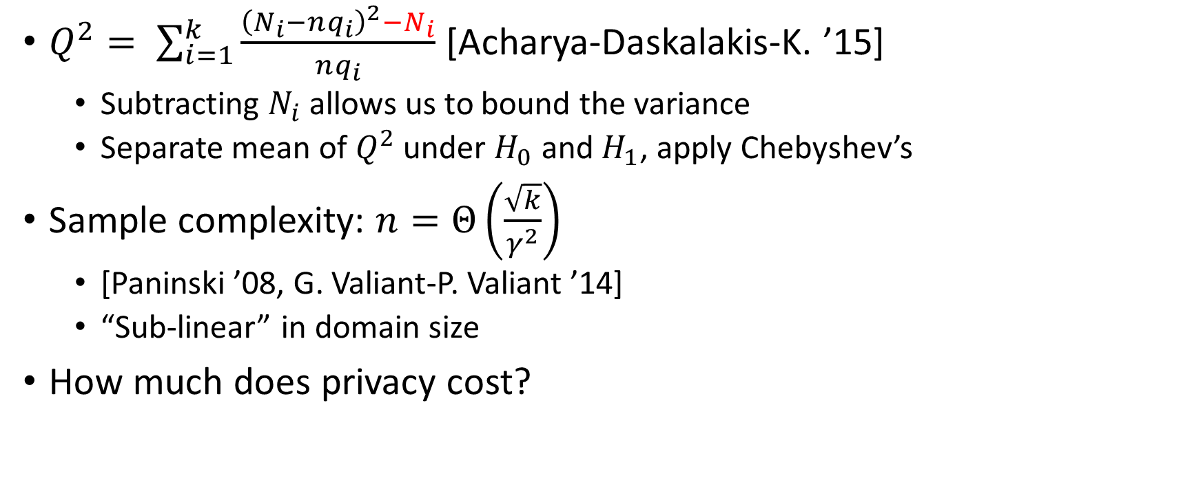
An minimax-optimal non-private test
$Q^{2}= \sum_{i=1}^{k}{\frac{{\left(N_{i}−nq_{i}\right)}^{2}−N_{i}}{nq_{i}}}$ [Acharya-Daskalakis-K. ’15]
  Subtracting $N_{i}$ allows us to bound the variance
  Separate mean of $Q^{2}$ under $H_{0}$ and $H_{1}$, apply Chebyshev’s
Sample complexity: $n=Θ\left(\frac{\sqrt{k}}{γ^{2}}\right)$
  [Paninski ’08, G. Valiant-P. Valiant ’14]
  “Sub-linear” in domain size
How much does privacy cost?

Slide 22
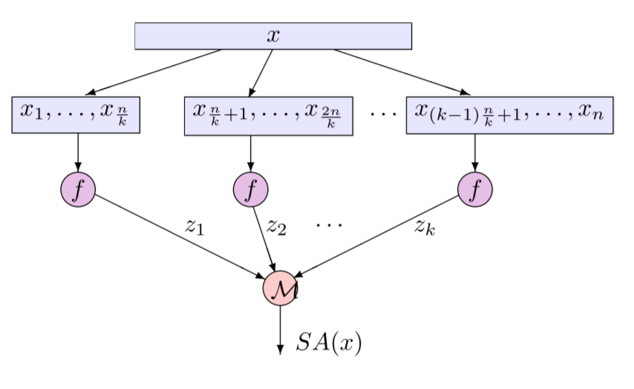
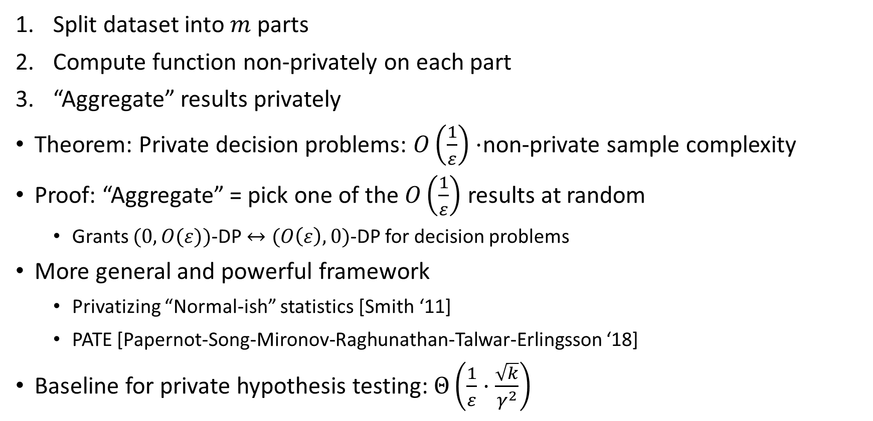
Subsample and Aggregate
[Nissim-Raskhodnikova-Smith ’07]
  Split dataset into $m$ parts
  Compute function non-privately on each part
  “Aggregate” results privately
  Theorem: Private decision problems: $O\left(\frac{1}{ε}\right)⋅$non-private sample complexity
  Proof: “Aggregate” = pick one of the $O\left(\frac{1}{ε}\right)$ results at random
    Grants $(0,O(ε))$-DP $↔(O\left(ε\right), 0)$-DP for decision problems
  More general and powerful framework
    Privatizing “Normal-ish” statistics [Smith ‘11]
    PATE [Papernot-Song-Mironov-Raghunathan-Talwar-Erlingsson ‘18]
  Baseline for private hypothesis testing: $Θ\left(\frac{1}{ε}⋅\frac{\sqrt{k}}{γ^{2}}\right)$

Slide 23
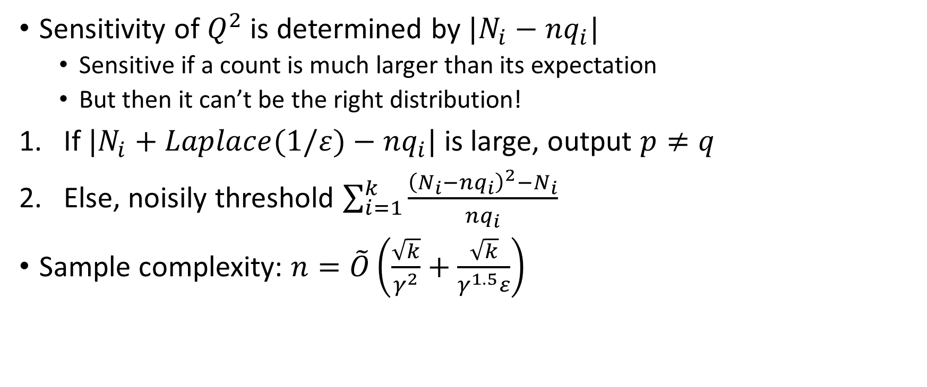
A Sensitivity-Limited Chi-Squared Test
[Cai-Daskalakis-K. ’17]
Sensitivity of $Q^{2}$ is determined by $|N_{i}−nq_{i}|$
  Sensitive if a count is much larger than its expectation
  But then it can’t be the right distribution!
If $|N_{i}+Laplace(1/ε)−nq_{i}|$ is large, output $p≠q$
Else, noisily threshold $\sum_{i=1}^{k}{\frac{{\left(N_{i}−nq_{i}\right)}^{2}−N_{i}}{nq_{i}}}$
Sample complexity: $n=\tilde{O}\left(\frac{\sqrt{k}}{γ^{2}}+\frac{\sqrt{k}}{γ^{1.5}ε}\right)$

Slide 24
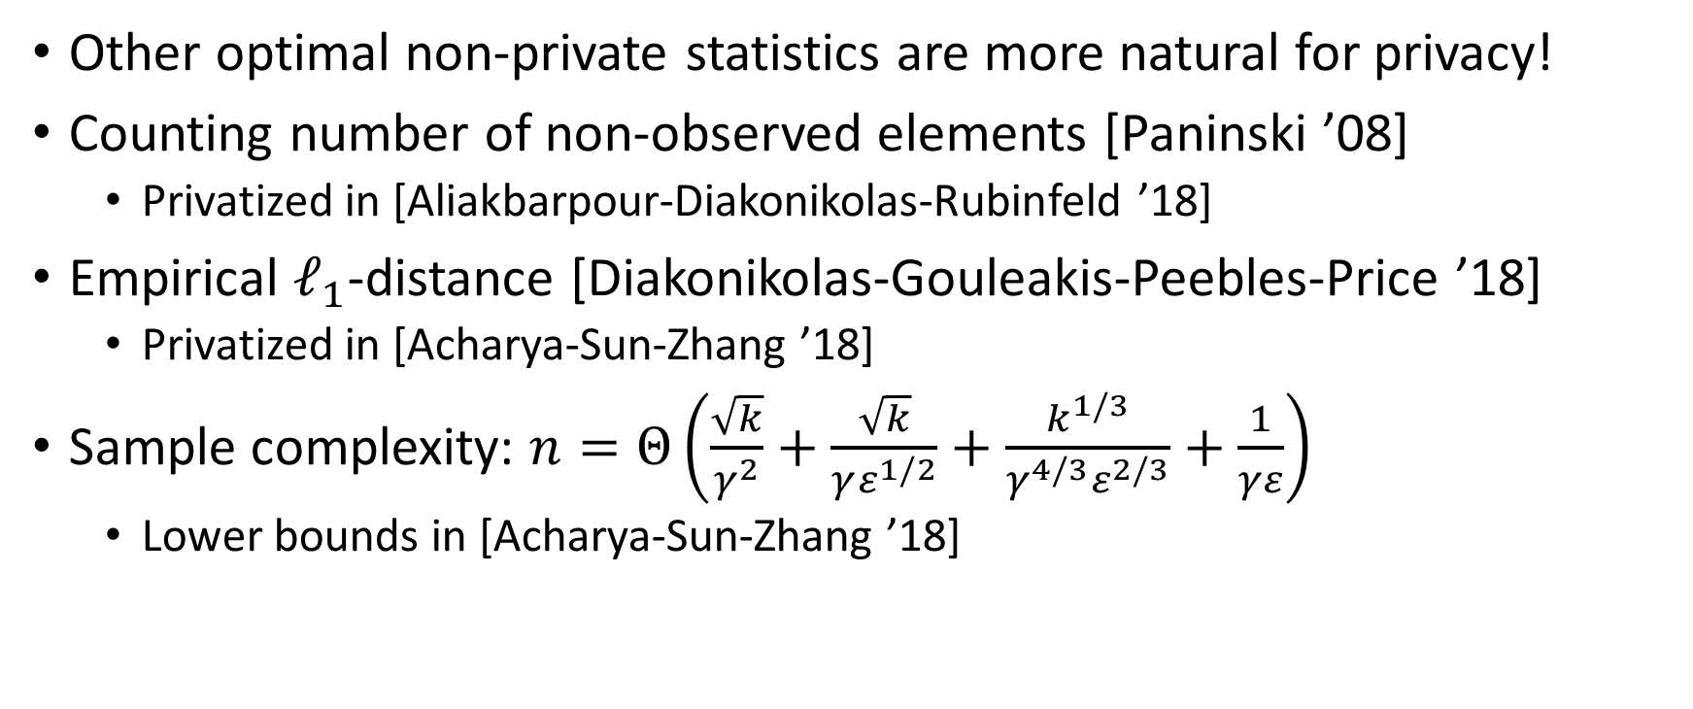
Even Better Tests!
Other optimal non-private statistics are more natural for privacy!
Counting number of non-observed elements [Paninski ’08]
  Privatized in [Aliakbarpour-Diakonikolas-Rubinfeld ’18]
Empirical $ℓ_{1}$-distance [Diakonikolas-Gouleakis-Peebles-Price ’18]
  Privatized in [Acharya-Sun-Zhang ’18]
Sample complexity: $n=Θ\left(\frac{\sqrt{k}}{γ^{2}}+\frac{\sqrt{k}}{γε^{1/2}}+\frac{k^{1/3}}{γ^{4/3}ε^{2/3}}+\frac{1}{γε}\right)$
  Lower bounds in [Acharya-Sun-Zhang ’18]

Slide 25
Distribution Estimation

Slide 26
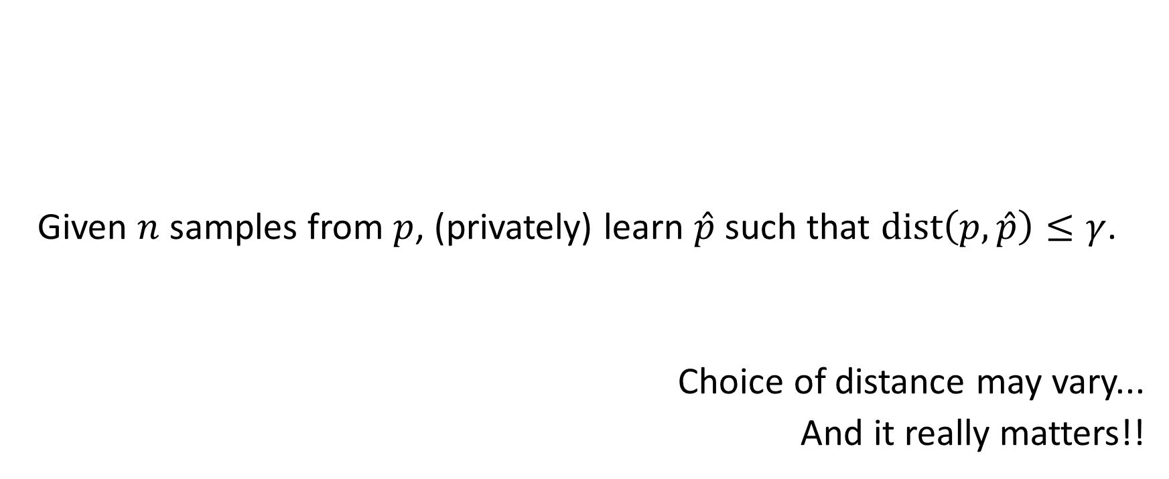
Private Distribution Estimation
Given $n$ samples from $p$, (privately) learn $\hat{p}$ such that $dist\left(p, \hat{p}\right)≤γ$.
Choice of distance may vary...
And it really matters!!

Slide 27
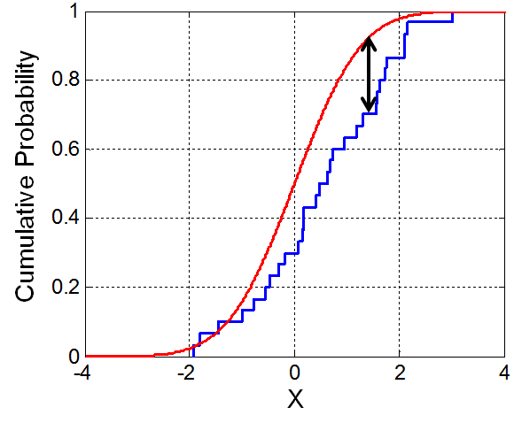

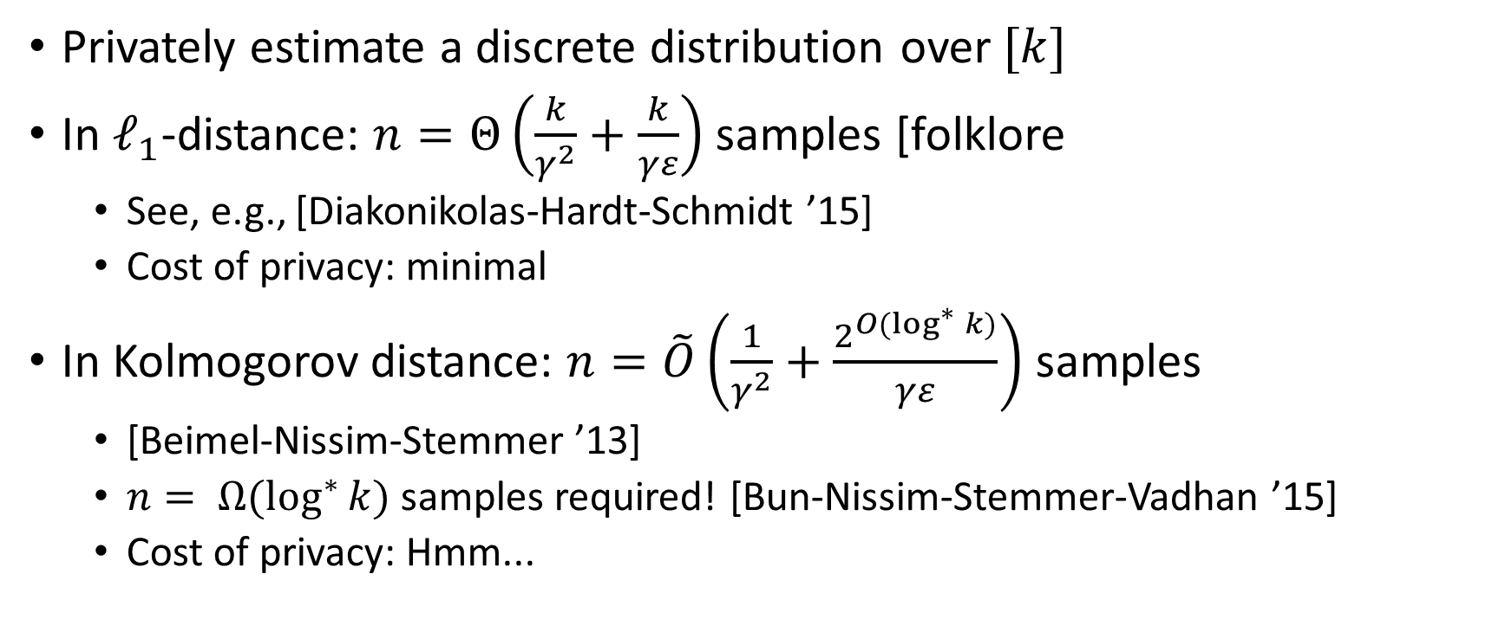
Univariate Learning: Multinomials
Privately estimate a discrete distribution over $[k]$
In $ℓ_{1}$-distance: $n=Θ\left(\frac{k}{γ^{2}}+\frac{k}{γε}\right)$ samples [folklore
  See, e.g., [Diakonikolas-Hardt-Schmidt ’15]
  Cost of privacy: minimal
In Kolmogorov distance: $n=\tilde{O}\left(\frac{1}{γ^{2}}+\frac{2^{O(\log^{∗}{k})}}{γε}\right)$ samples
  [Beimel-Nissim-Stemmer ’13]
  $n= Ω(\log^{∗}{k})$ samples required! [Bun-Nissim-Stemmer-Vadhan ’15]
  Cost of privacy: Hmm...
*$(ε,δ)$-DP

Slide 28
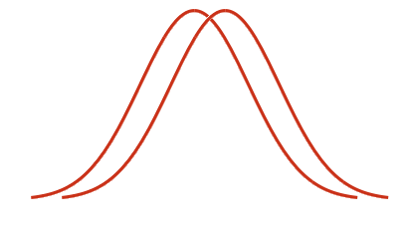
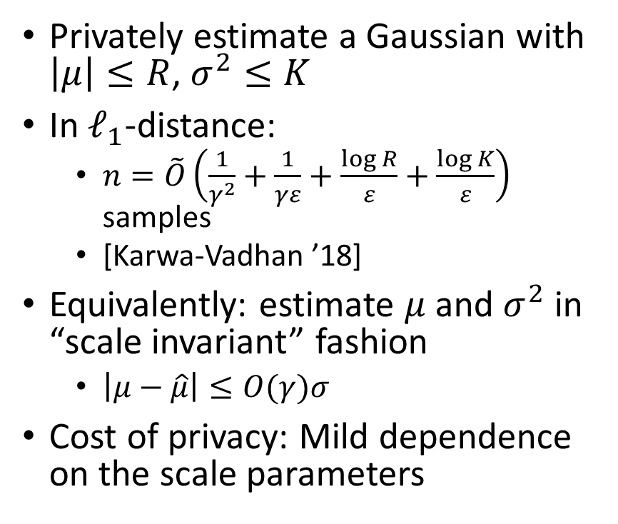
Univariate Learning: Gaussians
Privately estimate a Gaussian with $\left|μ\right|≤R$, $σ^{2}≤K$
In $ℓ_{1}$-distance:
  $n=\tilde{O}\left(\frac{1}{γ^{2}}+\frac{1}{γε}+\frac{\log{R}}{ε}+\frac{\log{K}}{ε}\right)$ samples
  [Karwa-Vadhan ’18]
Equivalently: estimate $μ$ and $σ^{2}$ in “scale invariant” fashion
  $\left|μ−\hat{μ}\right|≤O(γ)σ$
Cost of privacy: Mild dependence on the scale parameters

Slide 29
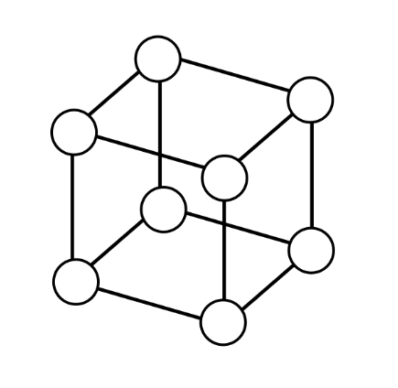

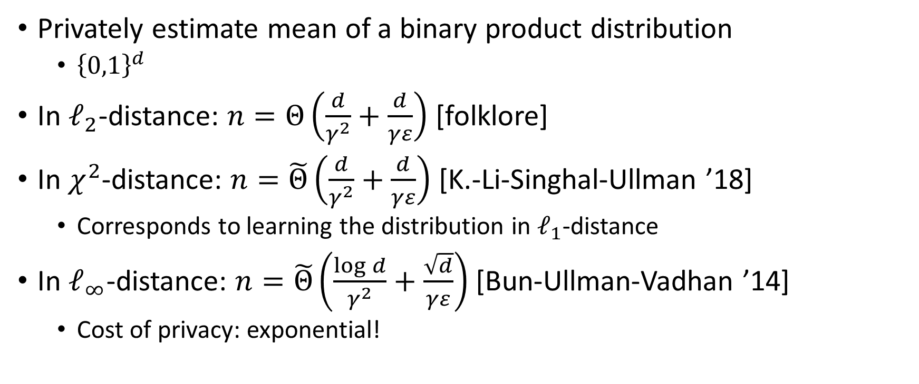
Multivariate Learning: Product Distributions
Privately estimate mean of a binary product distribution
  ${\left\{0,1\right\}}^{d}$
In $ℓ_{2}$-distance: $n=Θ\left(\frac{d}{γ^{2}}+\frac{d}{γε}\right)$ [folklore]
In $χ^{2}$-distance: $n=\tilde{Θ}\left(\frac{d}{γ^{2}}+\frac{d}{γε}\right)$ [K.-Li-Singhal-Ullman ’18]
  Corresponds to learning the distribution in $ℓ_{1}$-distance
In $ℓ_{∞}$-distance: $n=\tilde{Θ}\left(\frac{\log{d}}{γ^{2}}+\frac{\sqrt{d}}{γε}\right)$ [Bun-Ullman-Vadhan ’14]
  Cost of privacy: exponential!
*$(ε,δ)$-DP

Slide 30
Univariate Learning: Gaussians
Privately estimate a Gaussian with $\left|μ\right|≤R$, $σ^{2}≤K$
In $ℓ_{1}$-distance:
  $n=\tilde{O}\left(\frac{1}{γ^{2}}+\frac{1}{γε}+\frac{\log{R}}{ε}+\frac{\log{K}}{ε}\right)$ samples
  [Karwa-Vadhan ’18]
Equivalently: estimate $μ$ and $σ^{2}$ in “scale invariant” fashion
  $\left|μ−\hat{μ}\right|≤O(γ)σ$
Cost of privacy: Mild dependence on the scale parameters

Slide 31

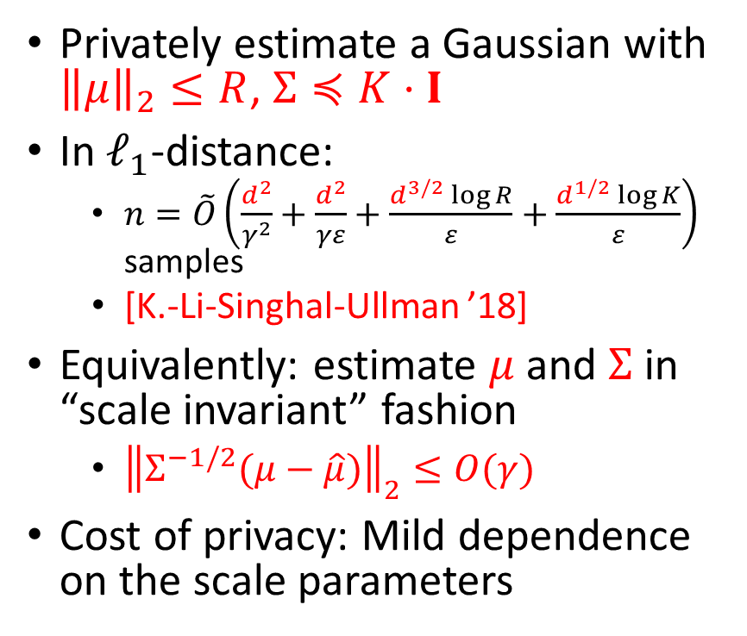
Multivariate Learning: Gaussians
*$(ε,δ)$-DP
Privately estimate a Gaussian with ${\left\|μ\right\|}_{2}≤R$, $Σ≼K⋅I$
In $ℓ_{1}$-distance:
  $n=\tilde{O}\left(\frac{d^{2}}{γ^{2}}+\frac{d^{2}}{γε}+\frac{d^{3/2}\log{R}}{ε}+\frac{d^{1/2}\log{K}}{ε}\right)$ samples
  [K.-Li-Singhal-Ullman ’18]
Equivalently: estimate $μ$ and $Σ$ in “scale invariant” fashion
  ${\left\|Σ^{−1/2}(μ−\hat{μ})\right\|}_{2}≤O(γ)$
Cost of privacy: Mild dependence on the scale parameters

Slide 32
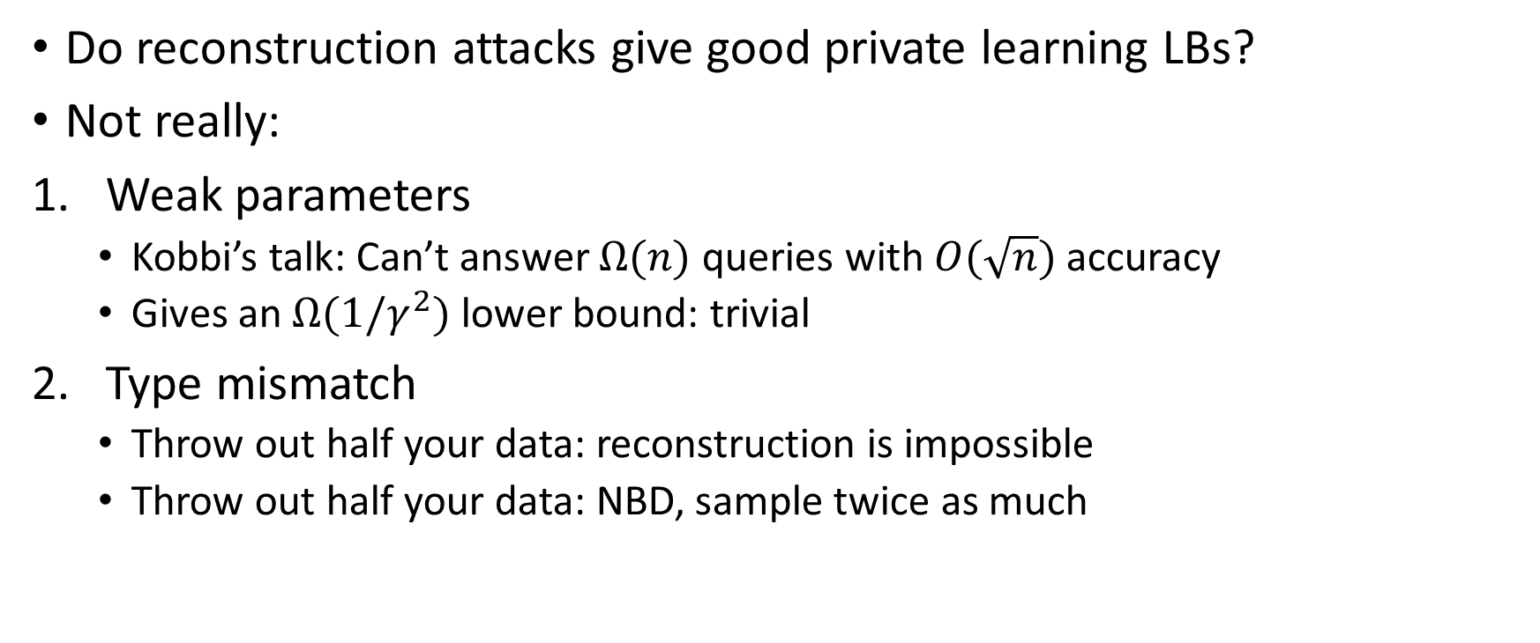
Distribution Learning vs. Reconstruction
Do reconstruction attacks give good private learning LBs?
Not really:
Weak parameters
  Kobbi’s talk: Can’t answer $Ω(n)$ queries with $O(\sqrt{n})$ accuracy
  Gives an $Ω(1/γ^{2})$ lower bound: trivial
Type mismatch
  Throw out half your data: reconstruction is impossible
  Throw out half your data: NBD, sample twice as much

Slide 33
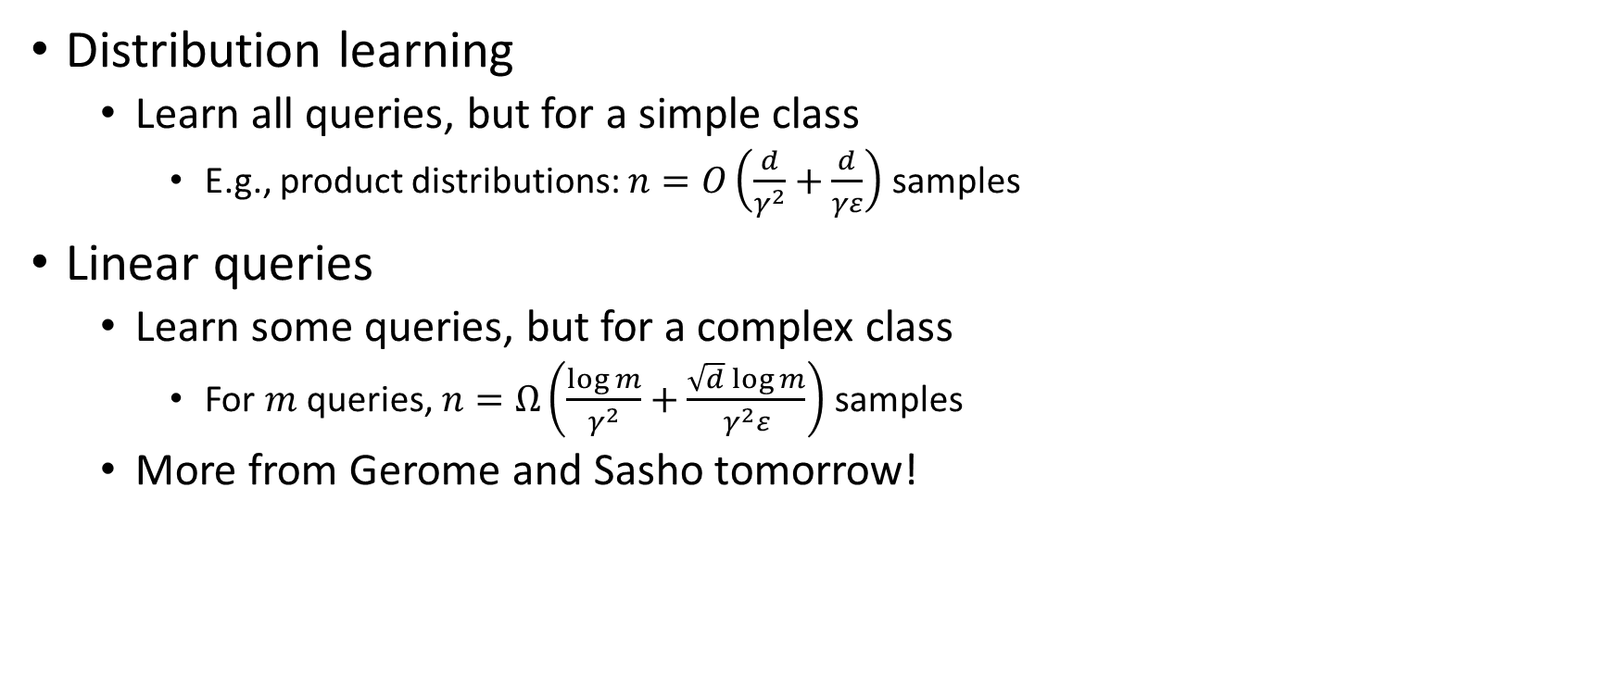
Distribution Learning vs. Linear Queries
Distribution learning
  Learn all queries, but for a simple class
    E.g., product distributions: $n=O\left(\frac{d}{γ^{2}}+\frac{d}{γε}\right)$ samples
Linear queries
  Learn some queries, but for a complex class
    For $m$ queries, $n=Ω\left(\frac{\log{m}}{γ^{2}}+\frac{\sqrt{d}\log{m}}{γ^{2}ε}\right)$ samples
  More from Gerome and Sasho tomorrow!

Slide 34
Other Private Statistics

Slide 35
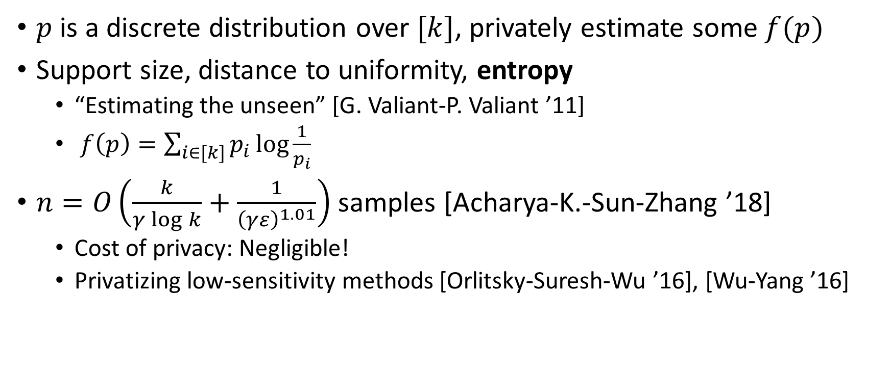
Distributional Functional Estimation
$p$ is a discrete distribution over $[k]$, privately estimate some $f(p)$
Support size, distance to uniformity, entropy
  “Estimating the unseen” [G. Valiant-P. Valiant ’11]
  $f\left(p\right)=\sum_{i∈[k]}{p_{i}\log{\frac{1}{p_{i}}}}$
$n=O\left(\frac{k}{γ\log{k}}+\frac{1}{{\left(γε\right)}^{1.01}}\right)$ samples [Acharya-K.-Sun-Zhang ’18]
  Cost of privacy: Negligible!
  Privatizing low-sensitivity methods [Orlitsky-Suresh-Wu ’16], [Wu-Yang ’16]

Slide 36

Simple Hypothesis Testing
Determine whether $X$ was generated from (known) $q_{0}$ or $q_{1}$
  Compute likelihood of data, see which one is bigger
$$LLR=\sum_{i=1}^{n}{\log{\frac{q_{0}\left(X_{i}\right)}{q_{1}\left(X_{i}\right)}}}$$
Neyman-Pearson Lemma: “The log-likelihood ratio test is optimal.”
Sample complexity: $n=Θ\left(\frac{1}{H^{2}(q_{0},q_{1})}\right)$ samples
  Hellinger distance: $H^{2}\left(q_{0},q_{1}\right)=\frac{1}{2}∫{\left(\sqrt{q_{0}\left(x\right)} −\sqrt{q_{1}\left(x\right)}\right)}^{2}dx$
How to privatize?

Slide 37

Private Simple Hypothesis Testing
$$ncLLR=\sum_{i=1}^{n}{{\left[\log{\frac{q_{0}\left(X_{i}\right)}{q_{1}\left(X_{i}\right)}}\right]}_{−ε^{′}}^{ε}+Laplace(2)}$$
But... what is $ε′$?
Simple private hypothesis testing: not so simple
Theorem: $ncLLR$ has the optimal sample complexity (up to constants)
  [Canonne-K.-McMillan-Smith-Ullman ’18]
Not quite Neyman-Pearson...

Slide 38

Private Simple Hypothesis Testing on Binomials
$q_{0}:Bernoulli(τ_{0})$, $q_{1}:Bernoulli\left(τ_{1}\right)$
Neyman-Pearson: Threshold $\sum_{i=1}^{n}{X_{i}}$
  Uniformly most powerful (UMP): same threshold is optimal for all $τ_{1}$ simultaneously
A UMP private test for Binomial data
  Noise using a “Truncated-Uniform-Laplace” (Tulap) distribution
  [Awan-Slavković ’18]
  Improves upon overlapping work by [Ghosh-Roughgarden-Sundararajan ’09]
UMPs can’t exist when the domain is larger than 2
  [Brenner-Nissim ’10]

Slide 39


Changepoint Detection
$X_{1},…,X_{t^{∗}−1}∼q_{0}$, $X_{t^{∗}},…,X_{n}∼q_{1}$
Output $\hat{t}$ which minimizes $|\hat{t}−t^{∗}|$
Non-private: Cumulative Sum (CUSUM)
  Based on log-likelihood ratio test
  Private analysis by [Cummings-Krehbiel-Mei-Tuo-Zhang ’18]
  Same drawbacks as LLR...
Reduction from changepoint detection to simple hypothesis testing
  Apply test from before
  [Canonne-K.-McMillan-Smith-Ullman ’18]

Slide 40
Other things

Slide 41
Local Privacy
Hypothesis Testing
  [Gaboardi-Rogers ’18], [Sheffet ’18], [Acharya-Canonne-Freitag-Tyagi ’19]
Distribution Estimation
  [Duchi-Jordan-Wainwright ’13]
  Multinomials: [Kairouz-Bonawitz-Ramage ’16], [Acharya-Sun-Zhang ’18], [Ye-Barg ’18]
  Gaussians: [Gaboardi-Rogers-Sheffet ’19], [Joseph-Kulkarni-Mao-Wu ’18]

Slide 42
Other related tasks
PCA
  [Chaudhuri-Sarwate-Sinha ’12], [Dwork-Talwar-Thakurta-Zhang ’14]
Clustering
  [Wang-Wang-Singh ’15], [Balcan-Dick-Liang-Mou-Zhang ’17]
Computing Robust Statistics
  [Dwork-Lei ’09]

Slide 43
Thanks!

