Slide 1
An Analysis of One-Dimensional Schelling Segregation
Gautam Kamath, Cornell University
Christina Brandt, Stanford University
Nicole Immorlica, Northwestern University
Robert Kleinberg, Cornell University

Slide 2
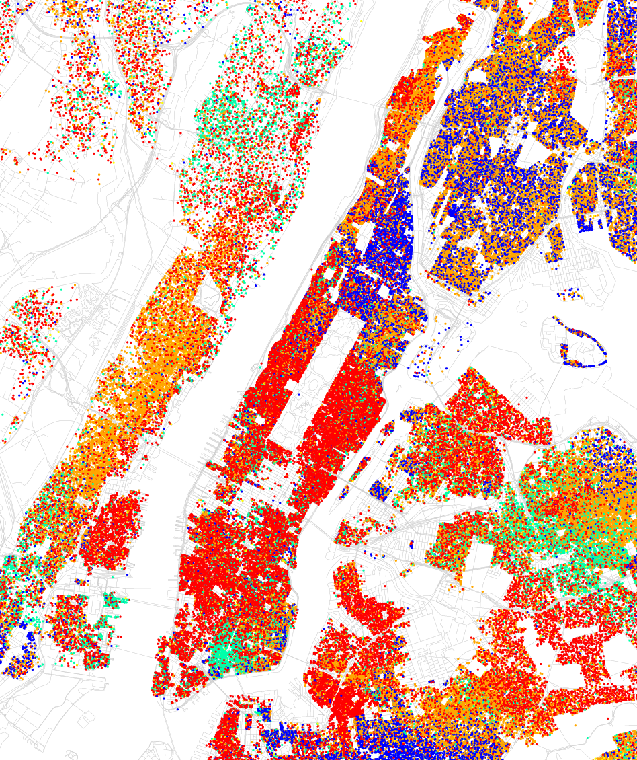
Goal: Mathematically model and
understand residential segregation
The New Yorker Hotel
- White
- Black
- Hispanic
In a one-dimensional network with local neighborhoods, segregation exhibits only local effects.
- Asian
map by Eric Fischer
Notes:
By Eric Fischer, inspired by Bill Rankin
Talk is about result: network with local neighborhoods -> segregation only has (small) local effects

Slide 3

Notes:
In 1969, Nobel prize Schelling presented a segregation model
Important for two reasons:
1. Movement from policy research to mathematical research
2. Benchmark model for understanding how local dynamics can cause global effects, a topic of interest in many fields, including game theory and economics

Slide 4
Start with a random coloring of the ring
n = size of ring
Notes:
Schelling’s model in the 1960’s
Describe model, give example of swap and why they’re unhappy
Abstract to general W
Happy with at least 50% like colored neighbors: no individual wants to be a minority, but also does not prefer to be surrounded by only individuals of the same type

Slide 5
Happy if at least 50%
like-colored near neighbors.
w = window size
Notes:
Schelling’s model in the 1960’s
Describe model, give example of swap and why they’re unhappy
Abstract to general W
Happy with at least 50% like colored neighbors: no individual wants to be a minority, but also does not prefer to be surrounded by only individuals of the same type

Slide 6
At each time step, swap
position of two unhappy
individuals of opposite color
Notes:
Schelling’s model in the 1960’s
Describe model, give example of swap and why they’re unhappy
Abstract to general W
Happy with at least 50% like colored neighbors: no individual wants to be a minority, but also does not prefer to be surrounded by only individuals of the same type

Slide 7
Segregation:
run-lengths in stable configuration

Slide 8


Schelling’s Experimental Result:
Local dynamics lead to segregation.
Schelling’s experiment: n = 70, w = 4
Average run length: 12
Notes:
Schelling provided some experimental results
Concluded: local dynamics lead to segregation
Run length 12 was much longer than needed to make everyone happy
Our experimental results were qualitatively similar
Question is: is segregation independent of n, meaning local segregation based solely on individual preferences?
Or is it dependent on n, meaning global segregation is inevitable.
If it’s independent of n, how severe is this segregation?
12 is a small constant times w, yet also a significant fraction of n
Not sufficient to classify the nature of the segregation

Slide 9
The Big Questions
Is run length a function of n or w?
Global vs. local segregation
If function of w, polynomial vs. exponential?

Slide 10
Young’s result:
In the perturbed Schelling model, segregation is global and severe. (stable run length: O(n))
[Young, 2001]
Our main result (informal):
In the unperturbed Schelling model, segregation is local and modest. (stable run length: O(w²))
[Brandt, Immorlica, Kamath, Kleinberg, 2012]
Notes:
Young, stochastic stability:
ring model, w=1, \tau=0.5
agents make mistakes with vanishingly small probability
Under these rules, global segregation is inevitable

Slide 11
Working our way up
With high probability, process will reach a stable configuration
Average run length independent of ring size
Average run length is modest

Slide 12
Techniques
Defn. A firewall is a sequence of w+1 consecutive individuals of the same type.
Claim: Firewalls are stable with respect to the dynamics.
Notes:
Define a firewall
Note that every individual in a firewall is happy

Slide 13
Convergence
Theorem. For any fixed window size w, as n grows, the probability that the process reaches a stable configuration converges to 1.
Proof Sketch:
With high probability, there exists a firewall in the initial configuration
Individual has positive probability of joining a firewall, and can never leave

Slide 14
Working our way up
✔
With high probability, process will reach a stable configuration
Average run length independent of ring size
Average run length is modest

Slide 15
An easy bound on run length
Theorem. Ave run length in final state is O(2^{w}).
Proof.
Expect to look O(2^{w}) steps before we find a blue firewall in both directions
Bounds length of a green firewall containing site
Symmetric for a blue firewall containing site
random site
look for blue firewall
look for blue firewall

Slide 16
Working our way up
✔
With high probability, process will reach a stable configuration
Average run length independent of ring size
Average run length is modest
✔

Slide 17
Techniques
A green firewall incubator, rich in green nodes.
A blue firewall incubator, rich in blue nodes.
Define firewall incubators, frequent at initialization.
Show firewall incubators are likely to become firewalls.
Notes:
so how to beat 2^w? i.e., need to show firewalls much more frequent as dynamics evolve.

Slide 18
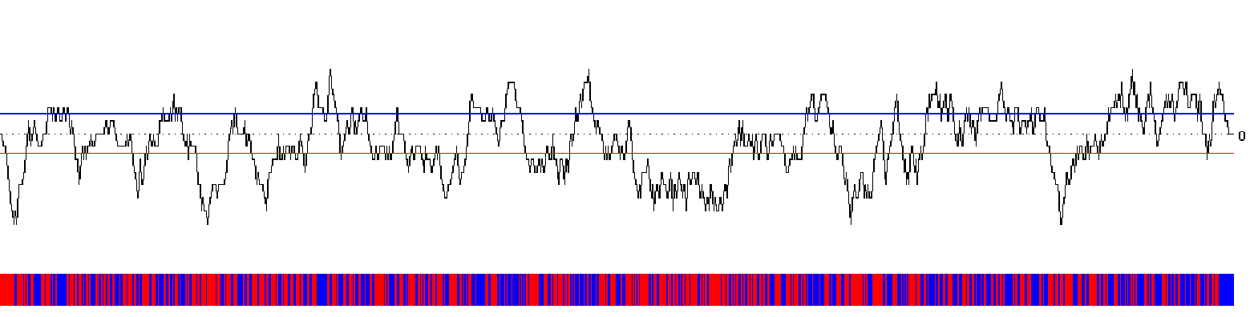
Simulation, n = 1000, w = 10
time t = 0
Notes:
Illustration of dynamics
Graph of location biases
Bias is defined as the number of blue individuals in that location’s neighborhood, minus the number of red individuals in that location’s neighborhood
Blue are happy above the dotted line, red are happy below the dotted line
Blue and red lines indicate regions of high bias, which are very likely to have blue or red neighborhoods in final configuration

Slide 19
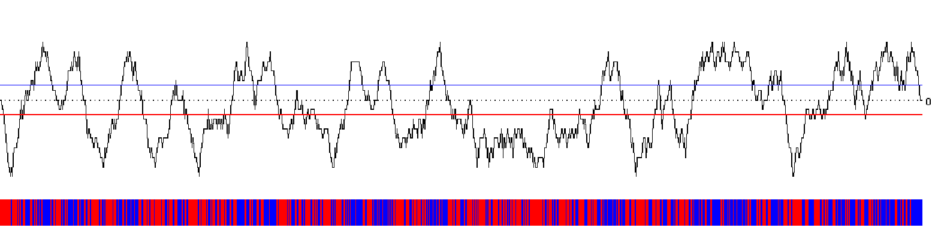
Simulation, n = 1000, w = 10
time t = 40

Slide 20
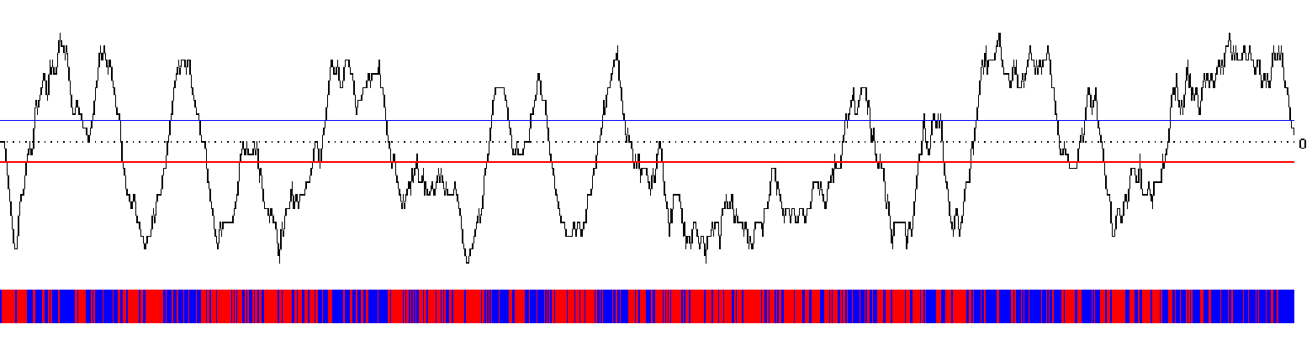
Simulation, n = 1000, w = 10
time t = 80

Slide 21
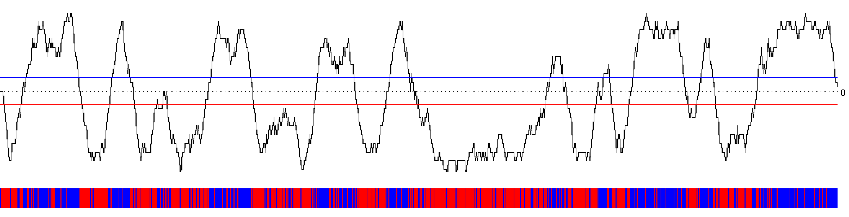
Simulation, n = 1000, w = 10
time t = 120

Slide 22
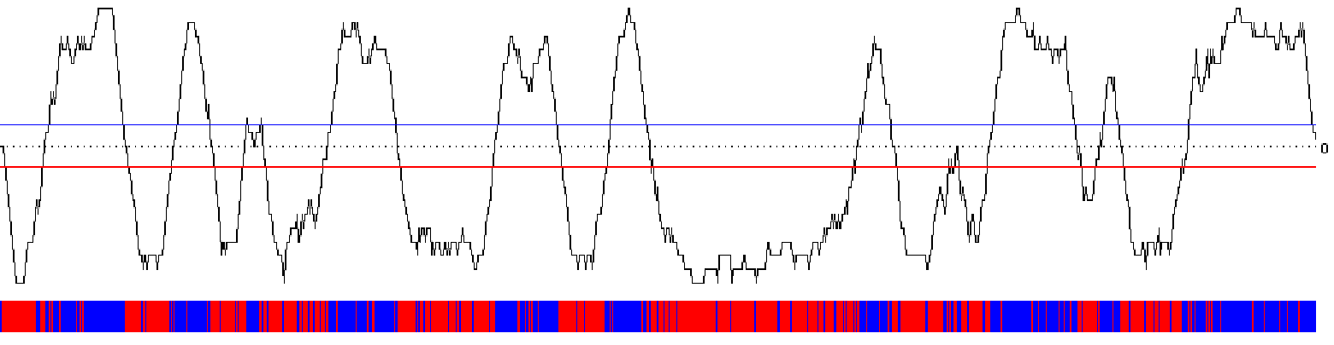
Simulation, n = 1000, w = 10
time t = 160

Slide 23
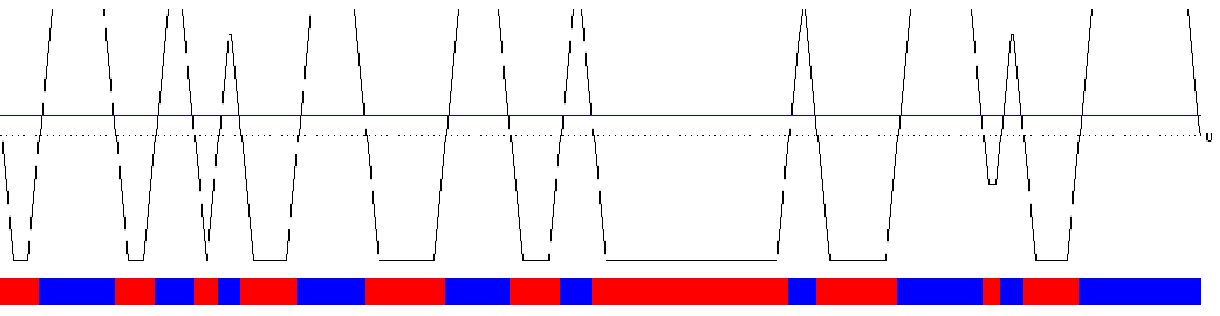
Simulation, n = 1000, w = 10
time t = 260 (final)

Slide 24
Simulation, n = 1000, w = 10
time t = 160

Slide 25
Simulation, n = 1000, w = 10
time t = 120

Slide 26
Simulation, n = 1000, w = 10
time t = 80

Slide 27
Simulation, n = 1000, w = 10
time t = 40

Slide 28
Simulation, n = 1000, w = 10
time t = 0
Notes:
Illustration of dynamics
Graph of location biases
Bias is defined as the number of blue individuals in that location’s neighborhood, minus the number of red individuals in that location’s neighborhood
Blue are happy above the dotted line, red are happy below the dotted line
Blue and red lines indicate regions of high bias, which are very likely to have blue or red neighborhoods in final configuration

Slide 29
Simulation, n = 1000, w = 10
time t = 40

Slide 30
Simulation, n = 1000, w = 10
time t = 80

Slide 31
Simulation, n = 1000, w = 10
time t = 120

Slide 32
Simulation, n = 1000, w = 10
time t = 160

Slide 33
Simulation, n = 1000, w = 10
time t = 260 (final)

Slide 34
Four steps to O(w²)
Firewall incubators are common

Slide 35
Firewall Incubators
Bias = +3
w sites
w sites
-1
+1
+1
+1
+1
+1
-1
+1
+1
+1
-1
-1
Definition. The bias of a site i at time t is the sum of the signs of sites in its neighborhood.
Notes:
Note bias never 0, + if blue happy there, - if green happy there.

Slide 36
Firewall Incubators
left
right
attacker
defender
internal
defender
attacker
w sites
w+1 sites
w+1 sites
w sites
Definition. A firewall incubator is a sequence of 3 biased blocks – left defender of length w+1, internal, right defender of length w+1.
At least 2w + 2 sites, where the bias of every site is > w^{1/2}.

Slide 37
Birth of a Firewall Incubator
Lemma. For any 6w consecutive sites, there’s a constant probability that a uniformly random labeling of sites contains a firewall incubator.
Proof Sketch. Random walks + central limit theorem
5w^{1/2}
0
-2w^{1/2}
Notes:
looks like this in both directions, so we have a string of them, then the center ones all have high min bias

Slide 38
Four steps to O(w²)
Firewall incubators are common
Define an event in which an incubator deterministically becomes a firewall

Slide 39
Lifecycle of a Firewall Incubator
attacker
defender
GOOD swap
Notes:
why not count x moving into attacker as good swap, or o moving out of defender as bad swap? not likely events.

Slide 40
Lifecycle of a Firewall Incubator
attacker
defender
BAD swap
Notes:
why not count x moving into attacker as good swap, or o moving out of defender as bad swap? not likely events.

Slide 41
Lifecycle of a Firewall Incubator
attacker
defender
swap time:
5
2
8
6
1
sign:
+1
+1
+1
-1
-1
transcript: +1, -1, +1, +1, -1
Definition. The transcript is the sign-sequence obtained by associating each blue attacker with a +1, each green defender by a -1, and then listing signs in reverse-order of when individuals move.
Proposition. If the partial sums of a transcript are non-negative, then
the firewall incubator becomes a firewall
Notes:
Prefix of the transcript indicates the difference between individuals helping and not helping the bias
If prefix is negative, implies that the bias turns negative

Slide 42
Four steps to O(w²)
Firewall incubators are common
There is an event in which an incubator deterministically becomes a firewall
Assuming swap order is random, this event happens

Slide 43
Lifecycle of a Firewall Incubator
Ballot Theorem. With probability (A – D)/(A + D), all the partial sums of a random permutation of A +1’s and D -1’s are positive.
Firewall incubator definition implies
A-D ≥ Ɵ(w^{0.5}) (bias condition of incubator)
A+D ≤ Ɵ(w) (length of attacker + defender)
Each defender survives with probability Ω(1/w^{0.5})
Incubator becomes a firewall with probability Ω(1/w)
Notes:
# perms with first step up that hit/cross x-axis = # perms with first step down that hit/cross x-axis
since A > D, all perms end up
hence # perms 1st step down that hit x-axis = # perms 1st step down = D
so 2D hit x-axis
so A+D-2D = A-D are always positive (A+D is # choices for first step, labeling up/down ticks)

Slide 44
Four steps to O(w²)
Firewall incubators are common
There is an event in which an incubator deterministically becomes a firewall
Assuming swap order is random, this event happens
Swap order is close to random

Slide 45
Lifecycle of a Firewall Incubator
Swaps are random if there is # unhappy green = # unhappy blue.
Notes:
Why not uniformly random permutation? If many more unhappy green than blue, then blues in config. more likely to be chosen so more likely to have an earlier satisfaction time.

Slide 46
Wormald’s Technique
We show numbers are approx. equal using Wormald’s theorem
Theorem [Wormald]. Under suitable technical conditions, a discrete-time stochastic process is well approximated by the solution of a continuous-time differential equation
Technically non-trivial due to complications with infinite differential equations
Don’t need to solve diff. eq., only exploit symmetry

Slide 47
Firewall incubators occur every O(w) locations
+
Incubator becomes firewall with probability Ω (1/w)
=
Firewalls occur every O(w²) locations

Slide 48
An better bound on run length
Theorem. Ave run length in final state is O(w²).
Proof.
Expect to look O(w²) steps before we find a blue firewall in both directions
Bounds length of a green firewall containing site
Symmetric for a blue firewall containing site
random site
look for blue firewall
look for blue firewall

Slide 49
Summary
First rigorous analysis of Schelling’s segregation model on one-dimensional ring
Demonstrated that only local, modest segregation occurs
Average run length is independent of n and poly(w)
Subsequent work: Ɵ(w) run length

Slide 50
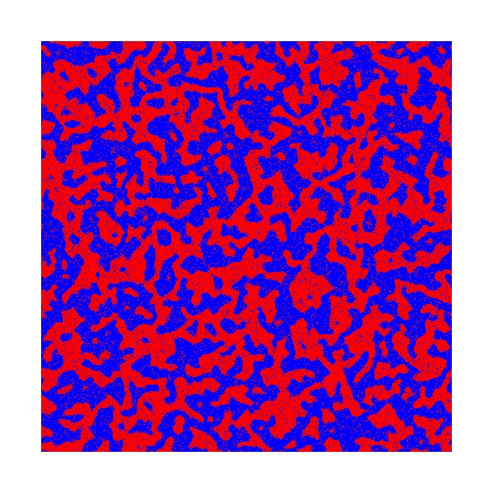
Open Questions
Vary parameters (proportion and number of types, tolerance)
Study segregation on other graphs
2D grid
Notes:
differing fractions of types
more than two types
different sensitivity to minority status

