Slide 1
Meeting 4

Slide 2
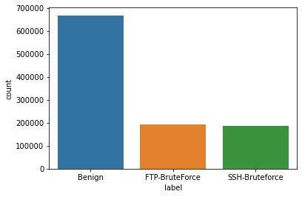
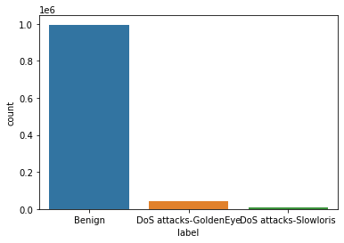
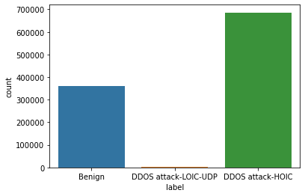
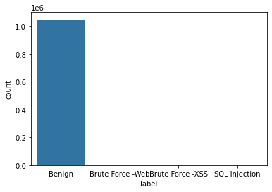
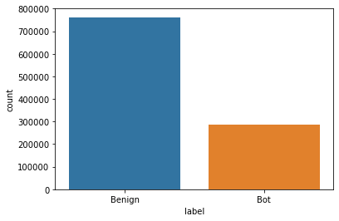
Data Statistics – IDS2018
Assumed each day data is from different organizations

Slide 3
Experiment Setting
Assumptions
Benign and Malicious users does not overlap (Malicious users never send benign flow)
Each malicious user attacks multiple organizations with a specific attack type
Each benign user uses all organizations (Arguable)
If not, it will never detect benign users as malicious (k>1)

Slide 4
Experiment Setting
Set N benign users → assign randomly (in uniform distribution)
Set M_{i} malicious users for each attack A_{i} → assign randomly (in uniform distribution)
About 6M flow data (Roughly 20% is malicious flow)
10 types of attack
Set N = 10000, Total M = 2000 (Split properly proportional to the number of malicious flow)

Slide 5
Experiment Setting
normal
Total
Number of data
malicious
day1
day2
day3
day4
day5
day6

Slide 6
Experiment Setting
Training
(80% benign)
→ Later, split to train:valid = 60:20
shuffle
Testing
(20% benign
+ partition of shuffled data)
* Partition size proportional to the training set

Slide 7
Evaluation
Determine by the average reconstruction loss of each identifier.
Baseline
If average is over some threshold, malicious
Otherwise, benign
Collaborative
When k out of N organizations determine it is malicious, malicious
Otherwise, benign

Slide 8
Expected Results
Malicious flows will be detected by the majority of organizations (As each organizations model knows the distribution of benign)
By requiring more than k votes from other organizations,
FPR will drop
TPR will decrease (Because it will be harder to detect)

Slide 9
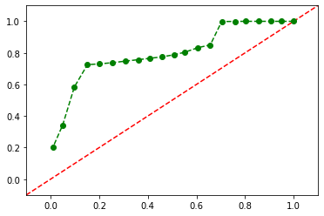
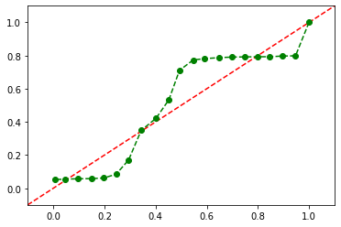
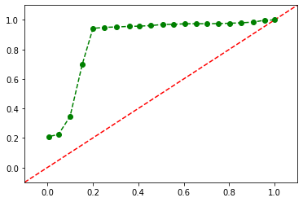
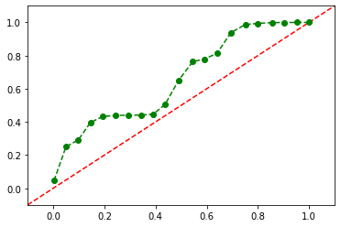
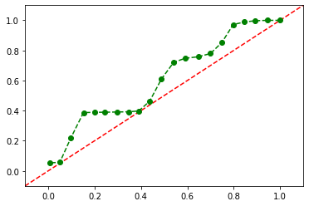
Result - Baseline
tpr
fpr

Slide 10
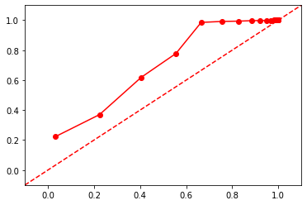
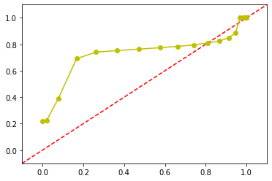
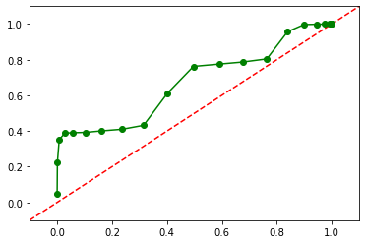
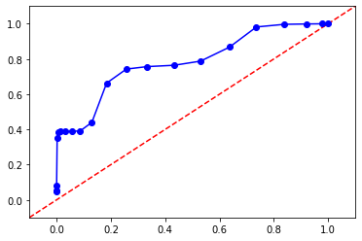
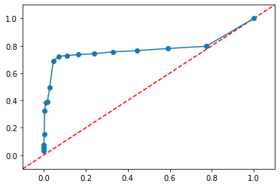
Result – Collaborative (Accept it even it didn’t vote for it)
Analysis
K=1 → increase TPR / increase FPR → skewed to the right
K=5 → decrease TPR / decrease FPR → skewed to the left
K=1
K=2
K=3
K=4
K=5

Slide 11
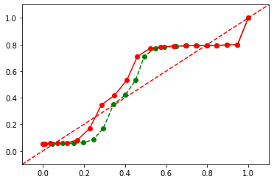
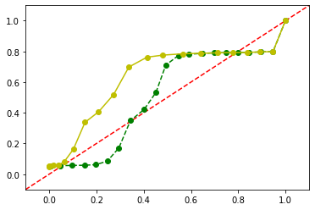
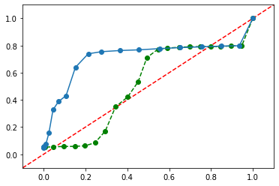
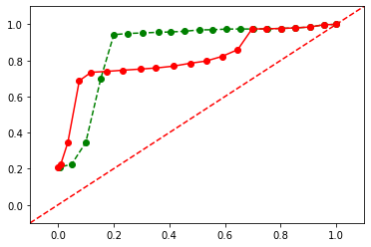
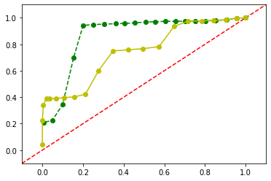
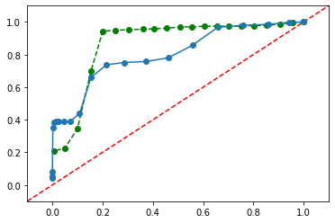
Result – Collaborative (Accept identifiers it voted for))
Day 2
K=2
K=3
K=4
K=5
Day 3
Worst model improve,
Best model degrades
K=2
K=3
K=4

Slide 12
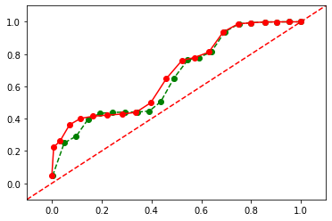
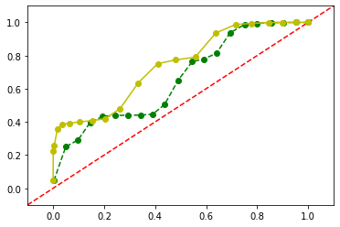
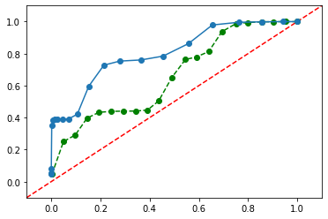
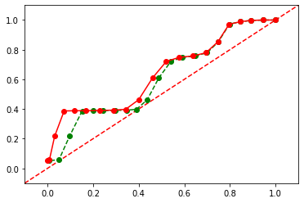
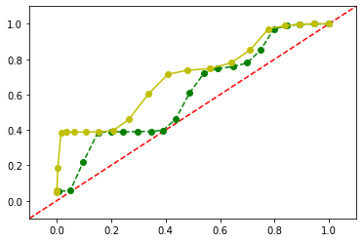
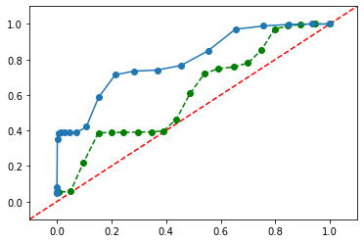
Result – Collaborative (Accept identifiers it voted for))
K=2
K=3
K=4
K=5
Main effect
More effective at decreasing the FPR
K=2
K=3
K=4
Notes:
Area of RoC / Change in TPR for each alpha

Slide 13
Main effect
More effective at decreasing the FPR

Slide 16
Reduced
TPR
Reduced
FPR
Reduced
FPR
Reduced
FPR
Reduced
FPR

