Slide 1
Magist: A Good Fit Or Not ?
Let's analyse Magist Data-
–
Group 1
11.06.2022

Slide 2
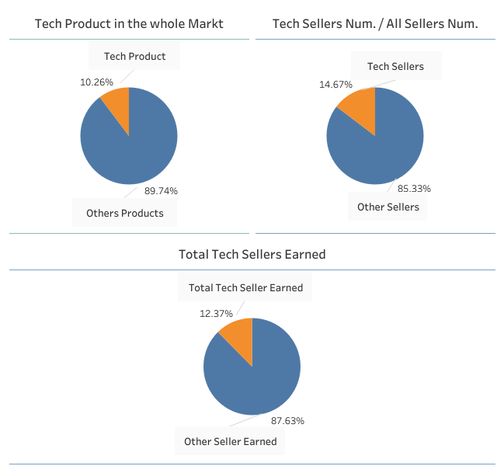
Is ‘Magist’ a good fit for high-tech products?
Notes:
Tech products make only about 10 % of all orders
Only 14.7 % of all sellers are tech sellers
Only 12% of the total income is earned by tech sellers

Slide 3
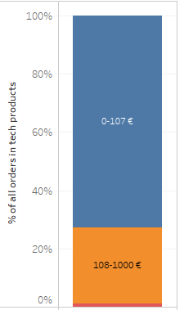
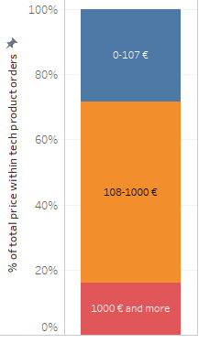
Is ‘Magist’ a good fit for high-tech products?

Slide 4
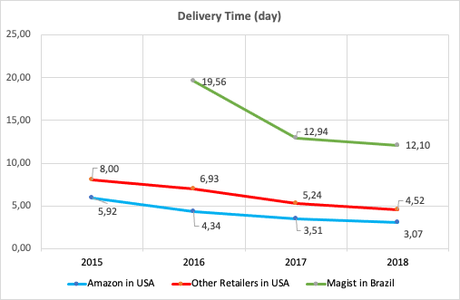
Are orders delivered on time?
Average delivery time in the U.S. compared to Magist (in days)
Almost 3 % of all orders could not be delivered.
Nearly 7 % of all orders have been delayed.
Average time between order and delivery is 12+ days.
Notes:
Total no of order = 99441, delivered order = 96478 or 97%, undelivered order = 2963 or 3%on time 89805 -- delayed 6673— total 96478—-7%
So, with the help of above data we can conclude many deliveries got delayed.
Let's analyse by taking an example of Amazon and other retailers in USA.
Further Queries: Delayed delivers and average delivery time for tech products and expensive tech products
Product delivered on time = 89805, Product delayed = 6673

Slide 5
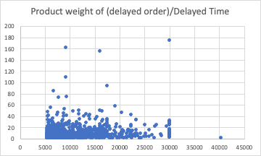
Delayed orders by weight and price
Delay range | weight avg
> 100 day Delay | 6157
3-7 day delay | 2077
1 week to 100 day delay | 2072
1 - 3 days delay | 1919
<= 1 day delay | 1892
average delivery time of tech products in days by price
11.6 | cheap
12.0 | mid-range
12.7 | expensive
Notes:
Tech products are also have 7% delayed of all orders.early 7 % of all orders have been delayed.

