Slide 1
To-do List (Task Management)
2024/12/3
An Efficient Way to Organize and Manage Tasks
Aqsa Ahmed Areeza Afridi Hoor Spogmay

Slide 2
Contents
01
Task Management System
02
What is Our Project?
03
Problem Statement
04
Total Modules and Their Description
05
What Data Structure Is Used
06
Why is it Used?

Slide 3
Contents
06
Conclusion

Slide 4
Task Management System
01

Slide 5



An Efficient Way to Organize and Manage Tasks
Centralized Task Repository
Customizable Task Views
Automated Notifications
Consolidate all tasks in a single platform for easy access and tracking.
Organize tasks by priority, due date, or project for better visibility.
Receive timely alerts for upcoming deadlines and task updates.

Slide 6
What is Your Project?
02

Slide 7

Overview
01
Streamline Tasks
02
Collaborate Efficiently
03
Gain Visibility
Organize and prioritize project tasks.
Enable team coordination and communication.
Monitor project progress and performance.

Slide 8
Problem Statement
03

Slide 9

Statement
In today’s fast paced world, it is very hard for the users to streamline their daily tasks. This ends up in missed deadlines and incomplete tasks. The existing systems are either very complex to use, or they lack the basic features of task management. Thus, there is a need to provide a robust and user-friendly system to the users.Enables users to prioritize and organize tasks effectively.

Slide 10
Total Modules and Their Description
04

Slide 11
Modules
Manage Tasks
01
Manage
Deadlines
02
Manage Priorities
03
Set Priorities
Sort Tasks.
Add Task
Delete Task
Edit Task
Mark as Delete Task
Add deadline
Edit Deadlines
Delete Deadlines
Notify User
Manage Status
04
Manage File
05
Update Status
Display Status
Add to File
Display From file
Clear File

Slide 12
Which Data Structures Is Used
05

Slide 13
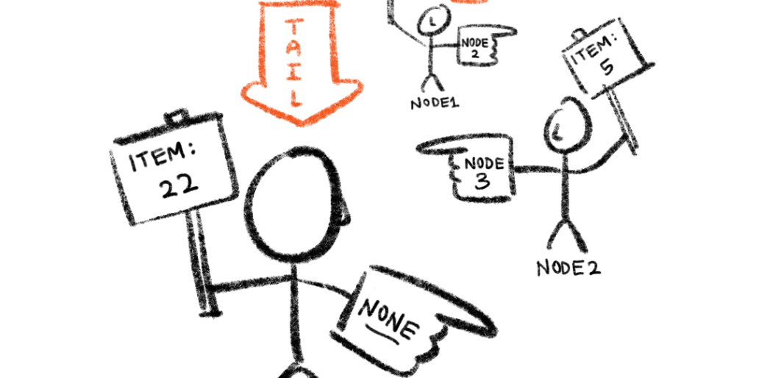
Linked List
Efficient Data Storage
Flexible Insertion and Deletion
Constant Time Complexity
Linked list provides dynamic memory allocation to store task data.
Tasks can be easily added or removed from the linked list.
Accessing and manipulating tasks in the linked list has O(1) time complexity.

Slide 14
Why Did We Use It?
06

Slide 15

Advantages of Linked List
Dynamic Size
Efficient Insertions and Deletions
Memory Utilization
Flexibility
No Predefined Limit
Constant Time Operations
No Shifting Required
No Wasted Space
Fragmented Memory

Slide 16
Advantages of Linked List
Ease of Implementation for Certain Operations
No Need for Resizing
Simplicity in Handling Complex Data
Sorting
Merging
Traversing tasks
Can be easily extended to create more complex data structures
Avoiding Resizing Overhead
Each task can be represented as a node containing various attributes.

Slide 17
Comparison with other Data Structures
Array:
Fixed Size: Arrays have a fixed size, which can lead to wasted space or overflow if the number of tasks exceeds the initial allocation.
Inefficient Insertions/Deletions: Inserting or deleting tasks in the middle of an array requires shifting elements, which can be time-consuming
2. Dynamic Array (e.g., std::vector):
While dynamic arrays can resize, they still involve copying elements to a new array when resizing occurs, which can be inefficient.
3. Other Structures (e.g., Trees, Hash Tables):
Trees (like binary search trees) could be used for more complex task management (e.g., sorting by priority or deadline).
Hash tables could provide fast access to tasks by ID but would not maintain any order among tasks.

Slide 18
Conclusion
07

Slide 19
Summary
Key Takeaways
Optimized Workflows
Scalable Solution
Streamlined task management, improved productivity, and enhanced collaboration.
Automated processes, customizable views, and real-time updates.
Flexible for small teams or enterprise-level organizations.

Slide 20
Thank You
20XX/01/01

