Slide 1
GECCO2017

Slide 2
Evolve Architecture
Build Network
Network Architecture Space
Network Architecture Candidate
Train Network
I
O
I
O
I
O
Return accuracy

Slide 3
Initialization
Calculate classification accuracy (fitness) with validation data
Selection
Reproduction
I
O
CNN training by backpropagation with training data
I
O
I
O

Slide 4
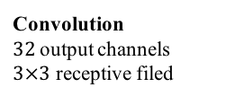
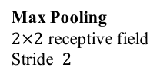
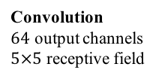
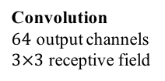
softmax
1
3
5
6
+
Summation
conv (32, 3)
conv (64, 5)
pool
(max)
0
7
Max Pooling
input
2
4
6
output
pool
(max)
conv (64, 3)
sum
Convolution
$64$ output channels $5×5$ receptive field
Convolution
$64$ output channels $3×3$ receptive field
3
4
(Node no.)
1
2
3
4
5
2
6
4
7
6
Genotype
C0
0
2
P1
0
0
C3
1
2
C2
2
1
P1
2
S
3
O
1
2
Convolution
$32$output channels $3×3$ receptive filed
Max Pooling $2×2$ receptive field
Stride $2$
Function ID
1st input node no.
2nd input node no.
: not expressed in the phenotype

Slide 5
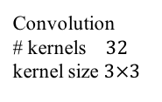
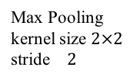
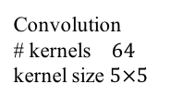
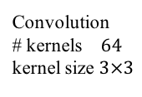
1
3
5
softmax
conv (32, 3)
conv (64, 5)
pool
(max)
0
7
+
Summation
input
2
4
6
softmax
pool
(max)
conv (64, 3)
sum
Convolution
# kernels $64$ kernel size $5×5$
Convolution
# kernels $64$ kernel size $3×3$
(node No.)
1
2
3
4
5
2
6
4
7
6
Convolution
# kernels $32$ kernel size $3×3$
Max Pooling kernel size $2×2$
stride $2$
Genotype
C0
0
2
P1
0
0
C3
1
2
C2
2
1
P1
2
S
3
O
Function ID
Input1 node No.
Input2 node No.
: not expressed in the phenotype

Slide 6
Input
Input
RB (128, 3)
MP
MP
CB (128, 3)
CB (32, 5)
CB (64, 3)
CB (128, 3)
RB (128, 3)
Sum
CB (128, 3)
CB (128, 3)
RB (128, 3)
CB (32, 5)
Sum
MP
AP
CB (64, 3)
CB (64, 3)
RB (32, 3)
CB (64, 5)
Concat
Sum
RB (128, 3)
Concat
Concat
RB (128, 3)
CB (128, 3)
CB (64, 3)
AP
CB (128, 3)
Concat
AP
CB (128, 3)
RB (128, 3)
CB (128, 3)
MP
CB (128, 5)
Softmax
Softmax

Slide 7
Input
CB (64, 3)
MP
CB (128, 3)
MP
CB (64, 5)
CB (64, 3)
CB (128, 3)
CB (64, 3)
CB (64, 3)
CB (128, 5)
Concat
MP
Sum
Concat
CB (32, 5)
Concat
CB (64, 5)
CB (128, 3)
MP
MP
CB (128, 5)
CB (128, 3)
Concat
Concat
CB (128, 5)
CB (64, 5)
CB (64, 5)
CB (128, 5)
Sum
CB (128, 5)
Concat
CB (32, 5)
Concat
CB (128, 5)
Sum
CB (64, 5)
Softmax

Slide 8
CGP2CNN (A)
CGP2CNN (B)
0.920
0.920
0.915
0.915
0.910
0.910
0.905
0.905
Accuracy
Accuracy
0.900
0.900
0.895
0.895
0.890
0.890
0.885
0.885
0.880
0.880
1
50
100
150
200
250
300
1
50
100
150
200
250
300
Generations
Generations

Slide 9
CGP2CNN (A)
CGP2CNN (B)
0.940
0.940
0.930
0.930
0.930
0.920
0.910
0.910
Accuracy
Accuracy
0.900
0.900
0.890
0.890
0.880
0.880
0.870
0.870
0.860
0.860
1
50
100
150
200
250
300
1
50
100
150
200
250
300
Generations
Generations

Slide 10
ConvBlock
Convolution
BatchNormalization
Summation
ReLU

Slide 11
Input
CB (64, 3)
Concat
CB (32, 5)
CB (64, 3)
CB (32, 5)
CB (128, 5)
CB (128, 3)
CB (128, 3)
AP
CB(128, 5)
CB (32, 5)
AP
MP
CB (128, 3)
Sum
Sum
Sum
CB (128, 5)
Softmax

Slide 12
Input
CB (32, 5)
CB (64, 3)
Concat
AP
CB (32, 3)
CB (64, 3)
MP
CB (128, 3)
CB (128, 5)
MP
CB (128, 3)
CB (32, 5)
CB (64, 3)
CB (128, 5)
AP
CB (128, 3)
Sum
Sum
CB (128, 5)
Softmax

