Slide 1

PLC ELEVATOR SYSTEM
Ezgi Gümüştekin
Emir Yorgun

Slide 2
Objective
To develop a professional and user-friendly PLC-controlled elevator system with an integrated HMI interface. The system handles a five-story building, enabling floor transitions, responsive user input processing, and real-time safety mechanisms, including emergency stops and maintenance. The HMI provides controls for floor selection, live status updates, user login/logout, and emergency functionalities.

Slide 3
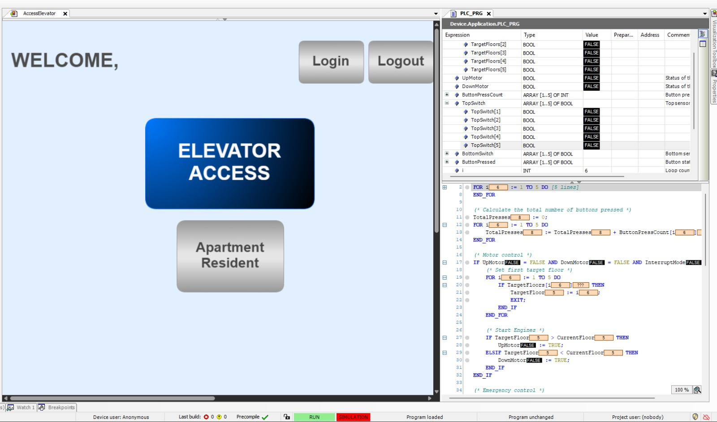
Main Menu Screen

Slide 4
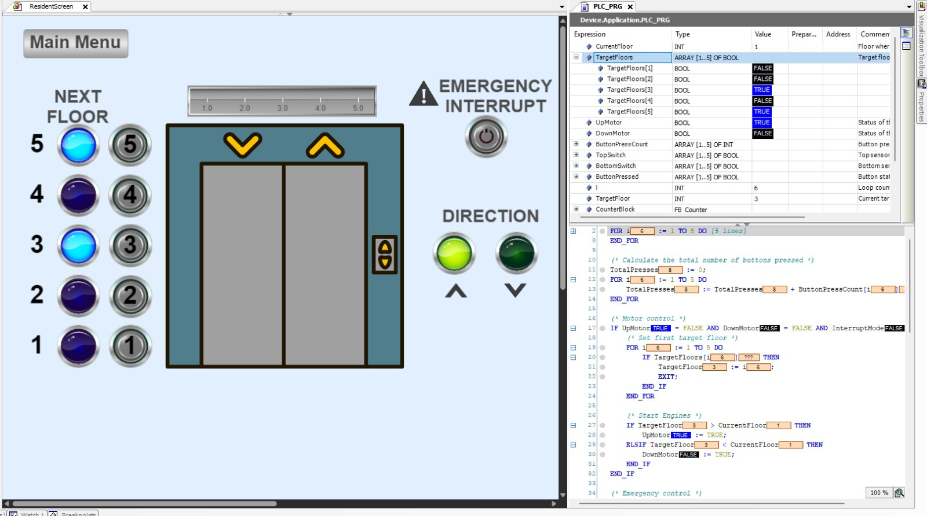
Resident Floor Screen
Apartment Resident Interaction

Slide 5
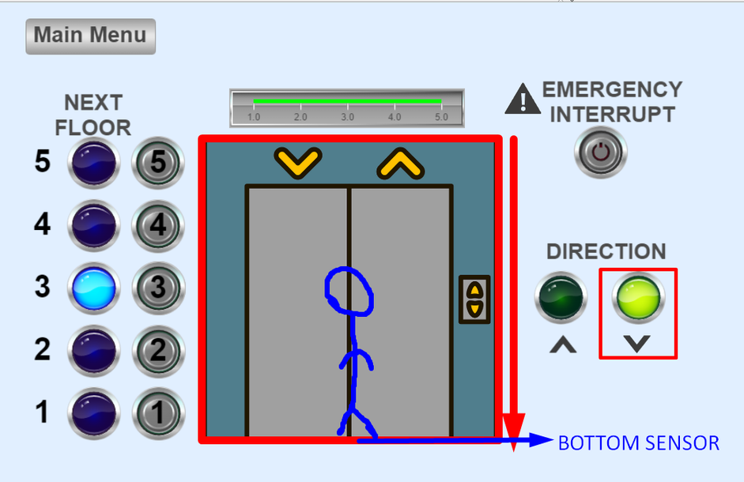
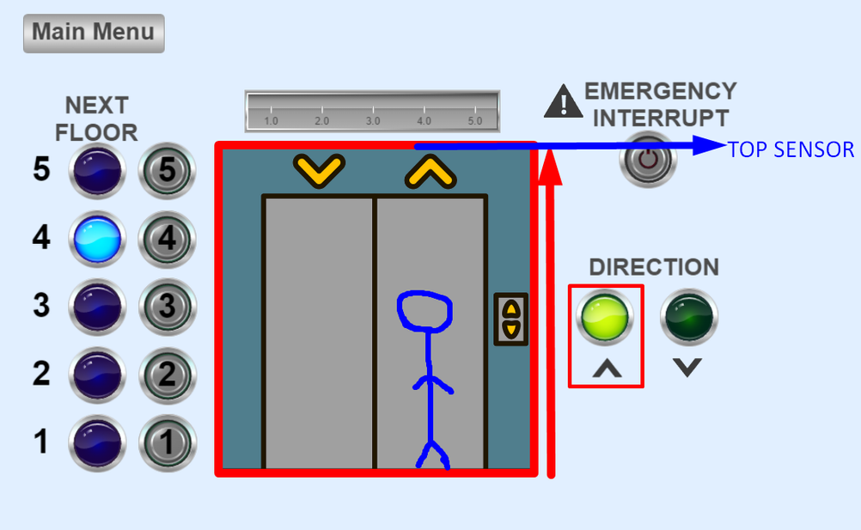
Sensors’ Logic
Bottom Sensor & Top Sensor

Slide 6
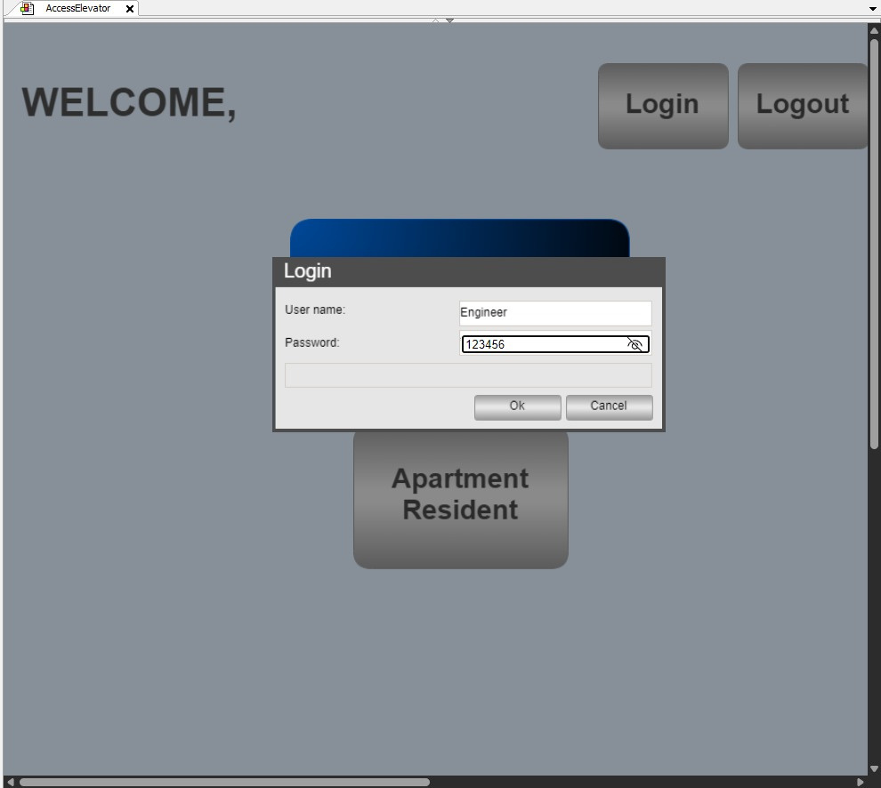
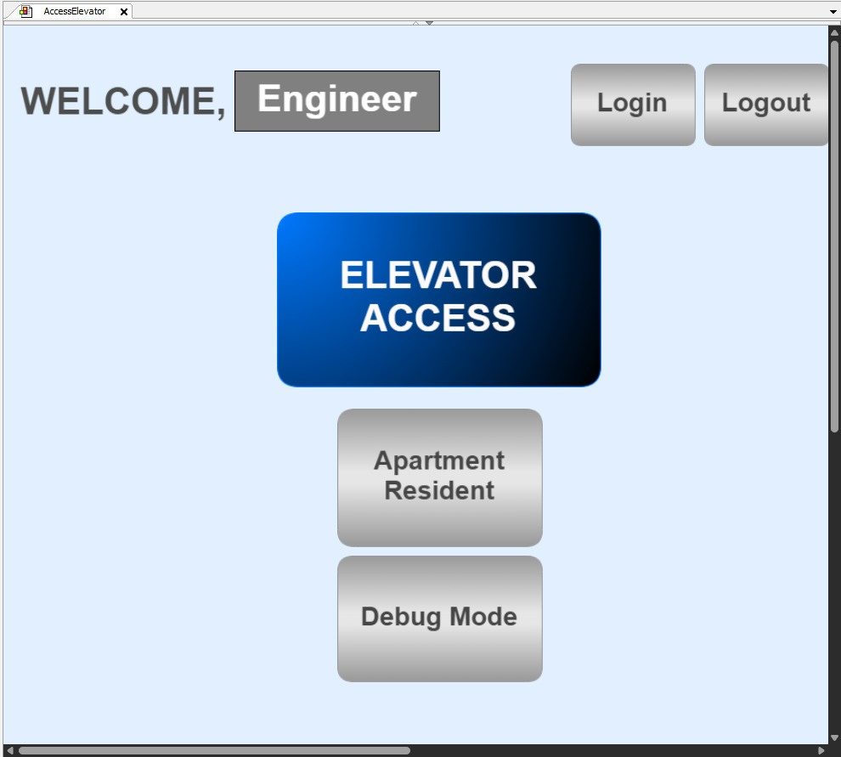
Main Menu Screen
Engineer Interaction (Login/Logout)

Slide 7
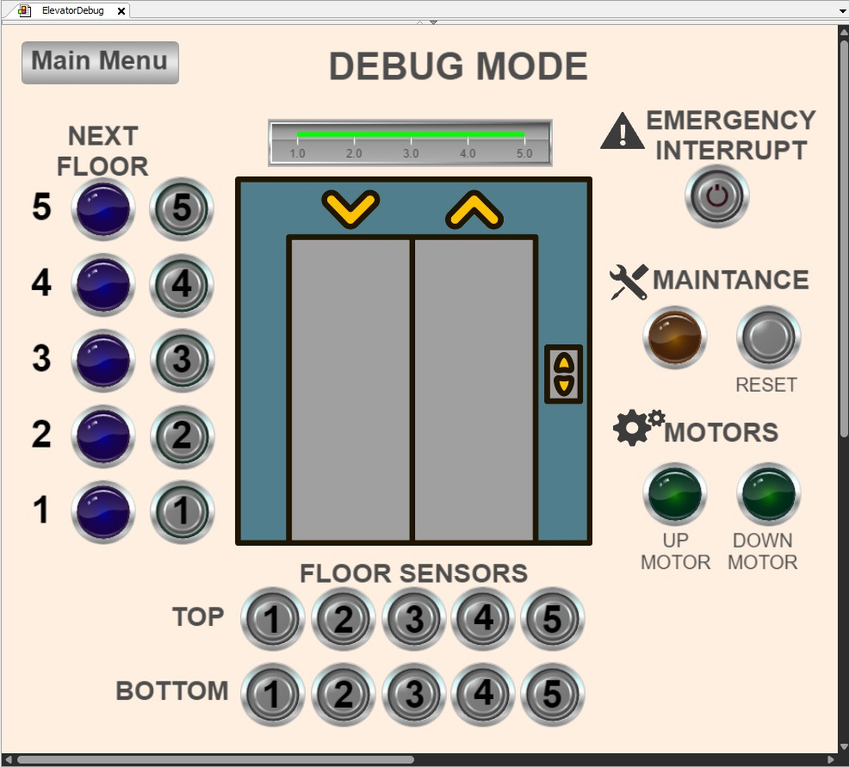
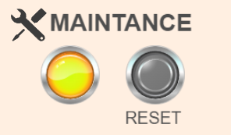
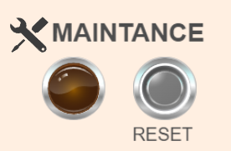
DEBUG SCREEN
Engineer Can Access (ONLY!)
Before
After

Slide 8
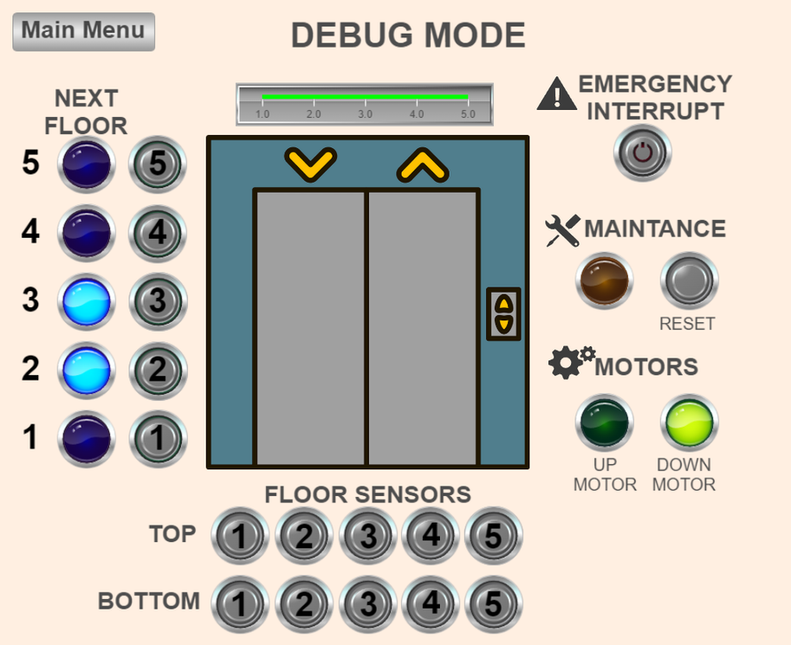
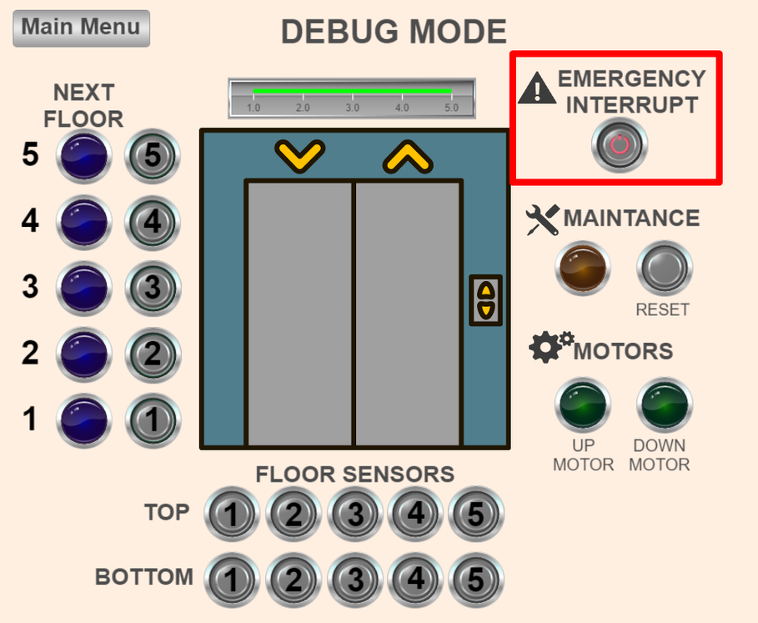
DEBUG SCREEN
Engineer Can Access (ONLY!)
Before Emergency Interrupt
After Emergency Interrupt
The elevator motor stopped.
Future floors have been canceled.
The elevator stopped on current floor.

Slide 9
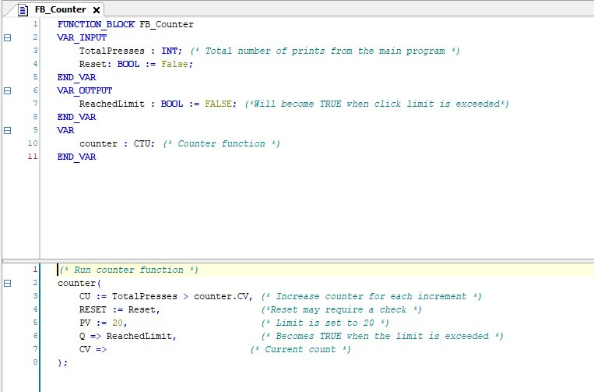
Function Block
FB_Counter

Slide 10
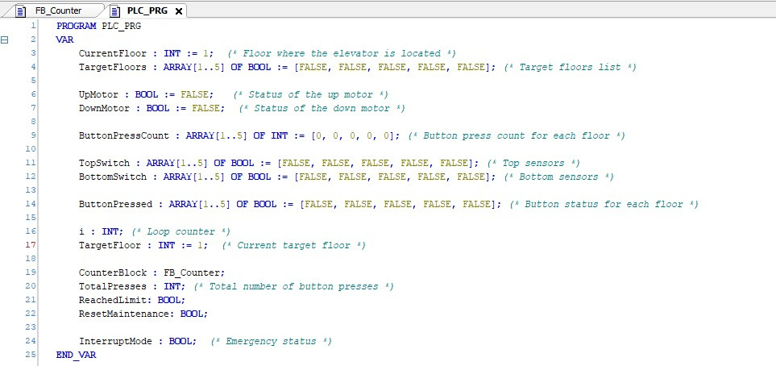
PLC_PRG’s Variables

Slide 11
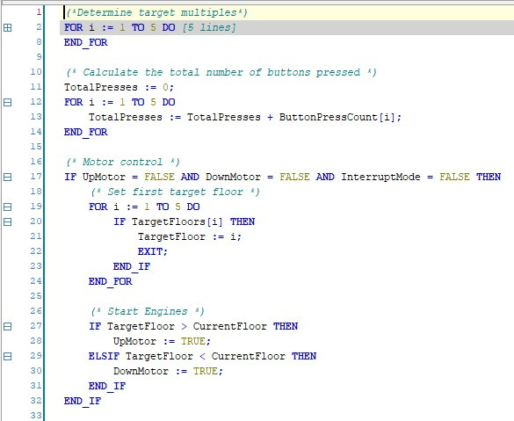
PLC_PRG’s Code (Part 1)

Slide 12
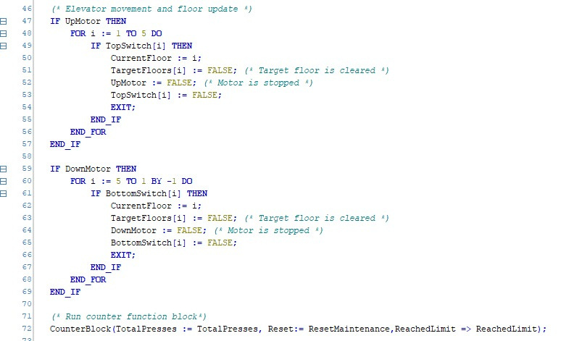
PLC_PRG’s Code (Part 2)

Slide 13
Thanks for listening!

