Slide 1
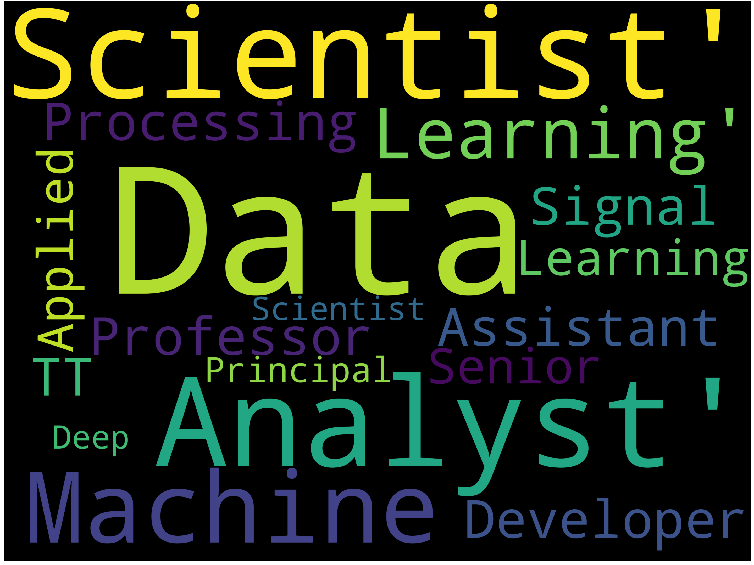
Data Science Job Market

Slide 2
Who are the top employers?
…and what are they looking for?

Slide 3

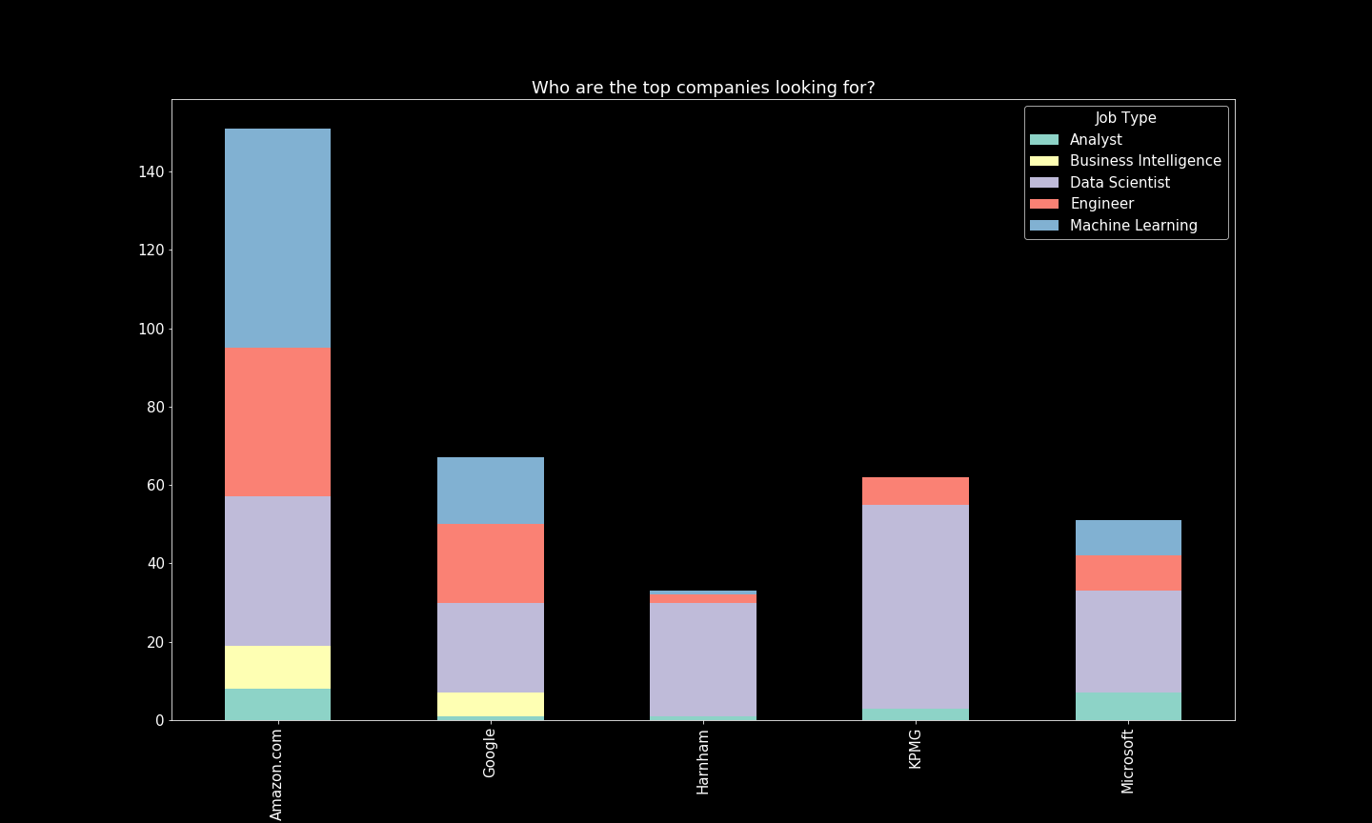
Data Scientist
Amazon: machine learning
Google: data scientist
Harnom: data scientist
Kpmg: data scientist
Microsoft: data scientist

