Slide 1
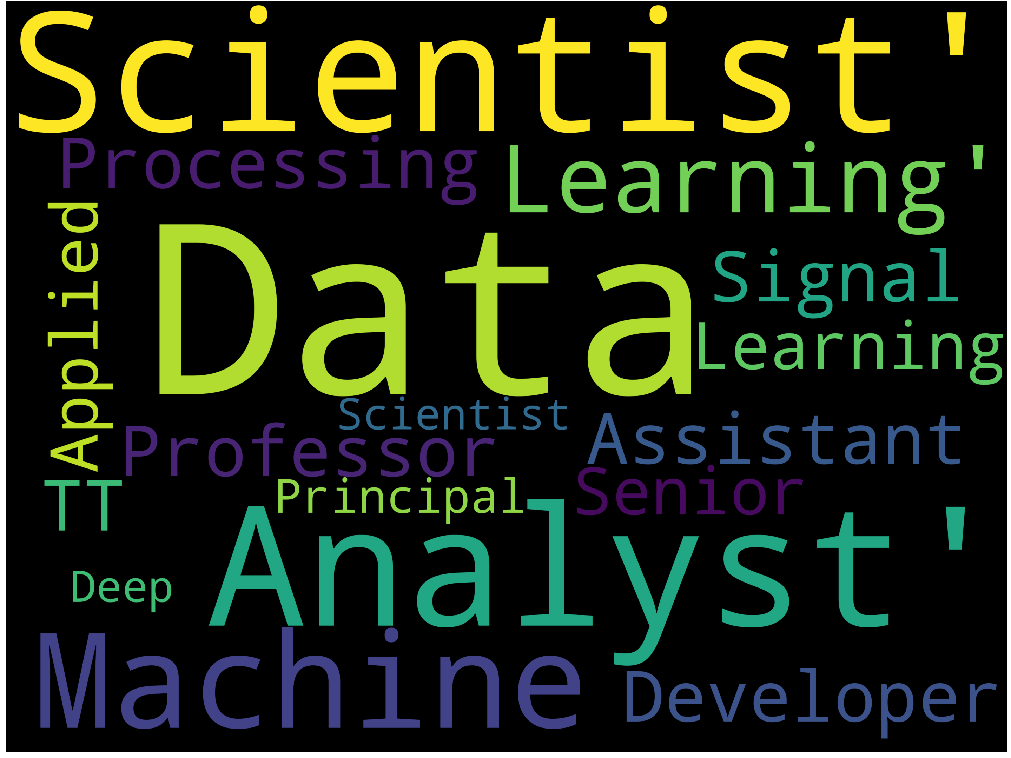
Data Science Job Market

Slide 2
Who are the top employers?
…and what are they looking for?

Slide 3
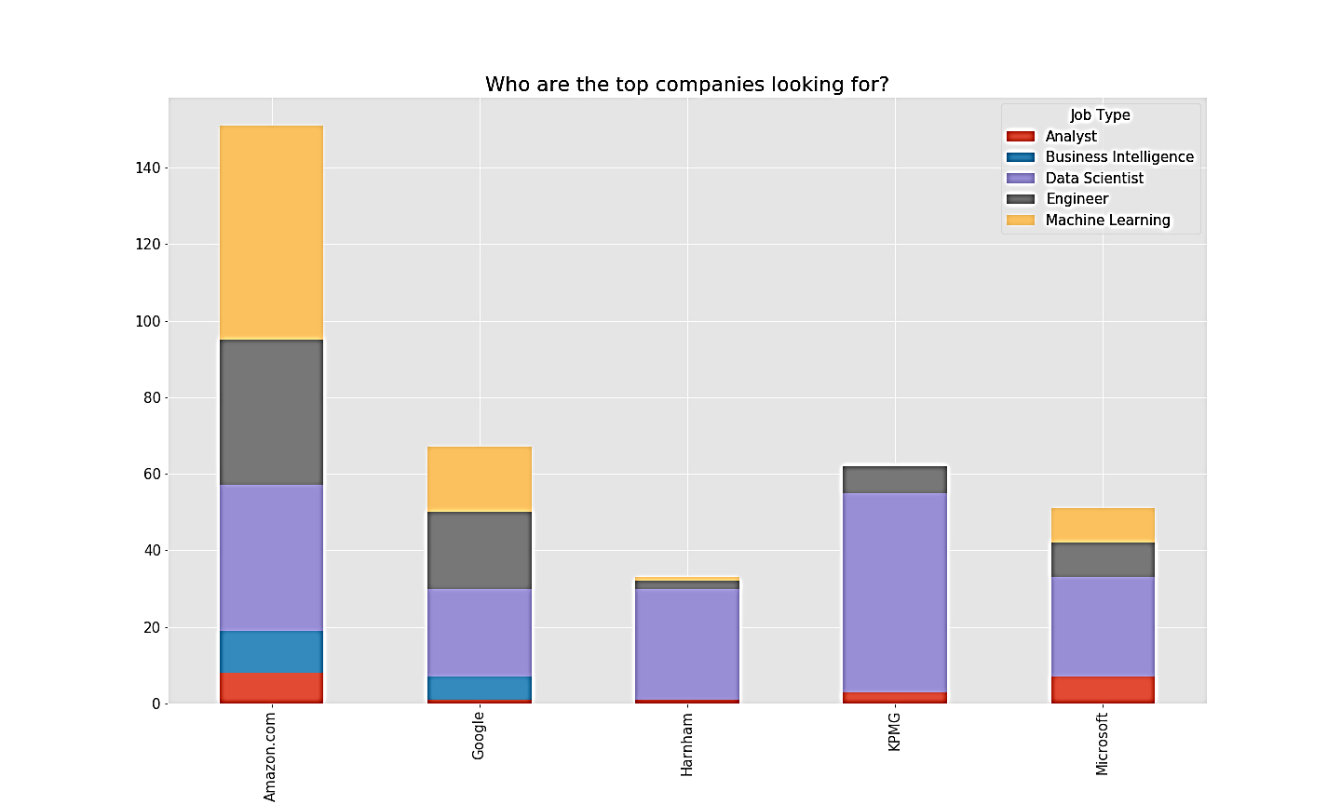
Data Scientist
Amazon: Machine Learning
Google: Data Scientist
Harnom: Data Scientist
Kpmg: Data Scientist
Microsoft: Data Scientist

Slide 4
Where are they hiring?

Slide 5
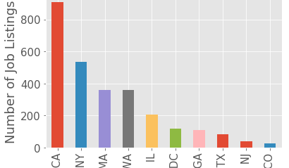
California
California dominates with NY coming in second.

