Slide 1
Mesh Animation Compression
Game Animation Course Project (COMP 6311)
Fall 2023
Hossein Pejman

Slide 2
INTRODUCTION
In this project the following paper related to mesh animation compression was implemented:
Motion-aware Compression and Transmission of Mesh Animation Sequences
​ Bailin Yang et al, ACM Trans. Intell. Syst. Technol. 10, 3, Article 25 (May 2019), 21 pages
Proposed method for
Vertex compression of mesh animation sequences.
Fixed connectivity between vertices (faces information) such that, the faces information of all frames is the same.
The main idea the proposed method is to find the motion similarity of vertices by
Grouping the frames with similar vertex motion strength (Temporal clustering)
Finding the motion strength similarity of vertices inside of each frame (spatial segmentation).
The idea is like to the fundamental approach used in video compression:
Removing temporal and spatial redundancies using inter-prediction and intra-prediction, respectively.

Slide 3
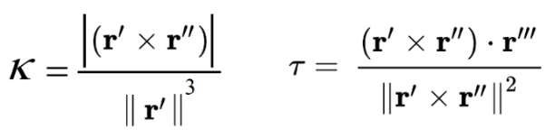
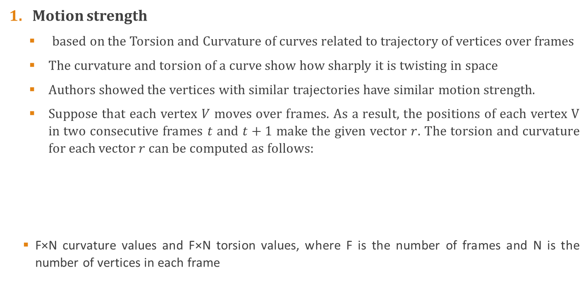
MESH ANIMATION COMPRESSION ALGORITHM
Motion strength
based on the Torsion and Curvature of curves related to trajectory of vertices over frames
The curvature and torsion of a curve show how sharply it is twisting in space
Authors showed the vertices with similar trajectories have similar motion strength.
Suppose that each vertex $V$ moves over frames. As a result, the positions of each vertex V in two consecutive frames $t$ and $t+1$ make the given vector $r$. The torsion and curvature for each vector $r$ can be computed as follows:
F×N curvature values and F×N torsion values, where F is the number of frames and N is the number of vertices in each frame

Slide 4
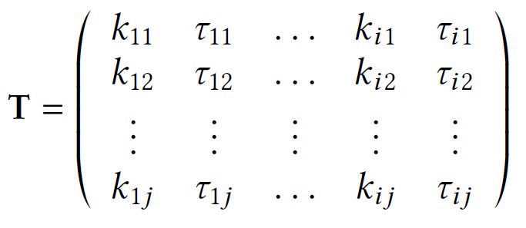
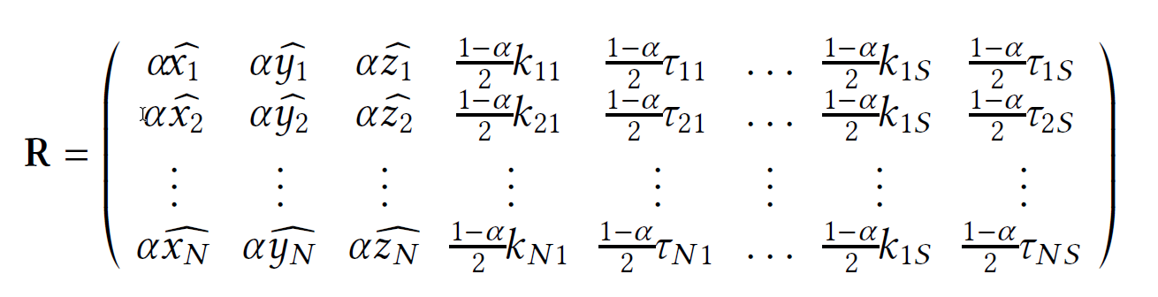
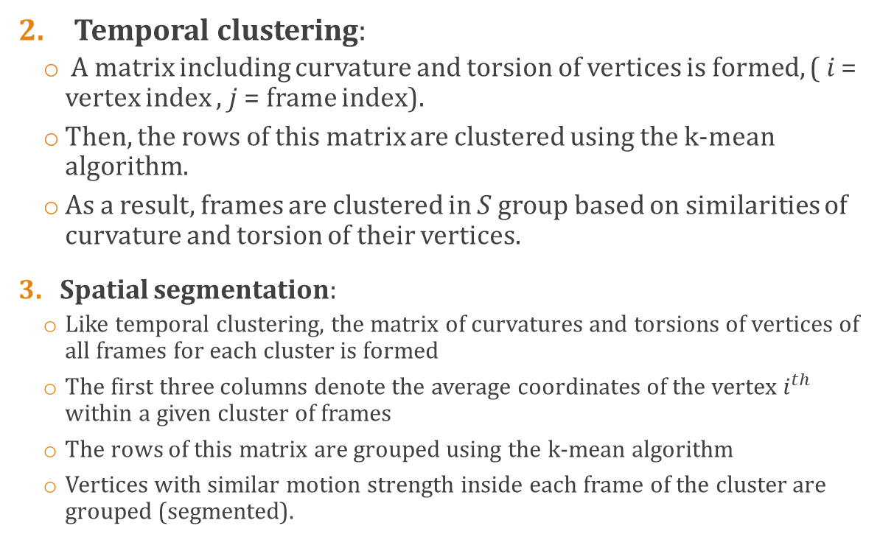
MESH ANIMATION COMPRESSION ALGORITHM
Temporal clustering:
A matrix including curvature and torsion of vertices is formed, ( 𝑖 = vertex index , 𝑗 = frame index).
Then, the rows of this matrix are clustered using the k-mean algorithm.
As a result, frames are clustered in 𝑆 group based on similarities of curvature and torsion of their vertices.
Spatial segmentation:
Like temporal clustering, the matrix of curvatures and torsions of vertices of all frames for each cluster is formed
The first three columns denote the average coordinates of the vertex $i^{th}$ within a given cluster of frames
The rows of this matrix are grouped using the k-mean algorithm
Vertices with similar motion strength inside each frame of the cluster are grouped (segmented).

Slide 5
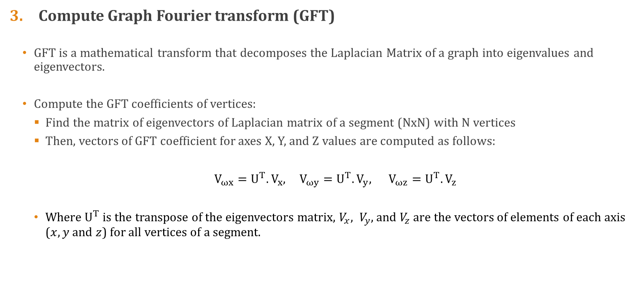
MESH ANIMATION COMPRESSION ALGORITHM
Compute Graph Fourier transform (GFT)
GFT is a mathematical transform that decomposes the Laplacian Matrix of a graph into eigenvalues and eigenvectors.
Compute the GFT coefficients of vertices:
Find the matrix of eigenvectors of Laplacian matrix of a segment (NxN) with N vertices
Then, vectors of GFT coefficient for axes X, Y, and Z values are computed as follows:
$V_{ωx}=U^{T}.V_{x}$, $V_{ωy}=U^{T}.V_{y}$, $V_{ωz}=U^{T}.V_{z}$
Where $U^{T}$ is the transpose of the eigenvectors matrix, $V_{x}, V_{y},$ and $V_{z}$ are the vectors of elements of each axis ($x,y$ and $z$) for all vertices of a segment.

Slide 6
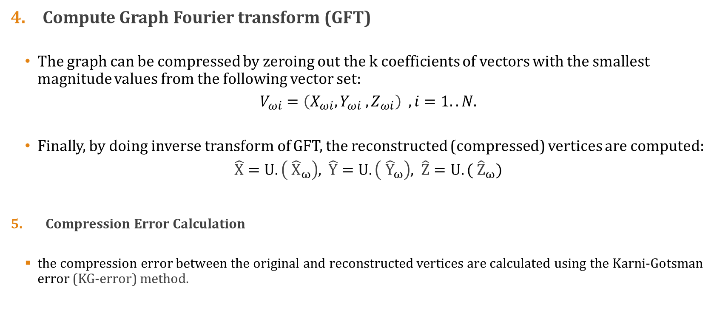
MESH ANIMATION COMPRESSION ALGORITHM
Compute Graph Fourier transform (GFT)
The graph can be compressed by zeroing out the k coefficients of vectors with the smallest magnitude values from the following vector set:
$V_{ωi}=\left(X_{ωi},Y_{ωi} ,Z_{ωi}\right)$ $, i=1..N$.
Finally, by doing inverse transform of GFT, the reconstructed (compressed) vertices are computed:
$\hat{X}=U.\left({ \hat{X}}_{ω}\right)$, $\hat{Y}=U.\left({ \hat{Y}}_{ω}\right)$, $\hat{Z}=U.({ \hat{Z}}_{ω})$
Compression Error Calculation
the compression error between the original and reconstructed vertices are calculated using the Karni-Gotsman error (KG-error) method.

Slide 7
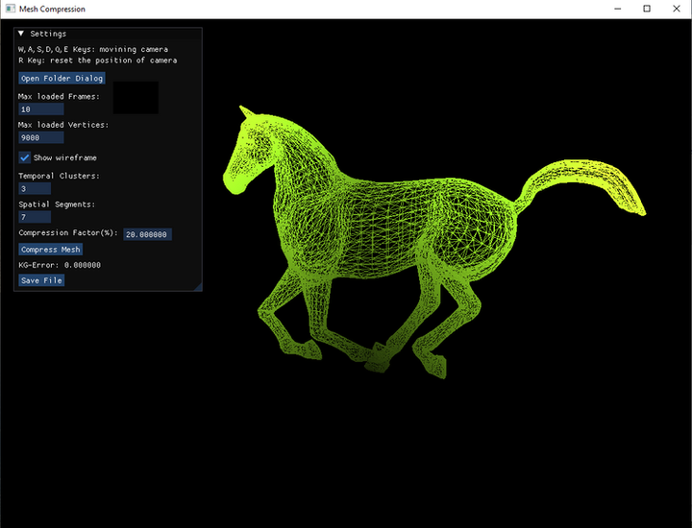
MESH ANIMATIOM COMPRESSION SOFTWARE
The software has the following features:
Selecting the number of temporal clusters and spatial segments.
Loading the .obj file of a mesh animation with an optional number of frames and vertices.
Reconstructing the mesh animation with an optional compression factor.
Computing and showing the KG-error after reconstruction.
Save the reconstructed frames in an optional folder

Slide 8
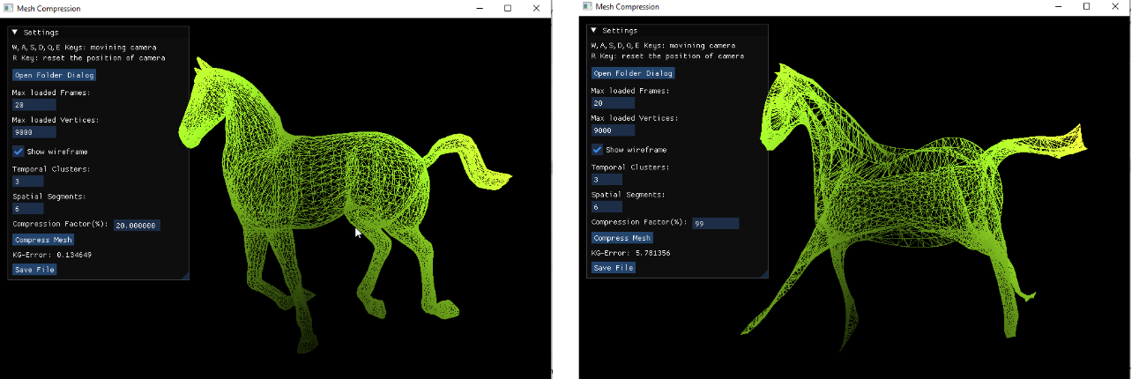
MESH ANIMATIOM COMPRESSION SOFTWARE
An example of reconstructed mesh animation with compression factor of 20% (left) and 99% (right).
As can be seen the shape of the object with compression factor of 99% is obviouly changed.

Slide 9
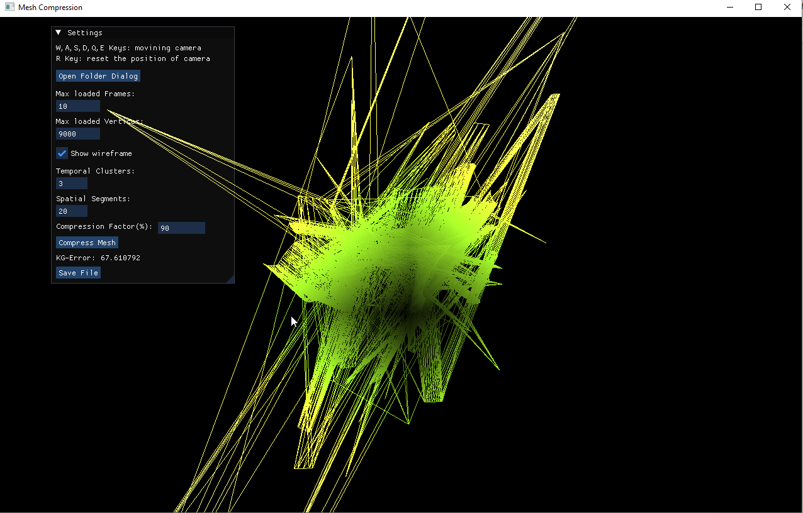
MESH ANIMATIOM COMPRESSION SOFTWARE
A drawback of this method that was observed during evaluation:
The quality of reconstructed mesh is substantially dependent on the numbers of temporal clusters and spatial segments.
For example, choosing 20 segments completely destroys the shape of the object.
Therefore, the number of temporal clusters and spatial segments must be carefully selected.

Slide 10
Thank you….

