Slide 1
Resume Screening: the 8-step process
Python · pypdf · OpenAI API
Notes:
This deck takes the eight panels of the resume screening flow diagram and gives each its own slide: the diagram on the left, the explanation and the matching code on the right.

Slide 2

Resume Screening: The 8-step process

Slide 3
Project Overview
1
SET UP
2
SET UP
3
READ
4
READ
Provide input files
Load config and validate
Read the job description
Find and read resumes
Resume PDFs plus one job description PDF
Read .env settings and check the paths exist
Turn the job PDF into text; stop if it is empty
List the PDFs, then extract text one resume at a time
5
ANALYSE
6
ANALYSE
7
DELIVER
8
DELIVER
Extract candidate details
Match resume to job
Rank candidates
Save results
The LLM pulls name, contact, skills, education and experience
The LLM scores the resume against the job, out of 100
Sort by score, then name, then filename
Write a results CSV and an error CSV

Slide 4
Understand The Project Files
app.py
Steps 1-8
config.py
Step 2
resume_parser.py
Steps 3-5
Runs the steps in order and catches errors per resume
Loads settings and the API key from .env
PDF text extraction and LLM detail extraction
main()
load_config()
extract_pdf_text()
ask_llm()
extract_candidate_details()
matching.py
Step 6
ranking.py
Step 7
utils.py
Steps 2,4,8
LLM scoring against a fixed 100-point rubric
Sorts candidates and numbers the ranking
Validation, resume discovery, CSV output, logging
score_candidate()
rank_candidates()
validate_inputs() find_resumes()
save_results() log_errors()

Slide 5
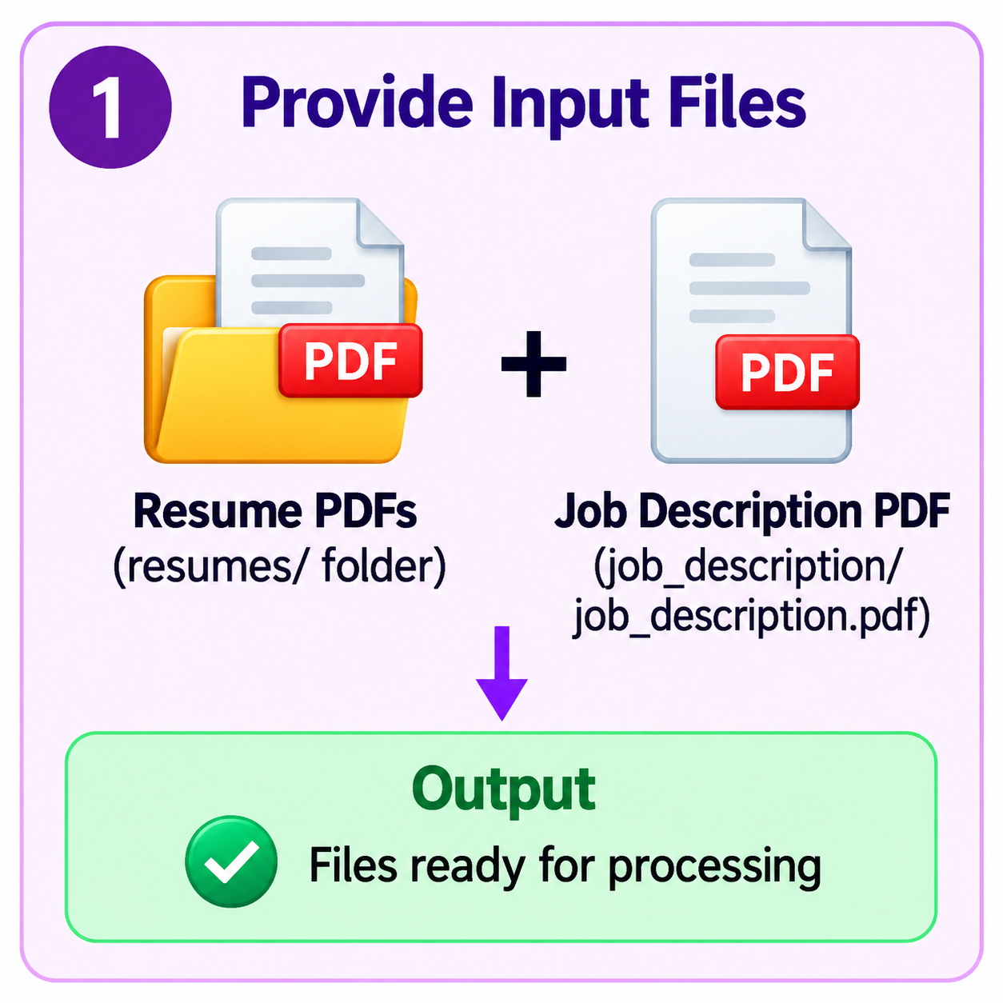
Provide input files
1
What happens
Put one PDF per candidate in the resumes/ folder
Add one job description PDF in job_description/
Nothing is processed yet; this only prepares the inputs
In the code
resumes/
job_description/job_description.pdf
Output: files ready for processing
1
2
3
4
5
6
7
8
Notes:
Step 1 only prepares the inputs: a folder of resume PDFs plus one job description PDF. In the sample project that is 20 resumes and an AI/ML Engineer (Fresher) job description.

Slide 6
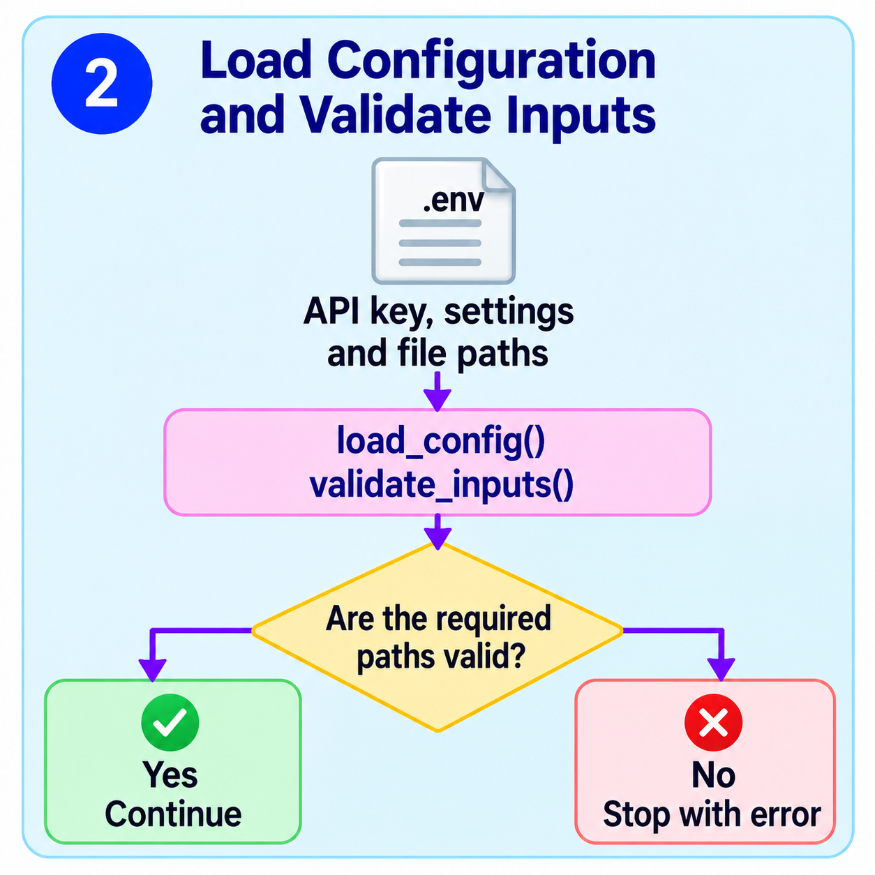
Load config and validate inputs
2
What happens
load_config() reads .env: the API key, model and file paths
validate_inputs() checks the resume folder and job PDF exist
If a path is missing, the program stops with an error
In the code
config.py load_config()
utils.py validate_inputs()
Output: valid settings, or a clear error
1
2
3
4
5
6
7
8
Notes:
load_config() needs OPENAI_API_KEY and falls back to defaults for the model and paths. validate_inputs() checks that the resumes folder and the job PDF exist and creates the output folders. A missing path stops the program immediately.

Slide 7
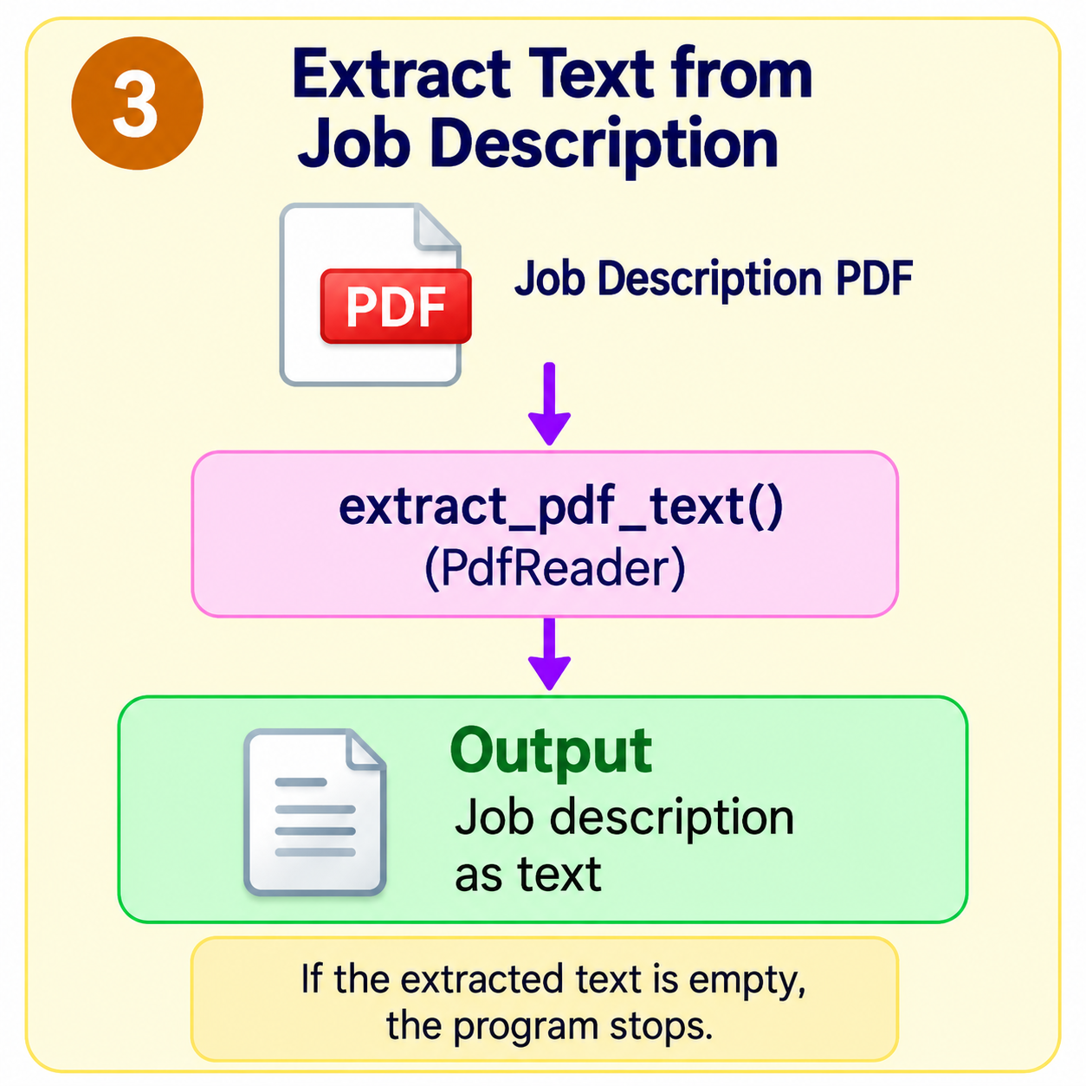
Extract text from the job description
3
What happens
extract_pdf_text() reads every page with pypdf's PdfReader
The page text is joined into one string
Empty text (for example a scanned PDF) stops the program
In the code
resume_parser.py extract_pdf_text()
app.py checks job_text.strip()
Output: the job description as text
1
2
3
4
5
6
7
8
Notes:
The job description is read once, before any resume. If no text can be extracted the program stops, because there would be nothing to compare resumes against. OCR is not included.

Slide 8
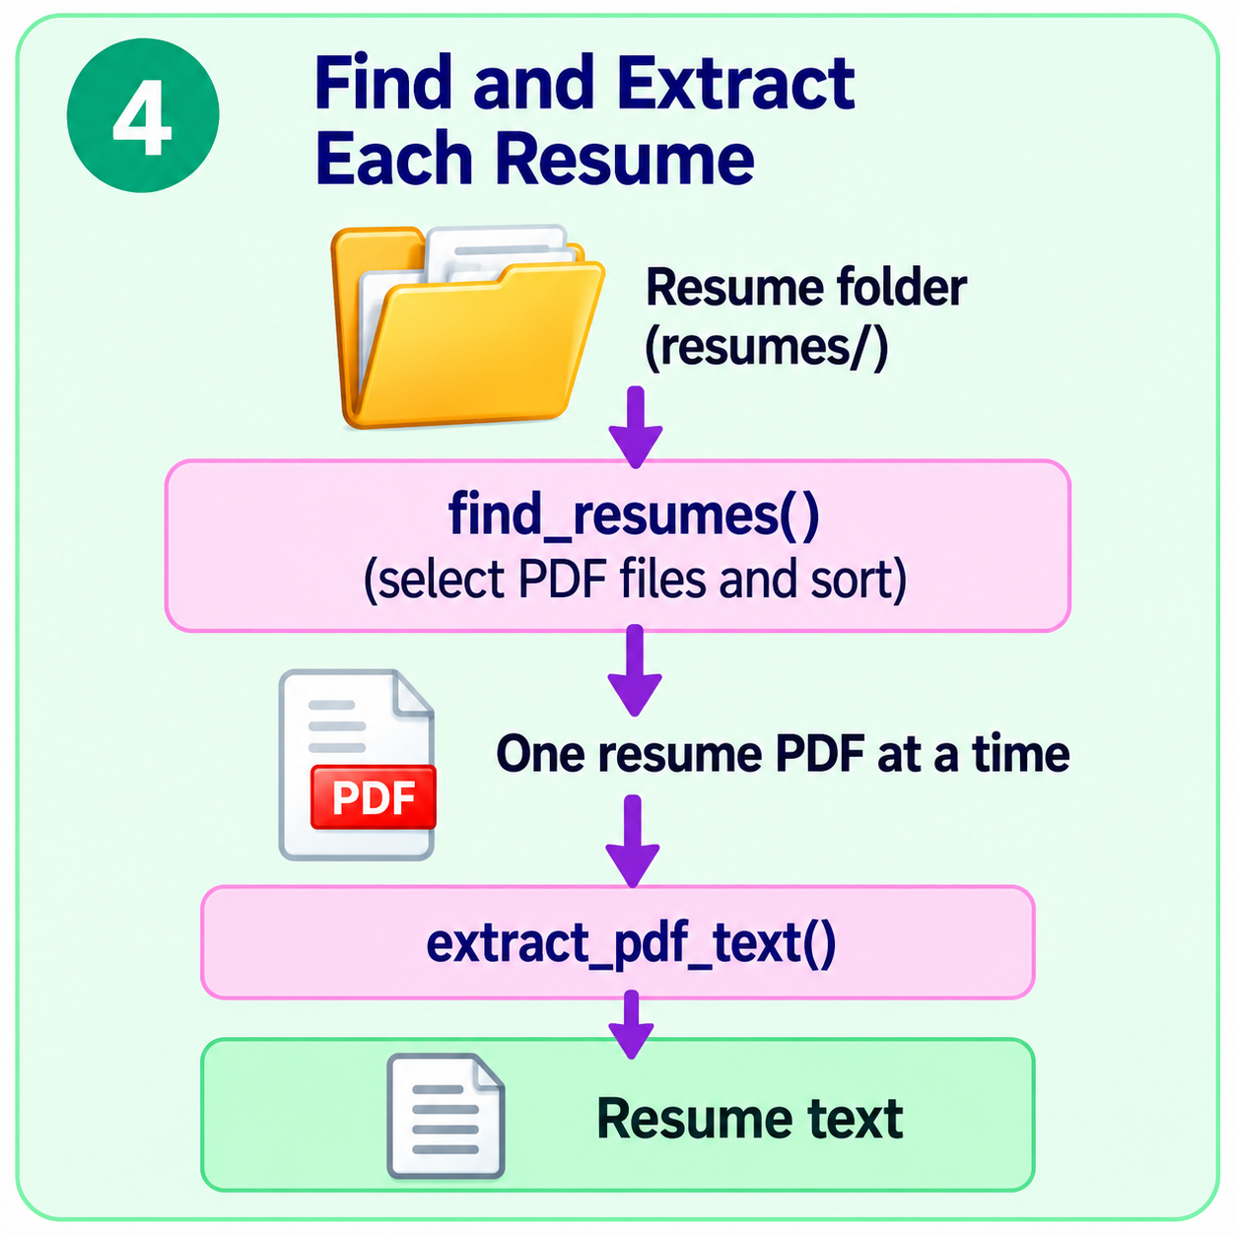
Find and Extract Each Resume
4
What happens
find_resumes() keeps only .pdf files and sorts them by name
Each resume is read one at a time with extract_pdf_text()
A resume that fails is logged and the next one continues
In the code
utils.py find_resumes()
resume_parser.py extract_pdf_text()
Output: the text of one resume
1
2
3
4
5
6
7
8
Notes:
Resumes are sorted by file name ignoring case so runs are repeatable. A resume with no readable text is recorded in the error CSV and never stops the batch.

Slide 9
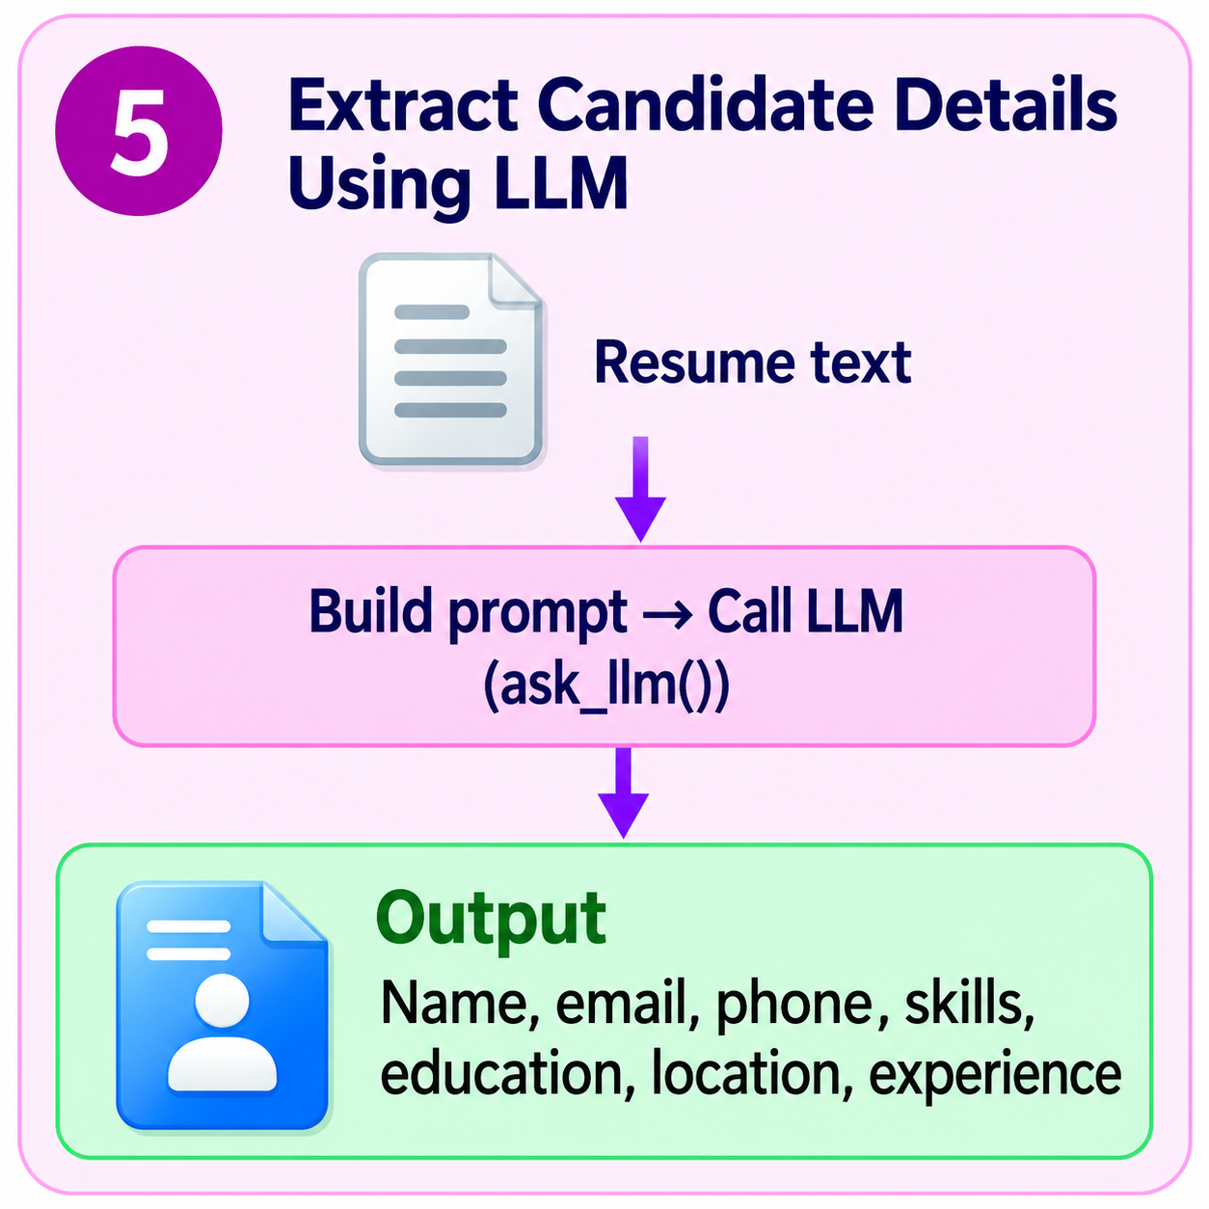
Extract candidate details using the LLM
5
What happens
A prompt is built from the resume text
ask_llm() calls the model with temperature 0 and a strict JSON schema
Only stated facts are extracted; missing values stay blank
Fields extracted from each resume
Name
Email
Phone
Skills
Education
Location
Experience
1
2
3
4
5
6
7
8
Notes:
This is the first LLM call per resume. The prompt says to extract only facts that are written, to use null or an empty list for anything missing, and to ignore protected characteristics such as age, gender, religion, caste, disability and marital status.

Slide 10
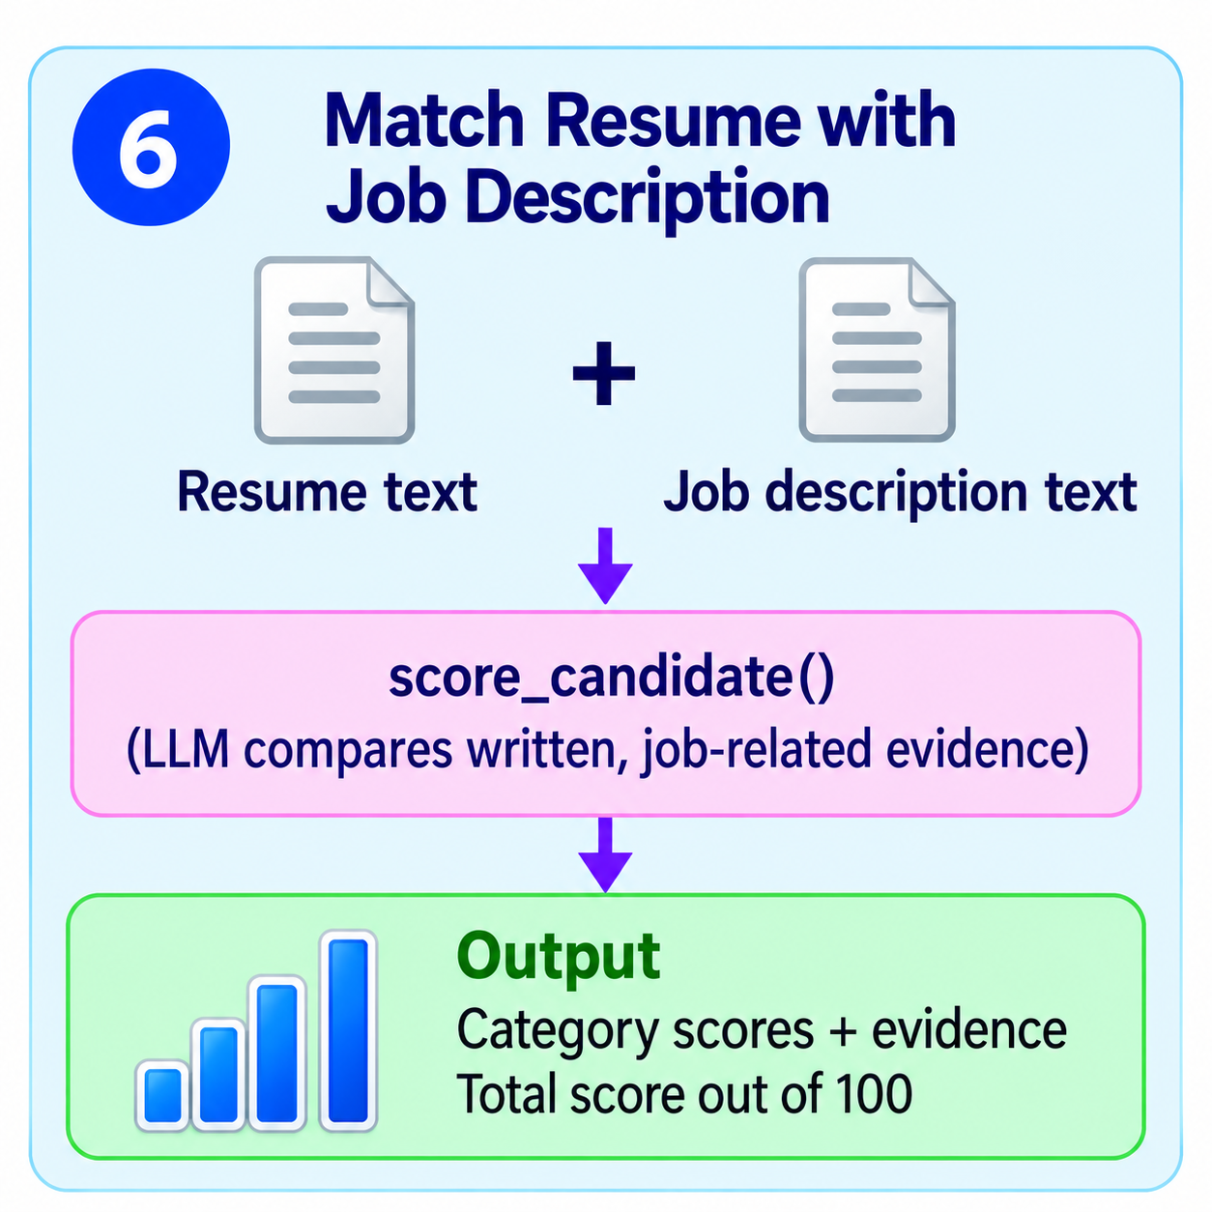
Match Resume with Job Description
6
What happens
The LLM compares only written, job-related evidence.
No double-counting, no guessing, and protected characteristics are ignored.
A short evidence list explains each score for the human reviewer
Maximum points per category
1
2
3
4
5
6
7
8
Notes:
This is the second LLM call. The model returns four integer scores within fixed limits plus short evidence notes. The Python code, not the model, sums them into the total out of 100.

Slide 11
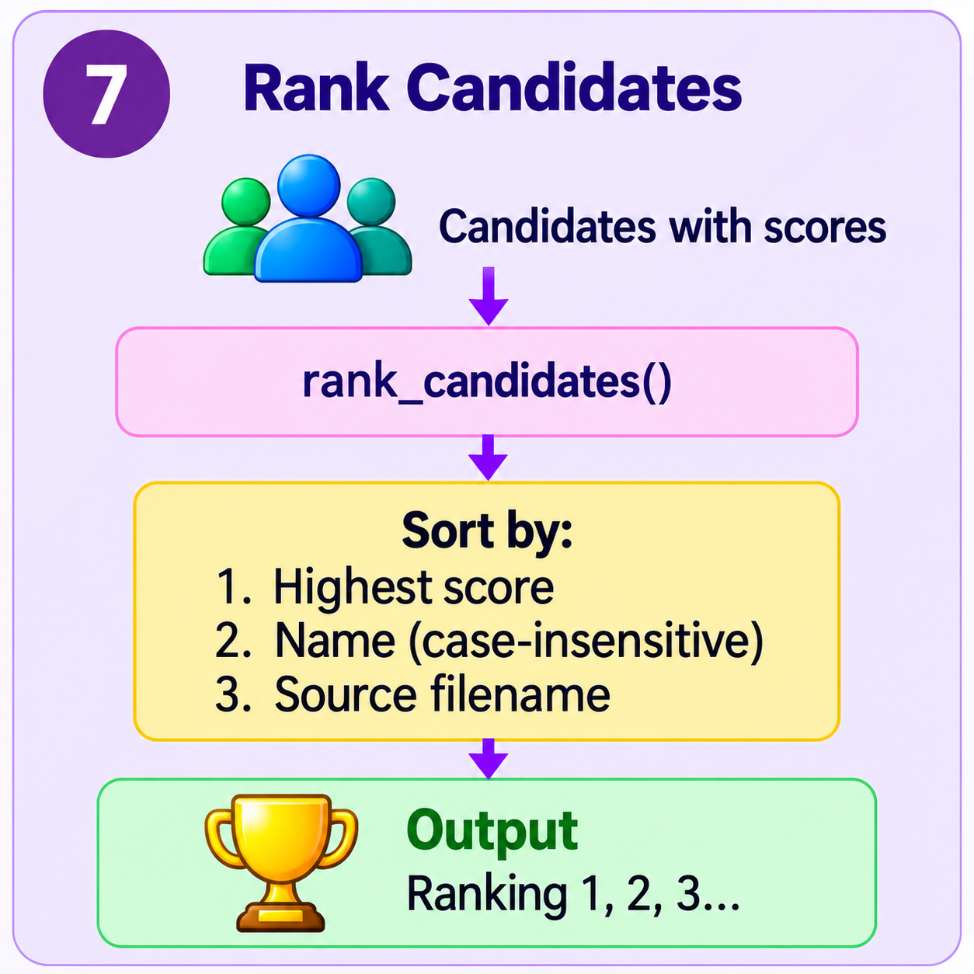
Rank candidates
7
What happens
Candidates are sorted by total score, highest first
Ties go to name (case-insensitive), then source filename
Each candidate gets a Ranking and a Match Score
In the code
ranking.py rank_candidates()
Output: ranking 1, 2, 3 ...
1
2
3
4
5
6
7
8
Notes:
Ranking is plain Python sorting with no LLM. The tie-break rules make the order repeatable: in the sample run four candidates tied at 25, and name then filename decided their order.

Slide 12
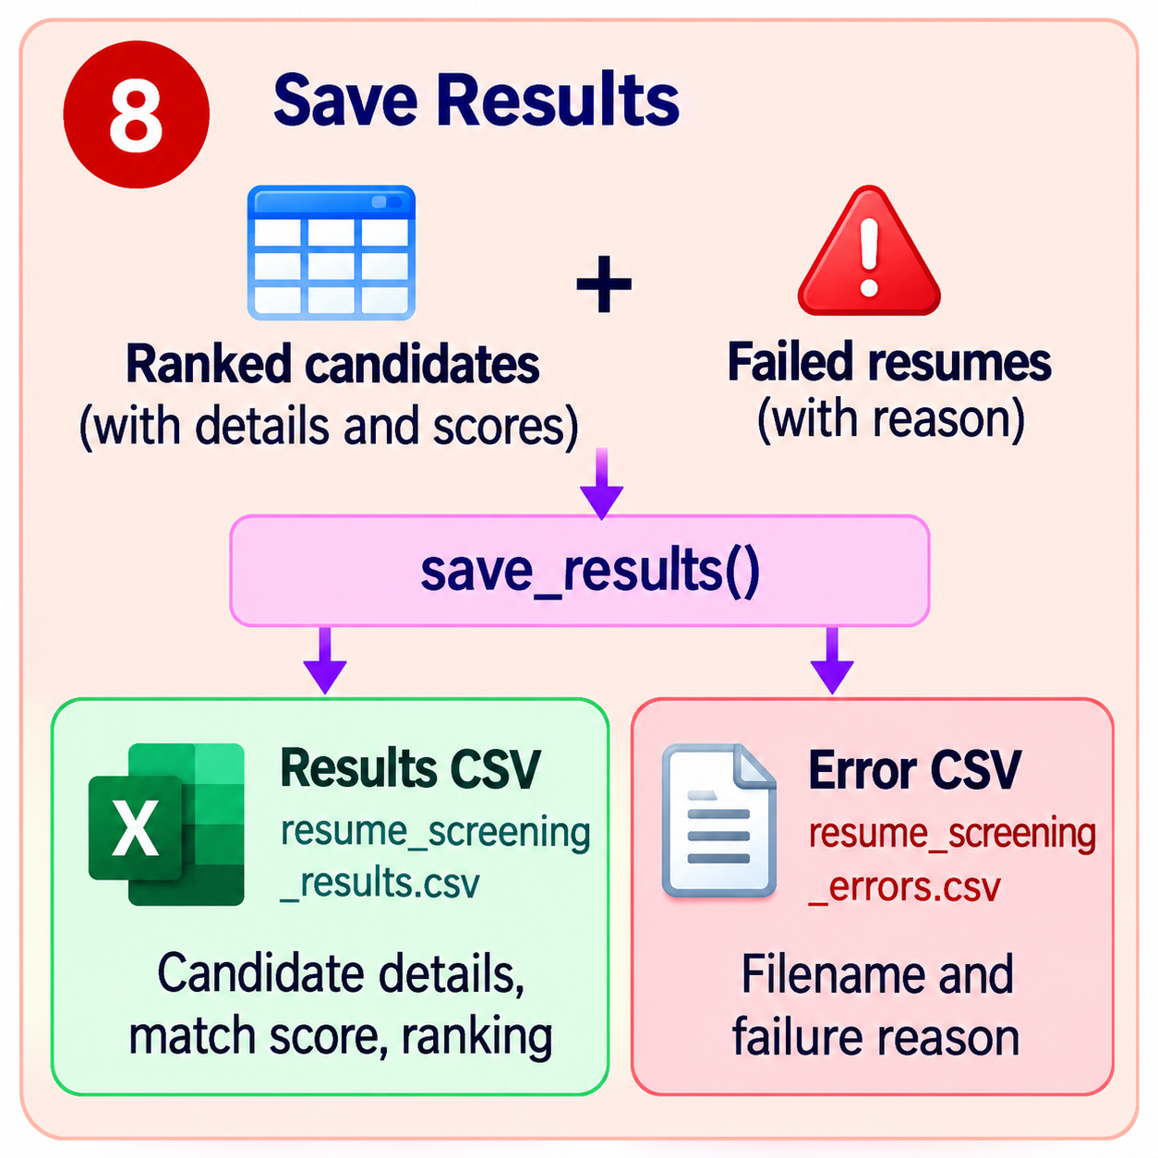
Save results
8
What happens
save_results() writes two CSV files
Ranked candidates go to the results CSV
Failed resumes go to the error CSV with a short reason
In the code
utils.py save_results()
resume_screening_results.csv
resume_screening_errors.csv
Output: a results CSV and an error CSV
1
2
3
4
5
6
7
8
Notes:
The results CSV has nine columns and opens cleanly in Excel, with phone numbers protected from losing leading zeros. The error CSV lists each failed filename with a reason trimmed to 200 characters. The run ends by printing how many resumes succeeded and failed.

Slide 13
The whole flow at a glance
1
2
3
4
Provide input files
Load config, validate
Read job description
Find and read resumes
5
6
7
8
Extract details (LLM)
Match to job (LLM)
Rank candidates
Save results
Notes:
Recap: PDFs in, two LLM calls per resume, a ranked CSV and an error CSV out. Scores support human review and should not be the sole basis for hiring decisions.

