Slide 1
CraftIQ
AI-Powered Career Intelligence Platform
Create • Analyze • Improve
Presented By:
Abdi Temesgen Terfasa
Course:
CPSC 5110 01 26SQ Fundamentals of Software Engineering
Technologies:
  ASP.NET Core MVC
  OpenRouter API
  SQLite Database

Slide 2
Why CraftIQ?
Problems
  Creating professional CVs takes time
  Cover letters are difficult to write
  Limited career guidance and feedback
  No single platform for career development
Solution
  AI CV Builder
  Cover Letter Generator
  Resume Analysis & ATS Scoring
  Job Matching & Career Guidance
  AI Code Refactoring
Goal
Improve job application success

Slide 3
Key Requirements
Functional Requirements
Users can create and edit CVs.
Users can generate cover letters.
Users can upload and analyze resumes.
Users can refactor source code using AI.
Users can save and export documents.
Non-Functional Requirements
Secure user data and files.
Fast AI response time.
Reliable document processing.
Support multiple file formats (PDF, DOCX, PNG).

Slide 4
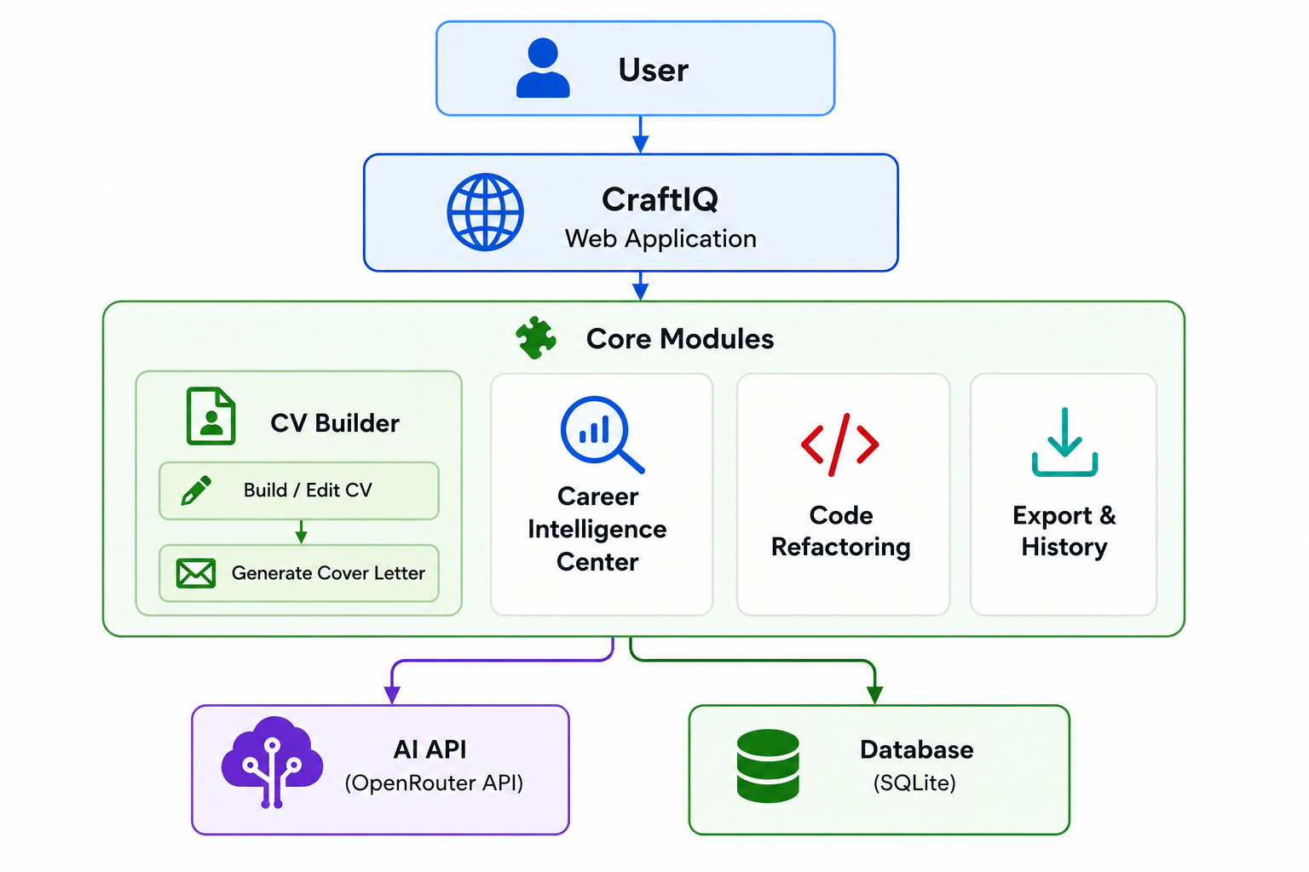
System Architecture
Frontend: Razor Views, HTML, CSS, JavaScript
Backend: ASP.NET Core MVC, C#
AI: OpenRouter API
Database: SQLite, Entity Framework Core

Slide 5
Demo
▶ Open CraftIQ

Slide 6
Key Challenges & Solutions
Challenge | Solution
Extracting data from PDF, DOCX, and image resumes | Implemented document parsing and OCR-based extraction
Integrating multiple AI-powered features into one platform | Used OpenRouter API with a modular service architecture
Providing accurate resume analysis and ATS scoring | Combined AI feedback with custom C# scoring logic
Ensuring system reliability and quality | Implemented automated testing using xUnit, Moq, and Coverlet
Supporting multiple export formats | Developed PDF, DOCX, PNG, TXT, and JSON export services

Slide 7
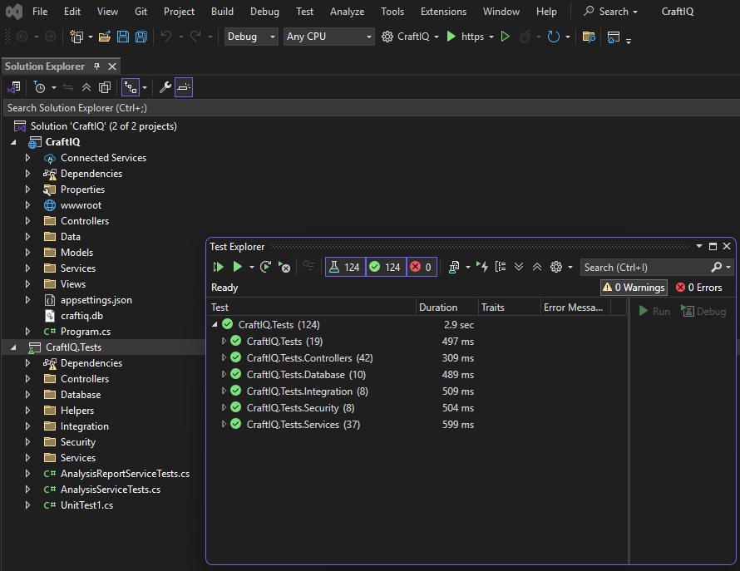
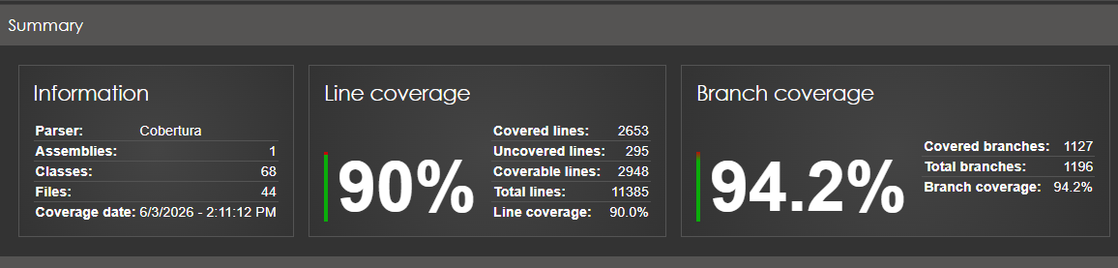
Testing & Quality Assurance
124 unit and integration tests executed covering Services (37), Controllers (42), Database (10), Security (8), Integration (8), and Analysis Reports (19).

Slide 8
Lessons Learned & Future Work
Lessons Learned
Learned how to design and build a complete software system.
Gained experience integrating AI into real-world applications.
Improved skills in selecting the right technologies and tools.
Strengthened testing and software quality practices.
Future Work
Add more premium and professional CV templates.
Develop a coding practice module.
Enhance AI-powered career assistance features.
Deploy CraftIQ for wider user access.

Slide 9
Q/A

