Slide 1
Axon
terminals
Myelin sheath
Input
Signals
Output
Signals
Dendrites
Axon
Cell nucleus
Schematic of a biological neuron.

Slide 2
Inputs
Weights
Net input
function
Activation function
1
w₀
x₁
w₁
Σ
output
w₂
x₂
w_{m}
.
.
.
x_{m}
Schematic of Rosenblatt’s perceptron.

Slide 3
g(w^{T}x)
1
w^{T}x
θ
-1
Unit step function.

Slide 4
x₂
x₁
Example of a linear decision boundary
for binary classification.

Slide 5
1
Error
w₀
x₁
w₁
Σ
output
w₂
x₂
Net input function
Activation function
w_{m}
.
.
.
x_{m}
Perceptron rule.
1
w₀
Error
x₁
w₁
Σ
output
w₂
x₂
Net input function
Activation function
Quantizer
w_{m}
.
.
.
x_{m}
Adaline.

Slide 6
1
w₀
Error
x₁
w₁
Σ
output
w₂
x₂
w_{m}
Net input function
Activation function
Unit step function
.
.
.
x_{m}
Schematic of a logistic regression classifier.

Slide 7
1
Error
w₀
x₁
w₁
Σ
output
w₂
x₂
w_{m}
.
.
.
x_{m}
Schematic of a perceptron classifier.

Slide 8
1
w₀
Error
x₁
w₁
Σ
output
w₂
x₂
w_{m}
.
.
.
x_{m}
Schematic of an Adaline classifier.

Slide 9
1 if z ≥ 0
-1 otherwise.
Unit step
g(z) =
1 if z ≥ 0
0 otherwise.
g(z) =
Linear
g(z) = z
Logistic
(sigmoid)
g(z) =
1 / (1 + exp(-z))
Hyperbolic
tangent
(sigmoid)
exp(2z) - 1
exp(2z) + 1
g(z) =
. . .
1
w₀
x₁
w₁
Σ
output
w₂
x₂
w_{m}
.
.
.
A selection of commonly used activation functions for artificial neurons.
x_{m}

Slide 10
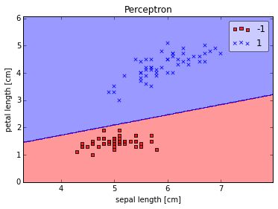
Decision boundary with large margin
Decision boundary
of the perceptron
Example of a large-margin decision boundary.

Slide 11
J(w)
Initial weight
J_{min}(w)
w
Schematic of gradient descent.

Slide 12
J(w)
J(w)
w
w
Large learning rate: Overshooting.
Small learning rate: Many iterations
until convergence and trapping in
local minima.

