Slide 1
Bank Marketing Data Analysis
Author: Hope Kimandi

Slide 2
Project Overview
Analysis of Portuguese bank marketing campaigns.
Dataset: 41,188 records, 21 features
Objective: Identify patterns, trends, and actionable insights

Slide 3
ETL Summary
- Extract: Loaded dataset into Python
- Transform: Cleaned data, removed duplicates, encoded features, created derived columns
- Load: Saved transformed dataset for analysis

Slide 4
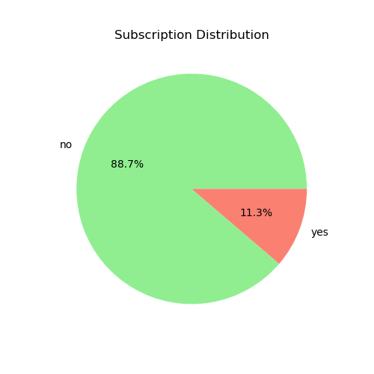
Subscription Distribution

Slide 5
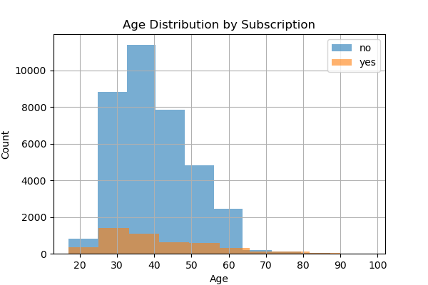
Age Distribution by Subscription

Slide 6
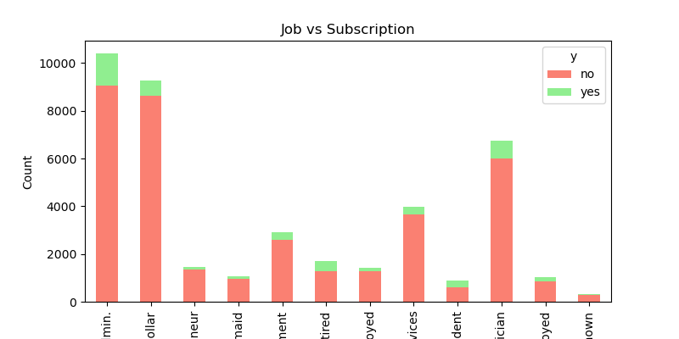
Job vs Subscription

Slide 7
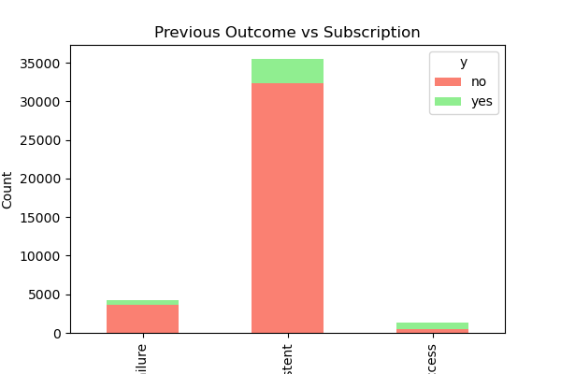
Previous Outcome vs Subscription

Slide 8
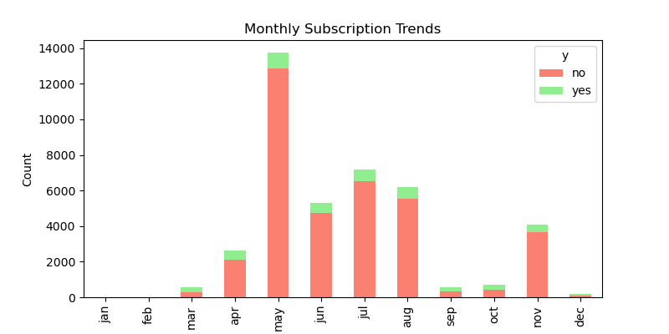
Monthly Subscription Trends

Slide 9
Key Insights & Recommendations
- Focus on high-potential groups (management, technicians)
- Optimize call duration for better results
- Prioritize clients with previous positive outcomes
- Target campaigns during May-July for higher subscription rates

Slide 10
Conclusion
The analysis provides actionable insights for optimizing bank marketing campaigns.
Segmentation, call strategies, and past client behavior improve subscription rates.

