Slide 1

The Structure of a Django Application
Dr. Charles R. Severance
www.dj4e.com
https://samples.dj4e.com/
https://github.com/csev/dj4e-samples

Slide 2
Django Terminology (i.e. folders)
Project is a collection of applications
Our project is "dj4e-samples"
Project-wide configuration is in dj4e-samples/dj4e-samples
Our first application is "hello"
We will do most of our web development in the application folder dj4e-samples/hello
https://samples.dj4e.com/
https://github.com/csev/dj4e-samples

Slide 3
Django files
$ ls -l dj4e-samples hello
dj4e-samples:
-rw-r--r-- 1 csev staff 0 Feb 15 __init__.py
-rw-r--r-- 1 csev staff 6106 Apr 23 settings.py
-rw-r--r-- 1 csev staff 2382 Apr 26 urls.py
-rw-r--r-- 1 csev staff 391 Feb 15 wsgi.py
hello:
-rw-r--r-- 1 csev staff 0 Feb 24 __init__.py
-rw-r--r-- 1 csev staff 63 Feb 24 admin.py
-rw-r--r-- 1 csev staff 85 Feb 24 apps.py
drwxr-xr-x 4 csev staff 128 Feb 24 migrations
-rw-r--r-- 1 csev staff 57 Feb 24 models.py
-rw-r--r-- 1 csev staff 60 Feb 24 tests.py
-rw-r--r-- 1 csev staff 101 Feb 24 urls.py
-rw-r--r-- 1 csev staff 509 Feb 24 views.py

Slide 4
Flow of a Web Request
When the request arrives at a Django app the incoming request URL is compared to the list of paths in urls.py in the variable urlpatterns
When there is a url match, it selects a "View" which is a bit of code that handles any database access and then produces and delivers the response to the browser
The view access the database indirectly through an abstraction called a "model"
This is a general web pattern called "Model-View-Controller" or MVC

Slide 5
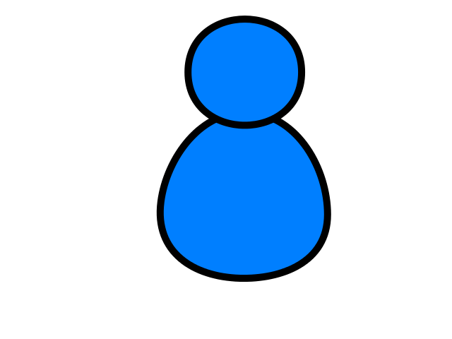
Browser
Linux
D
O
M
WGSIConfig
settings.py
1: Click
2: GET
Django
Routing
urls.py
Parse
Response
views.py
Views
forms.py
Javascript
Templates
model.py
Models
Database

Slide 6
Browser
Linux
D
O
M
WGSIConfig
settings.py
Django
Routing
3: Choose
urls.py
Parse
Response
views.py
Views
forms.py
Javascript
Templates
4: Store Data (optional)
model.py
Models
Database

Slide 7
Browser
Linux
D
O
M
WGSIConfig
settings.py
Django
Routing
urls.py
Parse
Response
views.py
7: Render
Views
5: Choose
forms.py
Javascript
Templates
6: Read Data
model.py
Models
Database

Slide 8
Browser
Linux
D
O
M
WGSIConfig
settings.py
1: Click
2: GET
Django
Routing
3: Choose
urls.py
Parse
Response
views.py
7: Render
Views
5: Choose
forms.py
Javascript
Templates
4: Store Data (optional)
6: Read Data
model.py
Models
Database

Slide 9
Virtual Hosting
Virtual Hosting – Many domains on one system
HTTP – Hypertext Transport Protocol
Connects to a domain
Includes the domain in the GET request
https://blog.pythonanywhere.com/36/

Slide 10
Web Server
$ telnet data.pr4e.org 80
Trying 74.208.28.177...
Connected to data.pr4e.org character is '^]'.
GET http://data.pr4e.org/page1.htm HTTP/1.0
HTTP/1.1 200 OK
Date: Thu, 04 Jan 2018 14:45:10 GMT
Server: Apache/2.4.7 (Ubuntu)
Last-Modified: Mon, 15 May 2017 11:11:47 GMT
Content-Type: text/html
<h1>The First Page</h1>
<p>If you like, you can switch to
the <a href="http://www.dr-chuck.com/page2.htm">Second Page</a>.</p>
Connection closed by foreign host.
Browser

Slide 11
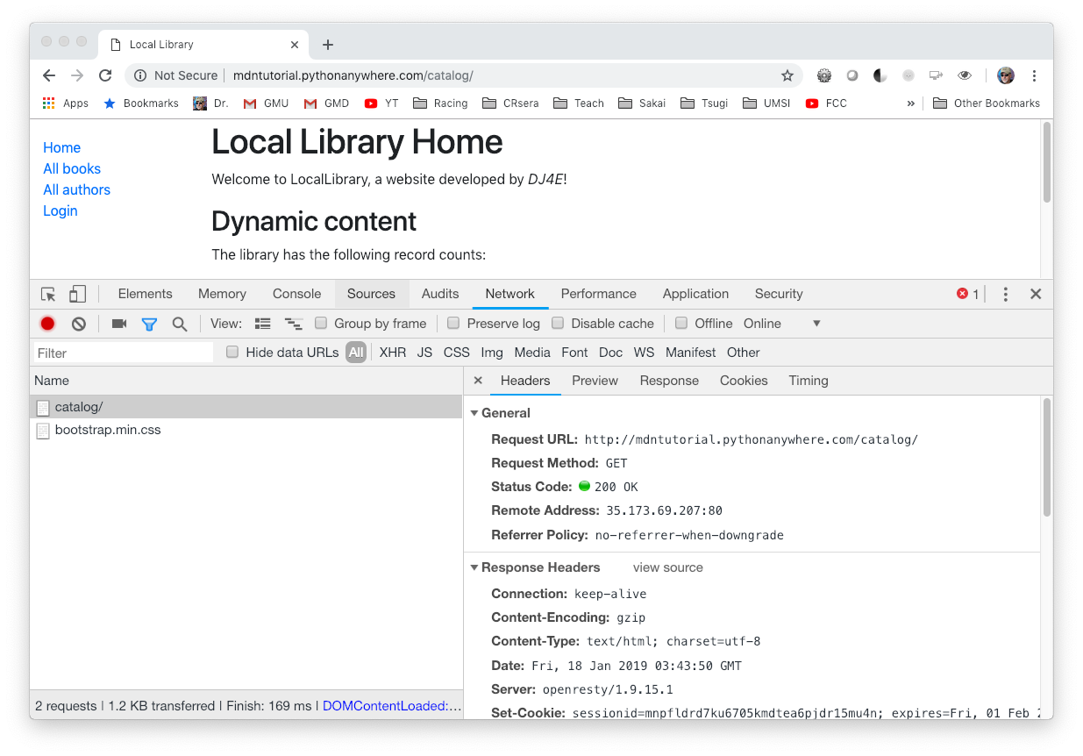

Slide 12
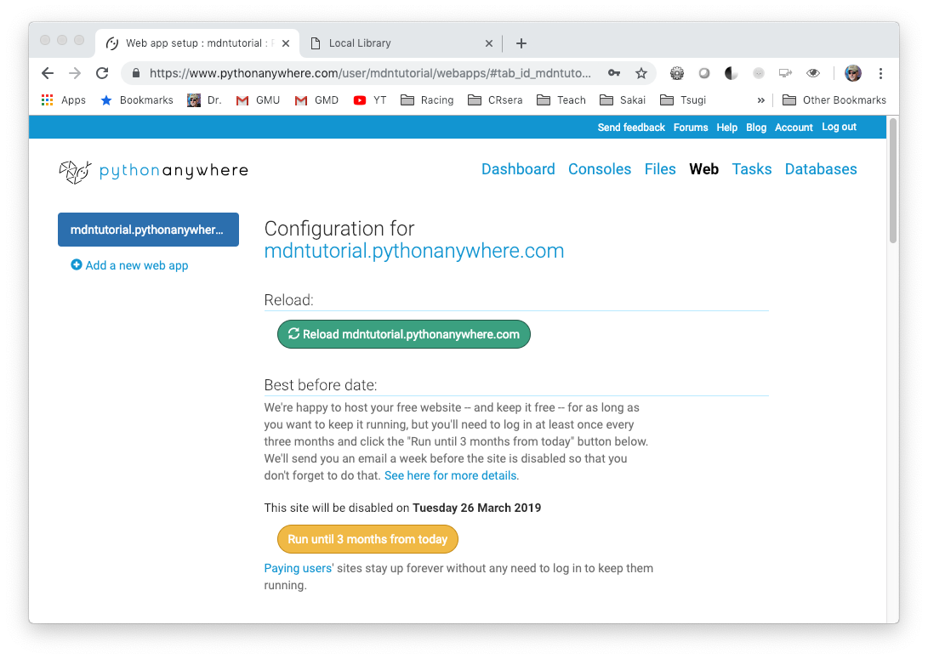
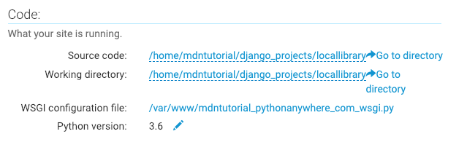

Slide 13
Browser
Linux
N
G
I
N X
WGSIConfig
settings.py
Django – mdntutorial.pythonanywhere.com
urls.py
views.py
model.py
WGSIConfig
settings.py
Django – dj4e.pythonanywhere.com
urls.py
views.py
model.py
……
WGSIConfig
Flask – flaskfun.pythonanywhere.com

Slide 14
Browser
Linux
D
O
M
WGSIConfig
settings.py
Django
Routing
urls.py
Parse
Response
views.py
Views
forms.py
Templates
model.py
Models
Database

Slide 15
Summary
It will take a while to fully understand the internal workings of a Django application – it gets easier after you have built and extended a few applications.
Having consistency in the "shape" of Django applications is very helpful when you get "dropped into" an existing project developed by someone else.

Slide 16

Acknowledgements / Contributions
These slides are Copyright 2019- Charles R. Severance (www.dr-chuck.com) of the University of Michigan School of Information and made available under a Creative Commons Attribution 4.0 License. Please maintain this last slide in all copies of the document to comply with the attribution requirements of the license. If you make a change, feel free to add your name and organization to the list of contributors on this page as you republish the materials.
Initial Development: Charles Severance, University of Michigan School of Information
… Insert new Contributors and Translators here
Continue…

