Slide 1


Views and Templates
Charles Severance
www.dj4e.com

Slide 2
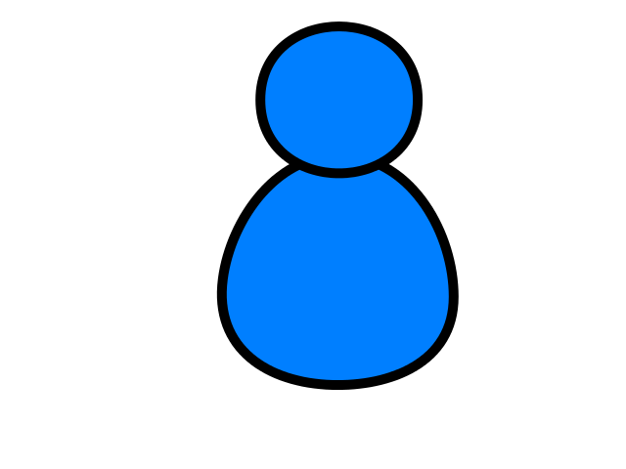
Browser
Linux
D
O
M
N
G
I
N X
WGSIConfig
settings.py
DJango
Routing
Click
urls.py
views.py
Parse
Response
Views
Templates
forms.py
Javascript
Database
Shell
Models
model.py
/admin
admin.py

Slide 3
Views are our control center
Django looks at the incoming request URL and uses urls.py to select a view
The view from views.py
Handle any incoming data in the request and copy it to the database through the model
Retrieve data to put on the page from the database though the model
Produce the HTML that will become the response and return it to the browser
https://github.com/csev/dj4e-samples/blob/master/views/home/urls.py
https://github.com/csev/dj4e-samples/blob/master/views/home/views.py

Slide 4
home/urls.py
home/views.py
home/templates/main.html
from django.urls import path
from . import views
from django.views.generic import TemplateView
# https://docs.djangoproject.com/en/2.1/topics/http/urls/
urlpatterns = [
path('', TemplateView.as_view(template_name='main.html')),
path('funky', views.funky),
path('danger', views.danger),
path('game', views.game),
path('rest/<int:guess>', views.rest),
path('bounce', views.bounce),
path('main', views.MainView.as_view()),
path('remain/<slug:guess>', views.RestMainView.as_view()),
]

Slide 5
home/urls.py
home/views.py
home/templates/main.html
<html><body><p>This is the views main.html sample</p>
<p>
<ul>
<li>This page is coming from a file in home/templates/main.html</li>
<li><a href="funky">Use a view function</a></li>
...
</ul>
</p>
<p>This sample code is available at
<a href="https://github.com/csev/dj4e-samples" target="_blank">
https://github.com/csev/dj4e-samples</a>
</p>
</body></html>

Slide 6
home/urls.py
home/views.py
home/templates/main.html
from django.http import HttpResponse
from django.http import HttpResponseRedirect
# Create your views here.
def funky(request):
response = """<html><body><p>This is the funky function sample</p>
<p>This sample code is available at
<a href="https://github.com/csev/dj4e-samples">
https://github.com/csev/dj4e-samples</a></p>
</body></html>"""
return HttpResponse(response)
def danger(request) :
...

Slide 7
Passing URL Path Values to the View
http://localhost:8000/rest/41
urlpatterns = [
path('rest/<int:guess>', views.rest),
]
<type:parameter-name>
from django.http import HttpResponse
from django.utils.html import escape
def rest(request, guess) :
response = """<html><body>
<p>Your guess was """+escape(guess)+"""</p>
</body></html>"""
return HttpResponse(response)

Slide 8
Class Based Views – Inheritance
urlpatterns = [
path('remain/<slug:guess>', views.RestMainView.as_view()),
]
from django.http import HttpResponse
from django.utils.html import escape
from django.views import View
class RestMainView(View) :
def get(self, request, guess):
print("We got a slug from the URL",guess);
response = """<html><body>
<p>Your guess was """+escape(guess)+"""</p>
</body></html>"""
return HttpResponse(response)
https://www.py4e.com/lessons/Objects

Slide 9
Demo / Walkthrough
https://github.com/csev/dj4e-samples/tree/master/views

Slide 10
Templates Organize Our HTML
Concatenation and escaping can get tiresome and lead to very obtuse looking code.
from django.http import HttpResponse
from django.utils.html import escape
from django.views import View
class RestMainView(View) :
def get(self, request, guess):
response = """<html><body>
<p>Your guess was """+escape(guess)+"""</p>
</body></html>"""
return HttpResponse(response)
https://github.com/csev/dj4e-samples/tree/master/templates

Slide 11
Template Render Process
Render Data
Template
Render
Engine
Rendered
Output

Slide 12
Template Render Process
<h1>Hi!</h1>
<pre>
{{ dat }}
</pre>
{ 'dat' : 'Fun Stuff' }
Render
Engine
<h1>Hi!</h1>
<pre>
Fun Stuff
</pre>

Slide 13
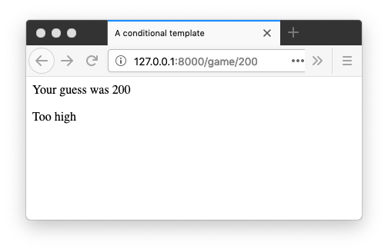
From the URL to the Template
urlpatterns = [
path('game/<slug:guess>', views.GameView.as_view()),
]
from django.views import View
class GameView(View) :
def get(self, request, guess) :
x = {'guess' : int(guess) }
return render(request, 'cond.html', x)

Slide 14
View Using a Template to make HTML
from django.views import View
class GameView(View) :
def get(self, request, guess) :
x = {'guess' : int(guess) }
return render(request, 'cond.html', x)
<html>
<head>
<title>A conditional template</title>
</head>
<body>
<p>Your guess was {{ guess }}</p>
{% if guess < 42 %}
<p>Too low</p>
{% elif guess > 42 %}
<p>Too high</p>
{% else %}
<p>Just right</p>
{% endif %}
</body>
</html>

Slide 15
Template Tags
{{ zap }}
{{ zap|safe }}
{% url 'cat-detail' cat.id %}
{% author.get_absolute_url %}
{% if zap > 100 %}
{% endif %}
{% block content %}
{% endblock %}
Substitution
Calling code
Logic
Blocks

Slide 16
Template "coding"
<html>
<head>
<title>A simple page</title>
</head>
<body>
<p>Your guess was {{ zap }}</p>
<p>Escaped {{ txt }}</p>
<p>Escaped not! {{ txt|safe }}</p>
</body>
</html>
<body>
<ul>
{% for x in fruits %}
<li>{{ x }}</li>
{% endfor %}
</ul>
{% if nuts %}
<p>Number of nuts: {{ nuts|length }}</p>
{% else %}
<p>No nuts.</p>
{% endif %}
</body>

Slide 17
Template Inheritance
Base
Template
Render
Data
Template
Render
Engine
Rendered
Output

Slide 18
Template Inheritance
base.html
<html>
<head>
<title>A template</title>
</head>
<body>
{% block content %}{% endblock %}
</body>
</html>
cond.html
<html>
<head>
<title>A conditional template</title>
</head>
<body>
<p>Your guess was {{ guess }}</p>
{% if guess < 42 %}
<p>Too low</p>
{% elif guess > 42 %}
<p>Too high</p>
{% else %}
<p>Just right</p>
{% endif %}
</body>
</html>
cond2.html
{% extends "base.html" %}
{% block content %}
<p>Your guess was {{ guess }}</p>
{% if guess < 42 %}
<p>Too low</p>
{% elif guess > 42 %}
<p>Too high</p>
{% else %}
<p>Just right</p>
{% endif %}
{% endblock %}

Slide 19
Demo / Walkthrough
https://github.com/csev/dj4e-samples/tree/master/templates

Slide 20
Summary
Views are where we bring the application components together to handle requests from browsers and produce responses for the browsers
Templates take a context and merge it into a template to produce HTML
Values can be substituted without without "escaping"
Conditional
Looping
Inheritance between templates

Slide 21
Acknowledgements / Contributions
These slides are Copyright 2019- Charles R. Severance (www.dr-chuck.com) as part of www.dj4e.com and made available under a Creative Commons Attribution 4.0 License. Please maintain this last slide in all copies of the document to comply with the attribution requirements of the license. If you make a change, feel free to add your name and organization to the list of contributors on this page as you republish the materials.
Initial Development: Charles Severance, University of Michigan School of Information
Insert new Contributors and Translators here including names and dates
Continue new Contributors and Translators here

