Slide 1


Browser
Linux
D
O
M
N
G
I
N X
WGSIConfig
settings.py
DJango
Routing
Click
urls.py
views.py
Parse
Response
Views
Templates
forms.py
Javascript
Database
Shell
Models
model.py
/admin
admin.py

Slide 2
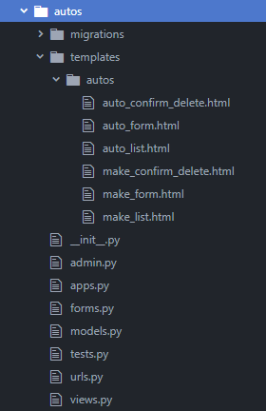
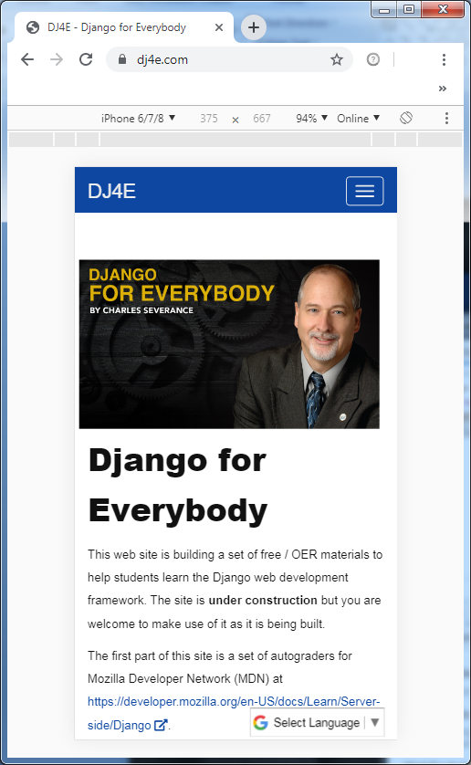
Routing
Click
urls.py
views.py
Views
Templates
forms.py

Slide 3

Routing
Click
urls.py
views.py
Views
Templates
forms.py
Urls.py

Slide 4
Routing
Click
urls.py
views.py
Views
Templates
forms.py
Urls.py
Will look for “class AutoCreate” in views.py

Slide 5
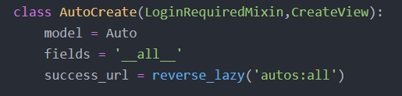
Built-in Class-based Views
Pre-existing views for common design requirements;
Generic views are included for display, editing, and date.
Urls.py
views.py

Slide 6
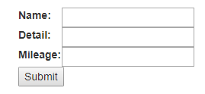
views.py
CreateView – invokes one of the generic edit views;
model = Auto – calls the database table “Auto”;
fields = ‘__all__’ – renders all fields from the table in the form;
success_url – specifies which URL name to return after ‘submit’;

Slide 7
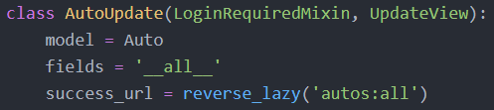
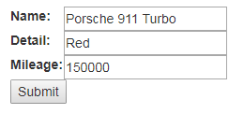
views.py
“CreateView”
Renders a blank form for adding new records.
views.py
“UpdateView”
Renders a form populated with an existing record for editing.

Slide 8
views.py
success_url – specifies which URL name to return after ‘submit’. The URL name is a Named URL Pattern which is specified in urls.py. This creates a DRY mechanism (Don’t Repeat Yourself) for referencing a URL which is useful in simplifying the code and helps prevent errors when PATH values are changed.
‘autos:all’ – This reference includes two elements (i) application namespace (autos) and (ii) the URL Name (all). The application namespace helps distinguish conflicting URL Names from different applications.
Urls.py

