Slide 1
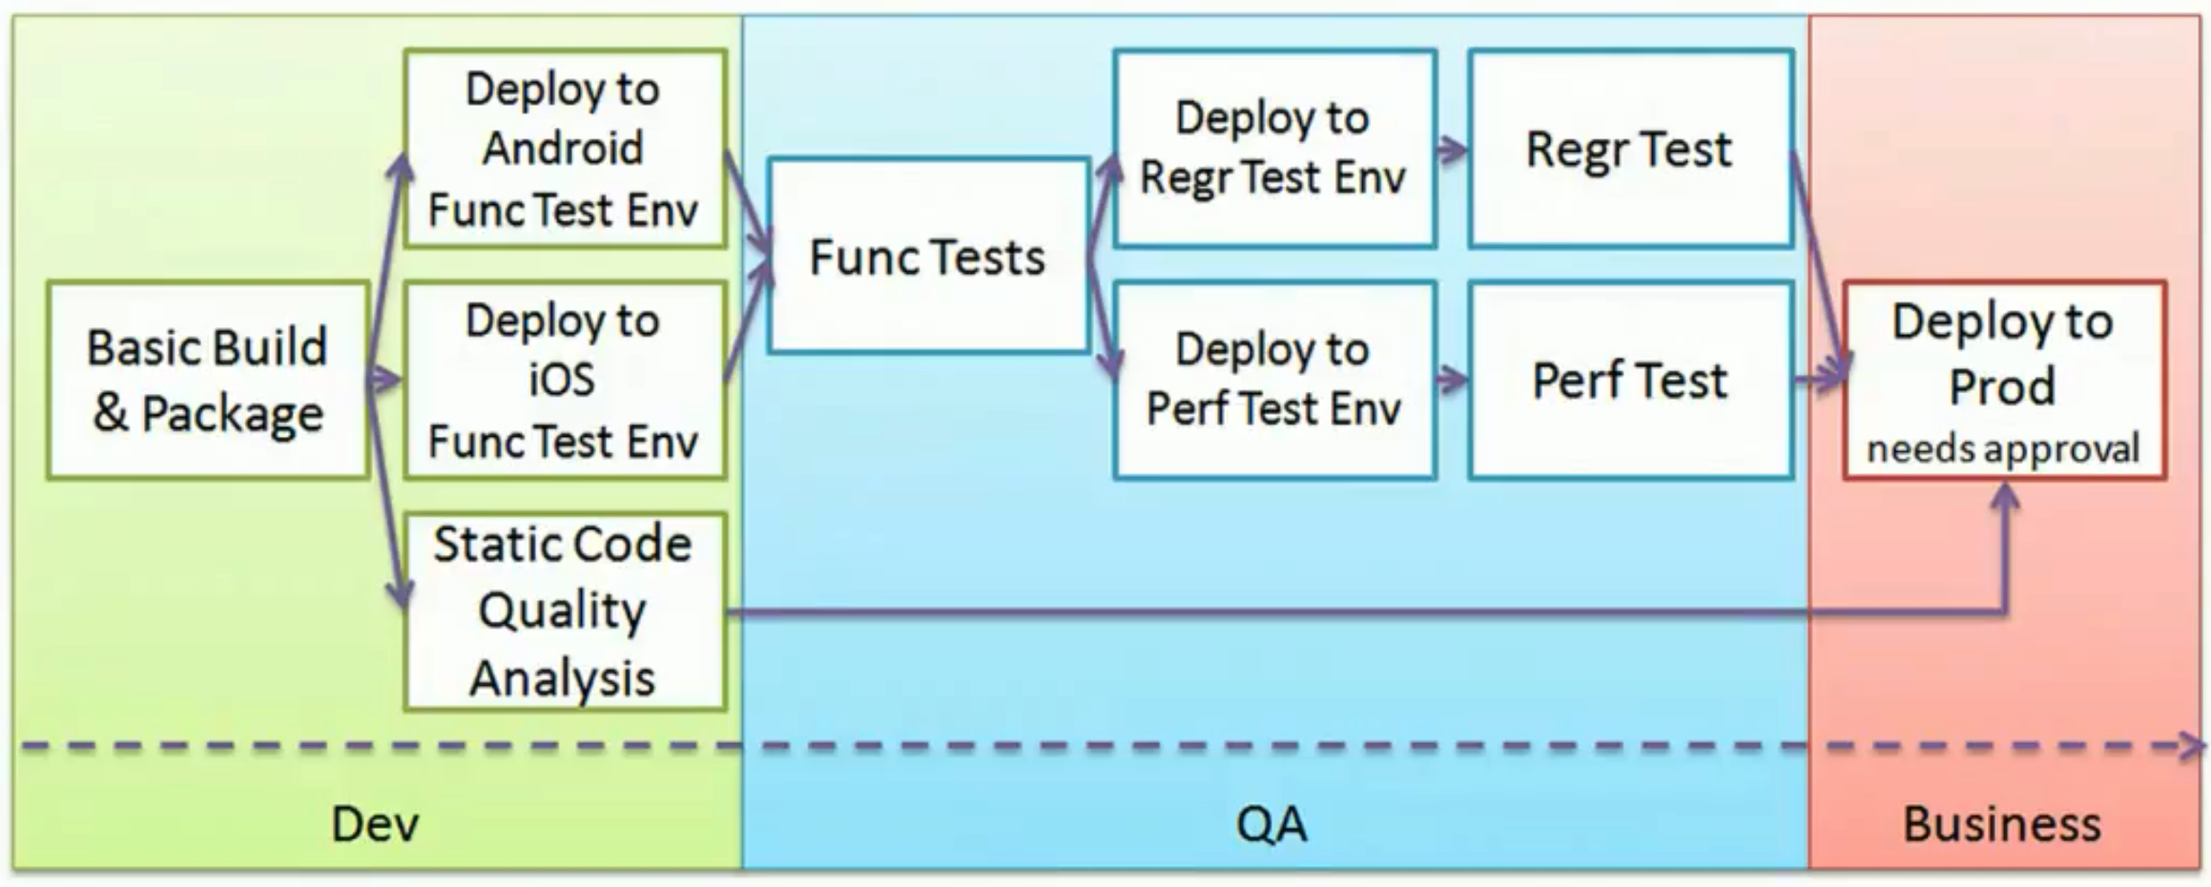
2014
Notes:
In Jenkins1, these are several separate jobs.
[32:45] http://www.infoq.com/articles/orch-pipelines-jenkins
March 29, 2014
* Ensuring reproducible builds
* Sharing build artifacts throughout the pipeline
* Choosing the right granularity for each job
* Parallelizing and joining jobs
* Gates and approvals
* Visualizing the pipeline
* Organizing and securing jobs
* Good practice: versioning your Jenkins configuration

Slide 2
CI Pipeline
SCM
app source
Artifactory images
DockerHub images
external APIs & DBs
on-server databases
Dockerfile
commit, tag
Java
only
Register
push
CI (Jenkins) collect
build & compile
publish
deploy image
smoke test
on app svr.
Instantiate CI server
Build Docker image with tag
Push Docker image to DockerHub
Pull Docker image
Provision VPC
Run Gulp, Maven, etc.
Code scan
Functional smoke & E2E test
Config. Jenkins packages
Checkout from GitHub
Logging
Monitoring
Scaling test
Notification to Slack, etc.
Define Docker credentials in CI
Run Docker
Invoke Docker
Notes:
grunt

Slide 3
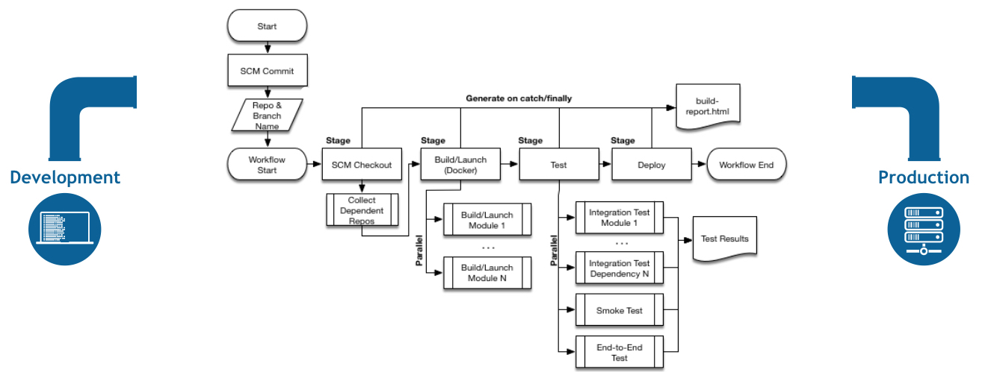

Slide 4
Register
multi-branch
item
subtasks
each
build
scm
workspace
git url:
Jenkinsfile
in GitHub
/var/lib/jenkins/

