Slide 1
AWS IoT Button setup
Downloads folder
browser setup
...pem.crt
Download
SSID
private.pem.key
web server for setup
AWS region
AWS IoT Resources
last 8 Serial #
AWS Lambda
web page
Lambda functions
internet router
internet
browser
SSID,
Password
Subdomain
AWS IoT
Endpoint
aws-iot-setup-v01.pptx. Copyright 2016 Wilson Mar. All rights reserved.

Slide 2
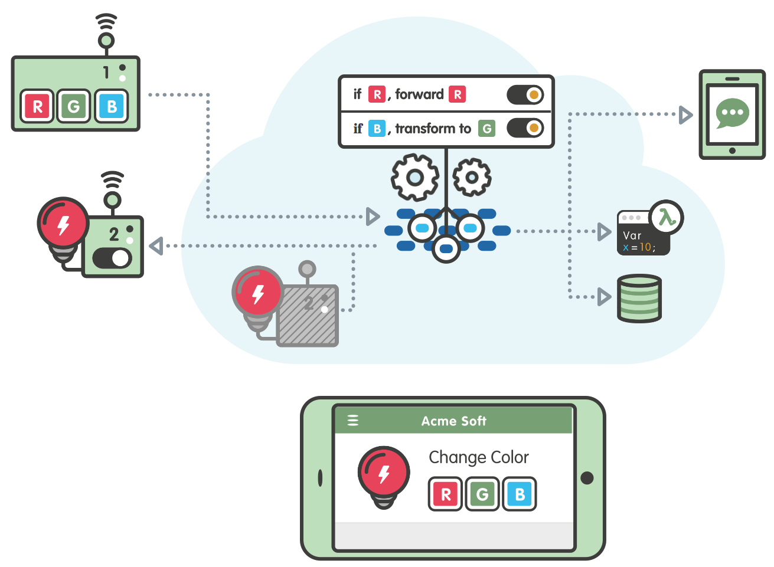
Device
Rules
Mobile app
Message broker
Rules Engine
Security
Lambda
Gateway
Thing registry
DynamoDB
Shadows
Notes:
http://blog.shippable.com/integrate-with-quay.io-and-private-docker-registry

Slide 3
