Slide 1
direct monetization
Twilio SMS
SendGrid email
Zapier
Internal
charge-backs
public
private
partners
Internal
efficiencies
API Business model
indirect monetization

Slide 2
API Gateway
API servers
Proxy style:
client apps
Order service
API Style
Customer service

Slide 3
order/987
API Gateway
Proxy style:
client apps
Order proxy
Order service
customer/123
Customer proxy
API Style
Customer service
customerOrder/456
Assembly style:
client apps
assembly

Slide 4
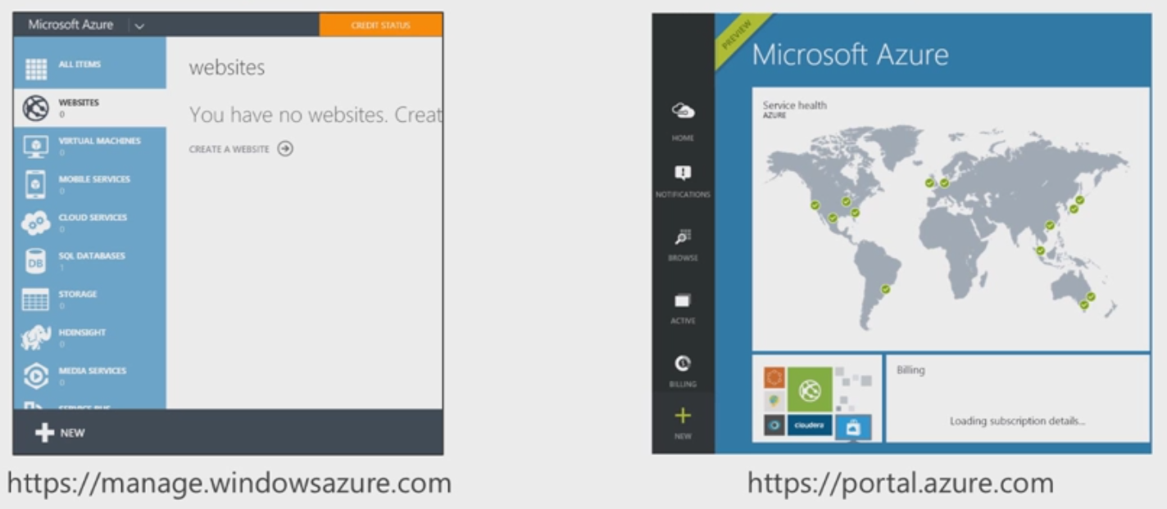
Azure Service Manager
Azure Resource Manager
Two Azure portals
“Classic”

