Slide 1
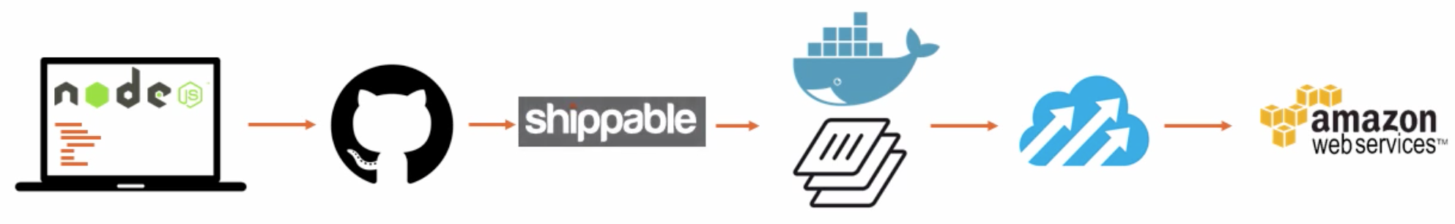



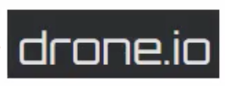
CI options
graphic source: 0:21 into https://app.pluralsight.com/player?course=integrating-docker-with-devops-automated-workflows &author=nigel-poulton&name=integrating-docker-with-devops-automated-workflows-m3&clip=0&mode=live

Slide 2
CI Pipeline
SCM
app source
Artifactory images
DockerHub images
external APIs & DBs
on-server databases
Dockerfile
commit, tag
Java
only
Register
push
CI (Jenkins) collect
build & compile
publish
deploy image
smoke test
on app svr.
Instantiate CI server
Build Docker image with tag
Push Docker image to DockerHub
Pull Docker image
Provision VPC
Run Gulp, Maven, etc.
Code scan
Functional smoke & E2E test
Config. Jenkins packages
Checkout from GitHub
Logging
Monitoring
Scaling
Notification to Slack
Define Docker credentials in CI
Run Docker
Invoke Docker
Notes:
grunt

Slide 3
