Slide 1

Security Group
Auto Scaling group
VPC subnet A
Availability Zone a
region us-west-2
AWS cloud

Slide 2

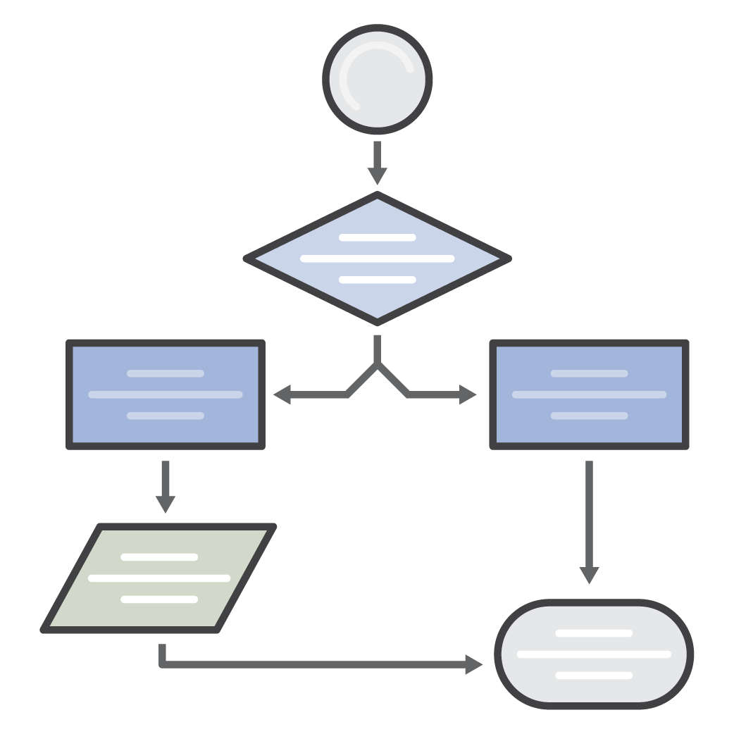


AWS Simple Icons
Check to make sure you have the most recent set of AWS Simple Icons
Find the most recent set at: aws.amazon.com/architecture/icons/
Always use icon labels
Be sure to always include a label below the icon or on the group in Arial. The only exception is in complex diagrams; you have the option to create a key.
Non-AWS technology
Any server or other non-AWS technology in an architecture diagram should be represented with the grey server (see Slide 29).
Creating diagrams
Try to use direct lines (rather than ‘criss-cross’), use adequate whitespace, and remember to label all icons.
Console icons
The first icon in most service sets is the console icon. These should be used to represent the service on a more general level when you will not be going into as much depth.
cluster
Amazon EC2
traditional server
AWS Simple Icons: Usage Guidelines

Slide 3
Table of Contents
Compute
4
Security & Identity
17
Enterprise Applications
31
Storage & Content Delivery
6
Analytics
20
General
32
Database
8
Internet of Things
22
On-Demand Workforce
33
Networking
11
Game Development
25
SDKs
34
Developer Tools
11
Mobile Services
27
Groups
35
Management Tools
15
Application Services
29
Example
37

Slide 4
Compute

Slide 5
















Compute
Amazon EC2
Amazon ECR
Amazon ECS
AWS Elastic Beanstalk
AWS
Lambda
Elastic Load Balancing
AMI
Auto Scaling
DB on instance
Elastic IP
application
instance
instances
instance with CloudWatch
deployment
optimized instance
Spot fleet
Spot instance

Slide 6
Storage & Content Delivery

Slide 7





















Storage & Content Delivery
Amazon CloudFront
Amazon EFS
Amazon Glacier
Amazon S3
AWS Import/
Export Snowball
AWS Storage Gateway
download distribution
archive
bucket
import/ export
cached volume
Amazon EBS
edge location
vault
bucket with objects
non-cached volume
snapshot
streaming distribution
object
virtual tape library
volume

Slide 8
Database

Slide 9




























Database
Database icons continue on next slide
Amazon DynamoDB
Amazon ElastiCache
Amazon RDS
Amazon Redshift
attribute
attributes
cache node
MS SQL instance
MS SQL instance alternate
MySQL DB instance
MySQL instance alternate
Oracle DB instance
dense compute node
global secondary index
item
Memcached
Oracle DB instance alternate
PIOP
Postgre SQL instance
RDS DB instance
dense storage node
items
table
Redis
RDS DB instance standby (multi-AZ)
RDS DB instance read replica
SQL master
SQL slave

Slide 10

Database (Continued)
AWS Database Migration Service

Slide 11
Networking

Slide 12














Networking
Amazon VPC
Amazon Route 53
AWS Direct Connect
customer gateway
endpoints
flow logs
hosted zone
Internet gateway
router
VPC NAT gateway
route table
VPN connection
VPN gateway
VPC peering

Slide 13
Developer Tools

Slide 14



Developer Tools
AWS CodeCommit
AWS CodeDeploy
AWS CodePipeline

Slide 15
Management Tools

Slide 16


















Management Tools
Amazon CloudWatch
AWS CloudFormation
AWS CloudTrail
AWS Config
AWS OpsWorks
AWS Service Catalog
AWS Trusted Advisor
alarm
stack
apps
deployments
instances
template
layers
monitoring
permissions
resources
stack

Slide 17
Security & Identity

Slide 18















Security & Identity
ACM
Amazon Inspector
AWS CloudHSM
AWS Directory Service
AWS IAM
AWS KMS
certificate manager
add-on
AWS STS
AWS STS (alternate)
data encryption key
encrypted data
long-term security credential
MFA token
permissions
role
temporary security credential

Slide 19

Security & Identity
AWS WAF

Slide 20
Analytics

Slide 21















Analytics
Amazon Elasticsearch Service
Amazon EMR
Amazon Kinesis
Amazon Machine Learning
Amazon QuickSight
AWS Data Pipeline
cluster
EMR engine
Amazon Kinesis Analytics
Amazon Kinesis– enabled app
EMR engine MapR M3
EMR engine MapR M5
Amazon Kinesis Firehose
EMR engine MapR M7
HDFS cluster
Amazon Kinesis Streams

Slide 22
Internet of Things (IoT)

Slide 23


















Internet of Things (IoT)
Internet of Things (IoT) icons continue on next slide
AWS IoT
IoT thing bank
IoT thing bicycle
IoT thing camera
IoT thing car
IoT thing cart
IoT thing coffee pot
IoT thing door lock
IoT thing factory
IoT thing generic
IoT thing house
IoT thing lightbulb
IoT thing medical emergency
IoT thing police emergency
IoT thing thermostat
IoT thing travel
IoT thing utility
IoT thing windfarm

Slide 24
















Internet of Things (IoT) (Continued)
AWS IoT (Continued)
IoT action
IoT actuator
IoT certificate
IoT desired state
IoT hardware board
IoT HTTP protocol
IoT HTTP/2 protocol
IoT MQTT protocol
IoT policy
IoT reported state
IoT rule
IoT sensor
IoT servo
IoT
shadow
IoT simulator
IoT topic

Slide 25
Game Development

Slide 26

Game Development
Amazon GameLift

Slide 27
Mobile Services

Slide 28








Mobile Services
Amazon Cognito
Amazon Mobile Analytics
Amazon SNS
AWS Device Farm
AWS Mobile Hub
email notification
HTTP notification
topic

Slide 29
Application Services

Slide 30













Application Services
Amazon API Gateway
Amazon AppStream
Amazon CloudSearch
Amazon Elastic Transcoder
Amazon
SES
Amazon SQS
Amazon
SWF
SDF metadata
email
message
decider
queue
worker

Slide 31
Enterprise Applications

Slide 32



Enterprise Applications
Amazon WorkDocs
Amazon WorkMail
Amazon WorkSpaces

Slide 33















General
AWS cloud
AWS Management Console
forums
virtual private cloud
client
Internet
mobile client
multimedia
user
users
corporate data center
disk
generic database
tape storage
traditional server
AWS Simple Icons: Non-Service Specific

Slide 34





On-Demand Workforce
Amazon Mechanical Turk
Amazon
Mechanical Turk
assignment/
task
human intelligence tasks (HIT)
requester
workers
Mechanical Turk vs. Amazon Mechanical Turk
Do not use simple "Mechanical Turk" to refer to Amazon Mechanical Turk. Use Amazon Mechanical Turk to describe the entire system, Amazon Mechanical Turk website for the worker website, and Amazon Mechanical Turk web service to describe the product.
AWS Simple Icons: On-Demand Workforce

Slide 35














SDKs
Android
iOS
Java
JavaScript
.NET
Node.js
PHP
Python (boto)
Ruby
Xamarin
AWS CLI
AWS Toolkit for Eclipse
AWS Toolkit for Visual Studio
AWS Tools for Windows PowerShell
AWS Simple Icons: SDKs

Slide 36
Groups
Auto Scaling group
Availability Zone
region
security group
Elastic Beanstalk container
EC2 instance contents
VPC subnet
server contents
AWS Simple Icons: Groups

Slide 37

Groups (Continued)
virtual private cloud
AWS cloud
corporate data center
AWS Simple Icons: Groups

Slide 38

Example: 2-Tier Scalable Web Application Architecture in 1 Zone
www.example.com
media.example.com
Amazon Route 53
CloudFront
distribution
web app
server
root volume
logs
Elastic Load Balancing
EC2 instance
security group
data volume
Amazon EBS snapshot
Amazon S3 bucket
Auto Scaling group
security group
Availability Zone #1
AWS Simple Icons: Example

