Slide 1
How to Master Git and GitHub
at StarWest
October 4, 2016
by @WilsonMar
Skype: wilsonmar4
https://wilsonmar.github.io

Slide 2

About Wilson Mar
Wilson Mar has been building and bringing enterprise applications to market on major platforms—from mobile to server clouds—as an architect, developer, performance tester, and manager. His website wilsonmar.github.io provides concise, in-depth advice on leading technologies, especially on LoadRunner and performance engineering.
by @WilsonMar
Skype: wilsonmar4
https://linkedin.com/in/wilsonmar

Slide 3
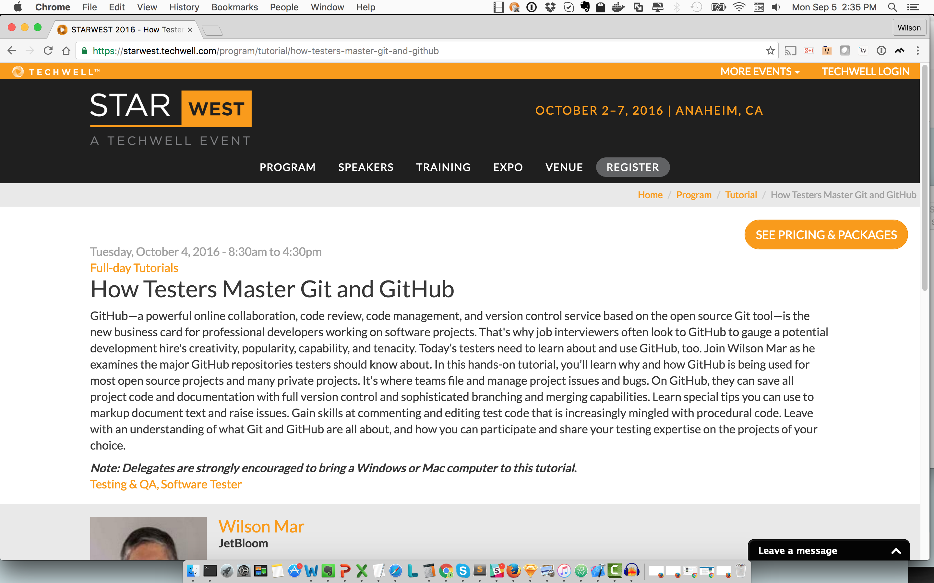

Slide 4
Learning techniques
Why
Visual cheat sheets
Videos animating diagrams
Step-by-step commentary book
Scripts of commands in sequence
Quizzes
Social sites and references

Slide 5
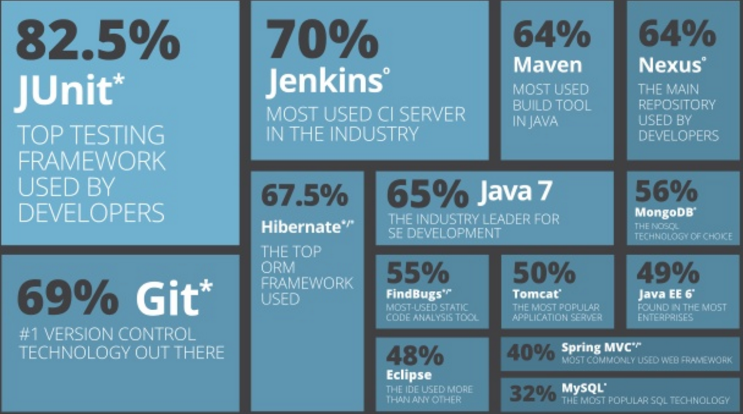
Java tools popularity
http://zeroturnaround.com/rebellabs/java-tools-and-technologies-landscape-for-2014/

Slide 6
Why
Files are not overwritten
Revert back to any older version of files
A common repository to hold the latest files
Complete history downloaded
Work on the same files simultaneously without conflict
See history of who worked on each file
Less finger-pointing and freaking out

Slide 7
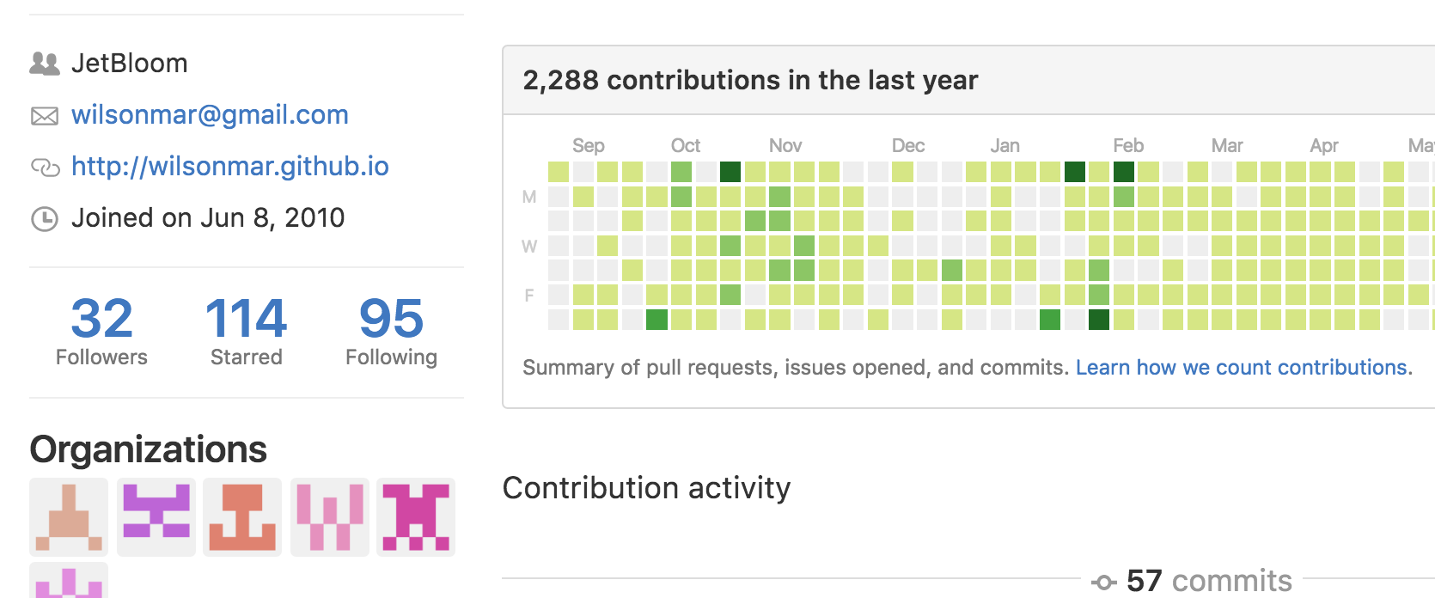
GitHub user statistics
newbie?
tenacious?
popular?
respected?

Slide 8
and GitHub File Handling
Finder or Windows Explorer
IDE/app
compare (diff)
client
your rep (on
GitHub .com)
Local repo.
your GitHub .com or hosted
repo
your GitHub .com or hosted
repo
app default
external copies
history
folder
folder
zip/ copy
folder
manual copy
file
file
file
Edit
local
machine
Download
Fork
Downloads folder
GitHub.com repo
unzip
repo-master.zip
upstream
@Copyright Wilson Mar 2015.
All rights reserved.
https://www.youtube.com/watch?v=Onv9nhPIBp0
Notes:
GitHub.com stores repositories, or repos for short. After opening a repo which we have not been designated as a contributor or member, when we try to edit that repo, GitHub automatically forks the repository under your personal account from what we call the upstream repo. Each new fork contains all history up until that operation.
If we want a copy of a repo on our local machine, we have several choices. For one-time use, we usually click Download ZIP on GitHub when we don’t want its change tracking history.
After we unzip to a new folder, its files are accessible by a Mac Finder or Windows File Explorer as well as IDEs and custom apps.
PROTIP: Apps usually have their own default folder so they have a consistent place to look for assets. So many unzip directly into that default folder.
There is always risk of hardware or human failure, so we always need to archive versions to fall back to. Traditionally we create occasional copies of entire files in full backups or by zipping to an external location (usually with a date and time stamp in the file folder name). This approach made it difficult to analyze differences among different versions.
Each IDE may have its own utility to identify and merge differences.
But people using would likely think this a messy, error-prone approach.
The more popular alternative today is to use a client to clone repos onto a local repository which apps access. GitHub would be the external file store.
provides its own way to compare changes over time that integrates with archival in GitHub.
Because does versioning at a fine-grained level, versions can also be managed at a low level.
NEXT: Let’s look at different security options for making that clone command.

Slide 9
GitHub Enterprise
https://enterprise.github.com/home
Launched 2011 for private repos
$250/user/year (less under SAP license)
24/7 support
On-premises OVF under VMware
LDAP/AD integration
Code review features

Slide 10
GitLab Enterprise vs. GitHub Enterprise
https://about.gitlab.com
_
$149/user/year (unlimited private repos)
24/7 support
On-premises on metal (not VMs), clustered
Binary files with GitLab Annex
LDAP/AD integration
Code review with approvals

Slide 11
Basic skills
Decide on GitHub
Enter the GitHub Ecosystem (famous repos)
Code Markdown text
Make a one-page static website
Install command line client
Configure environment (SSH)
Setup GUI client
Analyze a repo on GitHub

Slide 12
Daily tasks
Configure repo and workflow on GitHub
Configure a local repo from GitHub
Analyze local repository
Fetch remote changes into local repo
Make changes in a local repo
Remove files
Stash & un-stash tracked files temporarily
Ignore files in repo and globally
Commit changes and amend
Test locally and back-out

Slide 13
Scary-ish tasks
Resolve a conflicting merge condition
Identify differences
Install and try different diff/merge tools
File push request
Clean-up locally
Process GitHub repos automatically
Render Markdown locally
Beyond this tutorial
* Sub-modules and sub-trees

Slide 14
clone options (SSH)
~/.ssh/
Git client
ssh-keygen –t rsa –C“user1@corp.com”
passphrase
id_rsa
id_rsa-user1.pub
your repo (on
GitHub .com)
clone
http://server/project.git
via port 80
clone
via port 22
git@github.com:user1/project.git
clone
ssh:user@server:project.git
via port 22
clone
git://server/project.git
via port 9418
clone
file://myrepos/project
clone
/myrepos/project
via hard link
~/.ssh/config
Host github.com-user1
HostName github.com
User git
IdentityFile ~/.ssh/id_rsa-user1
Notes:
NOTE: This is described in ACTIVITY 8: Copy repo from GitHub to local git, page 71
A local copy of a repository from github.com or private enterprise repo
can be transferred using the clone command issued from within a executable.
Settings such as the user’s name and email address are specified in configuration commands.
The target URL is typically copied from the github web page.
But the client can also process commands which handle transfers more securely use public and private keys.
The ssh-keygen generates pairs in the .ssh folder in the home folder of the current user.
The command makes pass phrase optional, but we recommend it.
The contents of the public key is pasted in the github web site for use in signing what it sends out, through typically port 443 rather than port 80.
There are other options for cloning that we don’t have time for today.
But remember that one can add the name of a directory folder to create on the local drive.
See LukyBoy’s answer in http://stackoverflow.com/questions/4220416/can-i-specify-multiple-users-for-myself-in-gitconfig
https://orrsella.com/2013/08/10/git-using-different-user-emails-for-different-repositories/

Slide 15
~/.ssh/config
# personal account
Host github.com-user1
HostName github.com
User git
IdentityFile ~/.ssh/id_rsa
Host gist.github.com
HostName github.com
User git
IdentityFile ~/.ssh/id_rsa
Host github.com-user2
HostName github.com
User git
IdentityFile ~/.ssh/id_rsa_user2
Notes:
From page 45 of the Book v2 by Scott Chacon.

Slide 16
.gitconfig
[push]
default = simple
[user]
name = Wilson Mar
email = wilsonmar@gmail.com
username = wilsonmar
signingkey = 12345678
[core]
excludesfile = /Users/mac/.gitignore_global
[difftool "sourcetree"]
cmd = opendiff \"$LOCAL\" \"$REMOTE\"
path =
[mergetool "sourcetree"]
cmd = /Applications/SourceTree.app/Contents/Resources/opendiff-w.sh \"$LOCAL\" \"$REMOTE\" -ancestor \"$BASE\" -merge \"$MERGED\"
trustExitCode = true
[color]
ui = auto
[alias]
# git la to list aliases:
la = "!git config -l | grep alias | cut -c 7-”
Notes:
From page 45 of the Book v2 by Scott Chacon.

Slide 17
Aliases in .gitconfig
[alias]
# list aliases:
la = "!git config -l | grep alias | cut -c 7-"
# rao https://url.git
rao = remote add origin
# branch list sorted by last modified:
b = "!git for-each-ref --sort='-authordate' --format='%(refname) %(objectname:short) %(authordate)%09%09' refs/heads | sed -e 's-refs/heads/--'"
# checkout last branch:
col = "checkout @{-1}"
l = log --pretty='%Cred%h%Creset %C(yellow)%d%Creset %s %Cgreen(%cr)%Creset [%an]' –graph
lg = log --pretty=format:"%C(yellow)%h\\ %ad%Cred%d\\ %Creset%s%Cblue\\ [%cn]" --decorate --date=short
lol = "log --oneline --graph"
s = status –s
g = !gitk --all --date-order &
pu = !"git fetch origin -v; git fetch upstream -v; git merge upstream/master"
# git a "message":
a = !git add . && git commit –am
Notes:
based on https://gist.github.com/mwhite/6887990
https://githowto.com/aliases
git config --global alias.ci commit
http://durdn.com/blog/2012/11/22/must-have-git-aliases-advanced-examples/
http://blogs.atlassian.com/2014/10/advanced-git-aliases/
https://www.youtube.com/watch?v=-kVzV6m5_Qg
https://bitbucket.org/durdn/cfg/src/master/.gitconfig?at=master&fileviewer=file-view-default
https://git.wiki.kernel.org/index.php/Aliases
http://jondavidjohn.com/git-aliases-parameters/

Slide 18
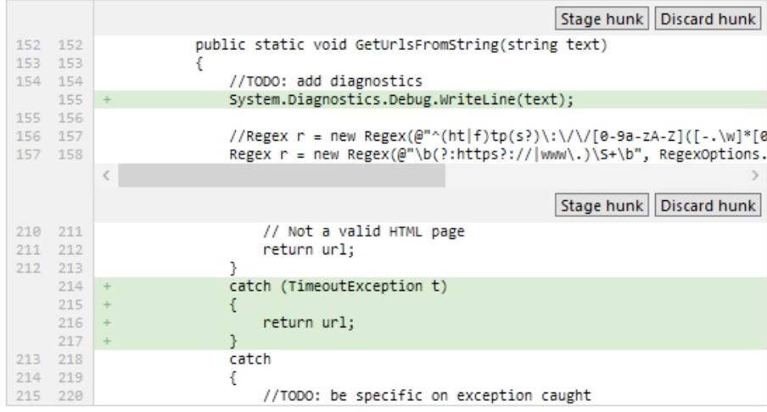
Commit individual hunk
Atlassian SourceTree
Notes:
Here is an example of of a feature available from SourceTree client not as easy with command line clients,
It can be done with a dash i added to commit add, for interactive.
From https://app.pluralsight.com/library/courses/using-git-with-gui/table-of-contents

Slide 19


Slide 20

Git Flow workflow (2010)
http://nvie.com/posts/a-successful-git-branching-model/
branches:
feature
develop
release
hotfix
master
support
Notes:
by Vincent Dressen
The master branch is the production branch.
The release branch provides a stable base for usually automated deploy to production at defined times.
The develop branch are used for automatic nightly integration test builds.
These are all long-running branches that remain on the repository indefinitely.
Hotfix branches are created only when needed to fix production. Having them in a separate branch enables regular work to continue while a hotfix is being developed and tested.
Branch names begin with “hotfix”.
Let’s construct a map of how to visualize how to work locally with your github repos on github.com.
Tracked? Modified?

Slide 21
Git battle map
~/.gitconfig
Git client
untracked?
~/.ssh/config, id_rsa_pub
Working directory
tree
staged?
unmerged?
your repo (on
GitHub .com)
modified?
deleted?
local .git
staging / index
/ cache
.gitignore
merge
stash
GitHub repo
git-commands-v05.pptx @Copyright Wilson Mar 2016. All rights reserved.
Notes:
Activity 13.

Slide 22
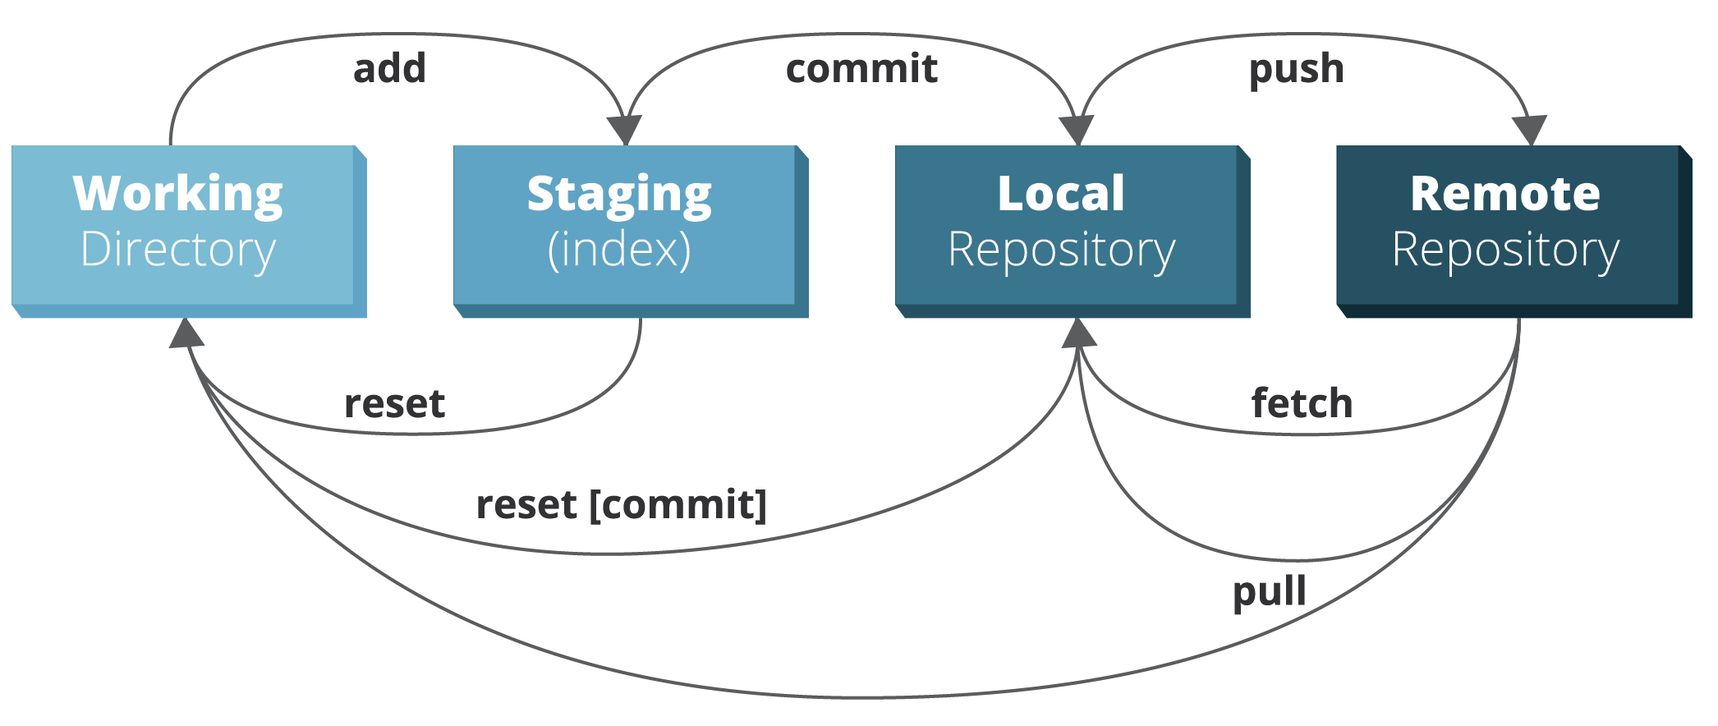
Basic action verbs
http://zeroturnaround.com/rebellabs/git-commands-and-best-practices-cheat-sheet/

Slide 23
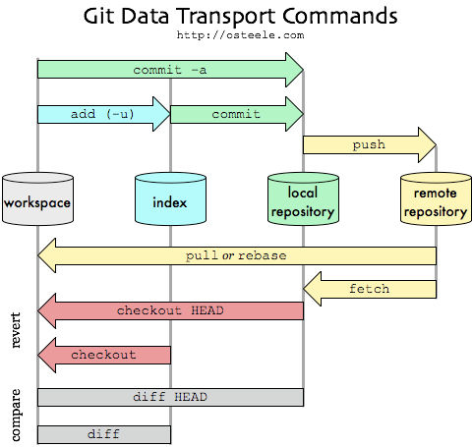
Basic workflows
https://github.com/skwp/git-workflows-book

Slide 24
Git command map
status -s
~/.gitconfig
Git client
untracked?
~/.ssh/config, id_rsa_pub
cloud
Working directory
tree
modified?
staged?
unmerged?
config
your repo (on
GitHub .com)
deleted?
edit
rebase -i
commit -m
shortlog
clone
$ mkdir
local .git
init
$ cd
add . –A -p
staging / index
/ cache
--amend
log (lol)
clean -
tag -a
push --force
$ ls -al
revert
reflog
push -u
$ touch
reset –hard HEAD
origin
reset HEAD -- <file>
.gitignore
master
branches
$ echo
stash save
merge
mergetool
fetch
develop
$ rm -rf
stash list
stash show
diff-tree
show
pull
merge
Edit
stash pop
diff
remote -v
Pull
stash apply
difftool
Request
Fork
stash
stash drop
checkout commit
branch
remote add
GitHub repo
upstream
checkout –b branch
download/unzip
git-commands-v06.pptx @Copyright Wilson Mar 2016. All rights reserved.
https://goo.gl/12C1BF
Notes:
Activity 13.

Slide 25
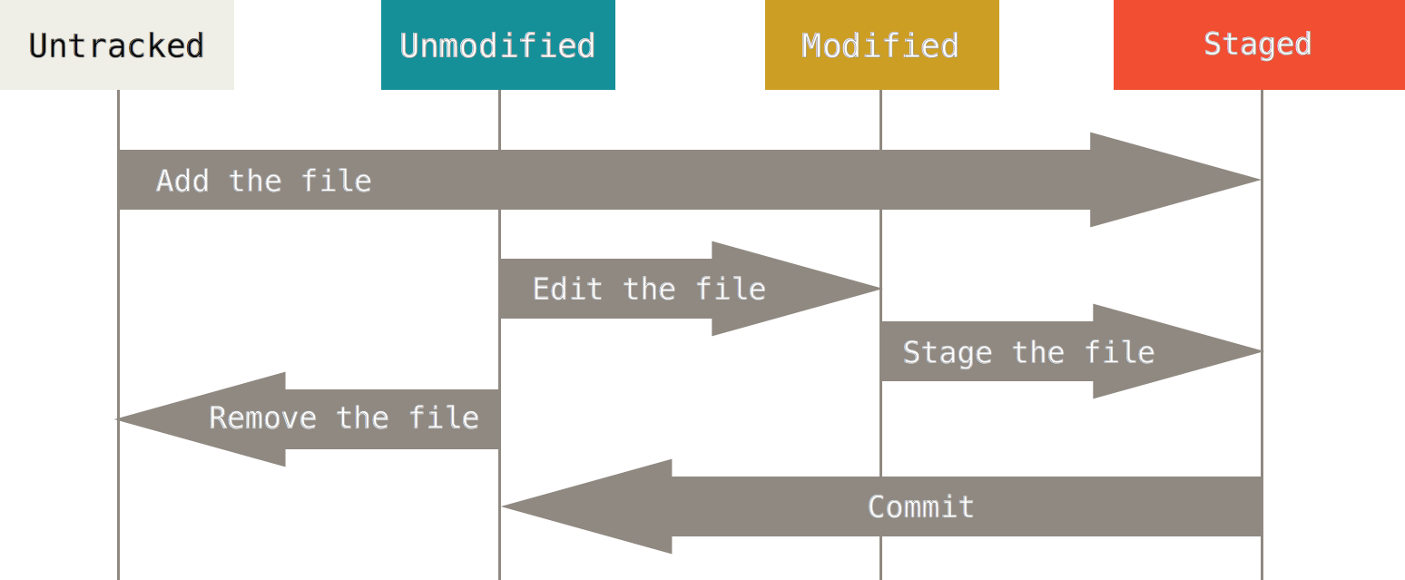
Lifecycle
http://git-scm.com/book/en/v2/Git-Basics-Recording-Changes-to-the-Repository#Removing-Files
Notes:
From page 45 of the Book v2 by Scott Chacon.

Slide 26
Lifecycle
http://git-scm.com/book/en/v2/Git-Basics-Recording-Changes-to-the-Repository#Removing-Files
Notes:
From page 45 of the Book v2 by Scott Chacon.

Slide 27
Commit or not?
Does git commit create a commit?
Does git tag create a commit?
Does git checkout new branch create a commit?
Does git merge create a commit?
Does git revert create a commit?
Yes. That’s its job.
No. It references a specific commit.
No. It creates files in working directory from a commit.
No. A separate commit is needed.
Yes. To “undo” previous commit(s)
Notes:
If you’re unsure any of these, let’s verify by creating a repository, next.

Slide 28
HEAD coding
most recent commit
git commit –m"Add f"
echo "f">>file-f.txt
git show --oneline HEAD
git commit -m"Add e"
HEAD~1 =
HEAD^ =
HEAD^1
echo "e">>file-e.txt
git branch -d feature1
HEAD~2 =
HEAD^^ =
HEAD~1^1
git merge feature1
~ tilde
parentage
^ caret sequence
git checkout master
git commit –m"Add d"
HEAD~2^2
echo "d">>file-d.txt
git commit –m"Add c"
HEAD@{5}
touch LICENSE.md
HEAD~2^3
git checkout v1 -b feature1
git tag v1
HEAD~3 =
HEAD^^^
HEAD~2^1
git commit –m"Add .gitignore"
echo "me">>.gitignore
HEAD~4 =
HEAD^^^^
HEAD~3^1
git commit –m"Add README.md"
touch README.md
1st commit
parent
git init
https://github.com/wilsonmar/git-utilities/blob/master/git-sample-repo-create.sh
https://git-scm.com/docs/git-show
Notes:
Changes are shown from the bottom up because that’s how git logs lists changes.
^ caret symbol, ~ tilde symbol
http://www.paulboxley.com/blog/2011/06/git-caret-and-tilde
objects are sharded within folders named for the first two characters of objects.

Slide 29
Feature branch
local git
GitHub / cloud
branches:
feature
develop
develop
release
master
(topic)
(local)
(remote)
(staging)
(prod)
PR or push
merge
tag
tag
rebase
6
6
6
6
6
resolved
5
fetch
hook
merge
diff
4
conflict!
4
pull
4
4
4
after test
3
after fix
2
@Copyright 2016.
Wilson Mar.
All rights reserved.
1
git
checkout
--branch
feature
1
git
clone
repo.git
1
1
1
parallel work
encapsulated
Notes:
See Activity 12.
Source: Josh Susser’s Agile and the Story Branch Pattern
http://reinh.com/blog/2009/03/02/a-git-workflow-for-agile-teams.html
Let’s construct a map of how to visualize how to work locally with your github repos on github.com.
This illustrates the interaction between local and GitHub website.
In many shops, the master branch is not updated manually but only automatically by a script after all tests in staging report success.
Assets in the release branch are updated after run tests run clean against the develop branch.
Those tests would ensure integration correctness by end-to-end test scripts and team walkthroughs.
So most developers only interact with the develop branch.
So when we clone a repo locally, we usually include a branch specification.
Each clone includes an entire copy of the repo, including all its history.
Each branch contains a set of commits, shown here with the oldest a the bottom and most recent at the top.
Only the first 3 characters of the hash for each commit is shown. usually shows the first 7 characters.
If we are to make a change, it’s best to create a new branch as a container for changes to several files made together.
The first change we make is add a new file, and commit it. But we don’t push it up yet because we’re not done with the package.
That evening, someone else committed a change in the repo.
In the morning we do a fetch and see it on our machine.
We make another change (mi3) locally and commit it locally.
When we do a fetch at noon, we realize someone else changed the same file and same line.
So we need to see what the diff is, then merge that with my changes.
Once we have resolved differences, we can merge again.
When we push into GitHub, everyone else will be able to review it and use it.
Kangax.hithub.io/compat-table/es6

Slide 30
Internals
|-- index
|-- info
| `-- exclude
|-- logs
| |-- HEAD
| `-- refs
| |-- heads
| | `-- master
| `-- remotes
| `-- origin
| `-- master
|-- objects
| |-- 00
| | |-- 0845179832190a64352439f621bb797d05f826
| |-- 01
| | |-- 17df35ff39701b1d10f996160b90c8b2b5d753
|-- packed-refs
`-- refs
|-- heads
| `-- master
|-- remotes
| `-- origin
| `-- HEAD
`-- tags
= (40 hex digits)
git rev-parse 0117
git cat-file –p 0117df

Slide 31
Agile activities
separate
clone or init local repository
Use “develop” branch instead of master
checkout feature branch, story, defect
add to local stage
edit & unit test hunks
add to staging
commit and commit --amend
rebase –i squash (combine commits)
fetch (pull) to update from remote
diff and edit little pieces (test code first?)
merge local master
push feature upstream
review code with others
tag release identifier (with signing)
hooks initiate integration tests
modify
integrate
http://reinh.com/blog/2009/03/02/a-git-workflow-for-agile-teams.html
Notes:
The 3 basic stages of work are first to separate a repo from github, modify it, then integrate changes back in.
The basic objective here is to enable individual developers to operate separately such that a main branch is kept pure and operational all the time while also providing feature branches "room" for developers to make modifications as experiments.
Automated testing at the unit level before uploading to GitHub AND automated invocation of end-to-end testing scripts on the repository shared by everyone is what keeps the system humming.
Source: Josh Susser’s Agile and the Story Branch Pattern
http://reinh.com/blog/2009/03/02/a-git-workflow-for-agile-teams.html
Let’s construct a map of how to visualize how to work locally with your github repos on github.com.
Tracked? Modified?

Slide 32
Github Flavored Markdown
# Heading 1 #
## Heading 1.1 #
0. List 1
* [Internal](Heading 1.1)
* <a target=“_blank” href=“#Heading1.1”>Internal</a>
```
init
```
| header1 | numbers |
| ------- | ------: |
| text 1 | 12.12 |
3 spaces before ``` to indent

Slide 33
browser
browser
stackedit.io
dillenger.io
Users:
local
browser
Haroopad,
mou.io, etc.
HTML+
iOS
kindle
Copyright 2016 by Wilson Mar
All rights reserved.
raw
API
CDN
offline
github.com
git
editor
AZW
acct/repo
acct/acct.github.io
mobi
pdf
markdown& code
gh-pages br.
ePub
markdown
markdown
render
Python
Ruby
Jekyll+ Kramdown Liquid
grip
Jekyll+
API
gitbook.io,
leanpub.com, EC2, etc.
ghw
acct.github.io
HTML+
CI/CD
_site
wiki
markdown
HTML+
HTML+
HTML+
/x
Dropbox
FTP
https://goo.gl/12C1BF

Slide 34
by @WilsonMar
Skype: wilsonmar4
https://wilsonmar.github.io

