Slide 1
Purpose
make the complex problem of building, testing & deploying software
frictionless

Slide 2
Keywords
So devs focus on innovation
Versioned source control
Frictionless
Cloud-native apps movement
Containers
Fastest
Multi-region
Multi-platform (AWS, Microsoft, Google)
Arbitrage vendor-neutral/agnostic
On-premises
No SSH
Blue/Green deployment for Stage to Prod

Slide 3
Focus
repository
declarative:
provision:
source
run environment
Shippable
“pipeline”
infrastructure
CI/CD (Jenkins) build
“minions”
“formations”
deploy.json
Kub
container registry
Docker containers
“cells”
server
Dev.
monitoring
Artifactory service
Build
build images
SIT
logging
UAT
notifications
Beta
monitoring
Prod.
Shippable Lighthouse
AWS
Google
Azure
On-prem.
speed
cost
reliability
portability
Notes:
A pipeline is the lifecycle for a unit of deployment, aka 'Cell'. A Cell is always deployed at one time and on the same node. What constitutes a cell is unique to your case. It can be a microservice, a service, or even your entire application. A monolithic application is likely to need just one pipeline while a microservices based application might need tens or hundreds of pipelines. “Continuous Delivery” deploys software to any given environment at any time.
Speed is the differentiator in almost any market that is getting disrupted by online services.
http://blog.shippable.com/shippables-idk-journey-i-delegate-to-kubernetes

Slide 4



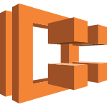






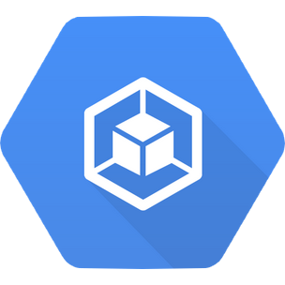





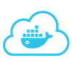

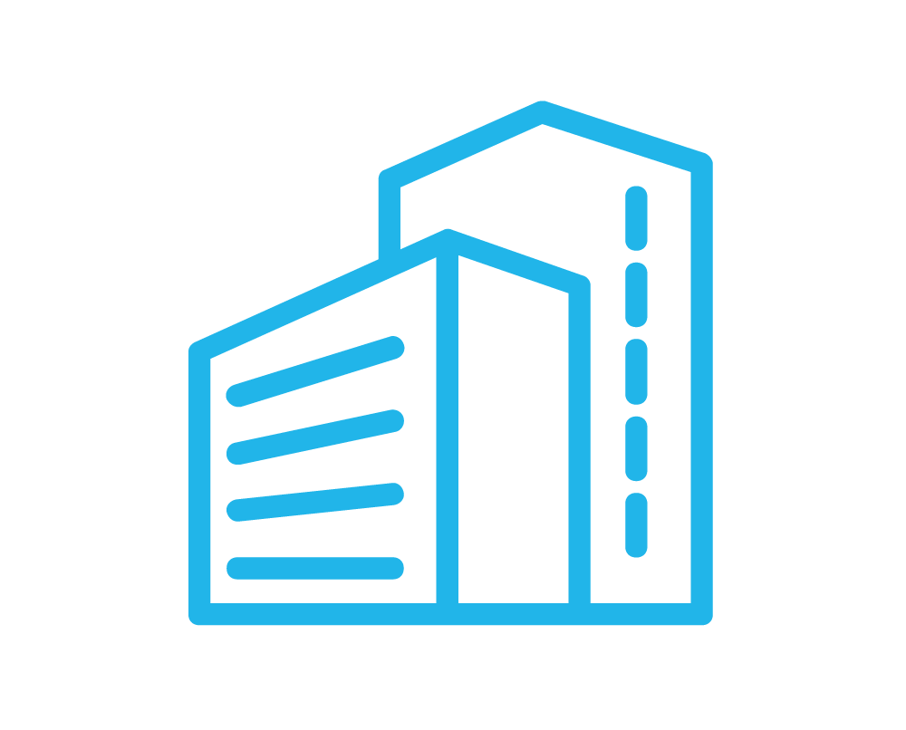

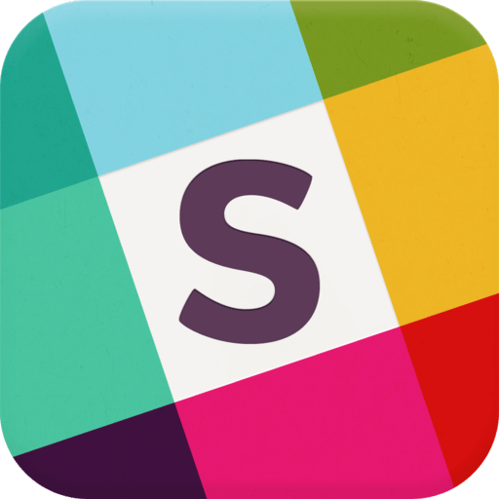




Integrations
GitHub
Code Commit
EC2 C. Registry
EC2 Container Service
Code Deploy
Opsworks
EC2
AWS
EBS
Gitlab
Container Registry
Container Engine
Compute Engine
Google Cloud
App Engine
Bitbucket
Docker Hub
Docker Cloud
Docker Build
Docker Datacenter
IRC
Slack
Quay
Azure
Digital Ocean
Heroku
Notes:
http://blog.shippable.com/shippables-idk-journey-i-delegate-to-kubernetes
Icons on this page have been shrunk to .8x.8 width

Slide 5
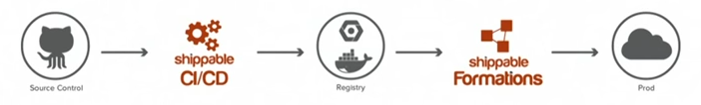
Frictionless pipeline
build
integrate
provision
deploy
source control
container registry
environments
declarative yml
Ansible
Docker
Artifactory
Kubernetes
cloud portability
idempotent
Docker Hub
GitHub
AWS ECR (EC2 Container Registry)
AWS
Test
GitLab
Google GKE Container Engine
Google
Beta
Bitbucket
Microsoft Azure Container Registry
Azure
Prod.
devops_2.0-v01.pptx Copyright 2016 Wilson Mar. All rights reserved.

Slide 6

GitHub repos
https://github.com/…
visualization
micro-smoker
dv
micro-www
micro-api
micro-image
box
cron
database
mlab.com

Slide 7
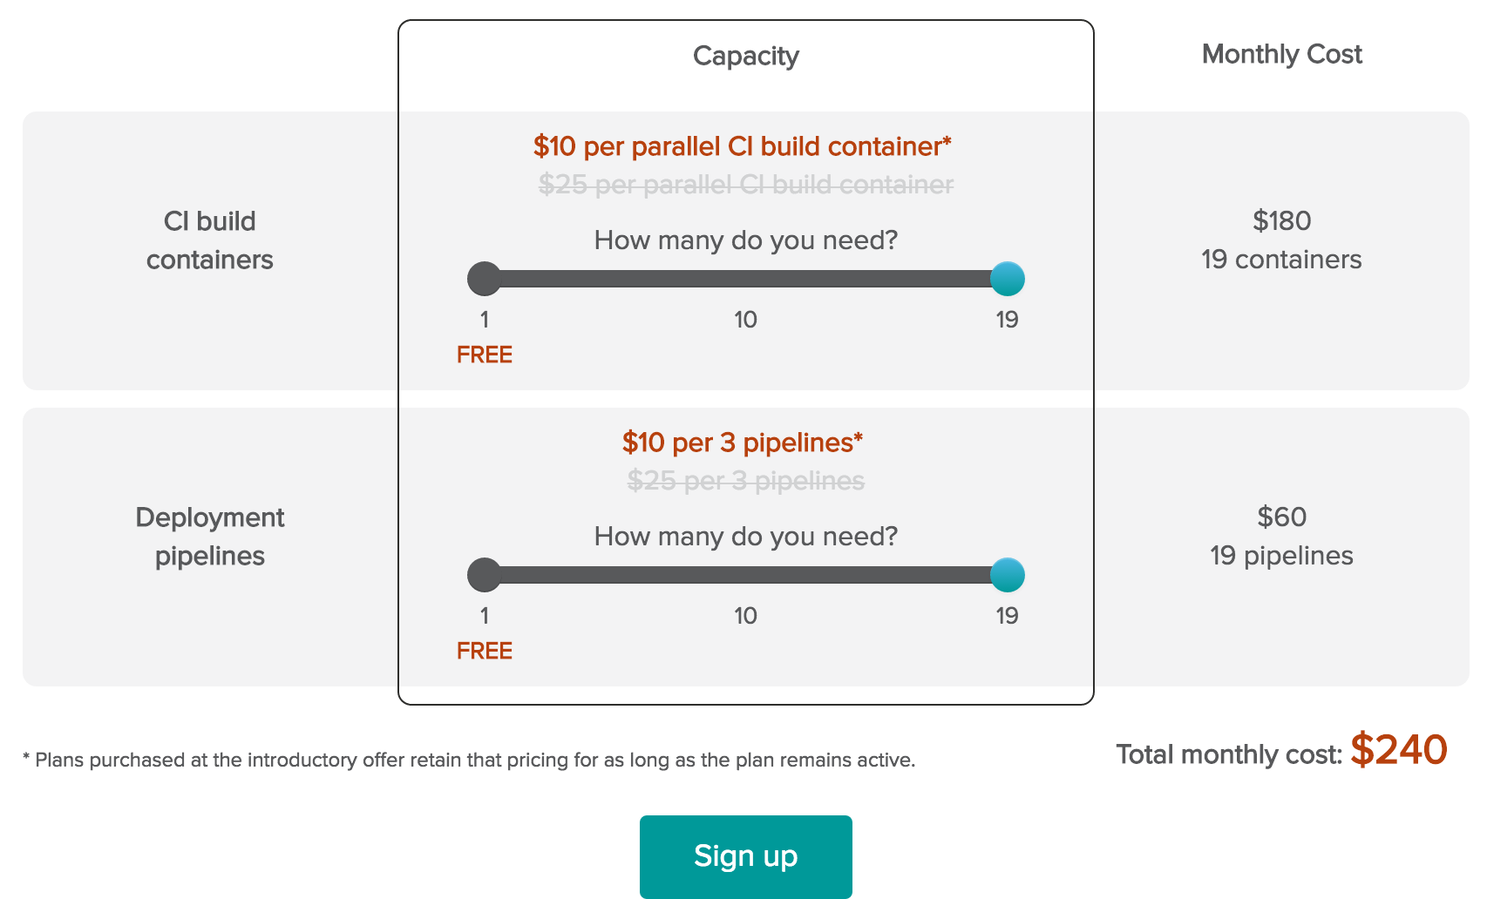
Pricing

