Slide 1

AWS IoT Button setup
Downloads folder
browser setup
...pem.crt
Download
to PC
SSID
private.pem.key
web server
AWS region
Policy
last 8 serial #
AWS IoT Resources
AWS Lambda
web page
Lambda functions
internet router
internet
browser
SSID,
Password
Subdomain
AWS IoT
Endpoint
aws-iot-setup-v02.pptx. Copyright 2016 Wilson Mar. All rights reserved.

Slide 2
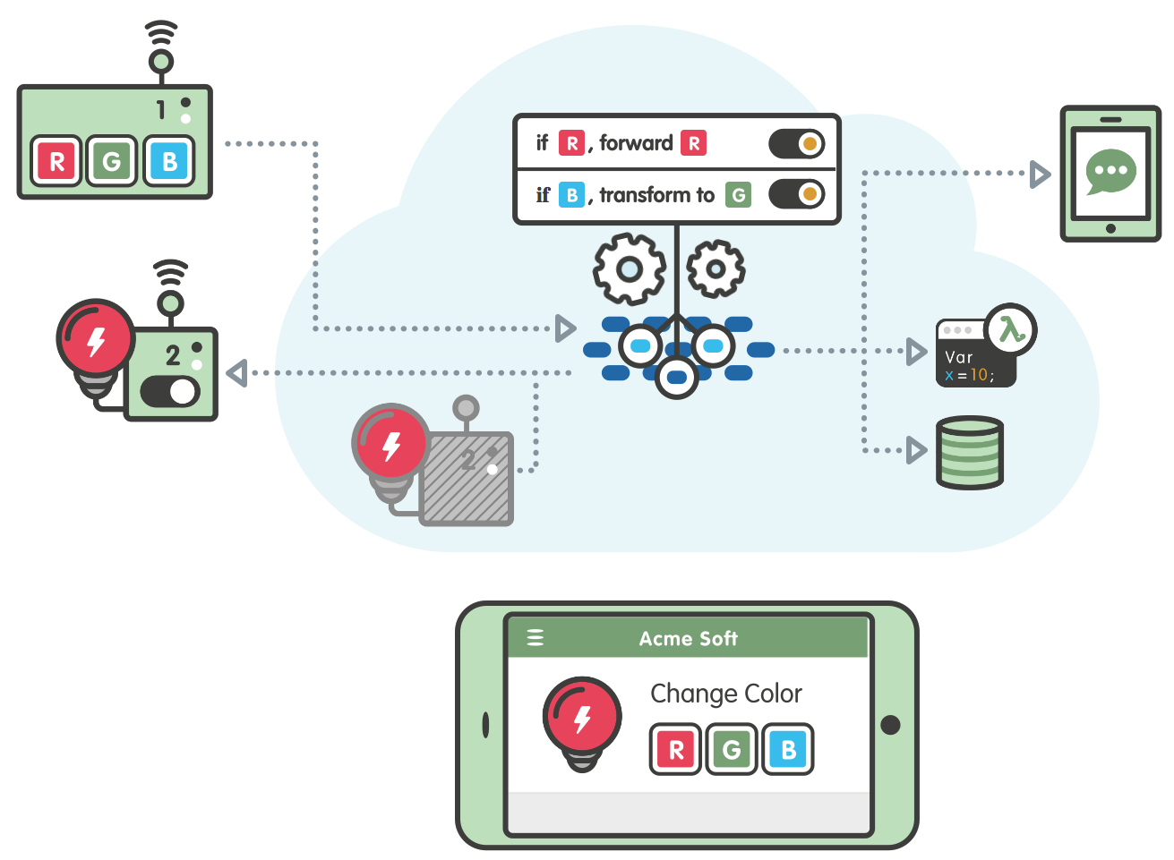
Device
Rules
Mobile app
Message broker
Rules Engine
Security
Lambda
Gateway
Thing registry
DynamoDB
Shadows
Notes:
http://blog.shippable.com/integrate-with-quay.io-and-private-docker-registry

Slide 3
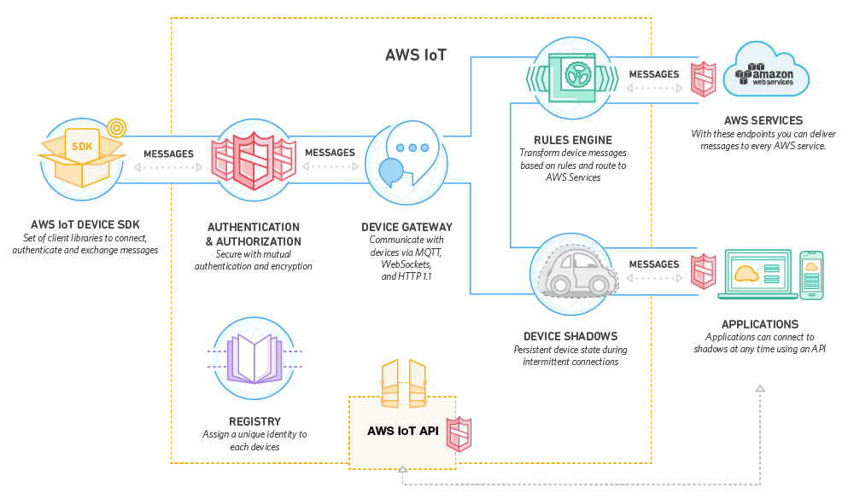

Slide 4
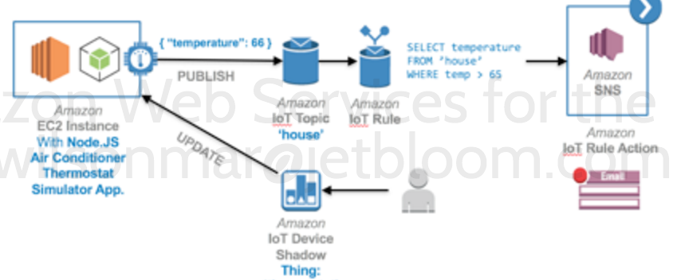

Slide 5
Samsung API
disconnect user device
history
aggregates
analytics
participants
histogram
export
application
presence
properties
trial devices
snapshots
administrators
latest
trial device
types
messages
version
invitationId
exportId
manifests
invitations
status
available manifest versions
trialId
devicetypeId
trials
rules
device
types
ruleId
device tokens
user
trials
user
properties
user
rules
deviceId
self
user
devices
devices
users
userId
iot-samsung-api-v01.pptx. Copyright 2016 Wilson Mar. All rights reserved.
userId

