Slide 1

AWS IoT Button setup
Downloads folder
browser setup
...pem.crt
Download
to PC
SSID
private.pem.key
web server
AWS region
Policy
last 8 serial #
AWS IoT Resources
AWS Lambda
web page
Lambda functions
internet router
internet
browser
SSID,
Password
Subdomain
AWS IoT
Endpoint
aws-iot-setup-v02.pptx. Copyright 2016 Wilson Mar. All rights reserved.

Slide 2
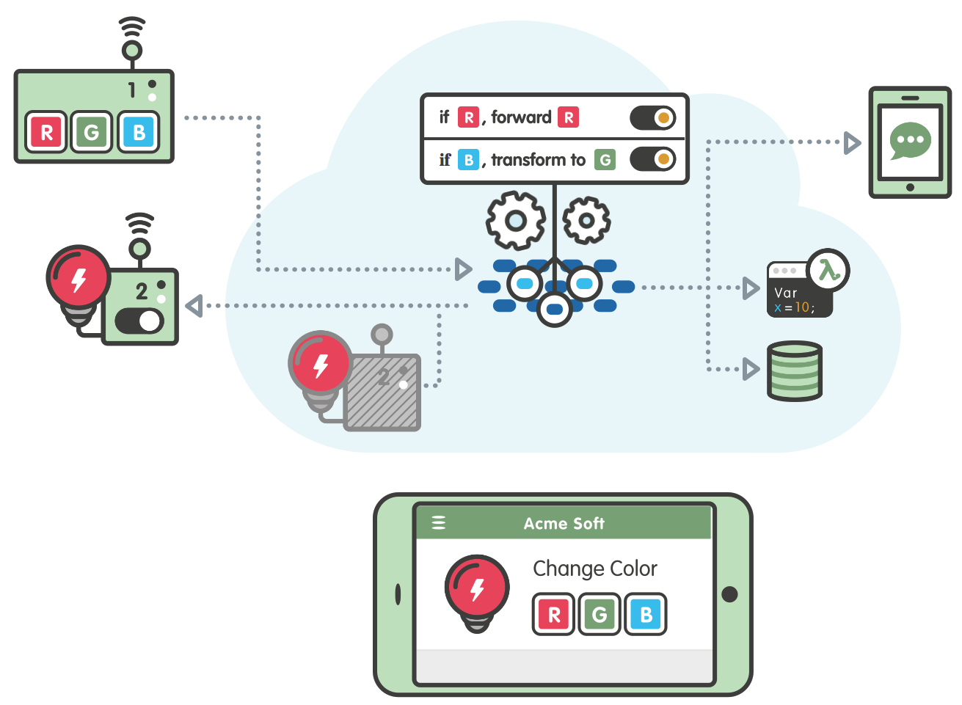
Device
Rules
Mobile app
Message broker
Rules Engine
Security
Lambda
Gateway
Thing registry
DynamoDB
Shadows
Notes:
http://blog.shippable.com/integrate-with-quay.io-and-private-docker-registry

Slide 3
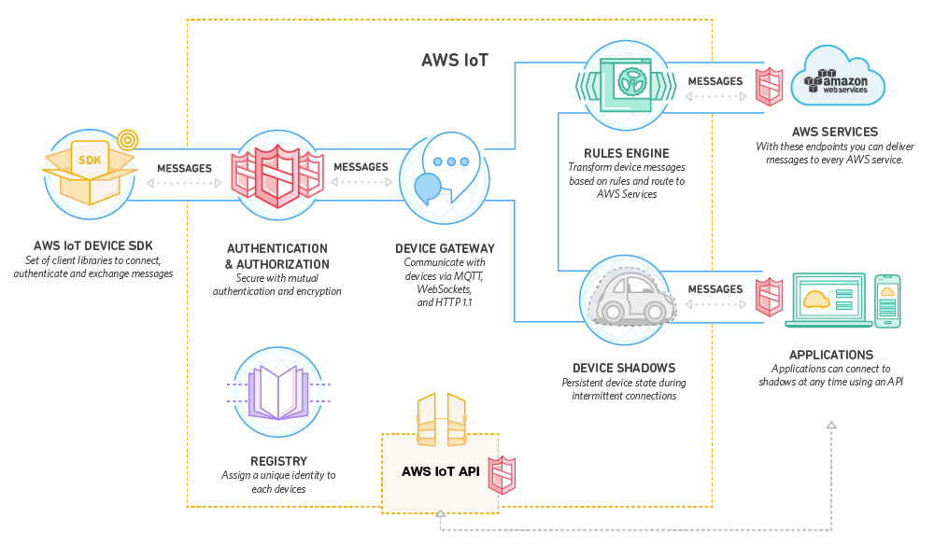

Slide 4
