Slide 1
Introductions
Notes:
In his role at Shippable, Tom has the unique opportunity to dive deep on both the technical and business aspects of CI/CD, DevOps, and modern architectures leveraging containers, and brings a broad perspective on the many companies and options available in the container ecosystem based on his work developing Shippable integration partnerships. With twenty-five years experience in large companies (Microsoft, SAP) and his own software startups, he understands the full spectrum of challenges facing software teams, large and small.
As Shippable’s Developer Evangelist, Wilson brings his 20 years of deep technical experience tuning enterprise systems. He is a regular blogger and speaker on use of Git for software development and DevOps.

Slide 2
Jenkins 2.0
Entire pipeline in text Jenkinsfile in SCM (GitHub)
Series of stages defined in Jenkinsfile
Multiple SCM repositories in each job
Jobs share reusable scripts, functions, variables, flows
Extendable DSL with loops, logic
Jobs can wait for user input before continuing
Durable tasks keep running while master restarts
Jobs starting in one agent can switch to another
Parallel execution of arbitrary build states ???
Notes:
In his role at Shippable, Tom has the unique opportunity to dive deep on both the technical and business aspects of CI/CD, DevOps, and modern architectures leveraging containers, and brings a broad perspective on the many companies and options available in the container ecosystem based on his work developing Shippable integration partnerships. With twenty-five years experience in large companies (Microsoft, SAP) and his own software startups, he understands the full spectrum of challenges facing software teams, large and small.
As Shippable’s Developer Evangelist, Wilson brings his 20 years of deep technical experience tuning enterprise systems. He is a regular blogger and speaker on use of Git for software development and DevOps.

Slide 3
Shippable
GitHub or GH Enterprise or GitLab or Bitbucket
Series of stages defined in shippable.yml
Multiple SCM repositories in each job
Jobs share reusable scripts, functions, variables, flows
Declarative pipeline workflow composable
Jobs can wait for user input before continuing
SaaS: Integrate with existing tools.
Auto-scaling & switching of agents ???
Parallel execution of arbitrary build states ???
Notes:
In his role at Shippable, Tom has the unique opportunity to dive deep on both the technical and business aspects of CI/CD, DevOps, and modern architectures leveraging containers, and brings a broad perspective on the many companies and options available in the container ecosystem based on his work developing Shippable integration partnerships. With twenty-five years experience in large companies (Microsoft, SAP) and his own software startups, he understands the full spectrum of challenges facing software teams, large and small.
As Shippable’s Developer Evangelist, Wilson brings his 20 years of deep technical experience tuning enterprise systems. He is a regular blogger and speaker on use of Git for software development and DevOps.

Slide 4
Cloudbees only
Resume from checkpoints
Notes:
In his role at Shippable, Tom has the unique opportunity to dive deep on both the technical and business aspects of CI/CD, DevOps, and modern architectures leveraging containers, and brings a broad perspective on the many companies and options available in the container ecosystem based on his work developing Shippable integration partnerships. With twenty-five years experience in large companies (Microsoft, SAP) and his own software startups, he understands the full spectrum of challenges facing software teams, large and small.
As Shippable’s Developer Evangelist, Wilson brings his 20 years of deep technical experience tuning enterprise systems. He is a regular blogger and speaker on use of Git for software development and DevOps.

Slide 5
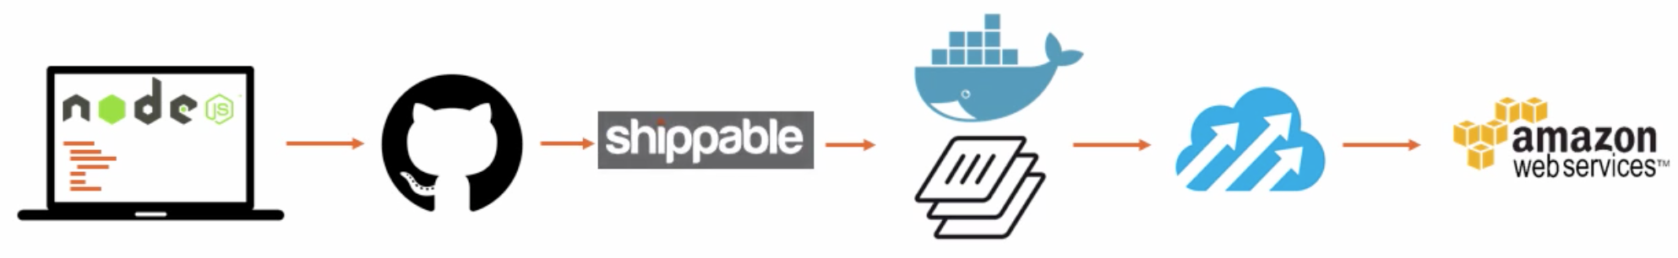


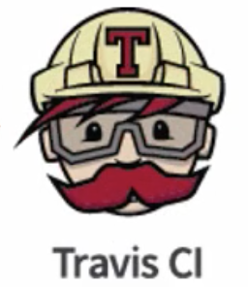
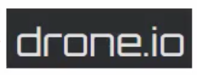
CI options
graphic source: 0:21 into https://app.pluralsight.com/player?course=integrating-docker-with-devops-automated-workflows &author=nigel-poulton&name=integrating-docker-with-devops-automated-workflows-m3&clip=0&mode=live

Slide 6
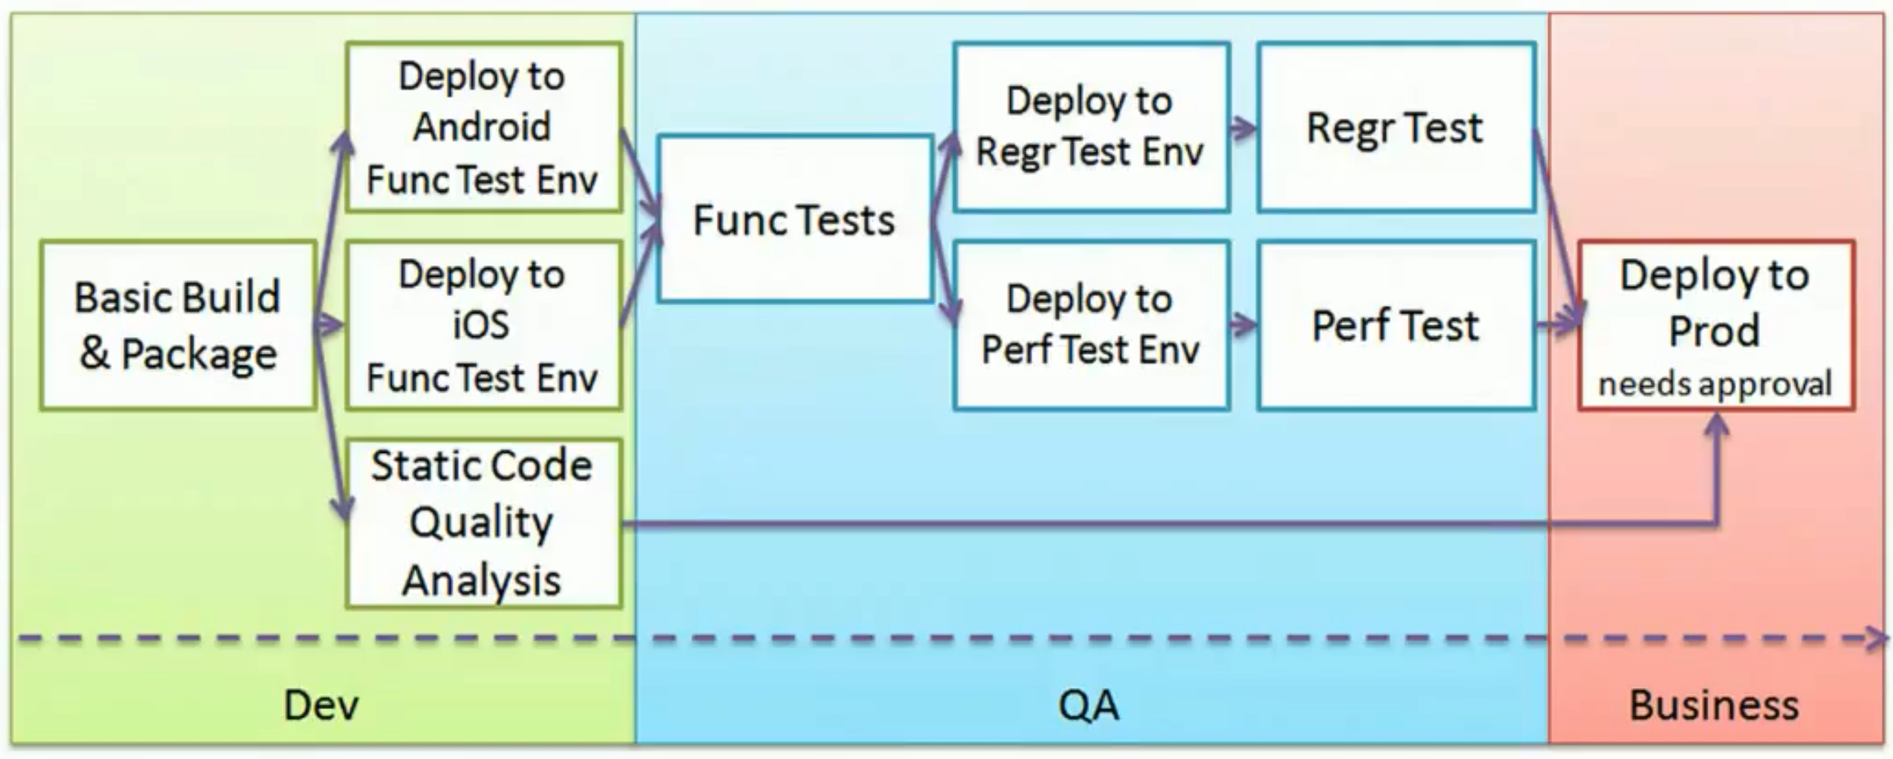
2014
Notes:
In Jenkins1, these are several separate jobs.
[32:45] http://www.infoq.com/articles/orch-pipelines-jenkins
March 29, 2014
* Ensuring reproducible builds
* Sharing build artifacts throughout the pipeline
* Choosing the right granularity for each job
* Parallelizing and joining jobs
* Gates and approvals
* Visualizing the pipeline
* Organizing and securing jobs
* Good practice: versioning your Jenkins configuration

Slide 7
CI Pipeline
SCM
app source
Artifactory images
DockerHub images
external APIs & DBs
on-server databases
Dockerfile
commit, tag
Java
only
Register
push
CI (Jenkins) collect
build & compile
publish
deploy image
smoke test
on app svr.
Instantiate CI server
Build Docker image with tag
Push Docker image to DockerHub
Pull Docker image
Provision VPC
Run Gulp, Maven, etc.
Code scan
Functional smoke & E2E test
Config. Jenkins packages
Checkout from GitHub
Logging
Monitoring
Scaling test
Notification to Slack, etc.
Define Docker credentials in CI
Run Docker
Invoke Docker
Notes:
grunt

Slide 8
