Slide 1

Uw .nET Session 2: final project
Clinical laboratory analyte manager
Shawn Hopkins : https://github.com/hopkinss/UW_NetCoreSession2_FinalProject

Slide 2
Overview
What it is: WPF .NET Core 3.1 app using MVVM design pattern
What it does: Manage metadata for laboratory analytes used in clinical drug trials
Laboratory, lab department (e.g. hematology, chemistry), standard units, specimen type
Reference ranges that identify normal values by subject characteristics
Conversions factors to translate reported units into standardized values

Slide 3
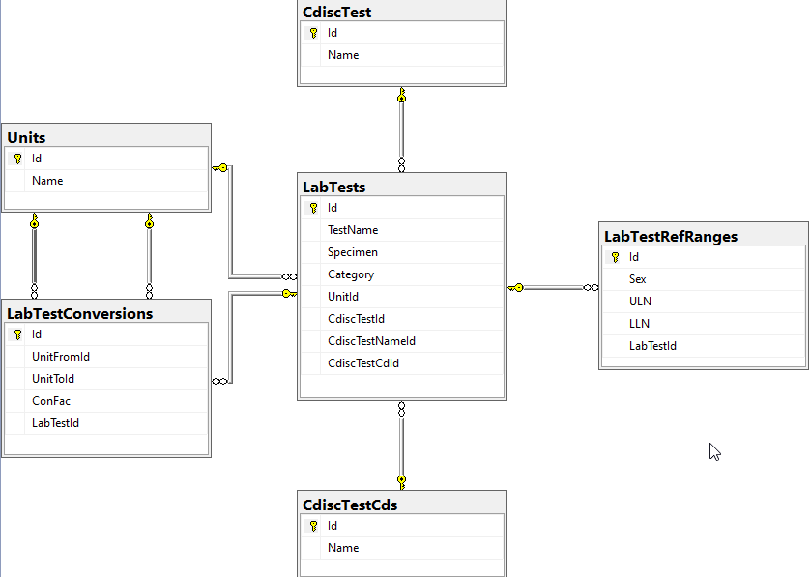
Data model

Slide 4
Design Patterns/Technologies
IoC – Autofac provides a container to register dependencies. Greatly simplifies injecting dependencies through the contstructor. Request an [interface] get an [concrete implementation]
Command – Prism.Commands
Binds to the Command property of objects in XAML
Prism’s DelegateCommand implments the ICommand interface and you specify an Execute and optionally a CanExecute method
Pub/Sub – Prism.Events EventAggregator
allows ViewModels to publish and subscribe to events to facilitate communication between one ore more ViewModels
Repository – generic repository class to handle CRUD operations.
EntityFramework Core – create classes then define, relationships, and seeding in a class that inherits DbContext
Create/update the SQL database schema and seed data through EF code first migrations
ViewModel Hierarchy – define common behavior in base classes and inherit (INPC, validation, generic events)

Slide 5
Other nuget packages used
ClosedXML – Export the data in Excel format
Newtonsoft – Export the data in JSON format
MahApps.Metro – Style the visual elements. Provides themes to easily transform the look of the entire app
MapApps.Metro.IconPack – Icon library, add the namespace to the XAML, define the icon to embed
<icons:PackIconMaterial Kind="FlaskEmptyRemoveOutline"/>
Microsoft.Extensions: Configuration, FileExtension, JSON, and DependencyInjection
support configuration through appsettings.json (replacement for app.config)

