Slide 1

Department of Information Science and Engineering Minor Project (18IS64) - 6th Semester BE Social Distancing Detection in Public Areas Evaluation- Phase-1
Academic Year – 2020-21
Carried out by:
CHINMAY NAIK 1RV18IS010
DHEERAJ SHENOY N 1RV18IS012
NEHAL N SHET 1RV18IS026
Internal Guide Name
ANISHA B.S
Assistant Professor, Dept. of ISE

Slide 2

Go, change the world
RV College of
Engineering
Agenda
Introduction
Topic Relevance to Information Science
Domain Knowledge
Literature Survey
Formulation of Objectives
Methodology task wise
Societal Relevance

Slide 3
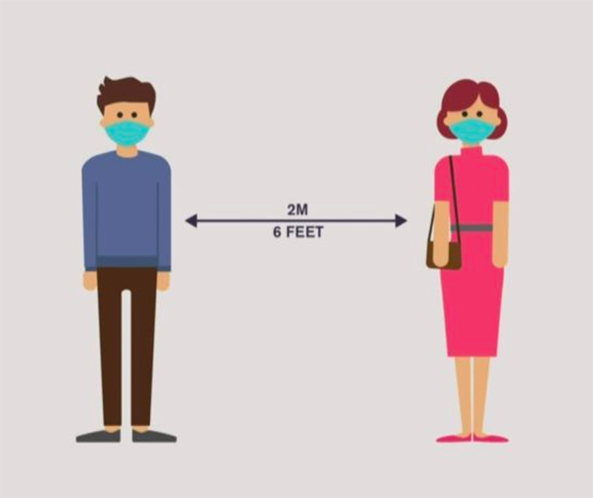
Go, change the world
RV College of
Engineering
Introduction
To limit the spread of an infectious disease, for instance, Covid-19, one of the most recommended measures is to practice social distancing.
Social distancing, also called “physical distancing”, means keeping a safe space between yourself and other people who are not from your
household.
In order to reduce COVID-19 transmission, social
distancing has been verified to be a really effective way
to bring down the spread of the illness.
It has been suggested that maintaining a distance of approximately 2 metres from another individual result in a marked reduction in transmission of most flu virus strains, including COVID 19.

Slide 4
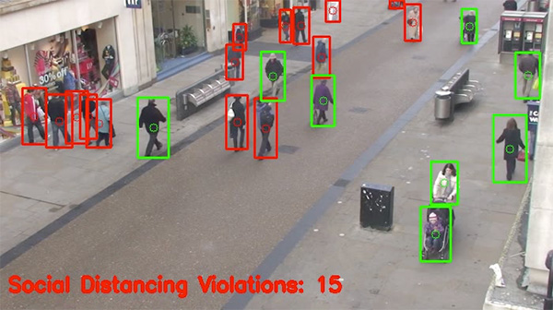
Go, change the world
RV College of
Engineering
Topic Relevance to Information Science
Using OpenCV, computer vision, and deep learning to monitor social distancing public places and workspaces.
The MobileNet Single Shot Multibox Detector (SSD) object following model and the OpenCV library for image processing are used in this study to detect social distance between people in areas of interest.

Slide 5
Go, change the world
RV College of
Engineering
Domain Knowledge
OpenCV: OpenCV is a library of programming functions mainly aimed at real-time computer vision.
TensorFlow: TensorFlow is a free and open-source software library for machine learning. It can be used across a range of tasks but has a particular focus on training and inference of deep neural networks.
SSD: Single Shot detector like YOLO takes only one shot to detect multiple objects present in an image using multibox. It is significantly faster in speed and high-accuracy object detection algorithm.
Euclidean Distance: In mathematics, the Euclidean distance between two points in Euclidean space is the length of a line segment between the two points.

Slide 6
Go, change the world
RV College of
Engineering
Literature Survey
Literature survey related to social distancing
Sl. no. | Paper | Authors | Work | Shortcomes | Reference
1 | Enabling and Emerging Technologies for Social Distancing: A Comprehensive Survey and Open Problems | Nguyen C.T., Saputra Y.M., Van Huynh N., Nguyen N.-T., Khoa T.V., Tuan B.M. | A survey of emerging technologies such as Wi-Fi, Bluetooth, smartphones, and GPS, as well as positioning (localization), computer vision, and deep learning, which can all play a role in a variety of realistic social distancing scenarios. | Not cost effective. It was a survey, not a research in particular field. Required a lot of computation power. | Nguyen C.T., Saputra Y.M., Van Huynh N., Nguyen N.-T., Khoa T.V., Tuan B.M. 2020. Enabling and emerging technologies for social distancing: a comprehensive survey and open problems.arXiv:2005.02816
2 | The use of drones during mass events | Robakowska M., Tyranska-Fobke A., Nowak J., Slezak D., Zuratynski P., Robakowski P. | Drones and surveillance cameras are used by some researchers to detect crowds | Detection of crowds was not sufficient for detecting social distancing violation | Robakowska M., Tyranska-Fobke A., Nowak J., Slezak D., Zuratynski P., Robakowski P., "The use of drones during mass events", Disaster and Emergency Medicine Journal. 2017;2:129–134.

Slide 7
3 | Internet of Medical Things for Smart Healthcare | Chinmay Chakraborty, Amit Banerjee, Lalit Garg, Joel J. P. C. Rodrigues | It is a book that contains various iot based technologies used to tackle various covid related health issues | -- | Chakraborty C., Banerjee A., Garg L., Coelho Rodrigues J.J.P. Series Studies in Big Data. 2021;80:98–136. doi: 10.1007/978-981-15-8097-0.
4 | The effect of control strategies to reduce social mixing on outcomes of the COVID-19 epidemic in Wuhan, China: a modelling study | Prem K., Liu Y., Russell T.W., Kucharski A.J., Eggo R.M., Davies N. The Lancet Public Health. 2020 | They studied the social distancing impacts on the spread of the COVID-19 outbreak. The studies concluded that the early and immediate practice of social distancing could gradually reduce the peak of the virus attack. | It is an economically unpleasant step. It was a study, no technological advancements | Prem K., Liu Y., Russell T.W., Kucharski A.J., Eggo R.M., Davies N., "The effect of control strategies to reduce social mixing on outcomes of the COVID-19 epidemic in Wuhan, China: a modelling study", The Lancet Public Health. 2020
5 | Monitoring COVID-19 social distancing with person detection and tracking via fine-tuned YOLO v3 and Deepsort techniques | Punn N.S., Sonbhadra S.K., Agarwal S | They proposed a method that uses the YOLOv3 model to detect humans and the Deepsort approach to monitoring them using bounding boxes and assigned IDs. They used a frontal view data collection from an open image data set (OID) repository. | Complicated approach that needs high computational power and requires high end devices for deployment | Punn N.S., Sonbhadra S.K., Agarwal S. 2020. Monitoring COVID-19 social distancing with person detection and tracking via fine-tuned YOLO v3 and Deepsort techniques.arXiv:2005.01385

Slide 8
6 | Applying deep learning algorithm to maintain social distance in public place through drone technology | Ramadass L., Arunachalam S., Sagayasree Z. | They created a social distance tracking model focused on an autonomous drone. They used the custom data set to train the YOLOv3 model. The data collection consists of frontal and side views of a small number of individuals. The study is also being expanded to include facial mask tracking. The YOLOv3 algorithm and the drone camera help distinguish social distance and observe people wearing masks in public from the side or front. | Complicated approach that needs high computational power, storage and requires high end devices for deployment | Ramadass L., Arunachalam S., Sagayasree Z., "Applying deep learning algorithm to maintain social distance in public place through drone technology ", International Journal of Pervasive Computing and Communications. 2020
7 | Monitoring physical distancing for crowd management: Real-time trajectory and group analysis | Pouw C.A., Toschi F., van Schadewijk F., Corbetta A | suggested an efficient graph-based monitoring framework for physical distancing and crowd management. | Not much effective with less accuracy rate | Pouw CAS, Toschi F, van Schadewijk F, Corbetta A (2020) Monitoring physical distancing for crowd management: Real-time trajectory and group analysis. PLoS ONE 15(10): e0240963. https://doi.org/10.1371/journal.pone.0240963

Slide 9
8 | COVID-robot: Monitoring social distancing constraints in crowded scenarios | Sathyamoorthy A.J., Patel U., Savle Y.A., Paul M., Manocha D. | They performed human detection in a crowded situation. The model is intended for people who do not adhere to a social distance limit of 6 feet between them. They used a handheld robot with an RGB-D camera and a 2-D lidar to navigate through crowds without colliding. | Required high computational power | Sathyamoorthy A.J., Patel U., Savle Y.A., Paul M., Manocha D. 2020. COVID-robot: Monitoring social distancing constraints in crowded scenarios.arXiv:2008.06585

Slide 10
Literature survey related to human detection
Sl. no. | Paper | Authors | Work | Shortcomes | Reference
1 | Automatic Control of Power Supply in Classroom Using Image Processing | D. Ganiger, K. A. Patil, P. Patil and M. Anandhalli | They proposed that automated power supply monitoring in the classroom, with motion detection as the primary means of detecting human presence. Context subtraction was used to detect the motion caused by human presence using image processing. The suggested approach involves pixel-level differentiation between two images and frames. One image is used as a reference image and as a background image in the background subtraction process. | If there is slight motion, such as strong wind, this approach has a downside, and animals will mistakenly believe they are in the presence of humans. | D. Ganiger, K. A. Patil, P. Patil and M. Anandhalli, "Automatic Control of Power Supply in Classroom Using Image Processing", Proceedings - 2017 International Conference on Recent Advances in Electronics and Communication Technology ICRAECT 2017, pp. 230-234, 2017.

Slide 11
2 | Comparative Study of Object Detection Algorithms | N. Yadav, U. Binay | They compared the performance of different object detection algorithms used in the convolutional neural network to find the best combination of speed and accuracy. The comparison is done with three different models which are Single Shot Detector (SSD), Faster Region-based Convolutional Neural Network (Faster R-CNN) and Region-based Fully Convolutional Neural Network (R-FCN). | This was a survey which compared the performances of pre-trained models. | N. Yadav and U. Binay, "Comparative Study of Object Detection Algorithms", Int. Res. J. Eng. Technol., pp. 586-591, 2017,
3 | Microsoft COCO: Common objects in context | Tsung-Yi Lin Michael, Maire Serge, Belongie James, Hays Pietro, Perona Deva, Ramanan Piotr, Dollár C., Lawrence Zitnick | They used the Popular Object in Context (COCO) dataset as the benchmark input in a related study. The Inception Resnet extractor model yields a maximum mean average precision (mAP) score of 30 and a minimum mAP score of 20 as a result of the experiment | This was a survey which compared the performances of pre-trained models. | Tsung-Yi Lin Michael, Maire Serge, Belongie James, Hays Pietro, Perona Deva, Ramanan Piotr, Dollár C., Lawrence Zitnick, "Microsoft COCO: Common objects in context", Lect. Notes Comput. Sci. (including Subser. Lect. Notes Artif. Intell. Lect. Notes Bioinformatics), vol. 8693 LNCS, no. PART 5, pp. 740-755, 2014.

Slide 12
Literature survey related to proximity algorithms
Sl. no. | Paper | Authors | Work | Shortcomes | Reference
1 | Navigating nets: Simple algorithms for proximity search | Robert Krauthgamer, James R. Lee | A research paper on various proximity algorithms | -- | Robert Krauthgamer James R. Lee, "Navigating nets: Simple algorithms for proximity search", https://www.cs.princeton.edu/courses/archive/spring05/cos598E/bib/KL-NavNets-SODA04.pdf

Slide 13
Go, change the world
RV College of
Engineering
Formulation of Objectives
Using the Mobilenet SSD to detect people in a video stream.
Determining the centroids for each detected person, compute the pairwise distances between all centroids and check if any pairwise distances were < N pixels apart, and if so, indicating that the pair of people violated social distancing rules.
Final Working model can be embedded into a raspberry pi system or CCTV system for usage in real life applications.
Recordings are uploaded to firebase cloud storage on regular intervals.

Slide 14
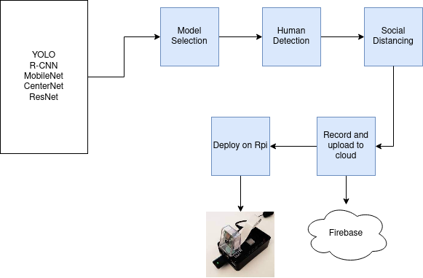
Go, change the world
RV College of
Engineering
Methodology
Model selection
Human Detection
Social distancing measurement
Record and cloud upload
Deploy on Rpi

Slide 15
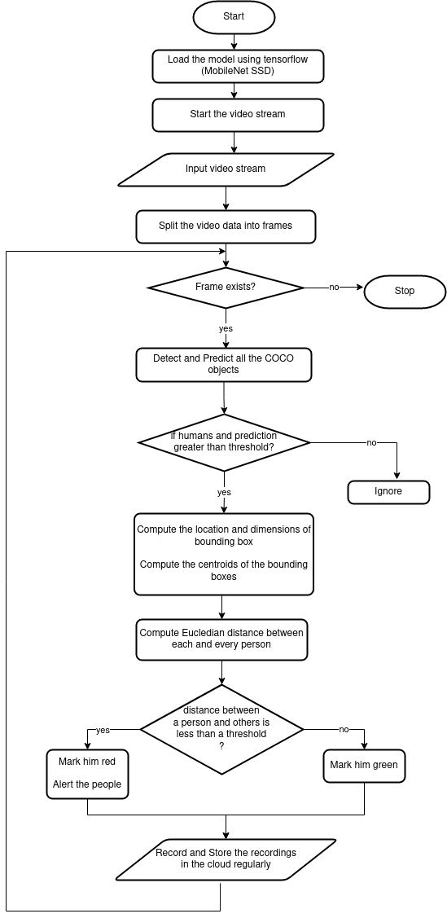

Slide 16
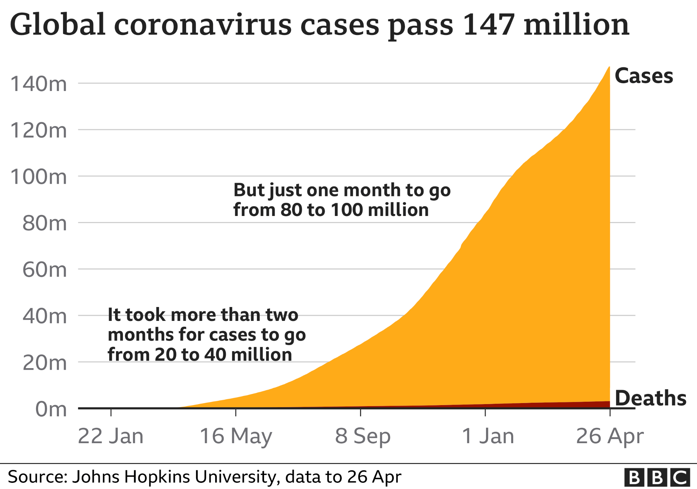
Go, change the world
RV College of
Engineering
Societal Relevance
In the fight against the COVID-19, social distancing has been verified to be a really effective way to bring down the spread of the illness.
Limiting our contact with people will slow down virus transmission and flatten the epidemic curve so that we can reduce the number of cases occurring at the peak of the epidemic.

Slide 17
Go, change the world
RV College of
Engineering
References
[1] https://covid19.who.int/
[2] Nguyen C.T., Saputra Y.M., Van Huynh N., Nguyen N.-T., Khoa T.V., Tuan B.M. 2020. Enabling and emerging technologies for social distancing: a comprehensive survey and open problems.arXiv:2005.02816.
[3] Harvey A., LaPlace J. 2019. Megapixels: Origins, ethics, and privacy implications of publicly available face recognition image datasets.
[4] Robakowska M., Tyranska-Fobke A., Nowak J., Slezak D., Zuratynski P., Robakowski P., "The use of drones during mass events", Disaster and Emergency Medicine Journal. 2017;2:129–134.
[5] Chakraborty C., Banerjee A., Garg L., Coelho Rodrigues J.J.P. Series Studies in Big Data. 2021;80:98–136. doi: 10.1007/978-981-15-8097-0.
[6] Prem K., Liu Y., Russell T.W., Kucharski A.J., Eggo R.M., Davies N., "The effect of control strategies to reduce social mixing on outcomes of the COVID-19 epidemic in Wuhan, China: a modelling study", The Lancet Public Health. 2020.
[7] Punn N.S., Sonbhadra S.K., Agarwal S. 2020. Monitoring COVID-19 social distancing with person detection and tracking via fine-tuned YOLO v3 and Deepsort techniques.arXiv:2005.01385.
[8] Ramadass L., Arunachalam S., Sagayasree Z., "Applying deep learning algorithm to maintain social distance in public place through drone technology ", International Journal of Pervasive Computing and Communications. 2020.
[9] Pouw CAS, Toschi F, van Schadewijk F, Corbetta A (2020) Monitoring physical distancing for crowd management: Real-time trajectory and group analysis. PLoS ONE 15(10): e0240963. https://doi.org/10.1371/journal.pone.0240963.

Slide 18
[10] Sathyamoorthy A.J., Patel U., Savle Y.A., Paul M., Manocha D. 2020. COVID-robot: Monitoring social distancing constraints in crowded scenarios.arXiv:2008.06585.
[11] D. Ganiger, K. A. Patil, P. Patil and M. Anandhalli, "Automatic Control of Power Supply in Classroom Using Image Processing", Proceedings - 2017 International Conference on Recent Advances in Electronics and Communication Technology ICRAECT 2017, pp. 230-234, 2017.
[12] N. Yadav and U. Binay, "Comparative Study of Object Detection Algorithms", Int. Res. J. Eng. Technol., pp. 586-591, 2017.
[13] Tsung-Yi Lin Michael, Maire Serge, Belongie James, Hays Pietro, Perona Deva, Ramanan Piotr, Dollár C., Lawrence Zitnick, "Microsoft COCO: Common objects in context", Lect. Notes Comput. Sci. (including Subser. Lect. Notes Artif. Intell. Lect. Notes Bioinformatics), vol. 8693 LNCS, no. PART 5, pp. 740-755, 2014.
[14] https://tfhub.dev/tensorflow/collections/object_detection/1
[15] Robert Krauthgamer James R. Lee, "Navigating nets: Simple algorithms for proximity search", https://www.cs.princeton.edu/courses/archive/spring05/cos598E/bib/KL-NavNets-SODA04.pdf
[16] http://www.csun.edu/~ctoth/Handbook/chap32.pdf
[17] https://en.wikipedia.org/wiki/Euclidean_distance

