Slide 1

McCormick
AI-ASSISTED SAP ENGINEERING
SPICE
UNIFIED REVIEW EXPERIENCE
Transport Objects
SAP Program Inspection
and Code Evaluation
ABAP Source
SAP ATC Checks
Smarter Reviews. Stronger Governance. Faster Delivery.
SAP AI Core
01
Transport Analysis
02
Source Inspection
03
ATC Integration
04
AI-Powered Review
SPICE / SAP Program Inspection and Code Evaluation
01 / 05

Slide 2
THE BUSINESS CASE
Transforming SAP Code Review Efficiency
From fragmented manual reviews to a unified, evidence-led experience.
TODAY
SPICE UNIFIED REVIEW
BUSINESS OUTCOME
Collect transport and object data
Faster reviews with consistent evidence, actionable recommendations and reviewer-controlled approval.
Inspect source code manually
01
02
03
Switch between ATC and SAP tools
SAP evidence
ATC + AI insights
Human decision
Variable review depth and capacity
3.75–4.5
~40
150–180
hours saved / transport
transports / month
hours reclaimed / month
~1,800–2,160 estimated reviewer hours annually
Pilot validation required
SPICE / SAP Program Inspection and Code Evaluation
02 / 05

Slide 3
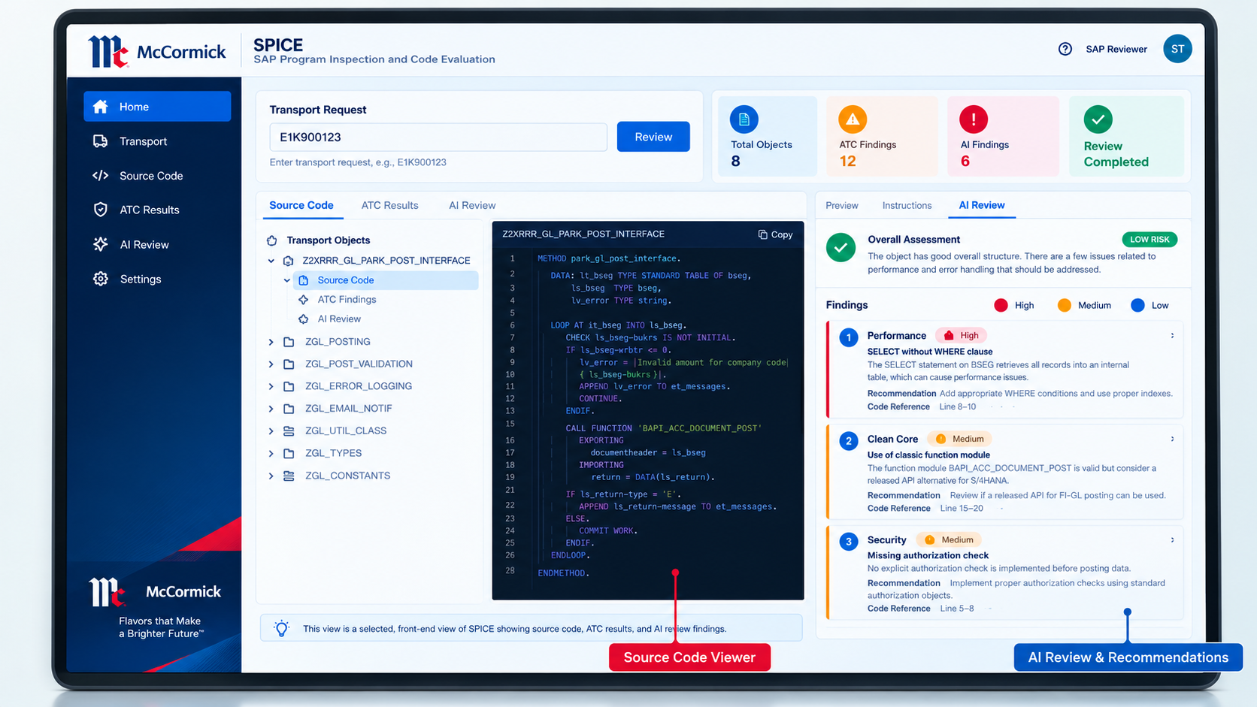
THE APPLICATION
One Workspace. Connected Enterprise Architecture.
A single review experience across transport objects, SAP checks and structured AI recommendations.
INTEGRATION FLOW
React • Tailwind CSS • Monaco Editor
Python FastAPI / Integration Layer
SAP ADT APIs + ATC
SAP AI Core
BTP destinations • SAP evidence
Foundation model • AI findings
SOURCE VIEWER
ATC RESULTS
AI RECOMMENDATIONS
FastAPI consolidation → SPICE dashboard
Human-led decisions • Backend-held AI credentials • No RAG in Phase 1
SPICE / SAP Program Inspection and Code Evaluation
03 / 05

Slide 4
RESPONSIBLE AI ECONOMICS
Enterprise AI Reviews with SAP AI Core
SAP evidence flows through FastAPI to SAP AI Core; people retain approval authority.
Code + ATC evidence
FastAPI review request
SAP AI Core
Structured findings
Human reviewer
REVIEW DIMENSIONS
Correctness
Performance
Security
Clean Core
Maintainability
AI CONSUMPTION / 40 TRANSPORTS PER MONTH
SMALL
TYPICAL
LARGE
TYPICAL COST
~17K
tokens / TR
~45K
tokens / TR
~88K
tokens / TR
~$7.80
~680K monthly
~1.8M monthly
~3.52M monthly
per month | illustrative
Model-provider planning estimates only; SAP AI Core entitlements, AI Units, model access and BTP charges require validation.
SPICE / SAP Program Inspection and Code Evaluation
04 / 05

Slide 5
STRATEGIC ROADMAP
From Code Review to Intelligent SAP Engineering
A phased vision — current architecture first; future opportunities subject to assessment and approval.
01
02
03
04
05
CORE SPICE
CONTEXT + RAG
AI DEVELOPMENT
DEVOPS
SAP AI ASSISTANT
Current architecture
Future opportunity
Future opportunity
Future opportunity
Future opportunity
Transport • ADT • ATC
SAP AI Core • Human review
HANA Cloud • Standards
Historical review insights
ABAP / RAP / CDS assistance
Refactoring • Unit tests
CI/CD review triggers
Quality gates • Auditability
Agents • Dependency analysis
Multi-step workflows
PRODUCTIVITY
QUALITY
GOVERNANCE
Less repetitive work
Earlier risk visibility
Human-controlled decisions
SPICE — Review Evidence. Surface Actionable Insights. Keep Human Judgment at the Center.
SPICE / SAP Program Inspection and Code Evaluation
05 / 05

