Slide 1


Slide 2
Vision
Single place for all notification channels
Integrations to major apps
Easy to integrate in apps
Vision

Slide 3
Advantages
Users
Single place for all notification channels
Available on all devices
Notification history
Vision

Slide 4
Advantages
Apps
Apps won’t have to implement notifications
Much work on different platforms
Apps get advertised through hopper
Easier to integrate than other notification services
Vision

Slide 5
Team
Konrad Hartwig
Designer, Implementer (Service Provider), Tech Writer
Marc Jacob
Implementer (Backend), Test Designer
Luca Schimweg
Project Management, Business Designer & Requirement Specifier, Implementer (Frontend), Graphic Artist
Project Management

Slide 6
Iterative Process
Rework specifications during development
Adjust to requirement changes
Improve code quality
Requires better planning
Project Management

Slide 7
Project Management
RUP
4 Phases
Inception
Elaboration
Construction
Transition
Different workflows
Requirements, Analysis & Design, Implementation, Test, Deployment, Configuration & Change Management, Project Management, Environment
Project Management

Slide 8
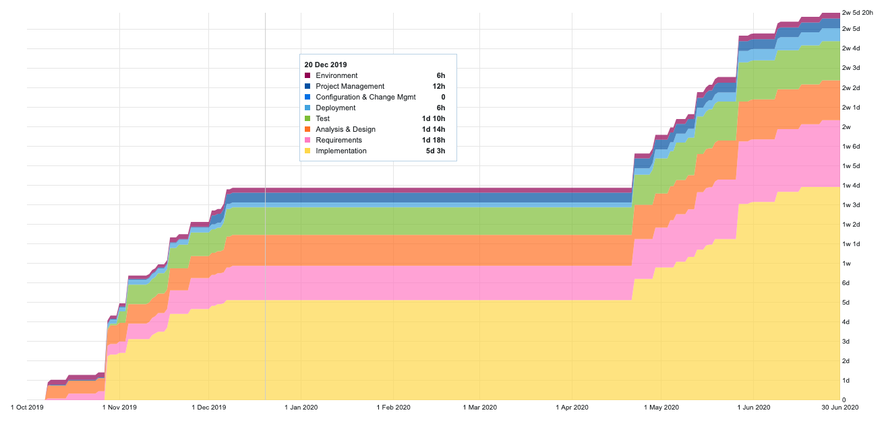
Project Management
RUP
Project Management

Slide 9
Project Methodology
Scrum
Sprints
Starts with Planning (Tasks for sprint get defined)
Sync meetings as needed
Ends with Retrospective
Scrumboard
4 Columns: To-Do, In-Progress, In-Review, Done
One board for each sprint
Project Management

Slide 10
Scrum in Hopper
Weekly sprints
Planning on Tuesday
Retrospective on Monday
Syncing every day
Remote work via MS Teams, Discord
Project Management

Slide 11
Scrum in YouTrack
Issues represent tasks
Scrumboard as Agile Board
Review Process:
Assignee
Code review
Functional testing
Project Management

Slide 12
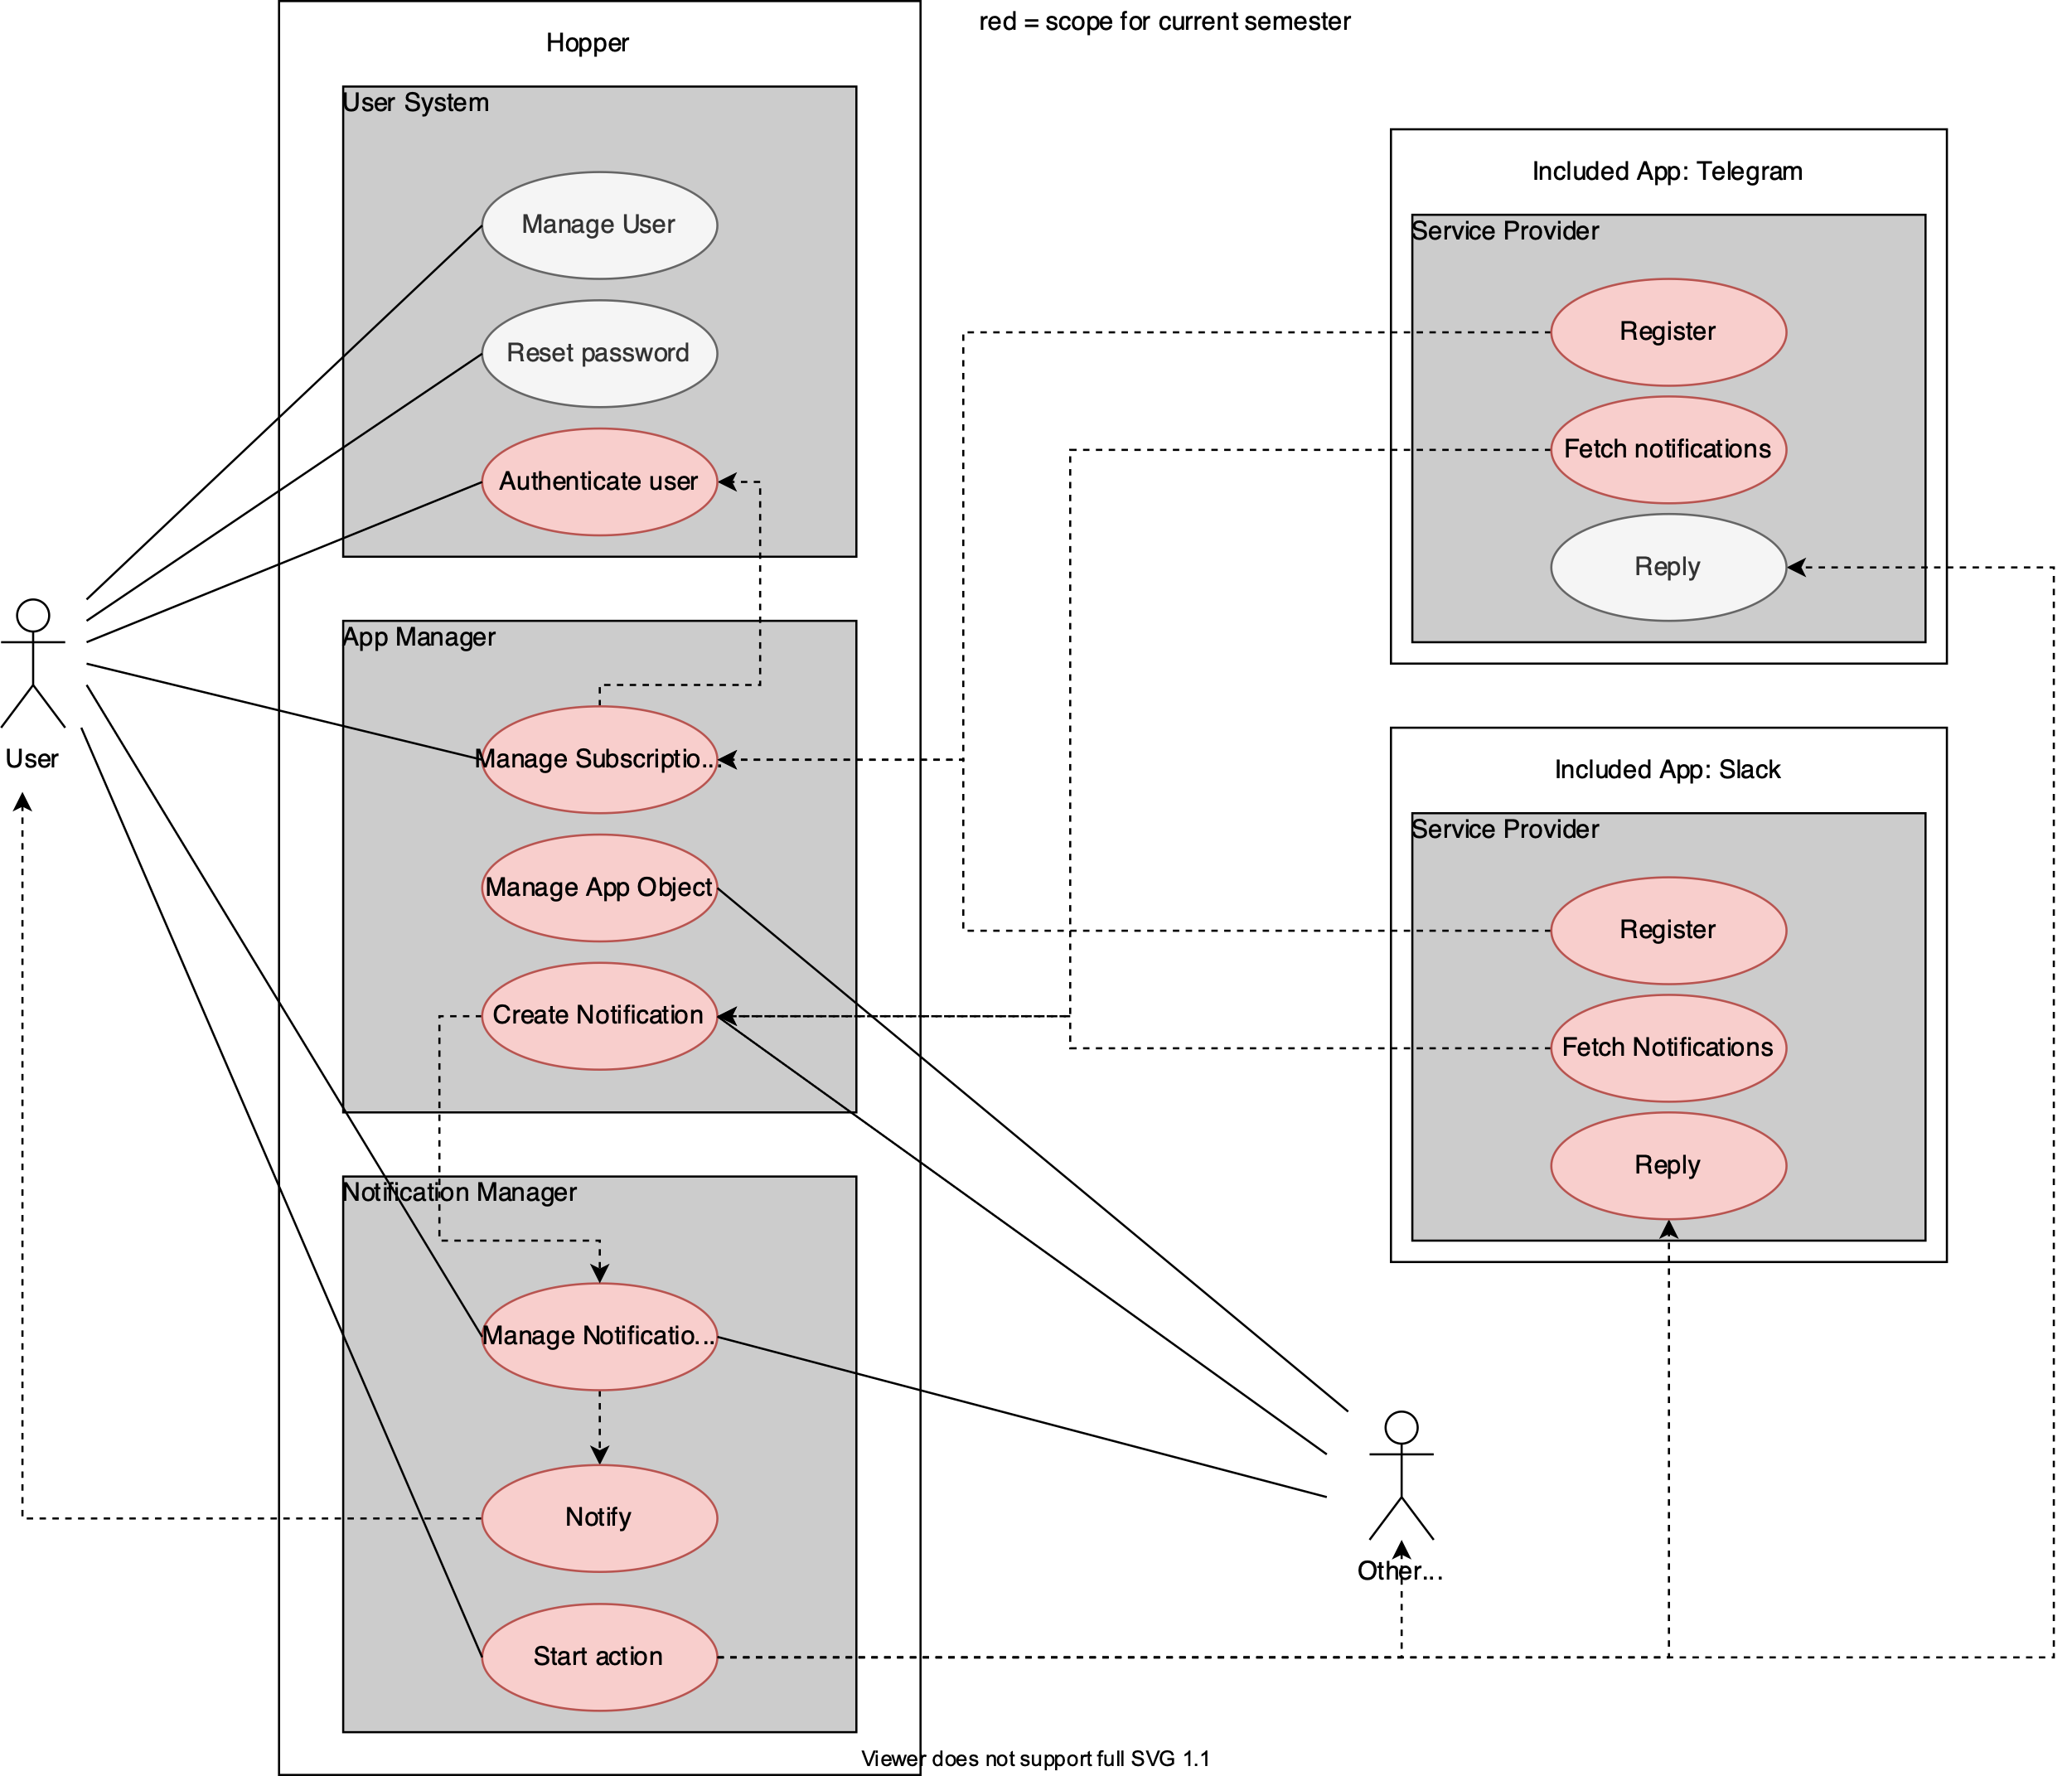
Use Cases
Project Management

Slide 13
Use Case time estimation
Use Case | Function Points | Estimated Time | Actual Time
Delete notification | 14.9 | 71.5h | 65h
Subscribe user to app | 20.15 | 96.7h | 100h
Start action | 4.55 | 21.8h | 20h
Project Management

Slide 14
Risk management
Not enough partners being available to users (Luca)
Build simple, easy to integrate APIs, collaborate with projects
Build connections ourselves
Inexperienced team members (Marc)
Pair programming
Upskilling
Real-time development performance shortfalls (Konrad)
Allocate enough buffers
Track performance
Keep all team members up to date (to be able to swap out assignee)
Project Management

Slide 15







Used technologies
Project Management
Code Management & Documentation
YouTrack
GitHub
Postman
SonarCloud
Testing
Deployment
TeamCity
Cucumber.js
Postman
Jest
TeamCity
Docker
Kubernetes
Technical Aspects

Slide 16





Used technologies
Backend
Frontend
TypeScript
NodeJS
Express.js
MongoDB
Mongoose
TypeScript, JavaScript
ReactJS
Webpack
Sass
IDE
WebStorm
Visual Studio Code
Technical Aspects

Slide 17


Communication
RESTful API
Backend
WebSocket
Frontend
Technical Aspects

Slide 18

Microservice-based architecture
Hopper
Technical Aspects

Slide 19
Microservice-based architecture
Hopper Backend
Hopper Frontend
Technical Aspects

Slide 20



Microservice-based architecture
Hopper Account
Hopper Backend
Hopper Frontend
Hopper Slack App
Hopper Telegram App
Technical Aspects

Slide 21
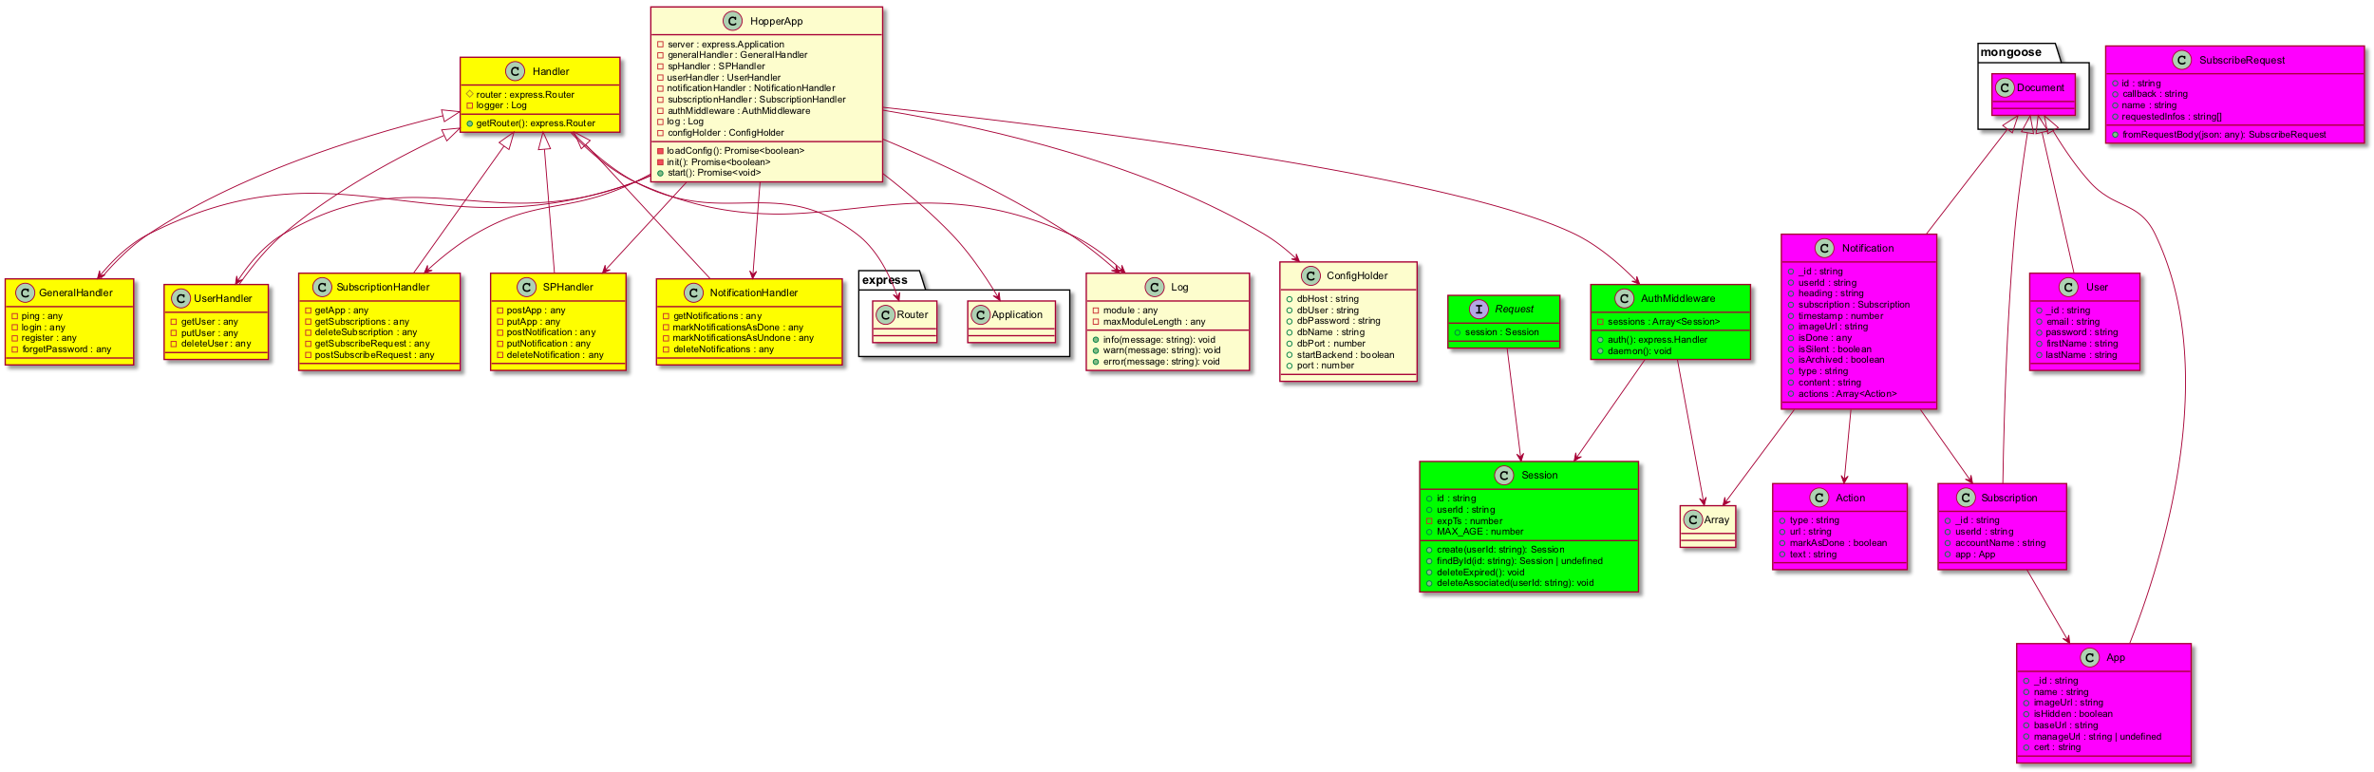
Class Diagram
Backend
Technical Aspects

Slide 22
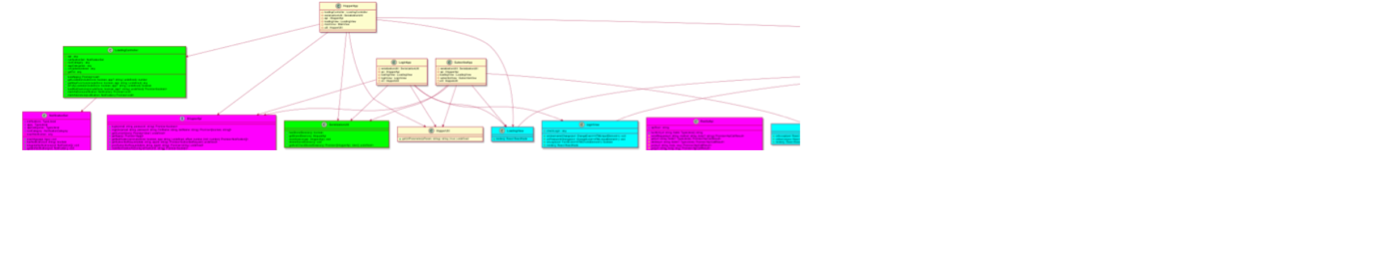
Class Diagram
Frontend
Technical Aspects

Slide 23
Source code management
GitHub-Organization: hopperteam
Multiple repositories:
hopper-server
hopper-ui
hopper-doc
hopper-account
…
Technical Aspects

Slide 24
Source code management
Hopper backend repository: hopper-server
Hopper frontend repository: hopper-ui
Feature branch + pull request for new features
Technical Aspects

Slide 25
Automations
On push to any pull request:
Start testing pipeline in TeamCity
Start code quality tools (Codacy, SonarCloud)
Report test status to GitHub
On push to master:
Start testing pipeline
When tests successful, start deployment pipeline for dev environment
Technical Aspects

Slide 26
Testing pipeline
Backend
Frontend
API testing
Postman runner tests
Unit testing
jest
Behavior testing
cucumber
Technical Aspects

Slide 27
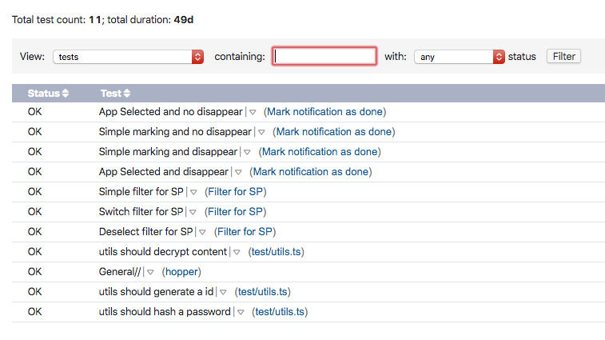
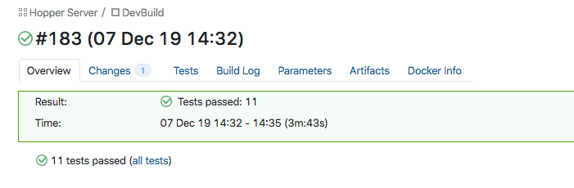
Testing pipeline
CI integration
Technical Aspects

Slide 28
Deployment pipeline
Build project
Compile TypeScript, Bundle dependencies, …
Build docker container
Based on default node-alpine container
Upload docker container
To docker repository
Upgrade Kubernetes Deployment
Using Kubernetes APIs
Technical Aspects

Slide 29
Configuration Management
Configuration by standard Kubernetes methodologies
Config maps
Environment variables
Contain database connection data, parameters for testing
Passwords are securely stored
Technical Aspects

Slide 30
Design Patterns
Builder Pattern
LoadingController is the only part of the application where NotificationSets are created
Iterator Pattern
For iterating though notifications in NotificationSet to abstract data storage
Bridge Pattern, Adapter Pattern
Two API Implementations (of IHopperAPI): HopperApi, DummyHopperApi
Allows for easier testing by switching API to dummy API
Technical Aspects

Slide 31
Code Metrics
Duplications
Perfect 0% duplications in all major repositories
Cognitive Complexity
How hard is the code to be understood by humans
Measured by SonarCloud
Largely improved within the last time
Backend much easier to understand than frontend
Technical Aspects

Slide 32


Partners
Technical Aspects

Slide 33
Demo
Demo

