Slide 1


Slide 2
Vision
Single place for all notification channels
Integrations to major apps
Easy to integrate in apps
Vision

Slide 3
Advantages
Users
Single place for all notification channels
Available on all devices
Notification history
Vision

Slide 4
Advantages
Apps
Apps won’t have to implement notifications
Much work on different platforms
Apps get advertised through hopper
Vision

Slide 5
Iterative Process
Rework specifications during development
Adjust to requirement changes
Improve code quality
Requires better planning
Project Management

Slide 6
Project Methodology
Scrum
Sprints
Starts with Planning (Tasks for sprint get defined)
Sync meetings as needed
Ends with Retrospective
Scrumboard
4 Columns: To-Do, In-Progress, In-Review, Done
One board for each sprint
Project Management

Slide 7
Scrum in Hopper
Weekly sprints
Planning on Monday
Retrospective on Sunday
Syncing every day in university
Project Management

Slide 8
Scrum in YouTrack
Issues represent tasks
Scrumboard as Agile Board
Review Process:
Assignee
Code review
Functional testing
Project Management

Slide 9
Team
Konrad Hartwig
Designer, Implementer (Test Service Provider), Tech Writer
Marc Jacob
Implementer (Backend), Test Designer
Luca Schimweg
Project Management, Business Designer & Requirement Specifier, Implementer (Frontend), Graphic Artist
Project Management

Slide 10
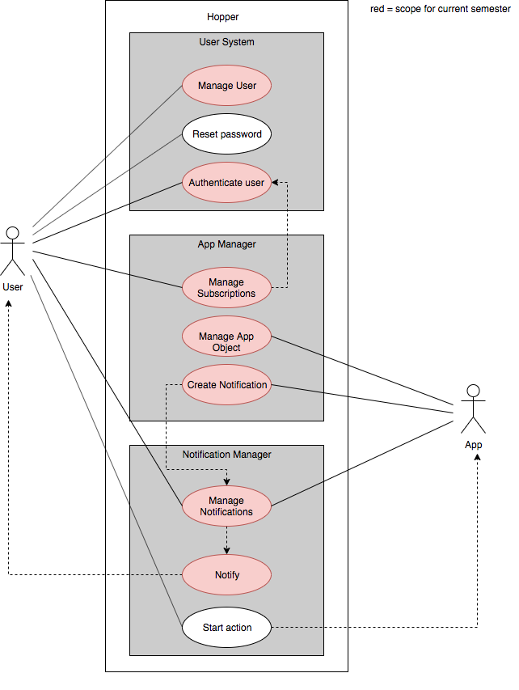
Use Cases
Project Management

Slide 11
Used technologies
Project Management
Code Management & Documentation
YouTrack
GitHub
Postman
Testing
Deployment
TeamCity
Cucumber.js
Postman
Jest
TeamCity
Docker
Technical Aspects

Slide 12
Used technologies
Backend
Frontend
TypeScript
NodeJS
Express.js
MongoDB
Mongoose
TypeScript, JavaScript
ReactJS
Webpack
Sass
IDE
WebStorm
Visual Studio Code
Technical Aspects

Slide 13


Communication
RESTful API
Backend
WebSocket
Frontend
Technical Aspects

Slide 14



Authentication of Apps
App creation
public key
Create App
App
Hopper
private key
Technical Aspects

Slide 15

Authentication of Apps
Subscribe request creation
subscription request data
App
hash (SHA-256)
subscription request
private key
encrypt (RSA)
signature
Technical Aspects

Slide 16
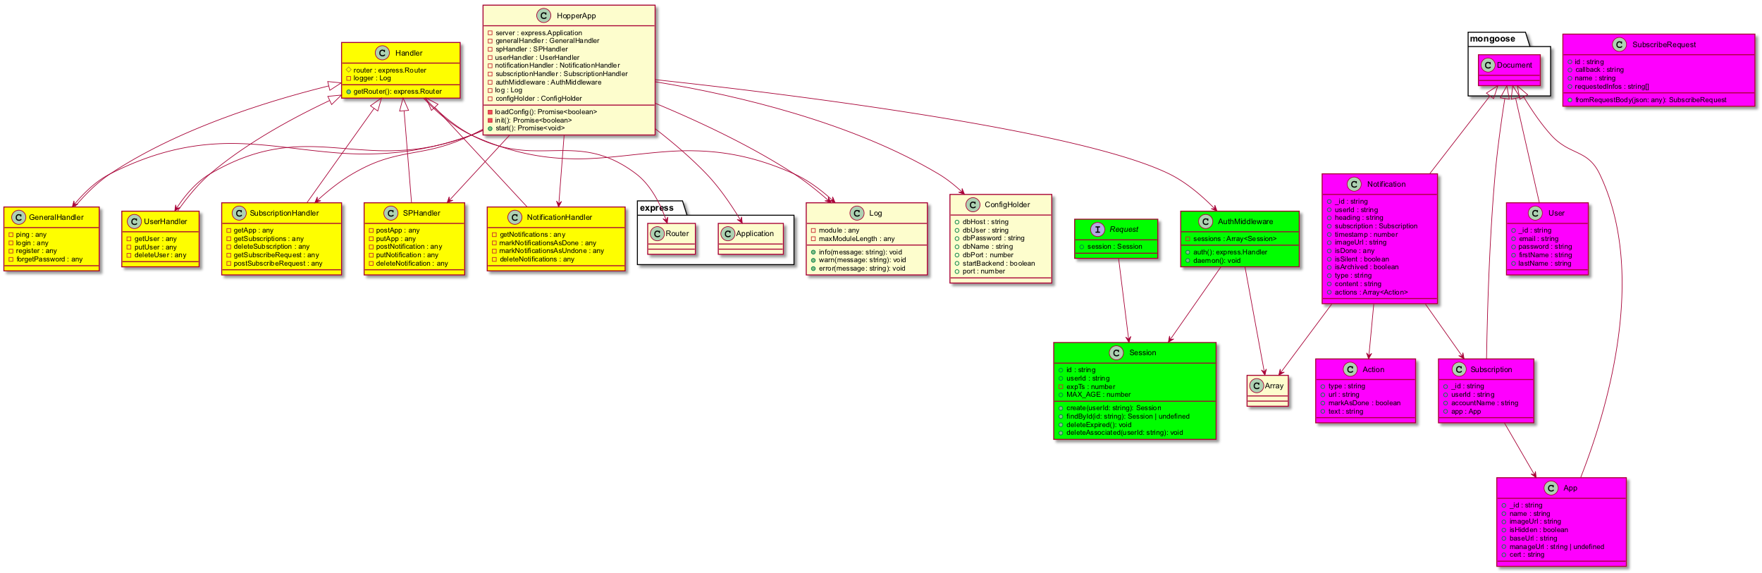
Class Diagram
Backend
Technical Aspects

Slide 17
Technical Aspects

Slide 18
Technical Aspects

Slide 19
Class Diagram
Backend
Technical Aspects

Slide 20
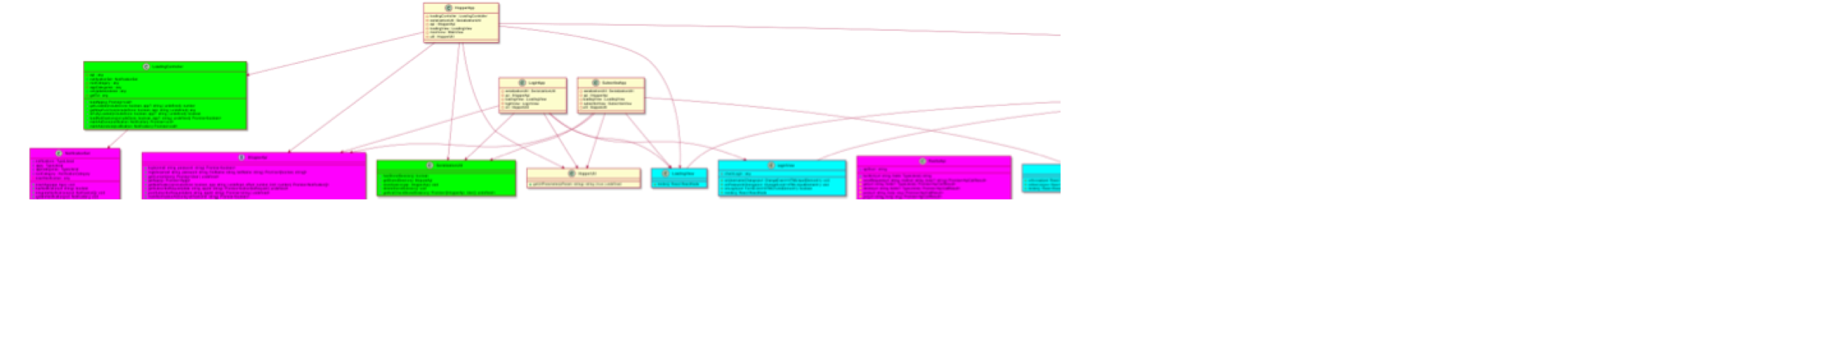
Class Diagram
Frontend
Technical Aspects

Slide 21
Technical Aspects

Slide 22
Technical Aspects

Slide 23
Technical Aspects

Slide 24
Class Diagram
Frontend
Technical Aspects

Slide 25
Source code management
GitHub-Organization: hopperteam
Multiple repositories:
hopper-server
hopper-doc
…
Technical Aspects

Slide 26
Source code management
hopper-server
Main Hopper repository
Front- & backend
2 Branches:
master: Development branch
rel: Release branch
No feature branches (only one developer per section)
Technical Aspects

Slide 27
Automations
On push to master:
Start testing pipeline
When tests successful, start deployment pipeline for dev environment
On push to rel:
Start deployment pipeline for rel environment
Technical Aspects

Slide 28
Testing pipeline
Backend
Frontend
API testing
Postman runner tests
Unit testing
jest
Behavior testing
cucumber
Technical Aspects

Slide 29
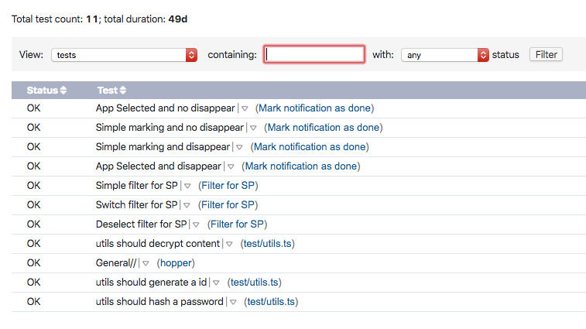
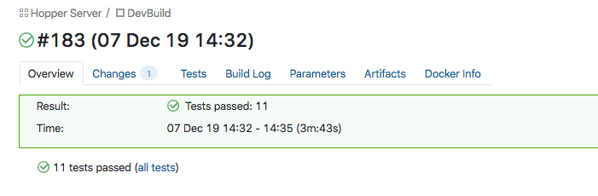
Testing pipeline
CI integration
Technical Aspects

Slide 30
Deployment pipeline
Build project
Compile TypeScript, Bundle dependencies, …
Build docker container
Based on default node container (uses ubuntu)
Upload docker container
To hopper’s docker repository
Restart running docker containers with new versions
Log into server via SSH, kill docker container, start new docker container
Technical Aspects

Slide 31
Configuration Management
Local configuration files on server get mapped into docker container
Contain database connection data, parameters for testing
Different configurations for release and development instances
Technical Aspects

Slide 32
Demo
Demo

