Slide 1

Effective Test Generation Using Pre-trained LLMs and Mutation Testing: Part Deux
Group 4: Philip Haapala and Grant Rusin

Slide 2
Agenda
• Introduction & Research Context
• Original MuTAP Framework
• Research Questions & Methodology
• Experiment Design
• Key Results
• Cross-Language Challenges
• Architectural Insights
• Comparative Analysis
• Conclusion & Future Directions

Slide 3
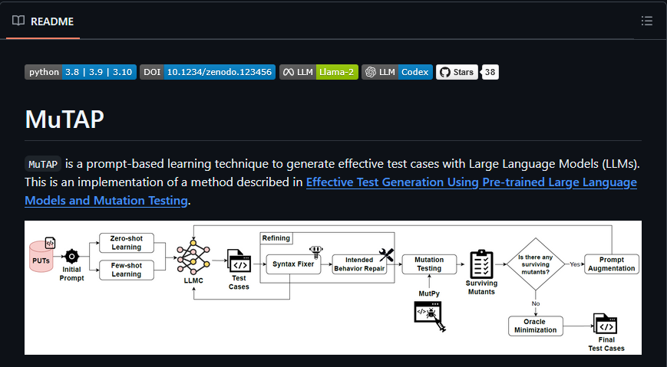
Research Context & Motivation
• Brief overview of software testing challenges
• Introduce MuTAP (original work)
• Highlight the gaps we addressed

Slide 4
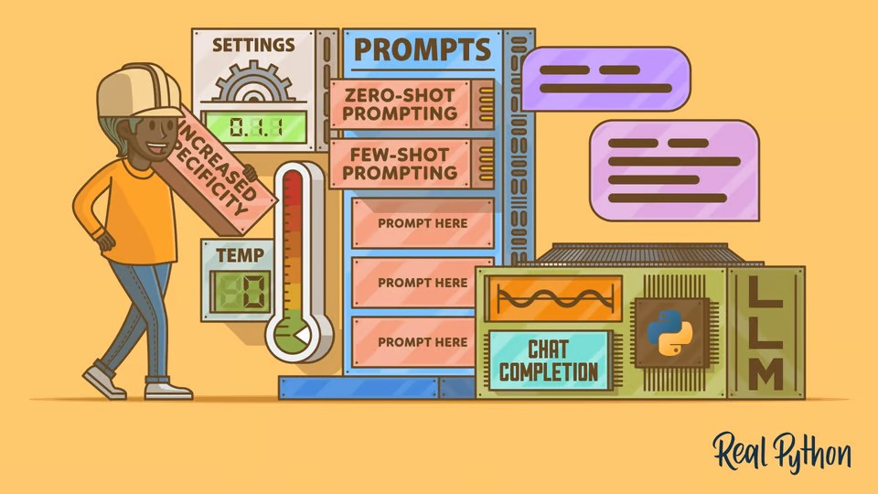
Original MuTAP Framework
• Brief explanation of MuTAP architecture
• Key components: LLM prompting, syntax fixing, mutation testing
• Results achieved in original work

Slide 5

Research Questions
• RQ1: How effective are newer LLMs compared to original ones?
• RQ2: How effectively can MuTAP's benefits transfer across programming languages?
• RQ3: What limitations exist in LLM-based test generation across languages?

Slide 6

Methodology Overview
• Two-pronged research approach
• Comparison of different LLMs
• Cross-language implementation with Blackjack example
• Methodology diagram from report

Slide 7

Experiment Design: LLM Comparison
• Experimental setup for comparing LLMs
• Controlled variables
• Evaluation metrics

Slide 8
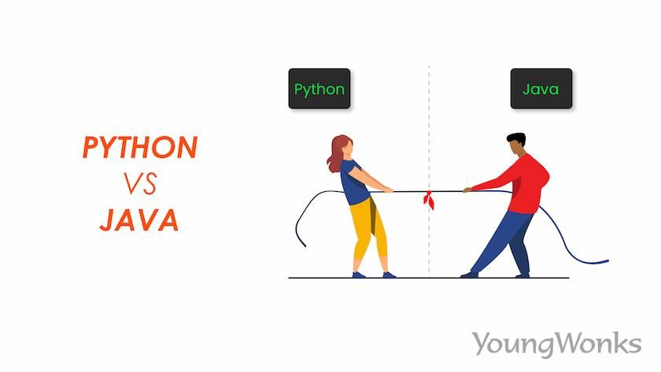
Experiment Design: Cross-Language Testing
• Blackjack implementation in Python and Java
• Test case generation and conversion process
• Evaluation metrics for cross-language comparison

Slide 9
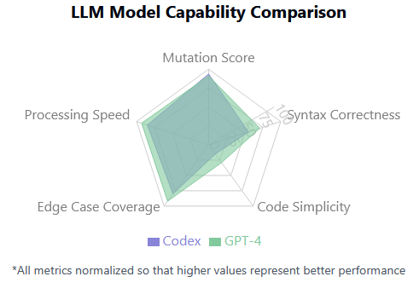
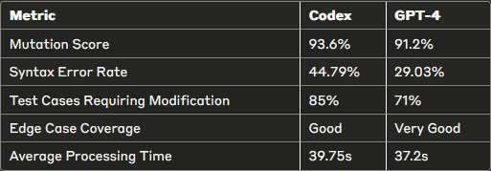
Key Results: LLM Comparison
• Comparison table of mutation scores across LLMs
• Performance metrics of GPT-4 vs. Codex
• Visual representation of effectiveness

Slide 10
Key Results: Cross-Language Effectiveness
Testing Method | File Tested | Statements | Missing Statements | Coverage (%)
Manual Tests | blackjack.py | 57 | 32 (Lines 11, 25-29, 49-87, 91) | 44%
MuTAP (OpenAI GPT-4) | blackjack.py | 57 | 6 (Lines 63-67, 91) | 89%
Combined Tests | blackjack.py | 57 | 1 (Line 91) | 98%
Java Conversion | blackjack.py | 57 | 0 | 100%
• Coverage metrics across languages (table from report)
• Comparison of test effectiveness
• Highlight key findings in cross-language transfer

Slide 11
Cross-Language Challenges
Test Case Structures between Python and Java
Aspect | Python | Java | Challenge
Testing | Unittest | JUnit5 | Java requires explicit @Test annotations
Assertions | (self.assertEquals()) | Assertions.assertEquals() | Different naming conventions and class imports
Exceptions | self.assertRaises(Exception, func) | assertThrows(Exception.class,() -> func()); | Java requires explicit lambdas
Mocking user input | Unittest.mock.patch | Requires Mockito (@Mock, @InjectMocks) | Java requires additional libraries
Test Setup | Inline test setup | @BeforeEach method required | Java requires explicit setup methods
Looping | for i in range(10): | for (int i=0; i<10;i++) | Java requires explicit type declaration
• Structural differences between Python and Java tests (Table 2)
• Syntax and logic differences (Table 3)
• Conversion challenges and limitations

Slide 12

Deeper Analysis: Limitations
• Testing framework differences
• Exception handling disparities
• Type enforcement challenges
• Mocking approach variations

Slide 13
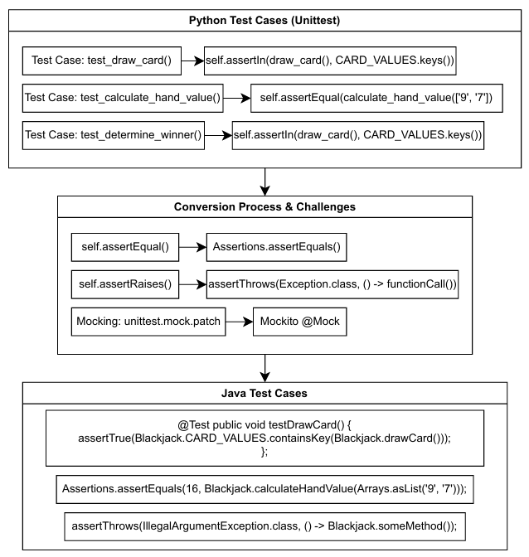
Architectural Insights
• MuTAP architecture for cross-language testing (figure from report)
• Components that transfer vs. require adaptation
• Language translation layer

Slide 14

Comparative Advantage Analysis
• Strengths of MuTAP in each language
• Unexpected benefits of cross-language implementation
• Edge cases differently addressed in each language

Slide 15

Threats to Validity
• Sample size and complexity limitations
• Potential biases in manual conversion
• Testing framework differences
• Tool differences for coverage measurement

Slide 16
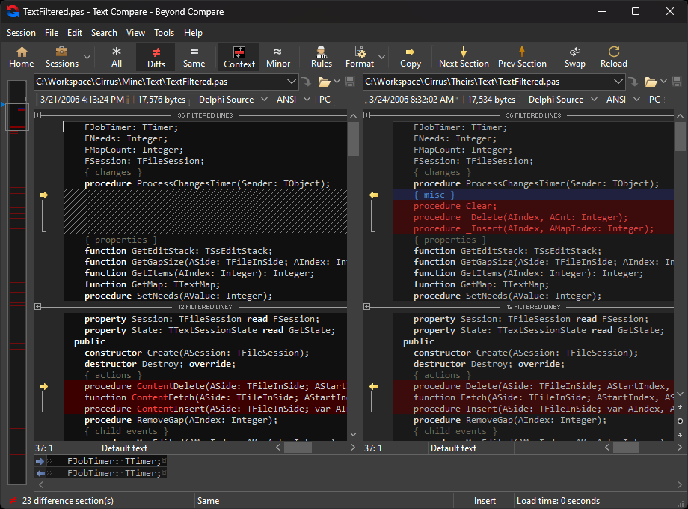
Comparison to Original Work
• Side-by-side comparison of our contributions vs. original work
• Novel insights gained through our extensions
• Limitations addressed and new limitations discovered

Slide 17
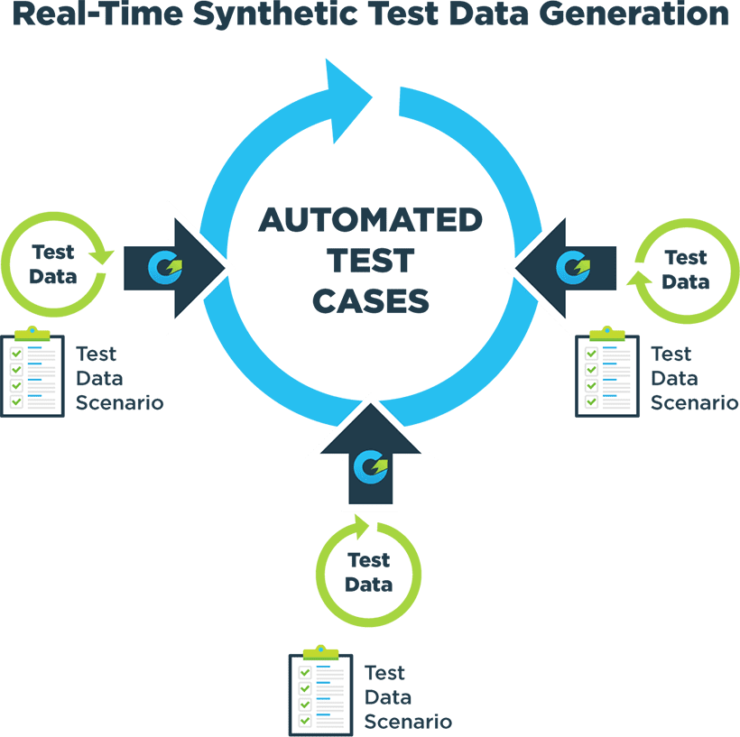
Future Research Directions
• Automated test case translation
• Multi-language MuTAP framework
• Larger-scale validation
• Integration with IDE tools

Slide 18

Key Takeaways
• Practical implications for software testing
• Theoretical contributions to automated testing research

Slide 19

• Contextualization within software testing field
• Final thoughts on significance

Slide 20

Thank you for your time and attention

