Slide 1







Database Management System Lab
0612-304
PRESENTED BY
PRESENTED TO
02. Mosaddek Hossain Mehedi
Fahim Foysal Abak
Lecturer
Department of CSE
Dhaka International University
21. Hasibul Haque Probal
22. Mst. Sultana Yeasmin
40. Azizur Rahman Arzu

Slide 2
Introduction
QuickShow is a modern movie theater booking platform designed to streamline the ticketing experience for both customers and administrators. It offers real-time seat selection, ensuring users can view and reserve available seats instantly. The platform integrates secure payment processing for smooth transactions, while an intuitive admin dashboard allows theater owners to efficiently manage shows, seating and bookings.

Slide 3
Objectives
Leaving the mark of developing an web marvel: using the trending technological tools to deploy a modern, scalable system.
Designing user friendly reservation system: ensuring highest users’ convenience.
Providing complete cineplex management solution: efficient management tool with full authority.
Easing the procedure: reduces effort from both ends, accelerates efficiency.

Slide 4
Tech Stack
Frontend
React + Vite – Fast, modern frontend setup for interactive UIs
Tailwind CSS – Clean, responsive design system
React Router DOM – Smooth navigation and route management
Axios – For efficient API communication
Lucide React – Lightweight and elegant icon library
Backend
Node.js + Express 5 – Robust API and server framework
MongoDB + Mongoose** – Scalable and schema-based data management
Stripe – Secure online payment processing
Clerk – Authentication and user management with roles
Cloudinary – Media storage for posters and images
Nodemailer – Automated booking email confirmations
Inngest – Background jobs and workflow automation

Slide 5
API Overview
Endpoint | Method | Description
/api/show | GET | Fetch available shows
/api/booking | POST | Create a new booking
/api/user/bookings | GET | Get all user bookings
/api/user/update-favourite | POST | Add or remove favorite movies
/api/user/favourites | GET | Fetch user favorite movies
/api/admin/add-show | POST | Admin: Add a new show
/api/stripe/webhook | POST | Stripe webhook for payments

Slide 6
Features
Smart Booking System – Real-time seat availability and interactive seat layouts
Secure Payments – Integrated with Stripe for ticket purchases
User Management – Login, favorites, and profile powered by Clerk
Admin Dashboard – Manage movies, shows, and analytics
Movie Catalog – Browse movies with ratings, trailers, and details
Email Notifications – Instant booking confirmations via Nodemailer
Cloud Storage – Efficient media management using Cloudinary
Responsive UI – Seamless experience on all devices
Event Workflows – Background operations powered by Inngest

Slide 7
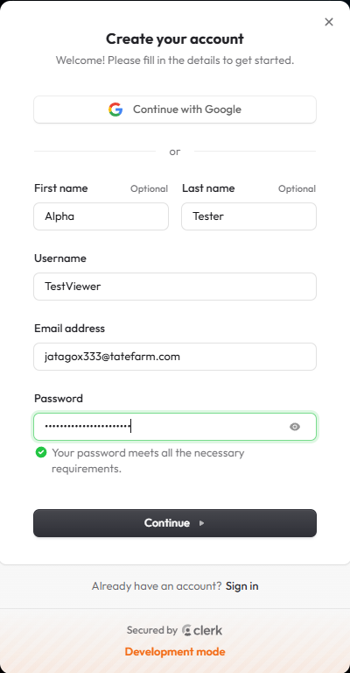
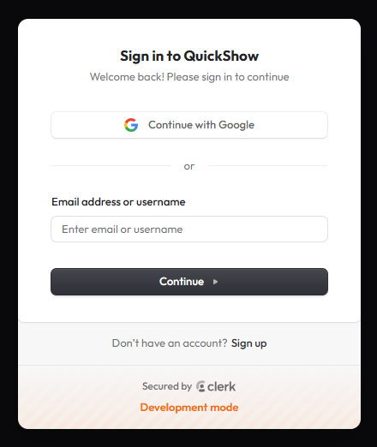

Feature Overview
Signup & Login
A Clerk-based authentication system was implemented to ensure secure login for both users and administrators, with role-based access control (RBAC). It supports manual credential-based signup as well as Google OAuth for seamless registration, while maintaining strong security and efficient session management

Slide 8
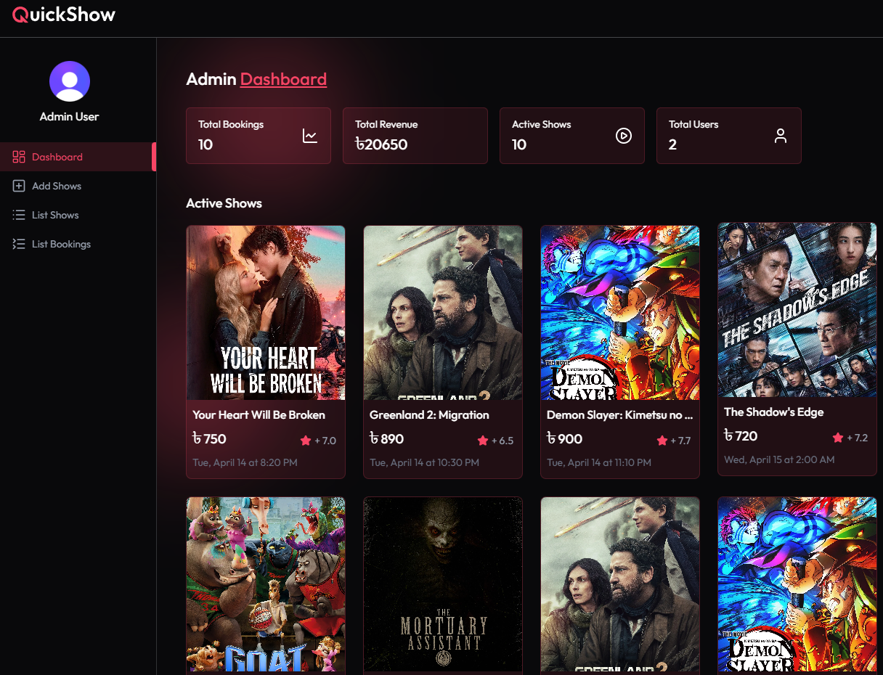
Feature Overview
Admin Dashboard
The admin dashboard gives a quick overview of total revenue, bookings, active shows, and users

Slide 9
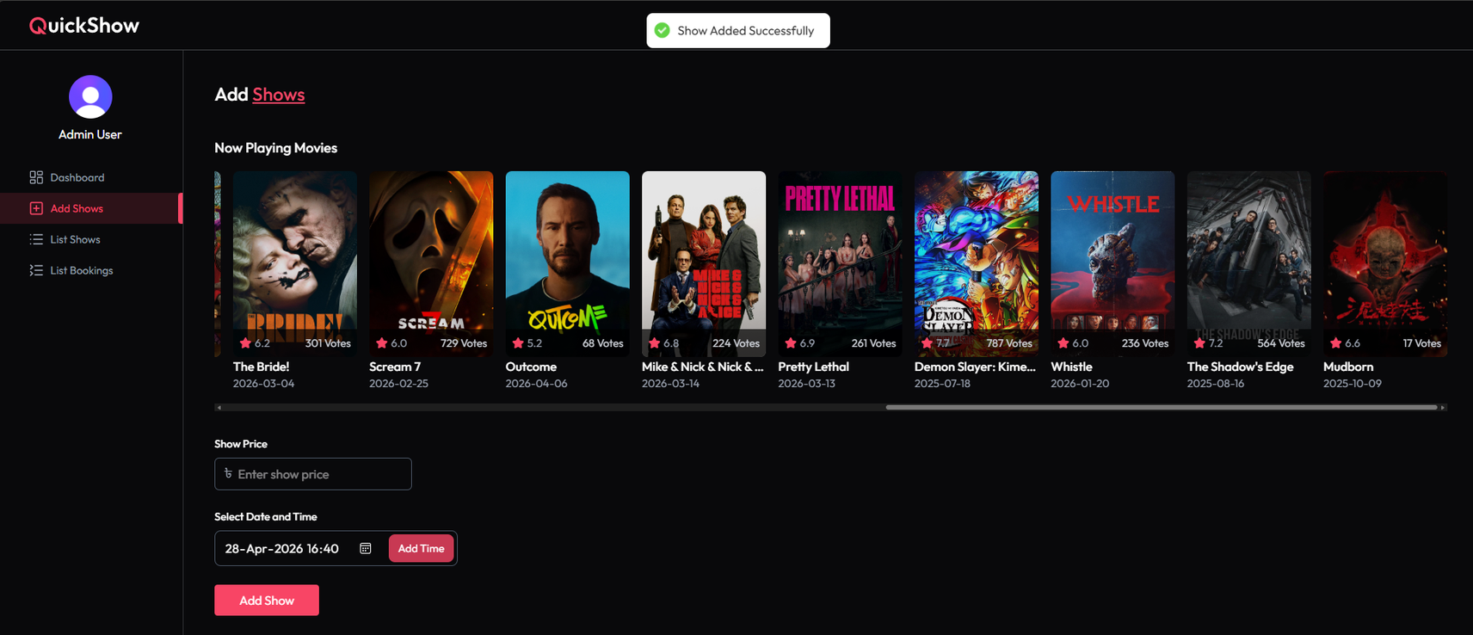
Feature Overview
Add New Shows
A movie is selected from the TMDB movie database and can be assigned multiple showtimes, with flexible scheduling and ticket pricing for each slot

Slide 10
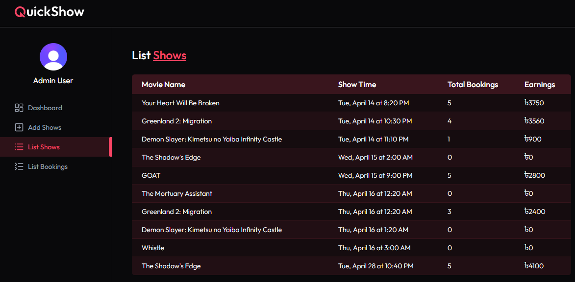
Feature Overview
List Shows
The shows list displays key details such as movie name, show time, total bookings, and earnings for each show. It helps in tracking performance and revenue of ongoing screenings.

Slide 11
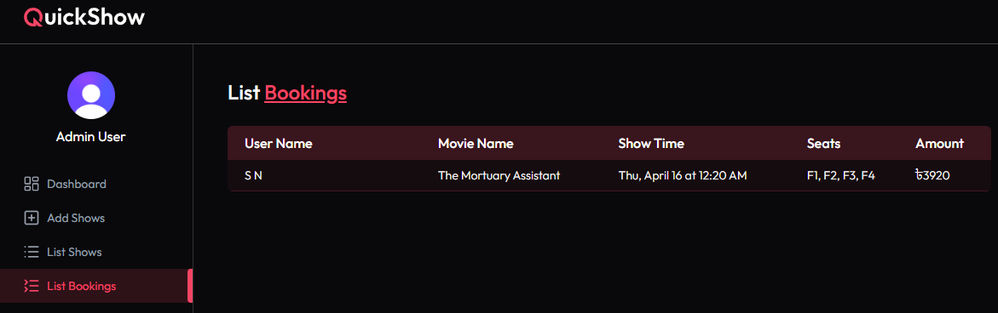
Feature Overview
List of Bookings
The booking list includes user name, movie name, show time, number of seats booked, and the total amount paid for each reservation

Slide 12
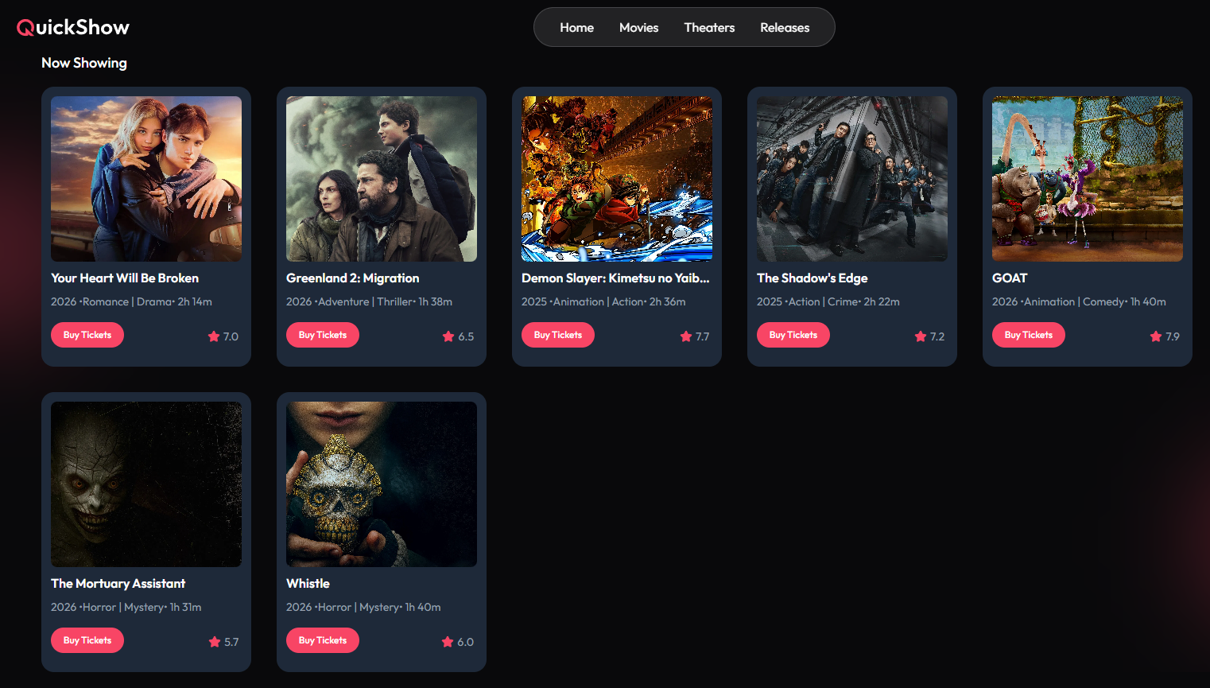
Feature Overview
Available Shows
Browse movies with ratings and detailed information to help you choose the perfect experience for booking tickets

Slide 13
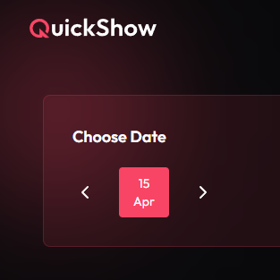
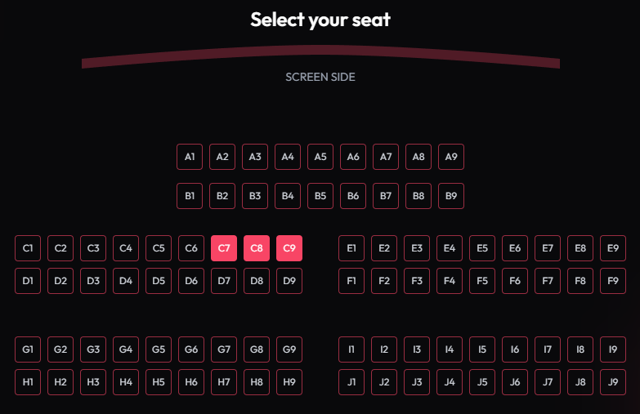
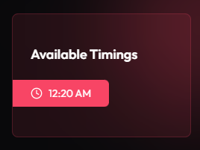
Feature Overview
Seat & Showtime Selection
Pick your favourite seats and showtime for a comfortable viewing experience

Slide 14
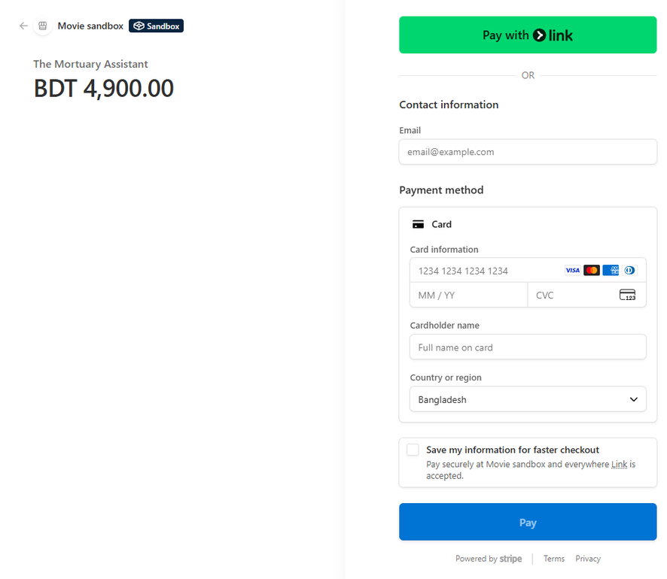
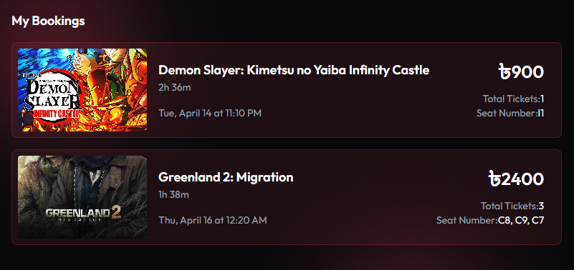
Feature Overview
Payments & Booking List
All payments are securely processed via Stripe for a fast and safe checkout experience. The Booking List provides an overview of all your movie ticket reservations in one place

Slide 15
Conclusion
QuickShow succeeds in providing a smooth, up-to-date way to reserve movie tickets by integrating live seat picking, secure payment options and helpful organizing features. It vastly improves the whole experience of customers with rapid and easy ticket buying and at the same time, lets administrators have total authority over shows, seats and bookings. In this way, QuickShow turns out to be an easy-to-use and dependable platform for both the cinema fans and the movie house owners

Slide 16


Thank you!

