Slide 1
INNOVATORS

Slide 2
Autonomous Drone Localization System (DEXTRA)

Slide 3
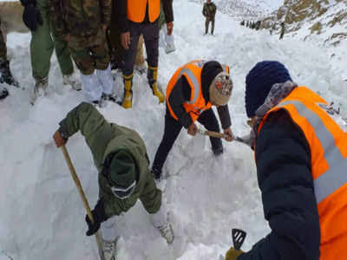
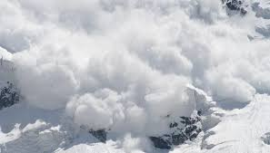
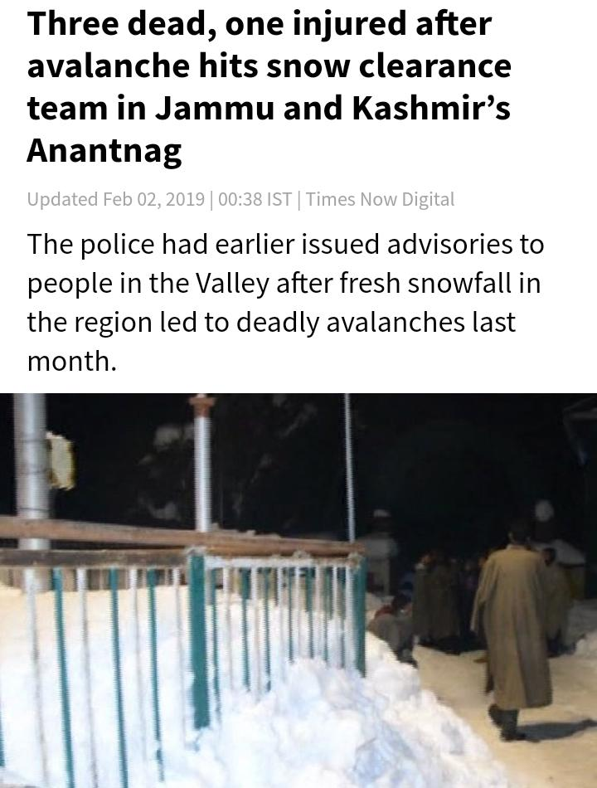
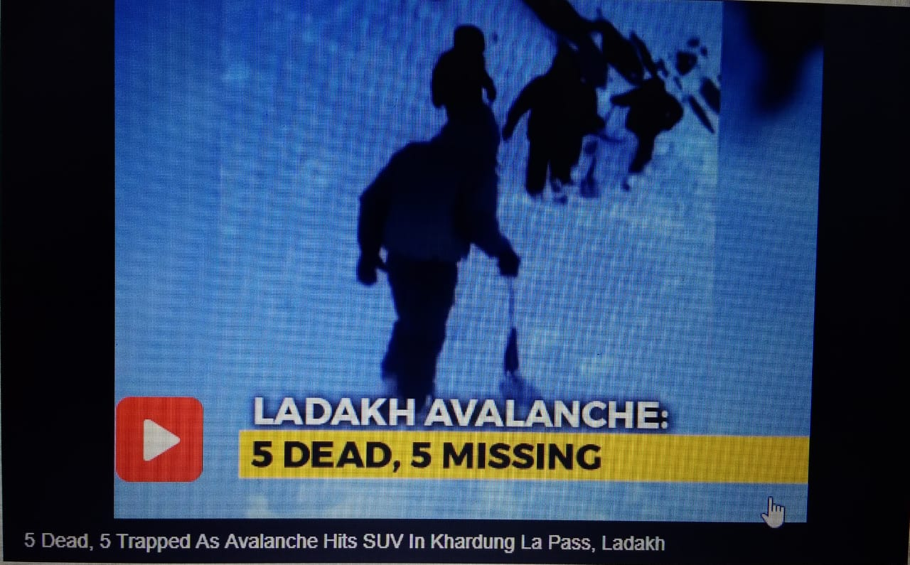
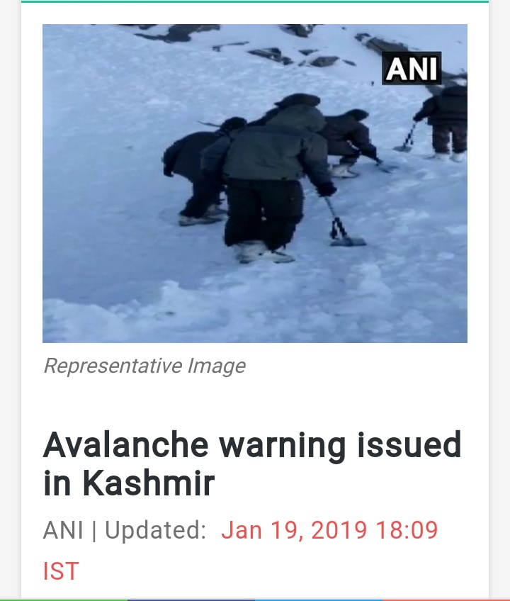
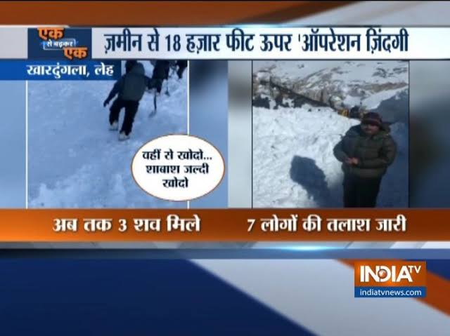
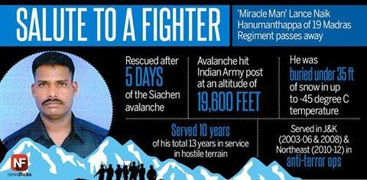
AVALANCHE

Slide 4
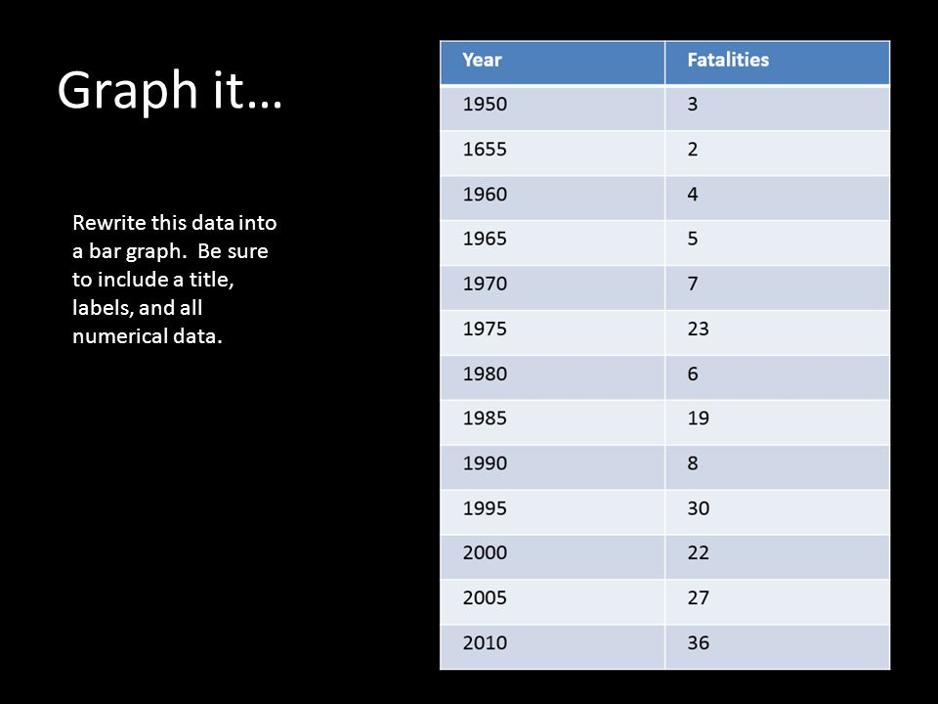
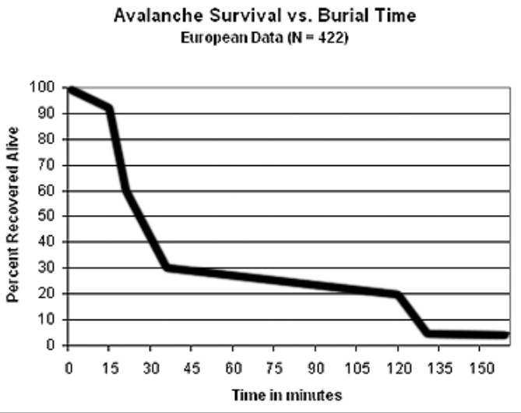
STATISTICS

Slide 5
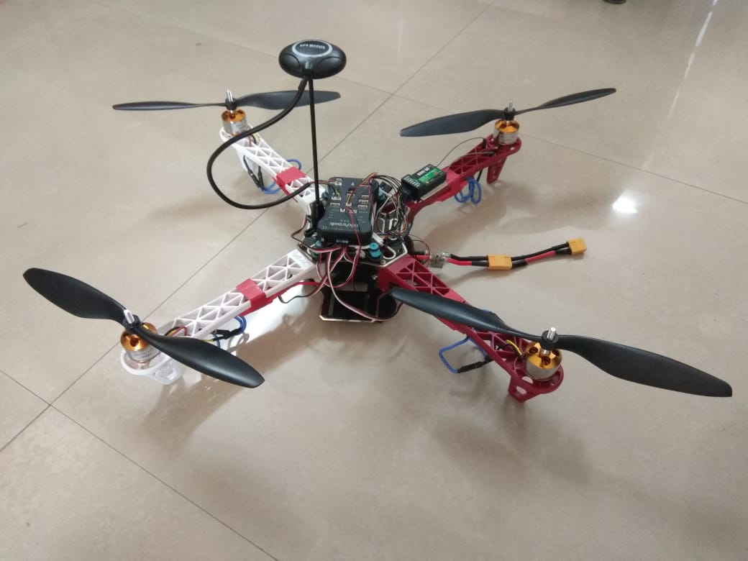
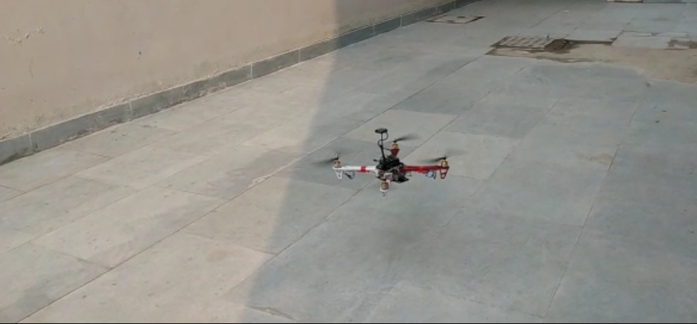
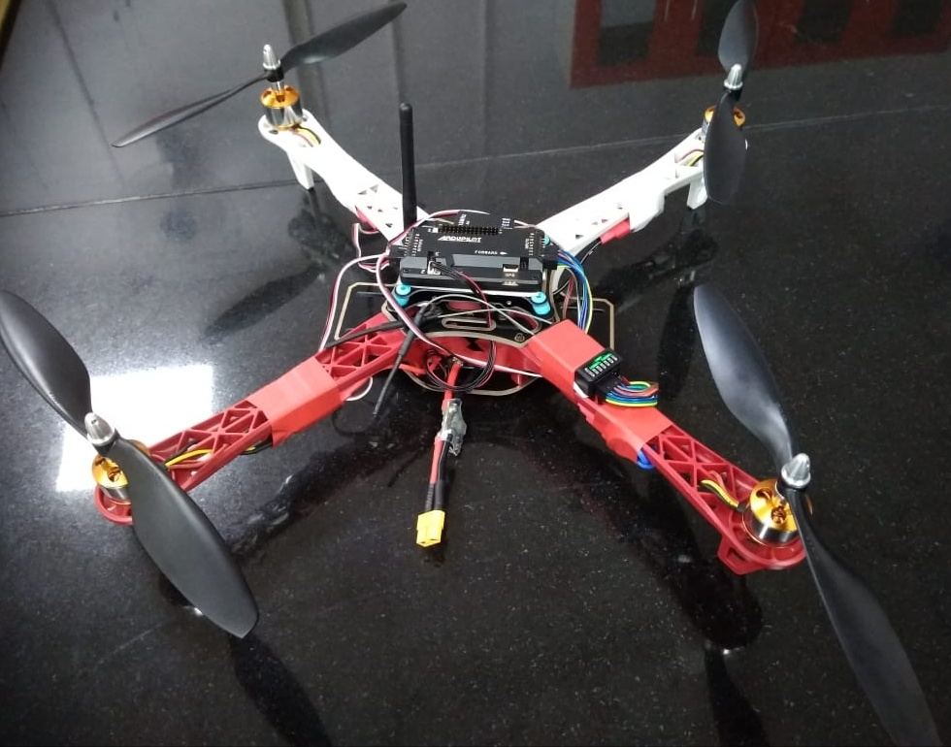
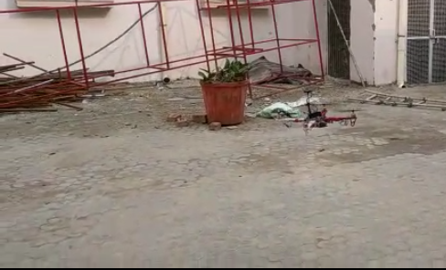
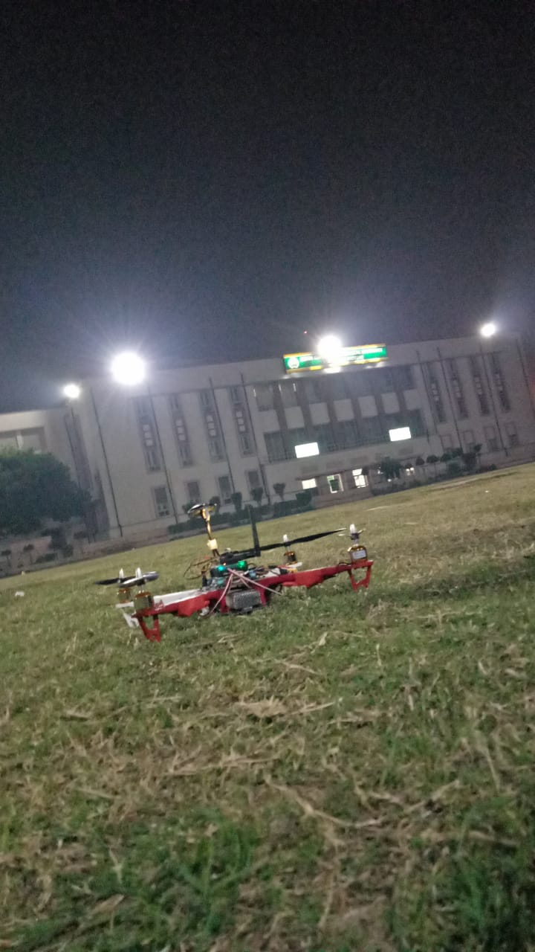

Slide 6
SOLUTION
human
drone
Base station
human
human
human
human
human

Slide 7
Previous Method

Slide 8
Current Method
Detector node
base station node
Human node

Slide 9
Future plans for next cohort
Performing Indoor localization :
We can perform the indoor localization of the tracking system that we made with Lora SX1278 chip with some more sensors in addition.
Use of Machine learning Techniques:
Using the concept of machine learning we can get rid of the multiple path problem which leading to a better solution.

Slide 10
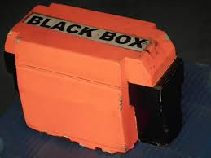
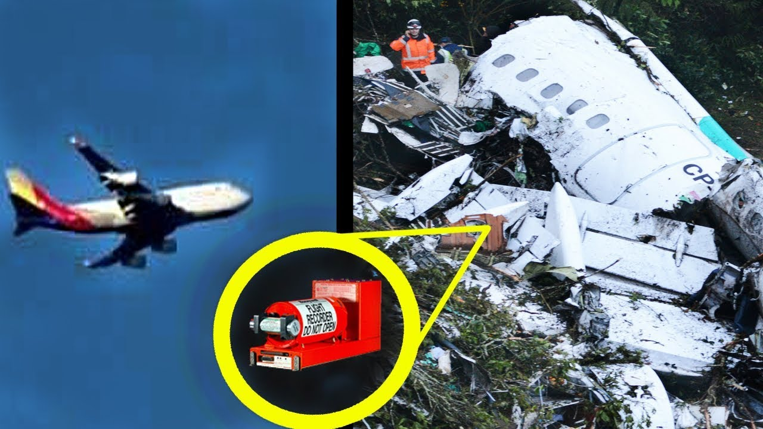
Use cases of current system
Used to find the black boxes in case of air crash , thus make
searching easier and relevant.

Slide 11
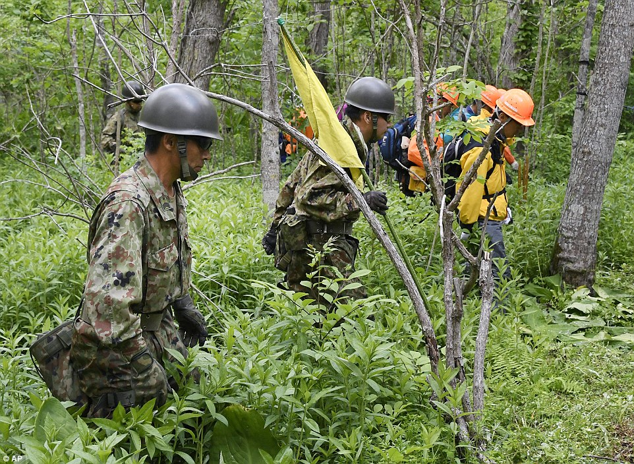
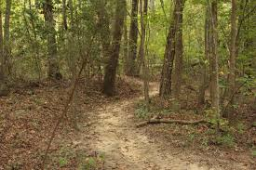
Use cases(continued)
Used as a tracking device to rescue army people in dense forest.

Slide 12


Slide 13
DEMO

Slide 14
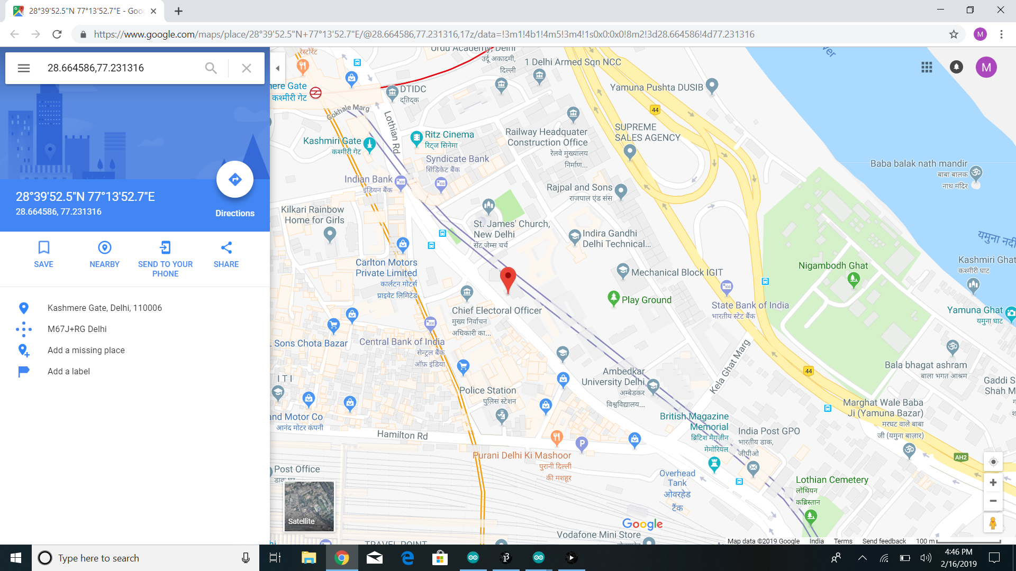

Slide 15
THANKS!!

Slide 16

Any Questions?

