Slide 1
SMART INDIA HACKATHON 2018 Team Name: Code Zillions Application Name: Appointo

Slide 2
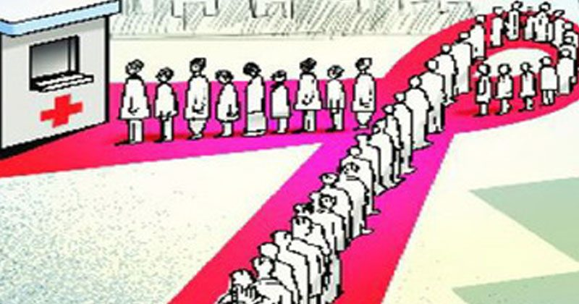
Problem Statement
Booking appointments at a tertiary care hospital is a tedious and disorganized process.
Patients have to stand in long queues to get an appointment, and thereafter wait long hours to eventually meet the doctor.

Slide 3

No mechanism is present to inform the patient if a doctor isn’t available in the hospital on a date.
The process of rescheduling appointment with any other doctor is also not available.
For follow-ups, the appointment scheduling system does not generate any reminders to the patients.
There is no mechanism for the government to perform quality analysis of the doctors and institutions.

Slide 4
Solution
The solution is to develop an application which will revolutionize the appointment scheduling system in large hospitals.
Provide users various features and facilities like booking a preferred appointment slot and be in waiting for one.
Build a system of doctor reviews and ratings analysis that is accessible and trustworthy for the general user.
Recommend doctors to your friends and family through other social platforms by sharing their appointment details.
Doctors can access their appointments for the day and accept/reject.
Notify users when their appointment gets confirmed.

Slide 5
Feature Ideation
Browsing through all available doctors in the hospital and even search the required doctor using the search option.
Booking appointments through a simple 3-step workflow.
Submit doctor ratings and access review analysis that you can trust.
Recommend a doctor to others by sharing his details over whatsapp, messenger, email etc.
Wait for an appointment slot in the queue.
Get notified when your appointment is confirmed.

Slide 6
Phase 1:
Built an MVP consisting of a simple 3-step workflow.
Select doctor -> Pick date -> Book
The patient logging in can view the list of the doctors in the hospital along with their specialization and location.
Suggestions from 1st Evaluation/Plan moving forward:
Judges pointed out the need to search for the doctor using the symptom.
Plan was to also integrate a functionality for sharing a doctor’s details to recommend him.
Functionality to book another appointment if doctor rejects.

Slide 7
Phase 2:
Developed login functionality for the doctors to access their side of the app.
Doctors can view all appointment requests for a day and accept/reject them.
Remodelled workflow to begin appointment booking from the patient’s symptom
Implemented functionality to recommend a doctor to your friends on multiple social platforms.
User profile shows the status of every appointment request.
Suggestions from 2nd Evaluation/Plan forward:
To build a system of reviewing and rating the appointment experience with the doctor -> Quality Assessment.
Dual login functionality in same app was appreciated.

Slide 8
Phase 3:
Added functionality for users to review doctors after the appointment
Doctors rated by patients on parameters like Punctuality, Openness to questions and Attentiveness to the problem.
Added functionality to book another appointment or follow up.
Integrated FCM Firebase Cloud Messaging service to send push notifications to users regarding appointment updates.

Slide 9

DEMO

Slide 10
Advantages to the users
Flexibility in taking the appointment.
The Disease type filter makes the search of doctors easier.
Date and time can be chosen by the users according to their convenience.
Sharing of the doctor details is an another advantage for the users.
Easy to use.
Long queues and time wastage issues tackled effectively.

Slide 11
Advantages to the institutions
Generate a digitized solution to a fundamental problem.
Managing hospital appointments in an efficient manner.
Understanding user perception.
Quality analysis of the doctors and the medical institution.
Growth in rate of appointments in government hospitals as citizen satisfaction increases.

Slide 12
Why Appointo?
Enhanced user experience due to its robust technology stack.
Recycler View
MVP Architecture
MicroServices Architecture
Optimized for low-bandwidth networks.
App Size is a mere 4 MB
3 step workflow.

Slide 13
Future Works
We will add chatbots which can assess users and also help them to understand their symptoms in a better way.
Payment gateway for paying appointment token fee.
Concept of Image recognition and machine learning will help users to get an idea of their health condition.
We can also add the select location option through which user can get the details of all the doctors in a particular location that they have chosen.

Slide 14

Thank you. Questions?

