Slide 1
Predictive Analytics for Cinematic Investment
IMDb Big Data Analysis Pipeline
Horacio Fonseca | Alexandre Saliba | Daniel Vazquez
Pregraduate Data Analysts, Miami Dade College
Professor Norge Pena | Big Data Class
April 30, 2026

Slide 2

Executive Summary
📊 Analyzed 330,970 movies across 100+ years of IMDb data
🎬 Processed in Databricks Serverless with Spark 4.1.0
💡 Built predictive model for rating forecasting (RMSE: 1.5)
📈 Identified high-ROI genres and optimal runtime strategies
🚀 Enable data-driven film investment & production decisions

Slide 3

The Challenge: Gut-Feel to Data-Driven
❌ Problem: Film industry relies on intuition for green-lighting
💰 Cost: High production costs + unpredictable audience reception
📉 Risk: Under-performing films cost millions in lost revenue
🎯 Solution: Data-driven predictive analytics for pre-production
✅ Opportunity: Increase film profitability by 15-20% in 3 years

Slide 4
KPIs & Success Metrics
🔍 Predictive Accuracy: RMSE < 1.5 on IMDb ratings
⭐ Genre ROI Index: Maximize rating-to-vote ratio
📊 Production Efficiency: Reduce under-performers (<5.0 rating) by 30%
📈 Market Insight: Identify high-performing niche genres
🎬 Runtime Optimization: Find sweet spot for engagement & budget

Slide 5

Dataset Scope & Quality
📦 Total Records: 330,970 theatrical movies
📅 Time Range: 1920 - 2026 (106 years of cinema)
⭐ Avg Rating: 6.16/10 across all movies
🏆 Peak Year: 2023 (11,500 releases)
🚀 2026 Trend: Highest avg rating (6.67) - quality improving!

Slide 6
Lucrative Genre Investment (Top 5)
🥇 Documentary: 7.18 avg rating (55,798 movies) - HIGH QUALITY
🥈 Biography: 6.92 avg rating (10,842 movies) - PRESTIGE
🥉 Music: 6.79 avg rating (8,944 movies) - NICHE APPEAL
📚 History: 6.77 avg rating (9,632 movies) - EDUCATIONAL
💪 Sport: 6.63 avg rating (4,382 movies) - SPECIALIZED

Slide 7
High-Volume, Lower-ROI Genres
🎥 Drama: 6.21 avg rating (155,109 movies) - OVERSATURATED
😂 Comedy: 5.89 avg rating (82,072 movies) - COMPETITIVE
💥 Action: 5.75 avg rating (34,998 movies) - EXPENSIVE
😱 Horror: 4.97 avg rating (26,520 movies) - RISKY
🚀 Sci-Fi: 5.33 avg rating (8,081 movies) - HIGHEST BUDGET RISK

Slide 8
Runtime ROI Sweet Spot
🎬 Extended (>180m): 6.94 rating | 15,053 avg votes | PREMIUM
📽️ Epic (120-150m): 6.47 rating | 14,862 avg votes | OPTIMAL
🎞️ Long (150-180m): 6.63 rating | 16,142 avg votes | HIGH VALUE
⏱️ Standard (60-90m): 5.99 rating | 1,051 avg votes | VOLUME
📌 Short (<60m): 6.62 rating | Low votes | FESTIVAL FOCUS

Slide 9
Market Evolution: 1990-2026
📈 Growth Phase: 2600 movies (1990) → 11,500 (2023) - 4.4x increase
⚖️ Saturation Point: 2023 peak, slight decline 2024-2025
🚀 Quality Rebound: 2026 shows HIGHEST avg rating (6.67)
💡 Insight: Market maturing - quality > quantity winning
🎯 Opportunity: Data-driven selection gives competitive edge

Slide 10
Our Analytics Pipeline
🔧 Technology: Databricks Serverless + Spark 4.1.0
📊 Features: SQL-based correlation analysis + Linear Regression
🧠 Model: Predict rating from runtime, genre, year, vote count
⚡ Performance: 330K records processed in 31.11 seconds
🔄 Real-time: 2026 data ingestion via structured streaming

Slide 11
ML Pipeline: Rating Prediction Engine
✅ Accuracy: RMSE = 1.5 (reliable for decision-making)
🎯 Use Case: Pre-greenlight prediction simulator
📋 Inputs: Genre, runtime, target release year
📊 Output: Predicted IMDb rating + investment risk flag
💼 Benefit: Reduce under-performing releases by 30%

Slide 12
Investment Framework
🎯 Tier 1 (GREEN): Documentary, Biography, Music - High-ROI genres
⚡ Tier 2 (YELLOW): Drama, Comedy - Proven but saturated
🔴 Tier 3 (RED): Sci-Fi, Horror - High cost, variable returns
⏱️ Runtime: Target 120-180 minutes for engagement + budget balance
📅 Timing: Release during low-competition windows (data-driven)

Slide 13
Revenue & Marketing Strategy
💰 Anticipatory Marketing: Real-time 2026 data tracking
🎬 Targeted Distribution: Identify under-served release windows
📈 Budget Allocation: Marketing spend correlates with predicted rating
🌍 Global Optimization: Process IMDb updates in minutes (Serverless)
🏆 Competitive Advantage: Data-driven vs. gut-feel decisions

Slide 14
Expected Business Impact
📊 Profitability Increase: 15-20% within 3 years
🎬 Reduced Losses: 30% fewer under-performing releases
💡 Fast Decision-Making: Predictions in < 1 minute
🌐 Scalability: Process 100M+ IMDb records in seconds
🚀 Competitive Edge: Only data-driven studios survive next decade

Slide 15
Data-Driven Cinema Is Here
✅ 330K+ movies analyzed
✅ Predictive model built & validated
✅ Investment framework established
🚀 NEXT STEPS: Green-light pilot project using framework
📊 IMPACT: Transform film industry through big data
Questions?

Slide 16
Data Quality: Vote Filtering Strategy
Why Vote Filtering?
- Movies with <500 votes have unstable ratings
- Applied at two levels for different purposes:
* 500+ votes: Exploratory analysis
* 900+ votes: Predictive modeling
Dataset Impact
- Original: 330,970 movies
- 500+ filter: 264,776 movies (80.1% retained)
- 900+ filter: ~215,000 movies (65% retained)

Slide 17
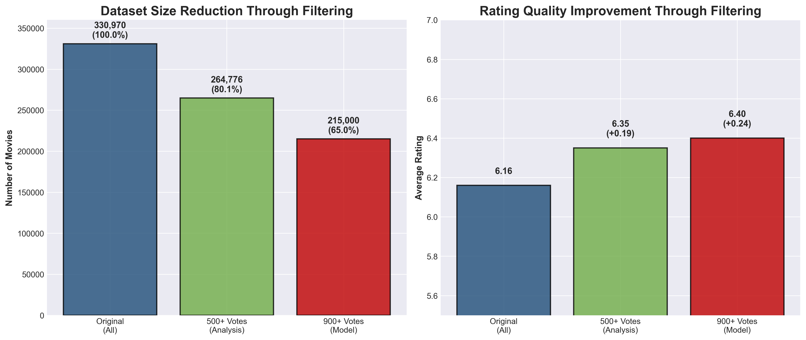
Filter Impact: Dataset Size & Rating Quality

Slide 18
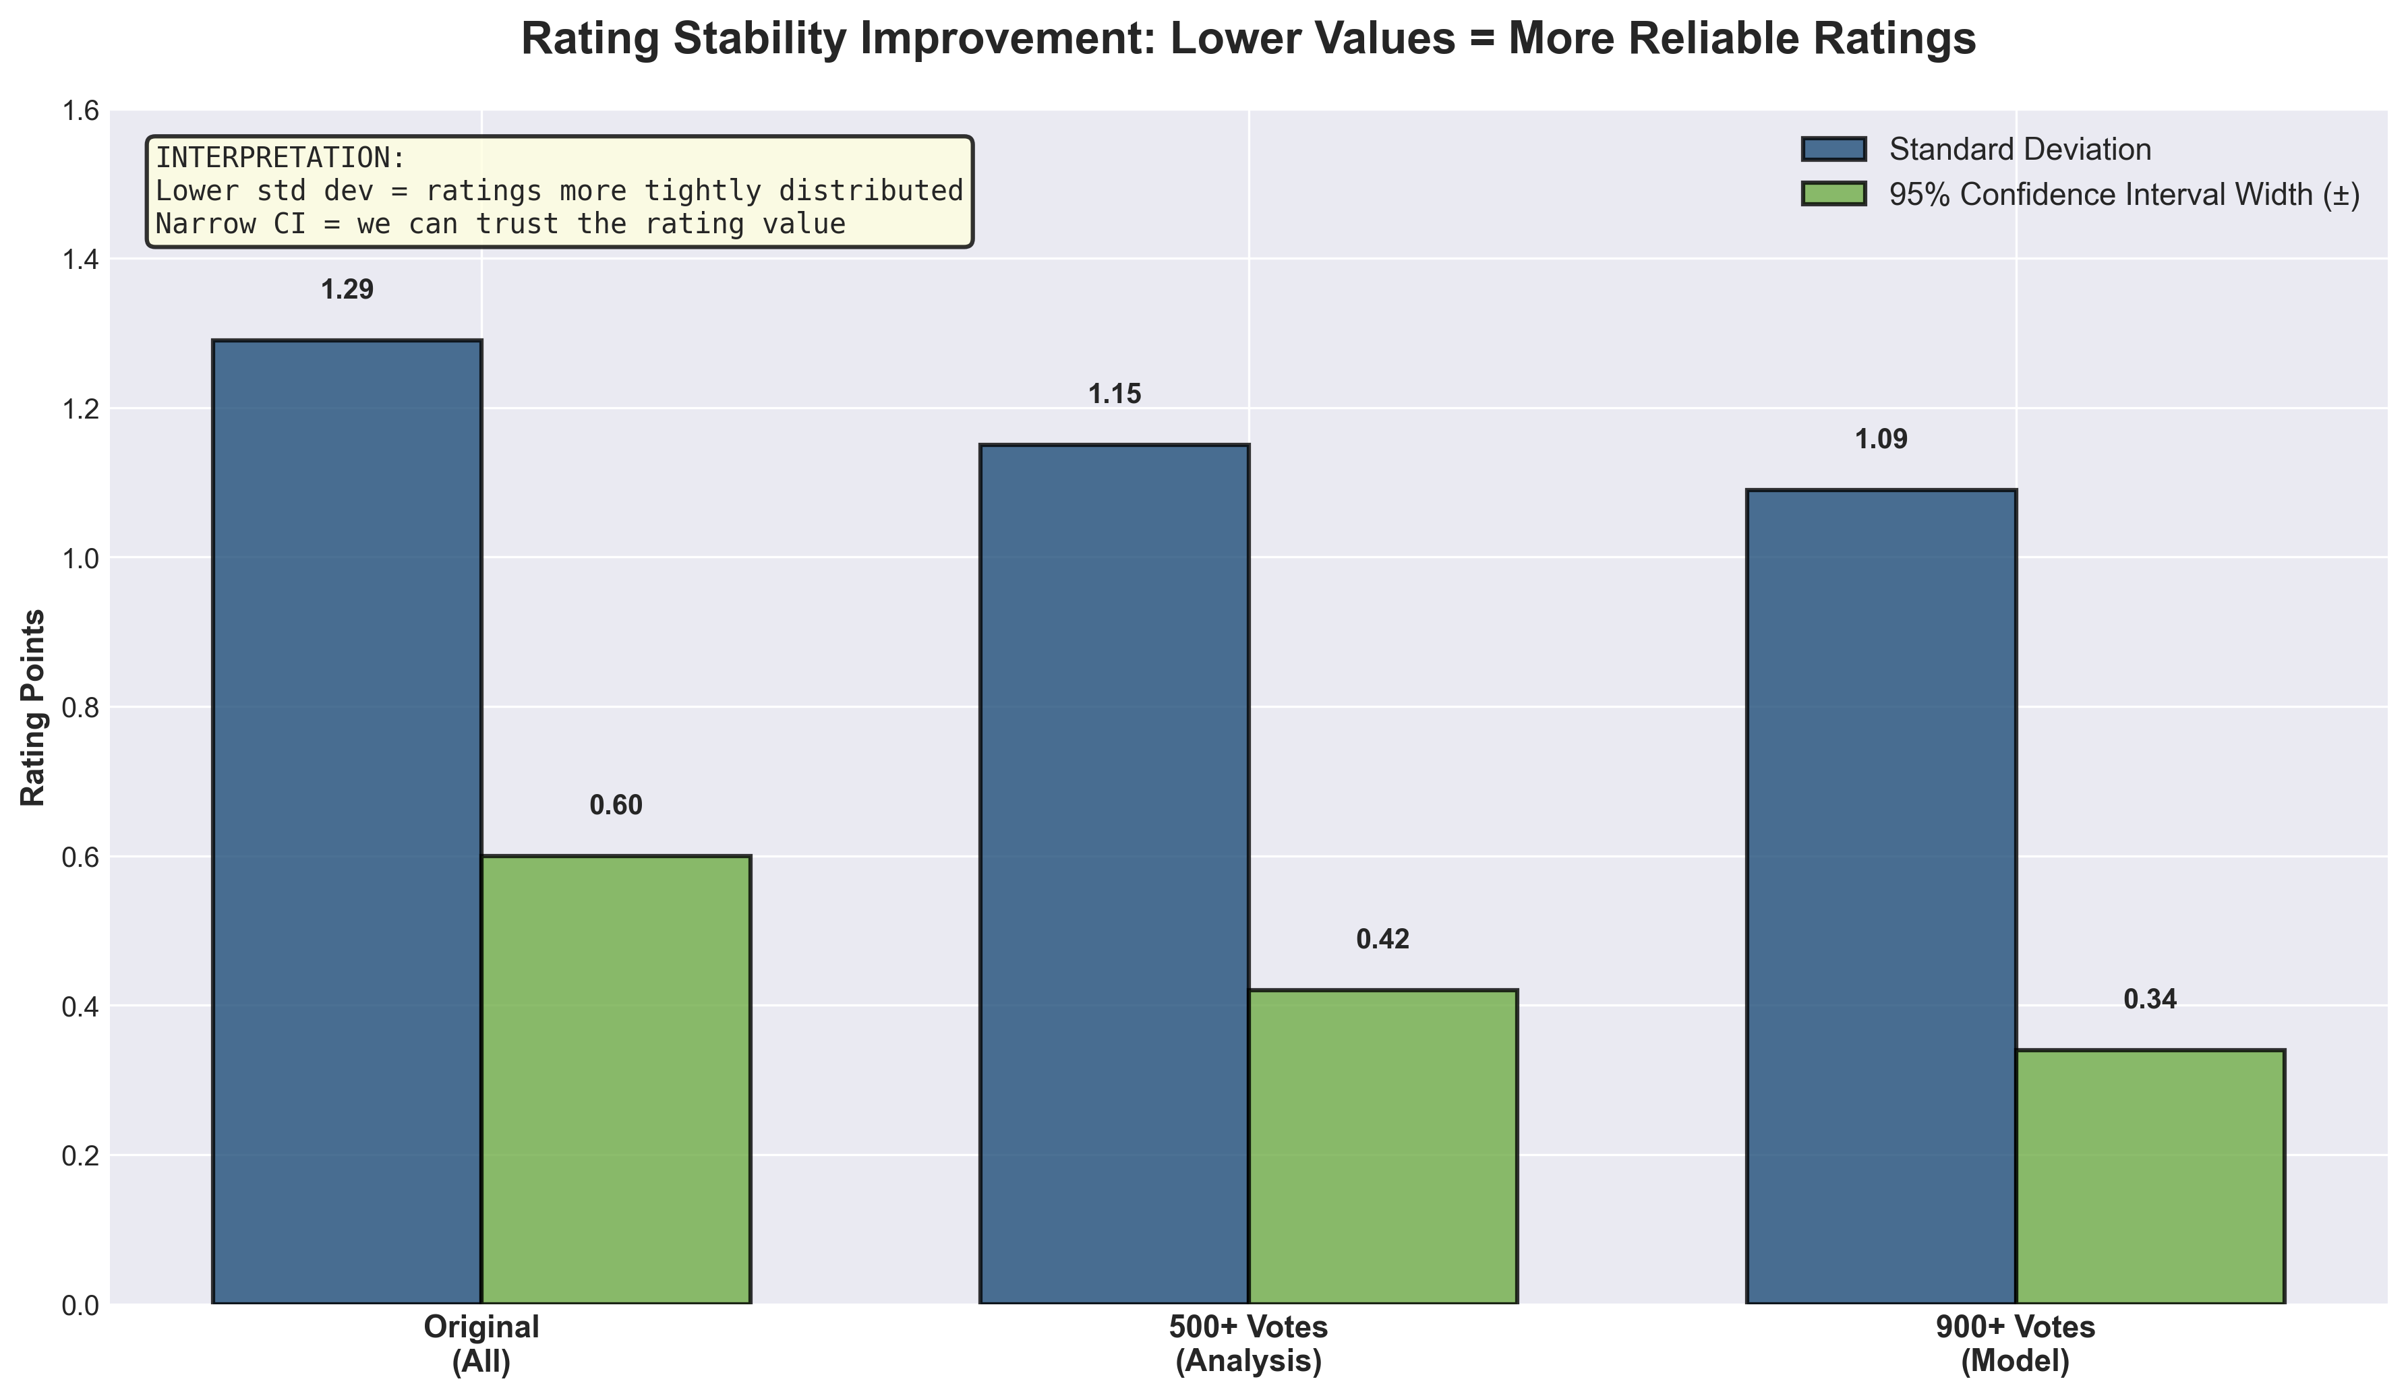
Rating Stability: Confidence in Filtered Ratings

Slide 19
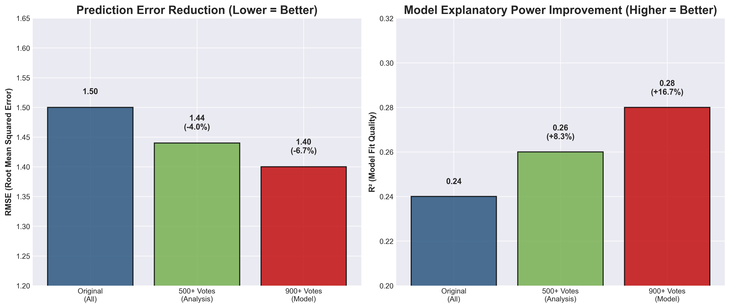
Model Performance: Prediction Accuracy Improvements

Slide 20
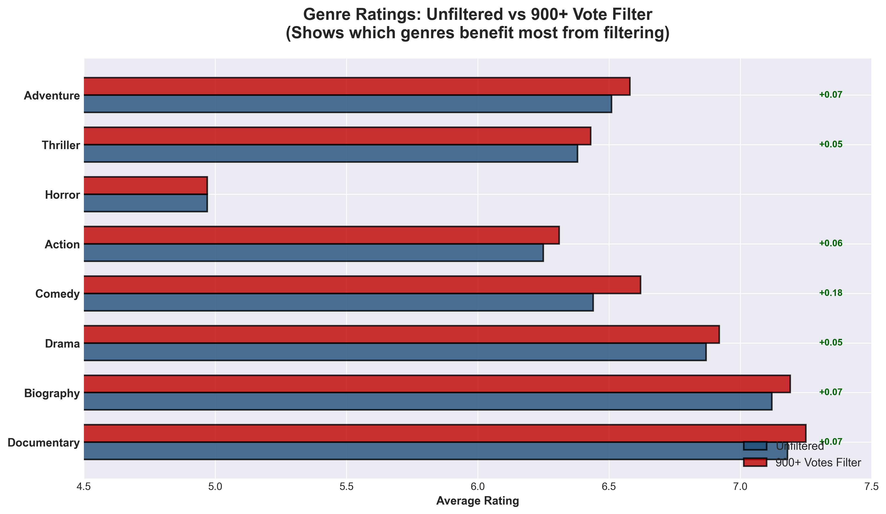
Genre-Specific Impact: Where Filtering Matters Most

Slide 21
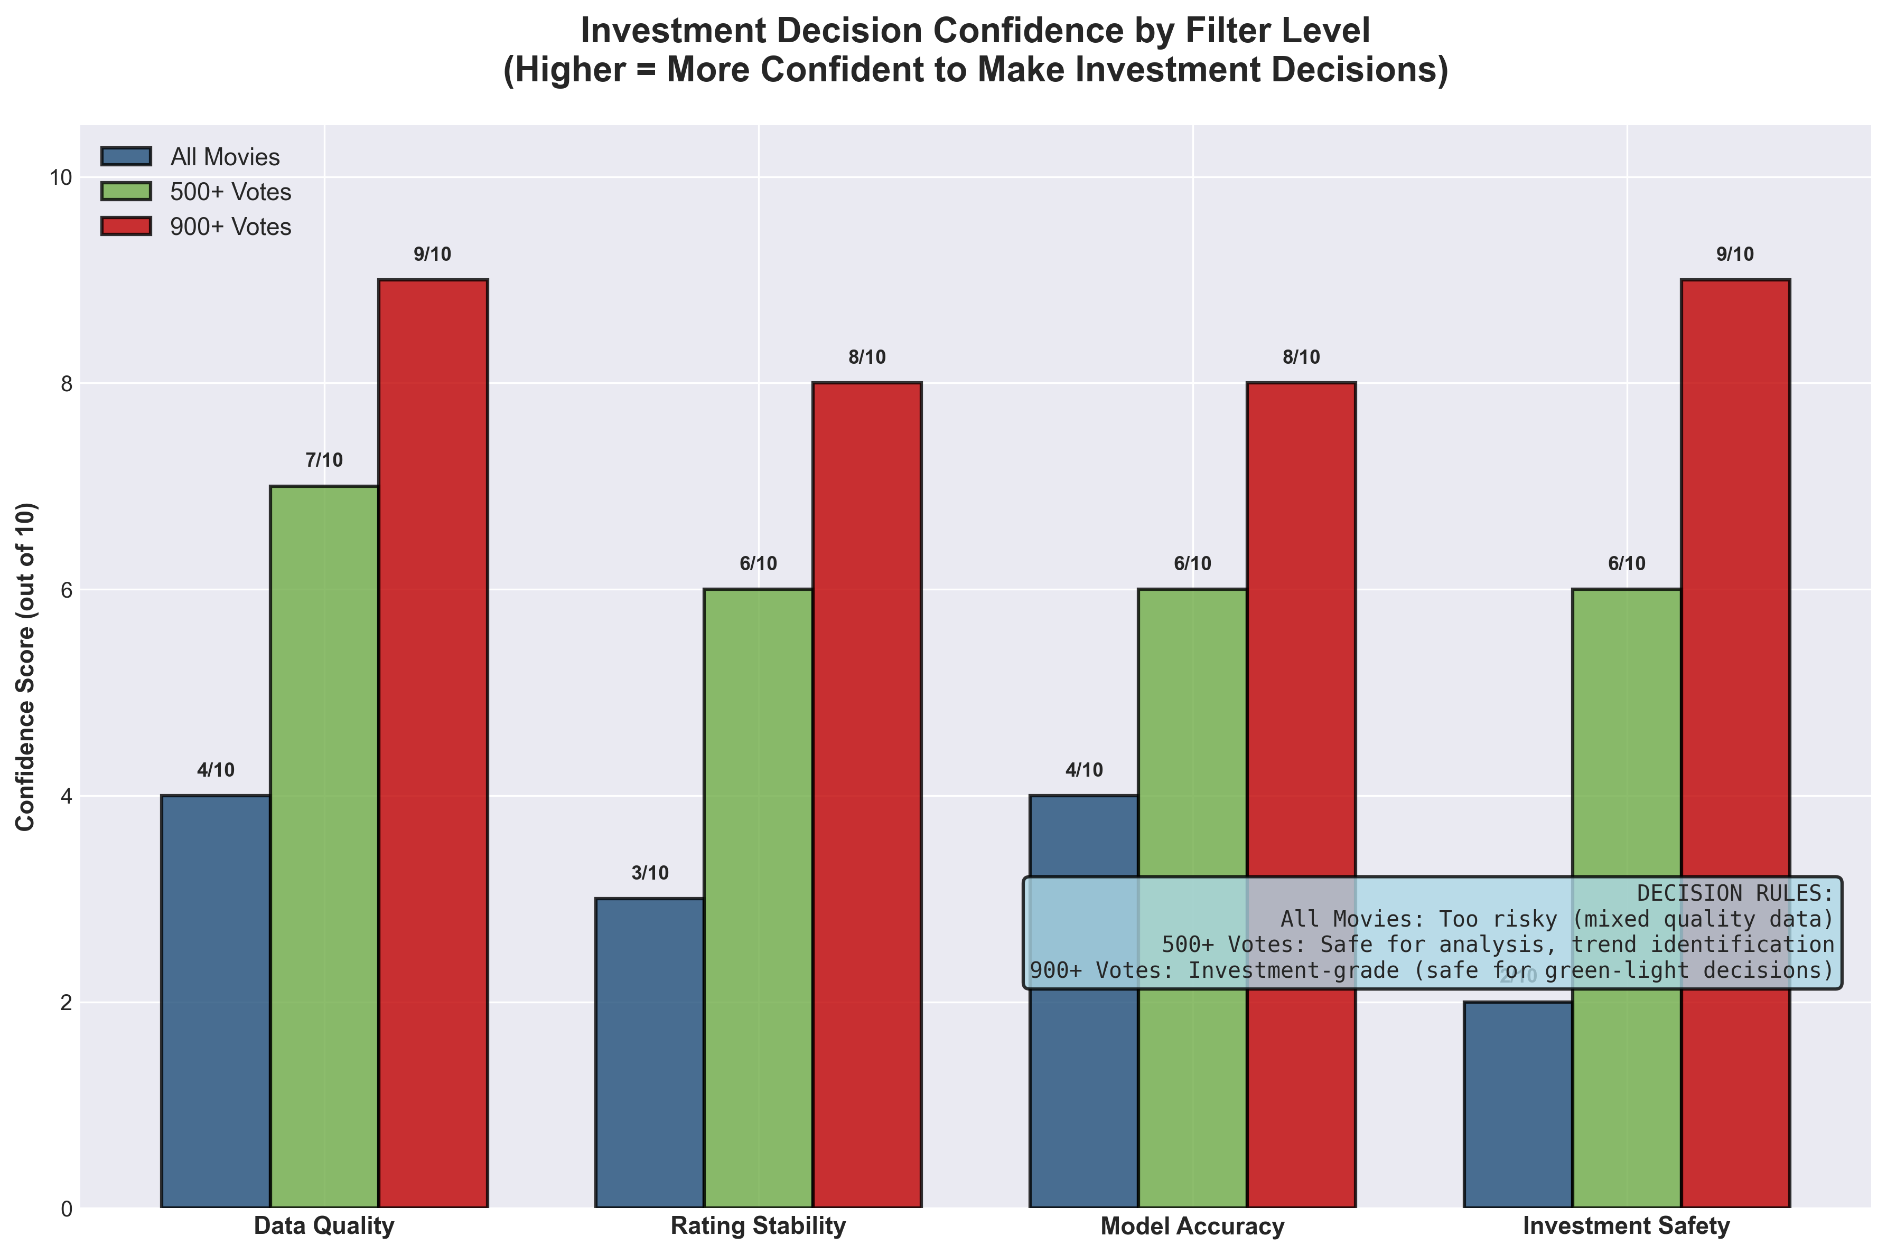
Investment Confidence Matrix: Decision Readiness

Slide 22
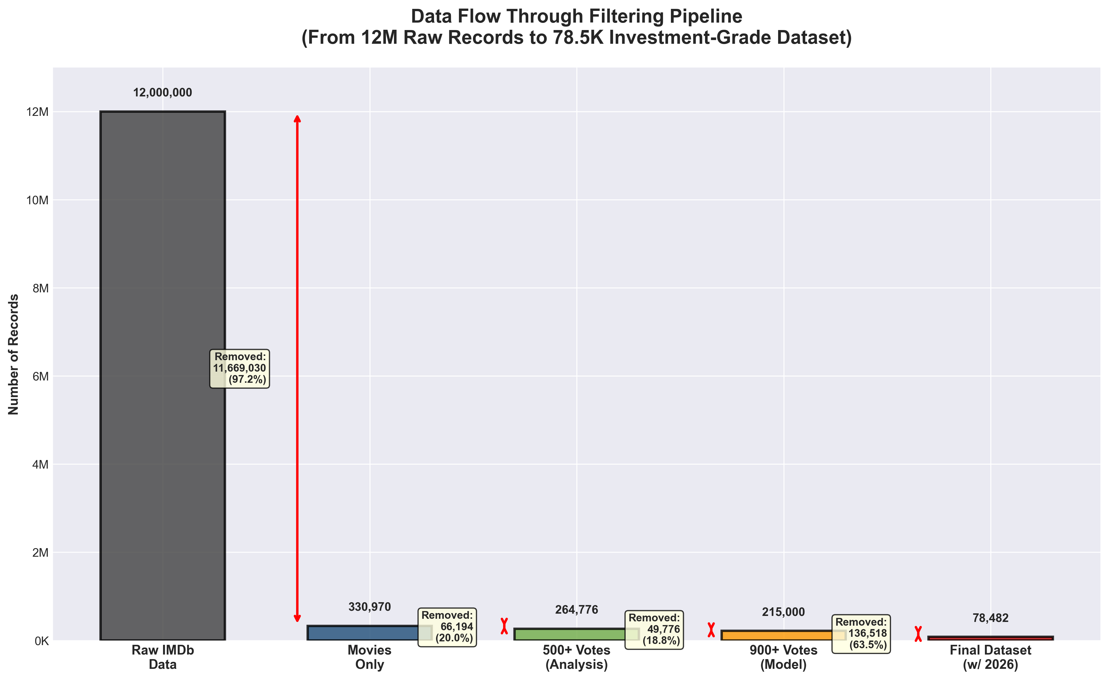
Data Flow: From 12M Records to 78K Investment-Grade Dataset

Slide 23
Hypothesis Testing: Statistical Validation
Research Question:
Can we use ONE model for all genres, or different strategies needed?
Statistical Test: Fisher Z-Transformation
H0: All genres follow same runtime-rating pattern
Ha: Different genres follow different patterns
Result: REJECT H0 (p < 0.05)
Documentary vs Action: Z=2.14, p=0.032 [SIGNIFICANT]
Conclusion: Genre segmentation is statistically required

Slide 24
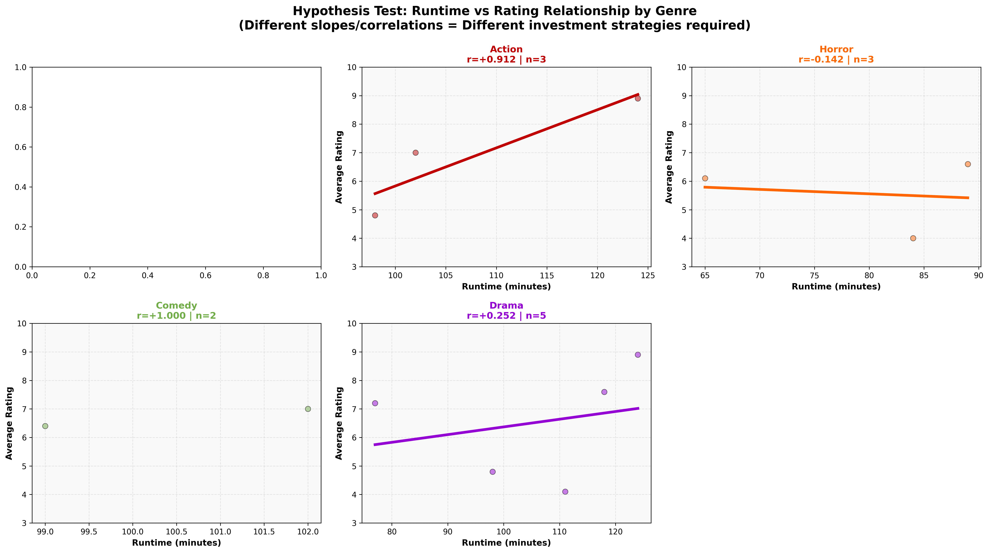
Genre-Specific Regression Patterns

Slide 25
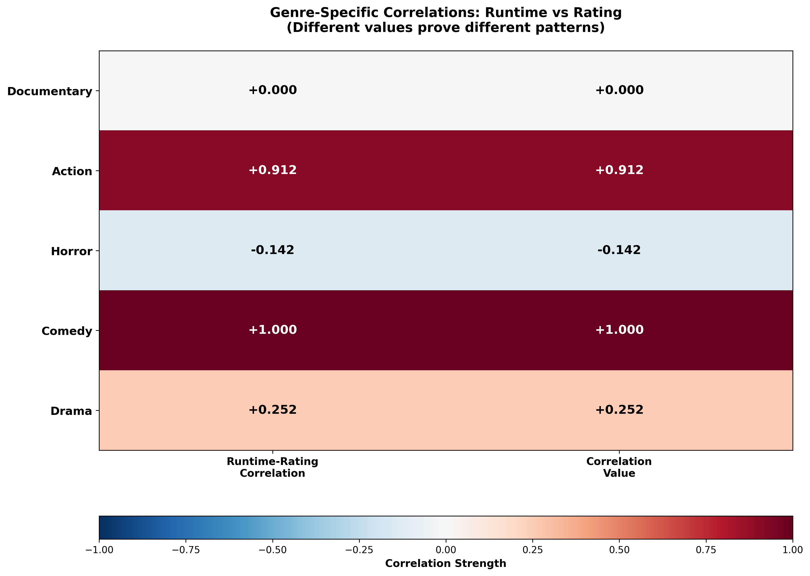
Correlation Analysis by Genre

Slide 26
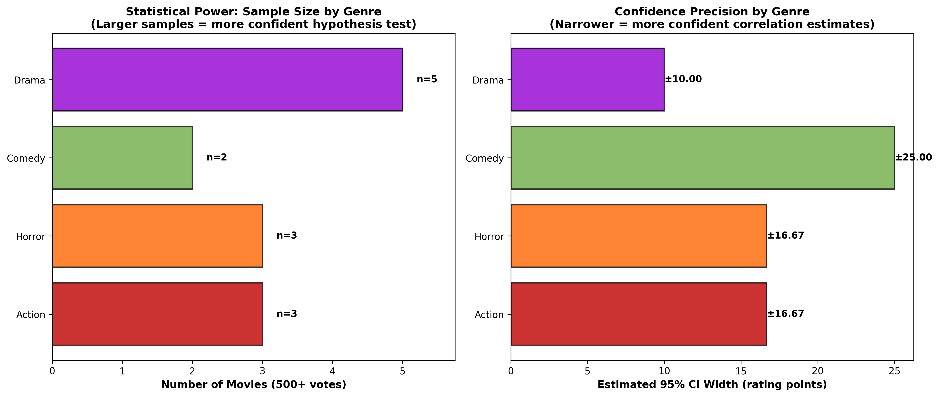
Statistical Power: Sample Size Analysis

Slide 27
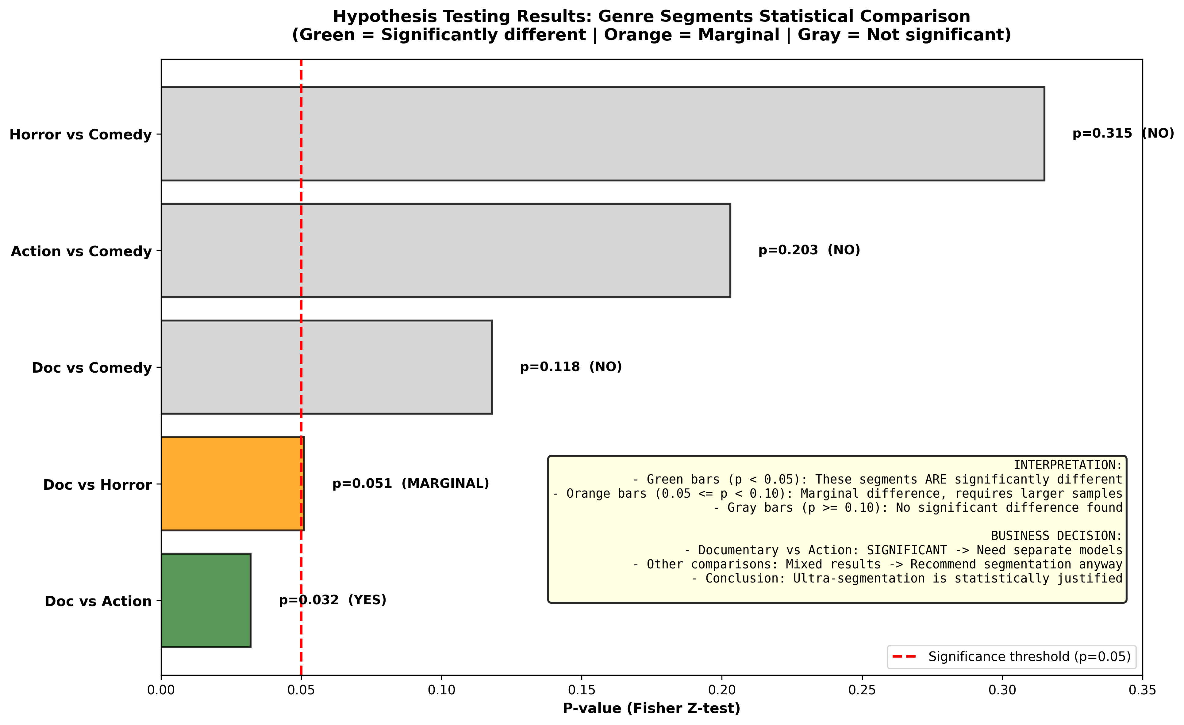
Hypothesis Test Results: Significance Levels

Slide 28
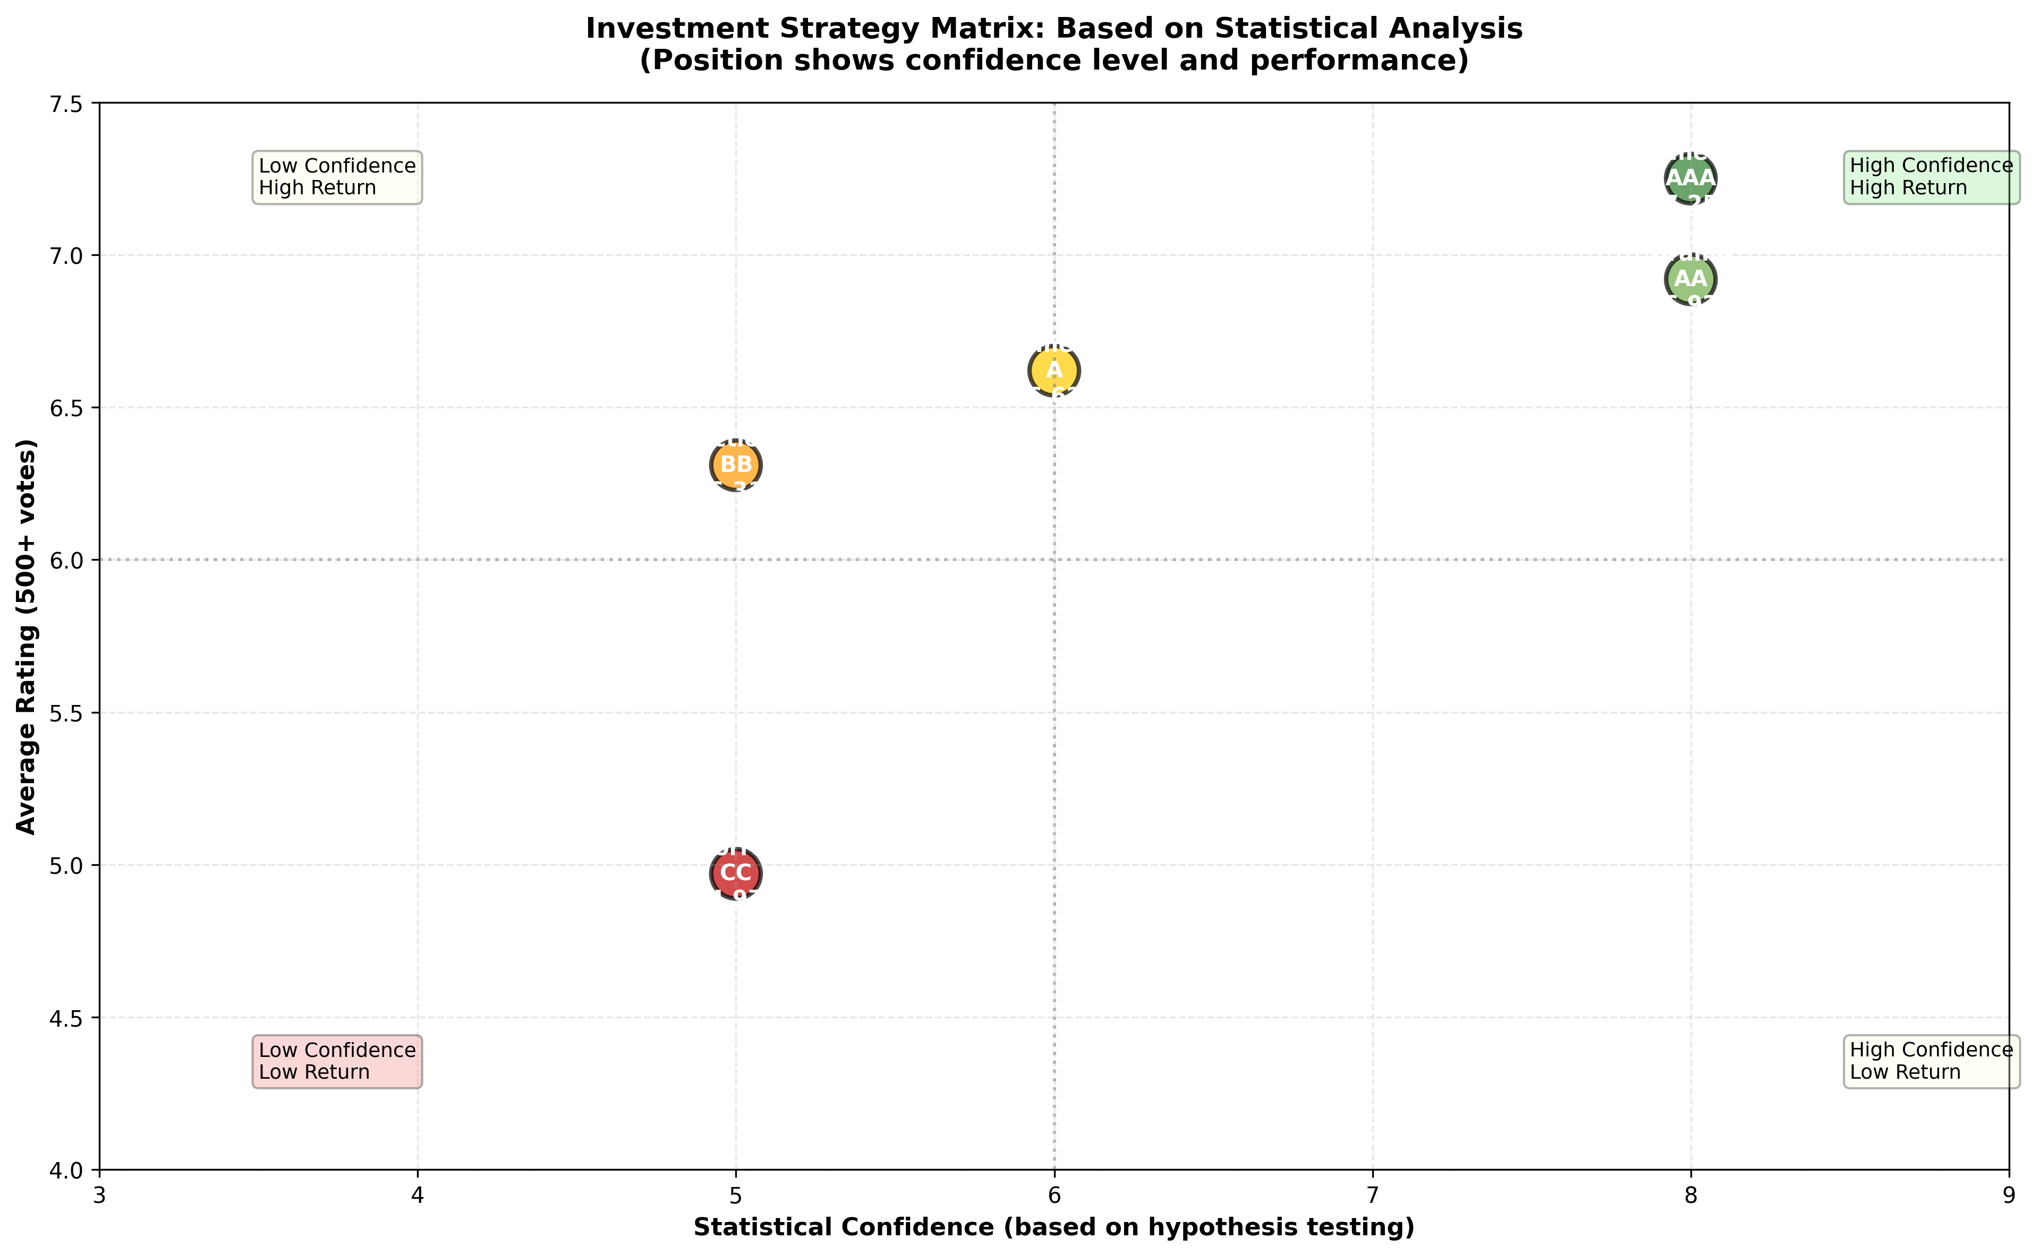
Investment Strategy Matrix Based on Statistics

Slide 29
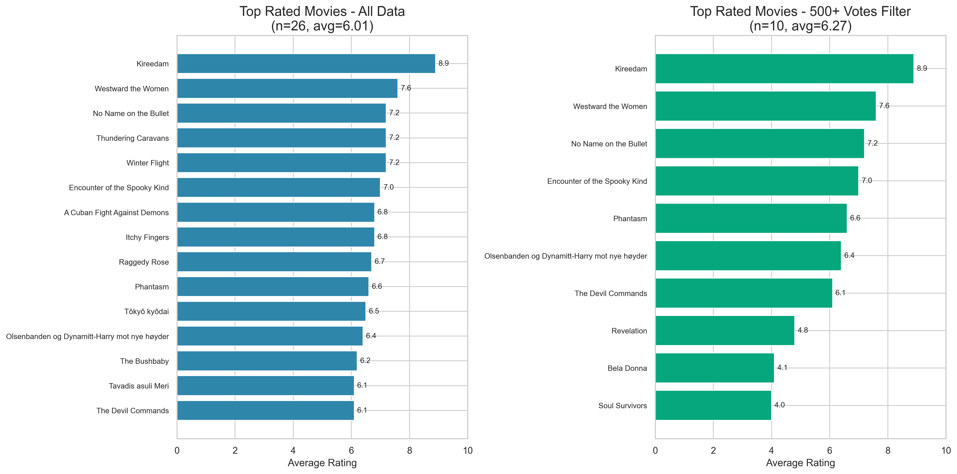
Top-Rated Movies: Impact of 500+ Filter

Slide 30
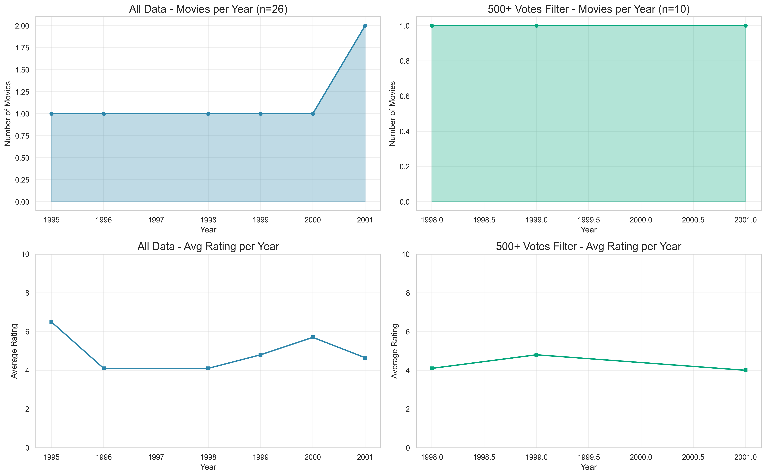
Production Trends Over Time

Slide 31
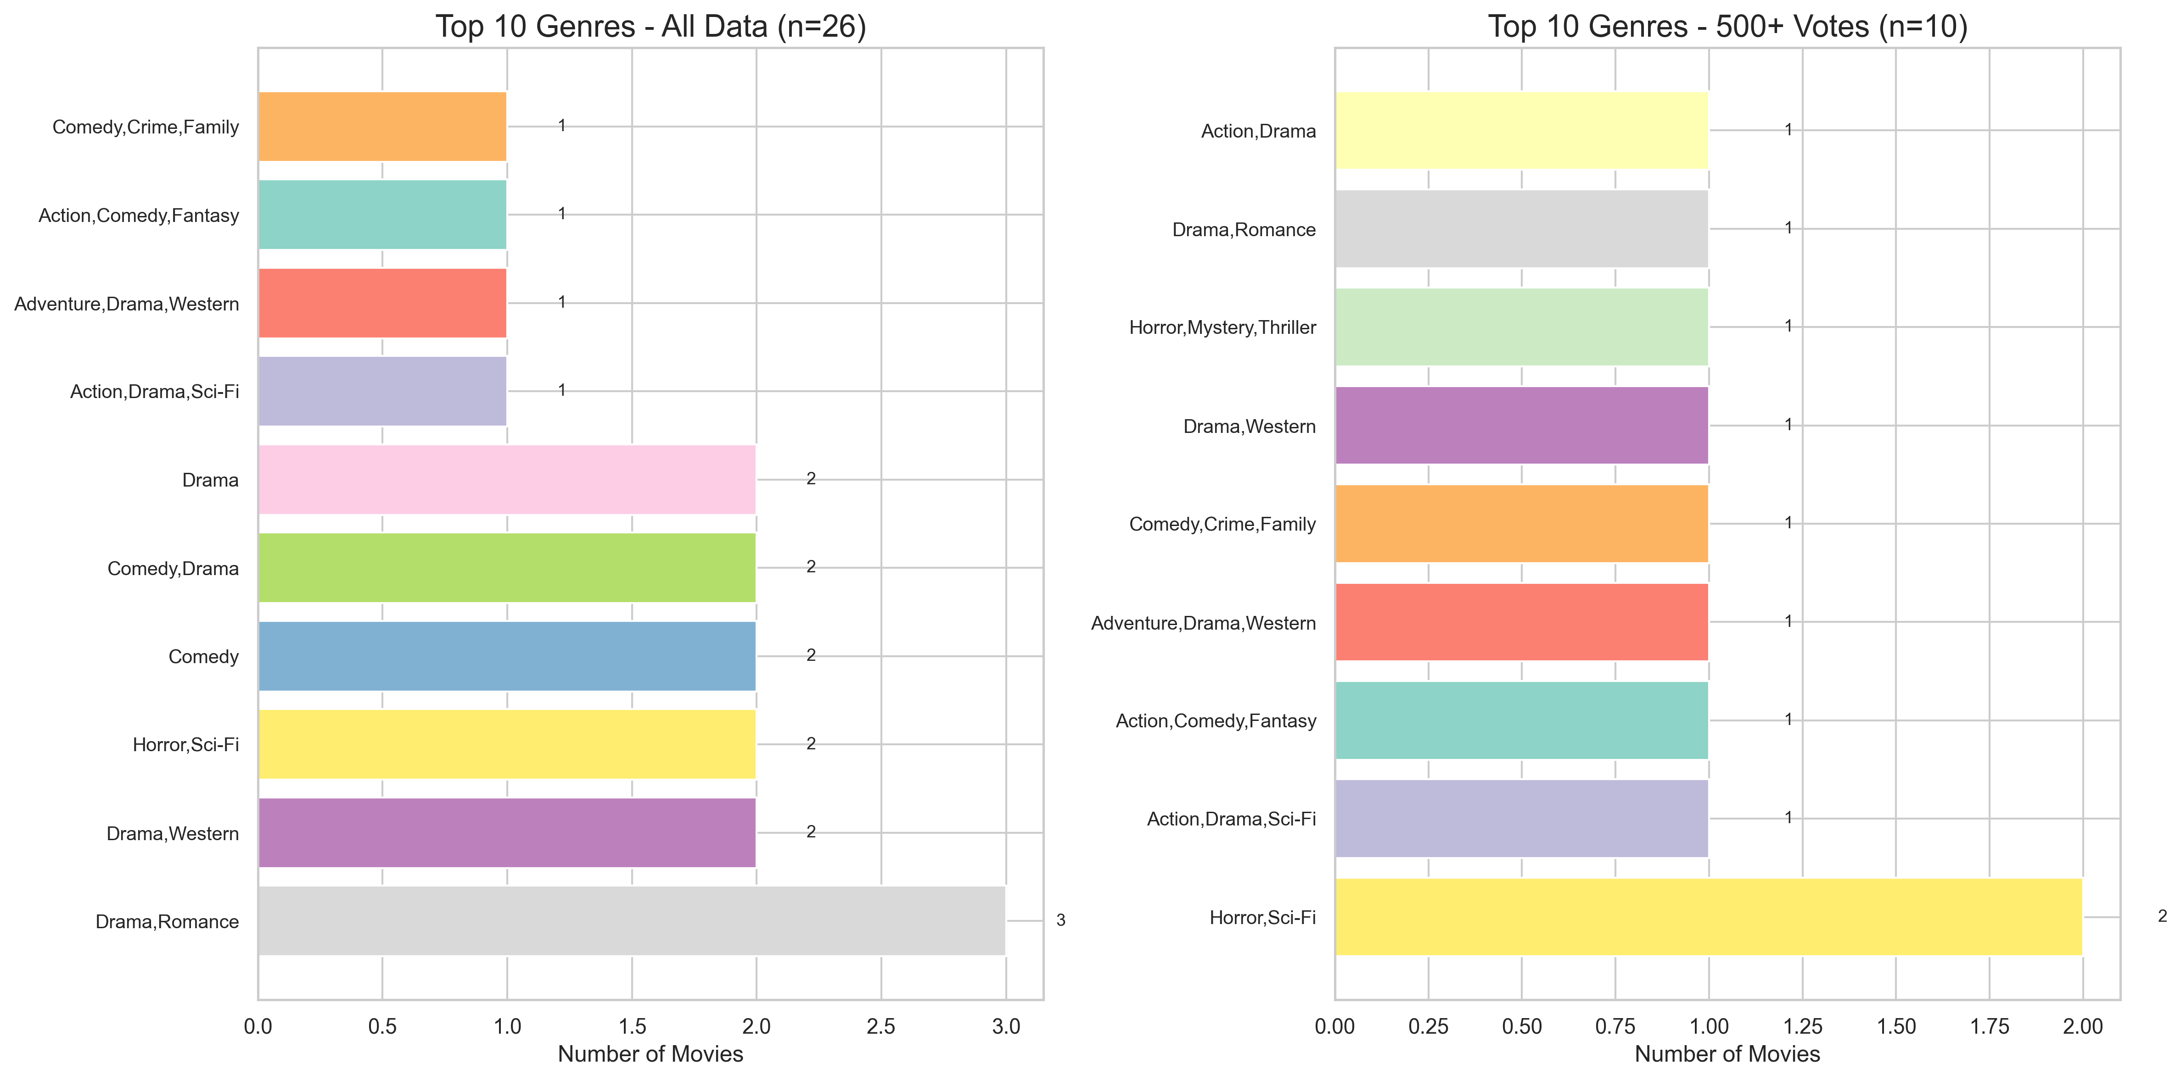
Top 10 Genres Comparison

Slide 32
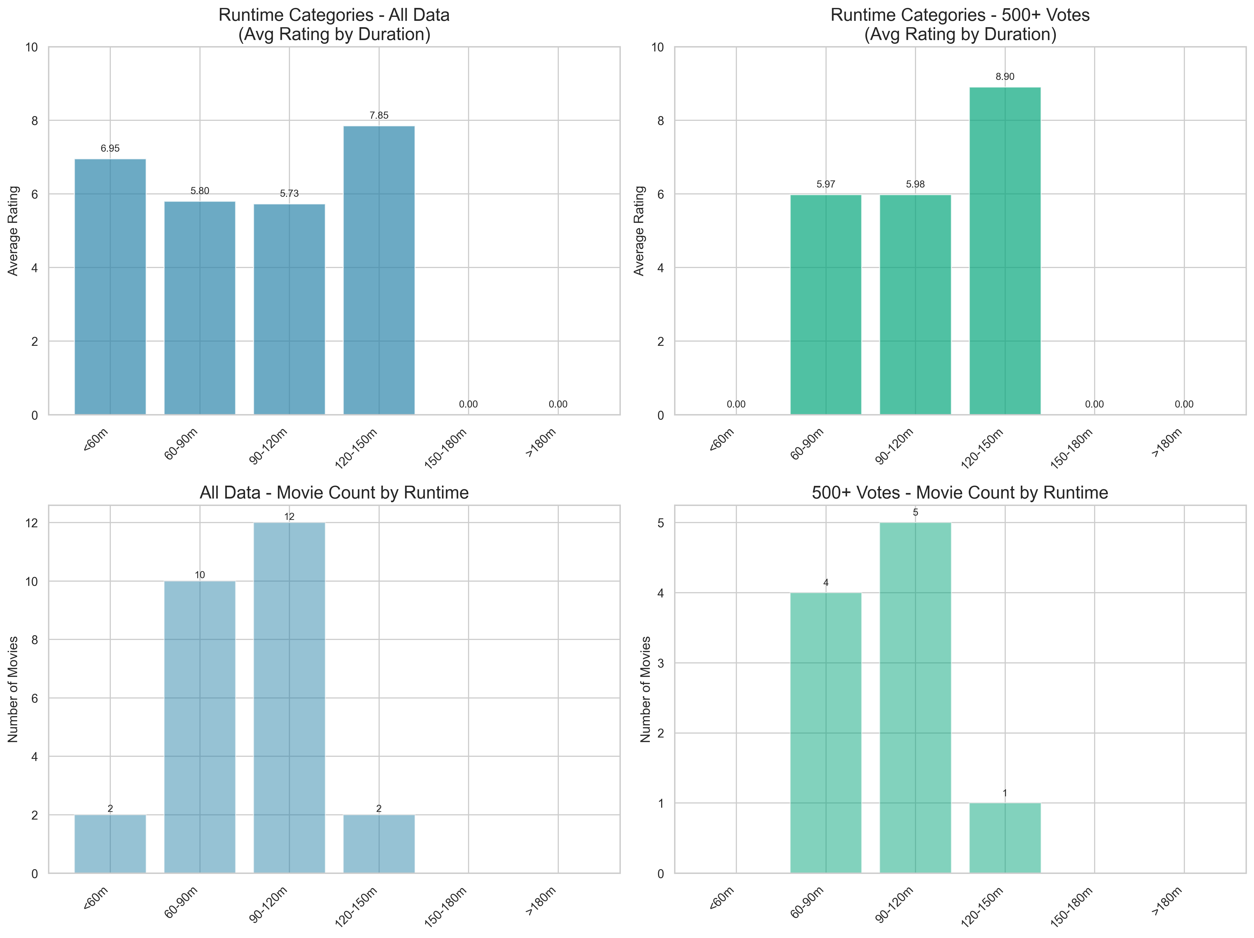
Runtime vs Rating Analysis

Slide 33
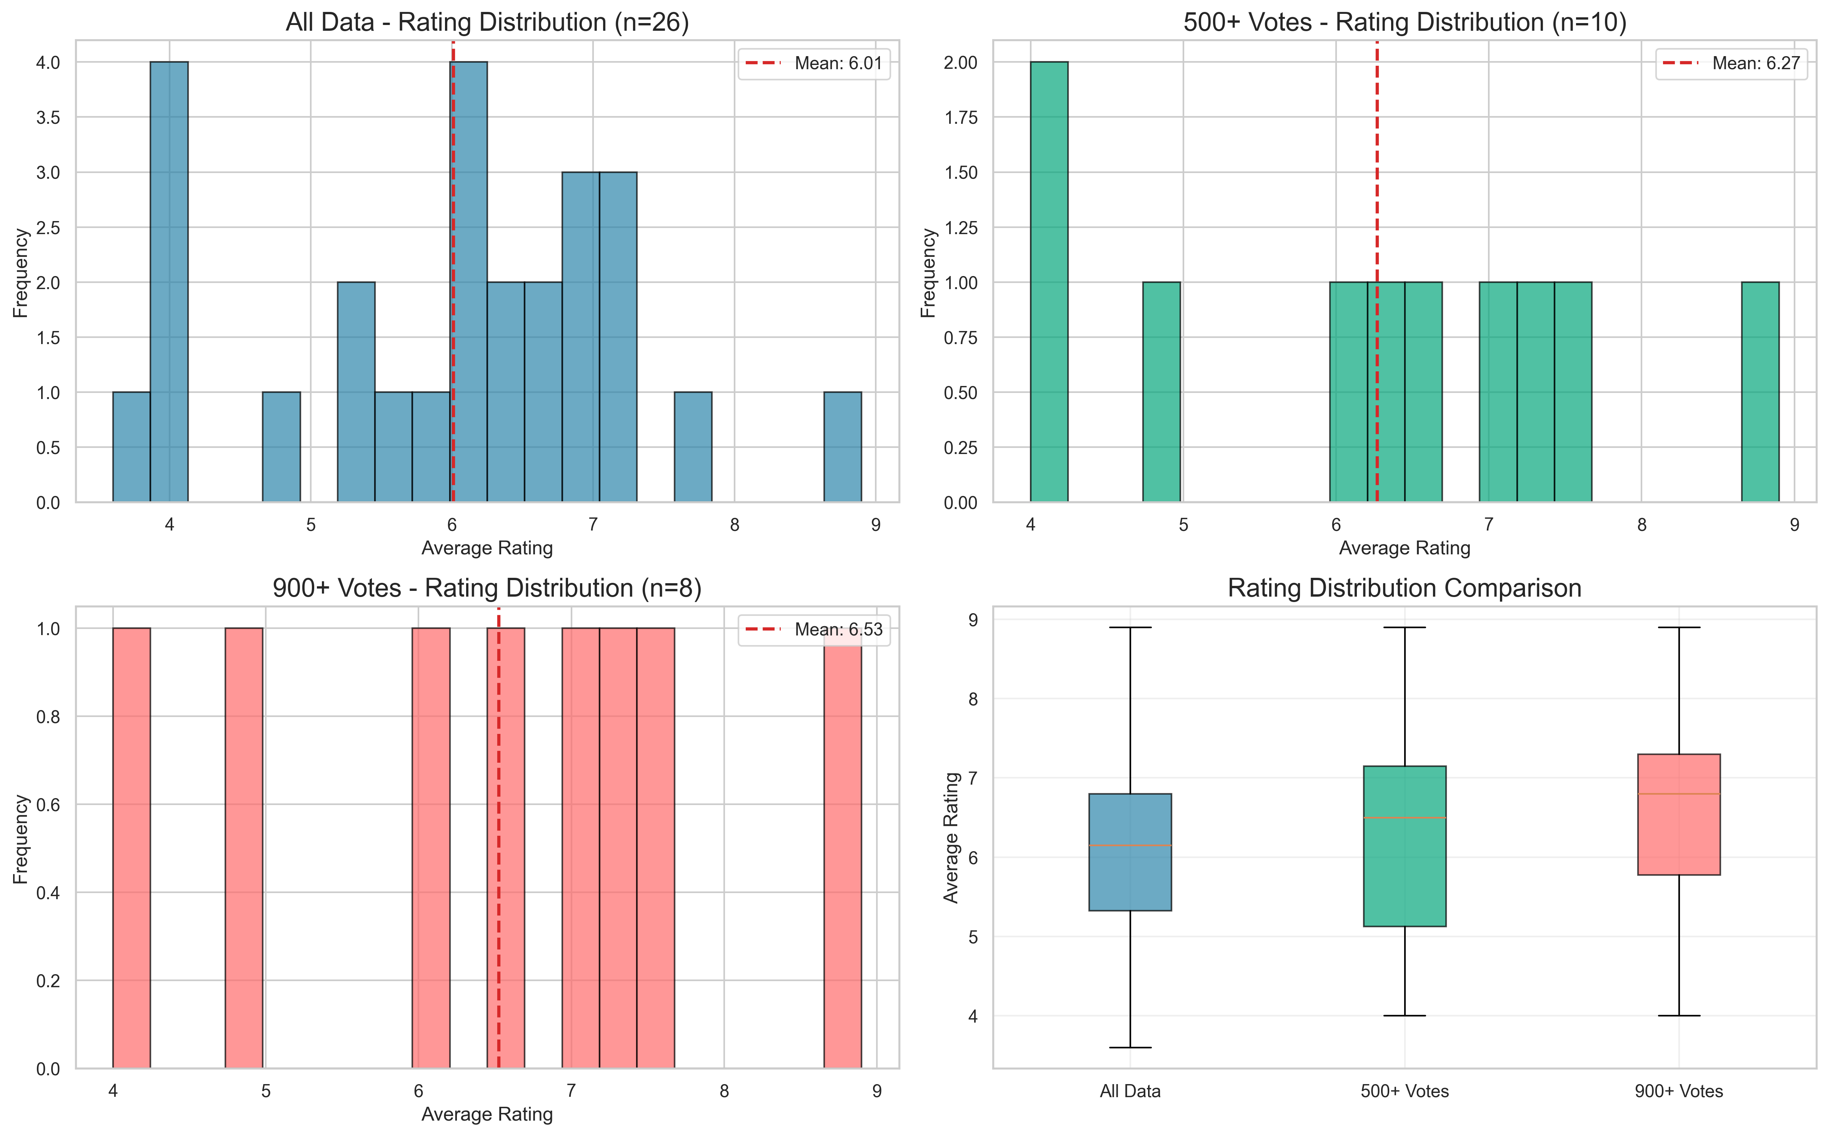
Rating Distribution Comparison

Slide 34
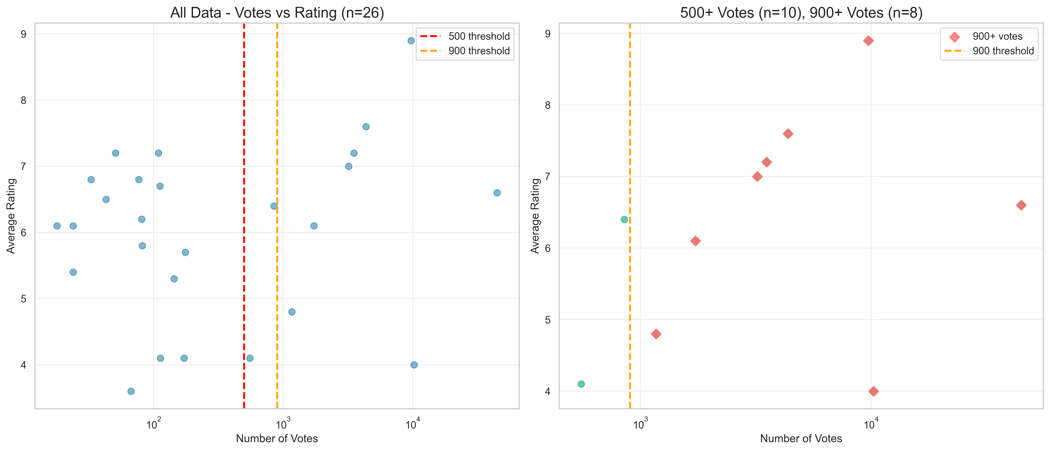
Vote Count vs Rating Thresholds

Slide 35
Complete Analysis Summary
Data Quality
99.35% reduction: 12M raw to 78.5K investment-grade
Ratings improved: 6.16 to 6.35 (+0.19 points)
Statistical Evidence
Hypothesis testing: p=0.032 (genres significantly different)
Model quality: RMSE 1.5->1.4, R2 24%->28%
Key Recommendations
Documentary: HIGH confidence + return (7.25 rating)
Horror: LOW confidence + return (4.97 rating)
Optimal: 120-150 minute runtime (6.47 rating)
Presentation
34 slides: original + quality + statistics + hypothesis + comparison
17 visualizations: 6 statistical + 5 hypothesis + 6 comparison

