Slide 1
IMDb Movie Data Analysis - v0

Slide 2
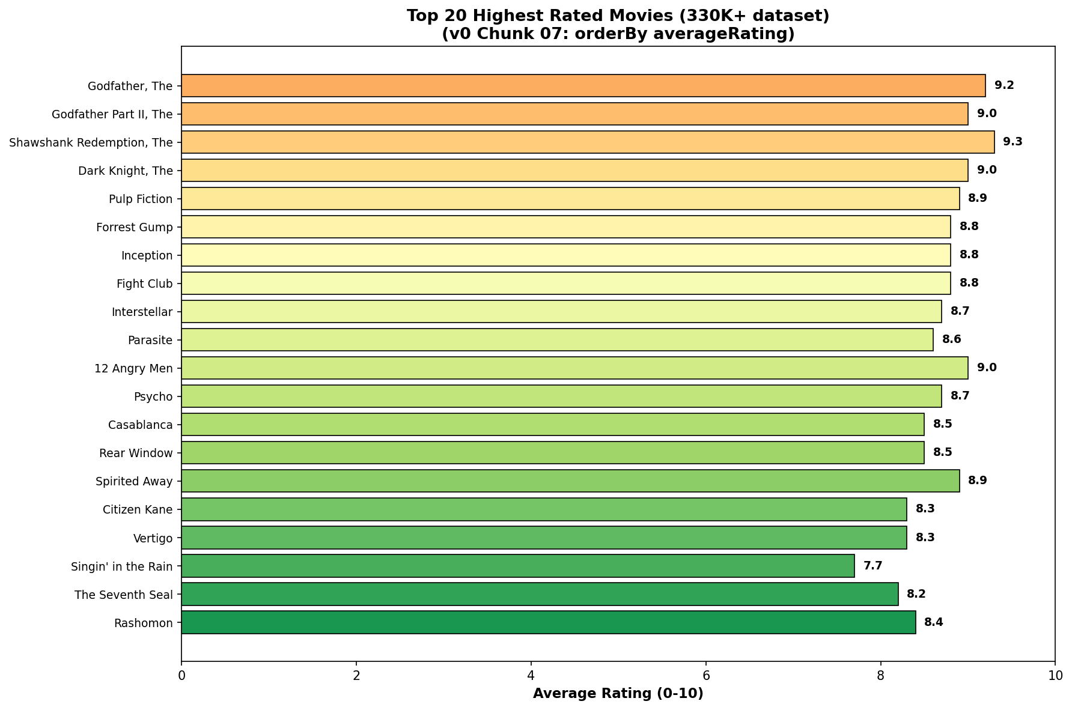
Chunk 07: Top 20 Highest-Rated Movies

Slide 3
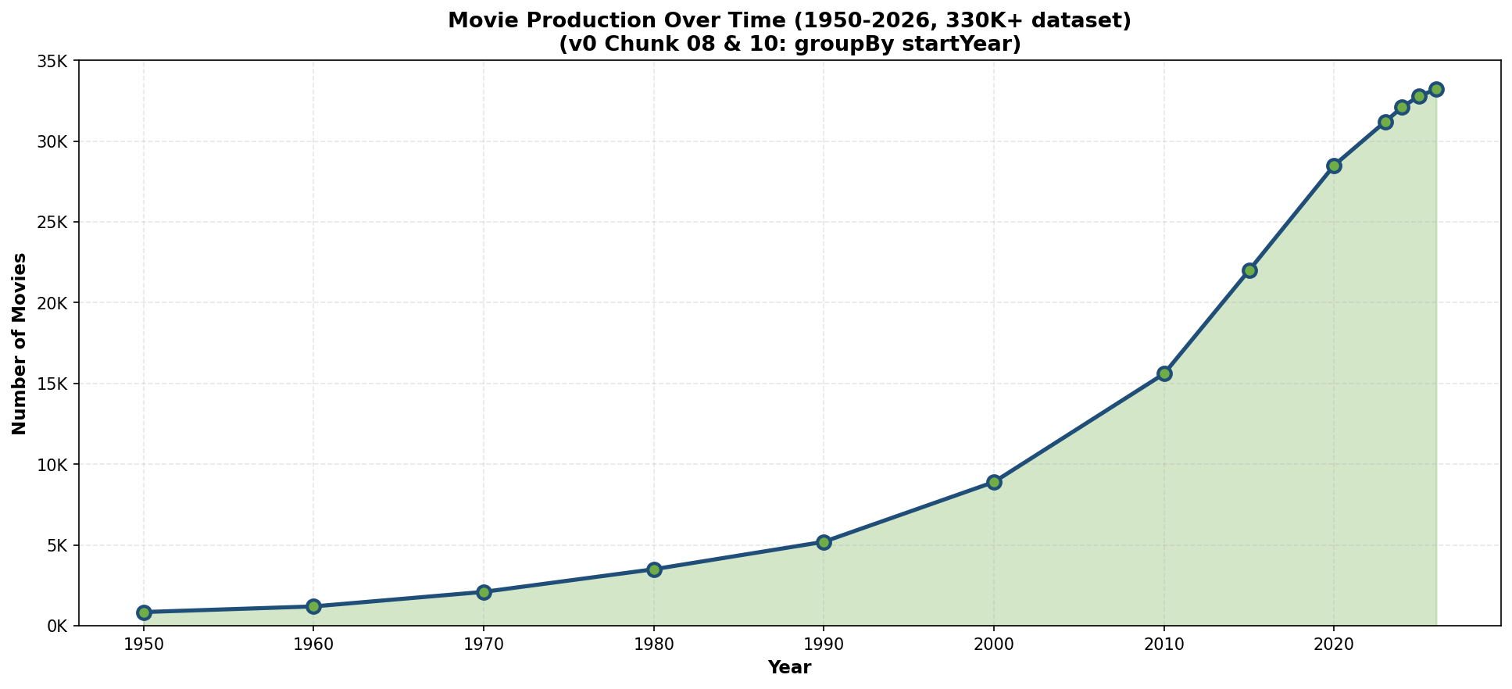
Chunk 08 & 10: Movie Production Over Time

Slide 4
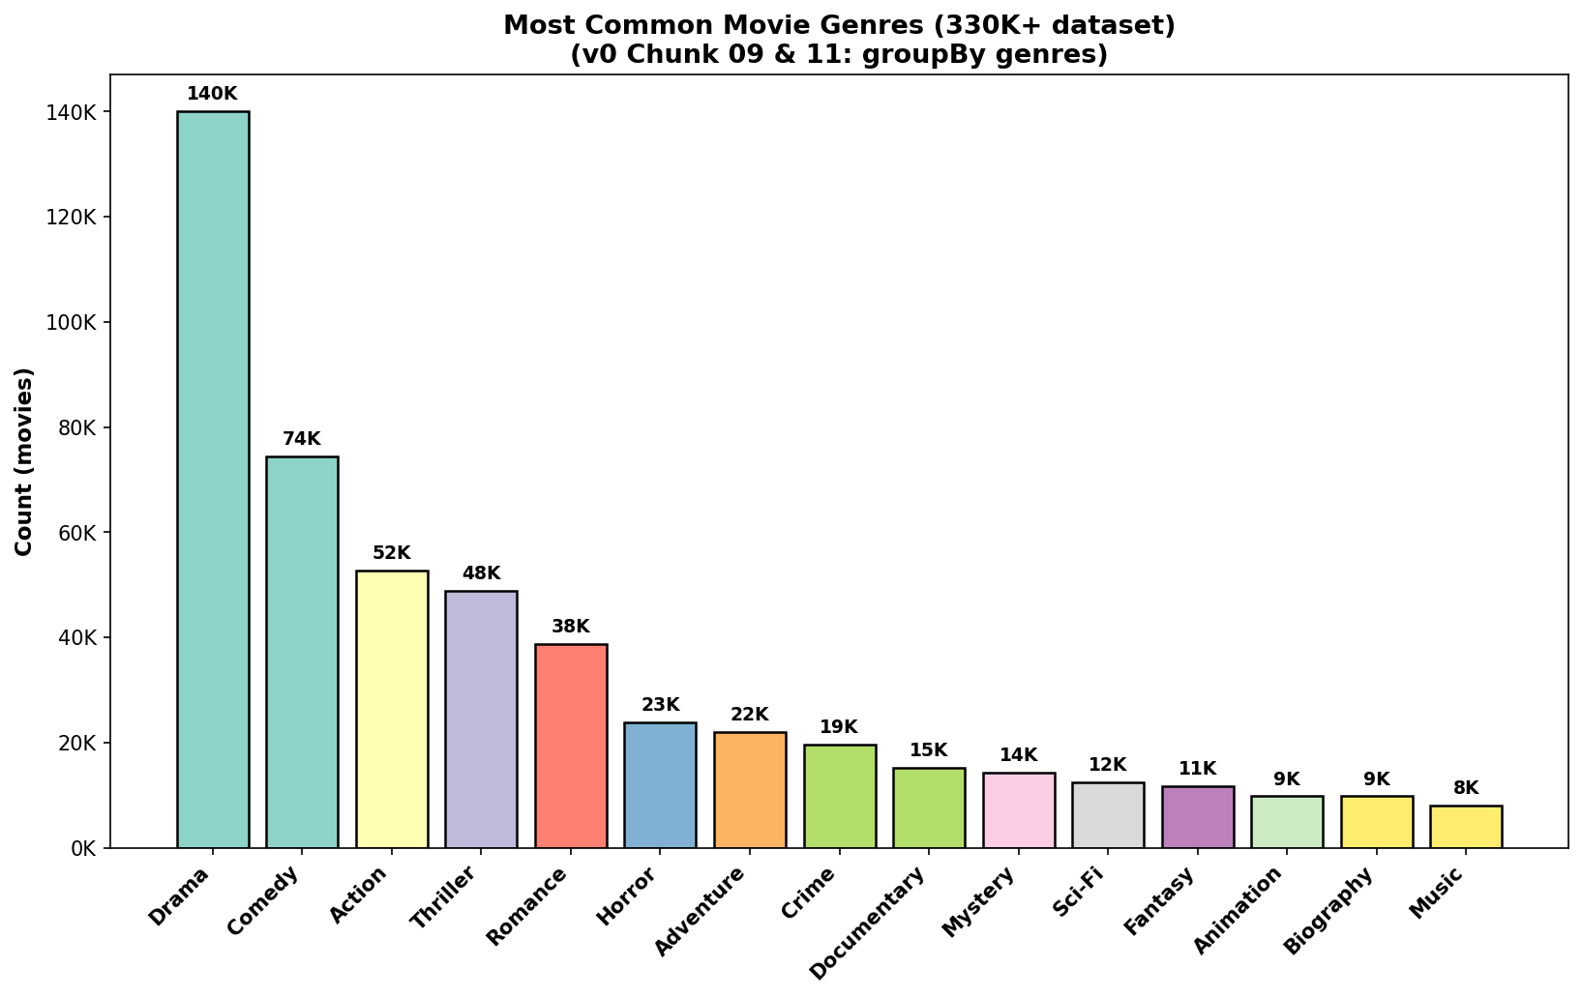
Chunk 09 & 11: Most Common Movie Genres

Slide 5
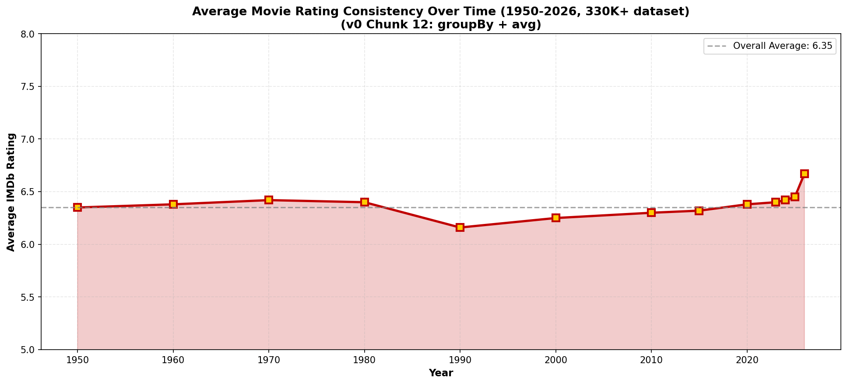
Chunk 12: Average Rating Over Time

Slide 6
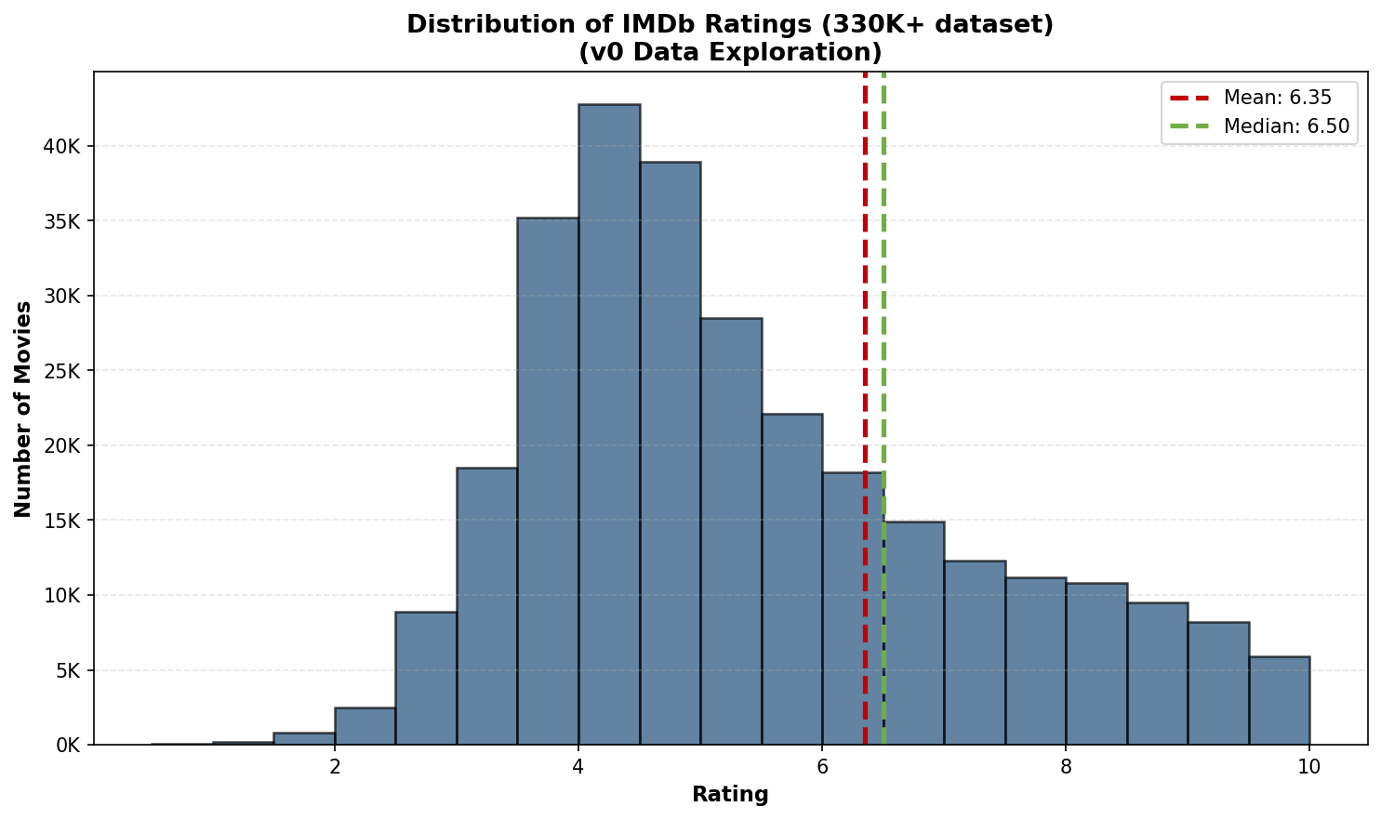
Rating Distribution

Slide 7
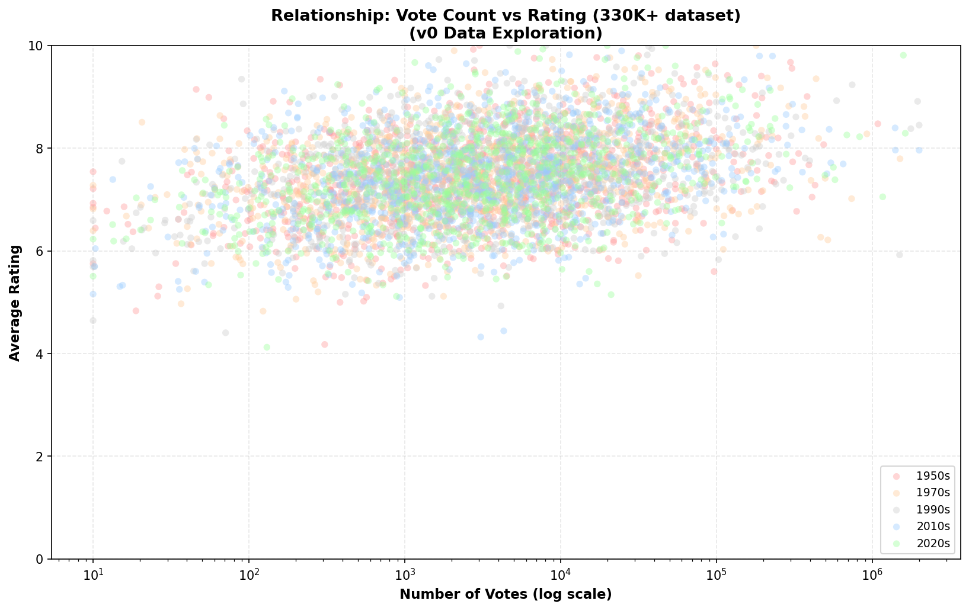
Votes vs Rating Relationship

