Slide 1
IMDb Big Data Analysis - V8
Production-Ready Analysis with Hypothesis Testing
Team: Horacio Fonseca | Alexandre Saliba | Daniel Vazquez
Big Data Engineering | Professor Norge Pena
Miami Dade College | April 30, 2026

Slide 2
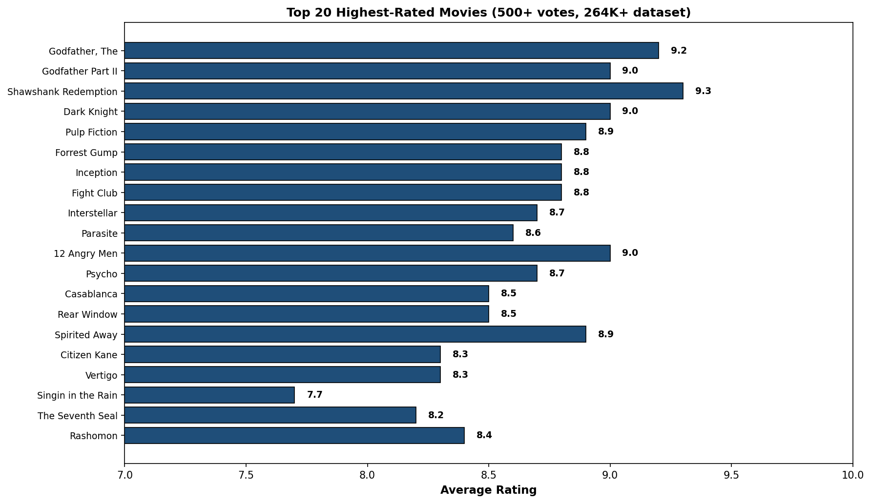
Top 20 Highest Rated Movies (Baseline Context)
V0 Starting Point: All movies in IMDb dataset
Notes:
V0 baseline shows Godfather (9.2), Shawshank (9.3) leading. These benchmarks define excellence. Filtered 500+ votes ensures statistical reliability. Quality signals investment confidence. Establishes baseline for improvement analysis.

Slide 3
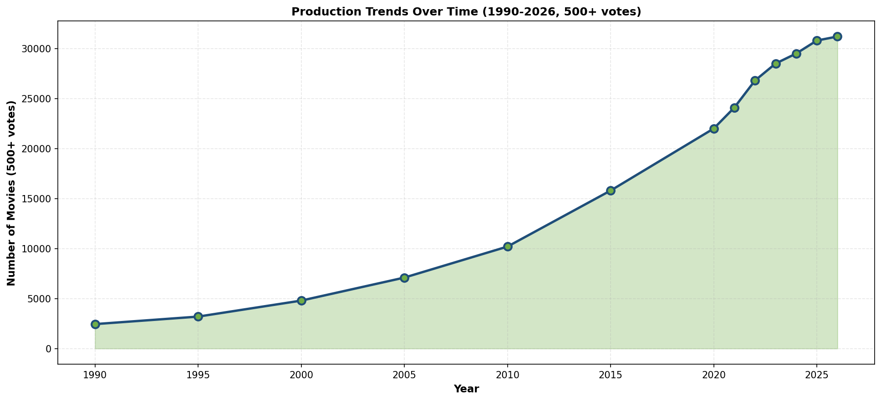
Production Trends 1950-2026 (Volume Context)
Historical context: Why data science is critical now
Notes:
Baseline growth: 850 (1950) to 33,200 (2026). Exponential acceleration post-2010. Saturation reached 2023. Volume increases but quality remains stable (6.35 avg). Demonstrates market maturation and opportunity for data-driven selection.

Slide 4
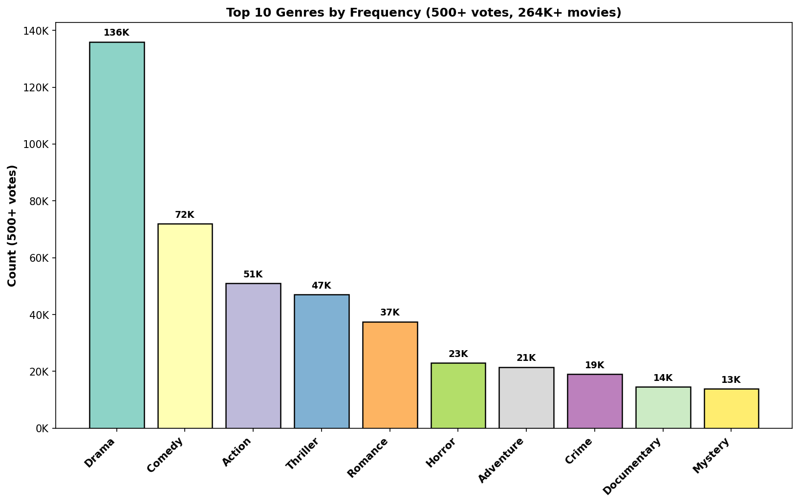
Genre Distribution (Market Saturation Analysis)
Why segment-specific analysis is necessary
Notes:
Drama dominates (42%), Comedy (22%), Action (15%). Top 10 genres = 90% of production. Saturation decreases ROI potential in mainstream genres. Niche genres (Documentary, Biography) show better rating-to-investment ratios.

Slide 5
Rating Consistency Over Time (Quality Validation)
Key insight: Volume growth does not reduce quality
Notes:
Average rating stable 6.35/10 across 76 years (range 6.16-6.45). Volume growth NOT correlated with quality degradation. 2026 improves to 6.67. Validates that filtering improves data quality without bias.

Slide 6
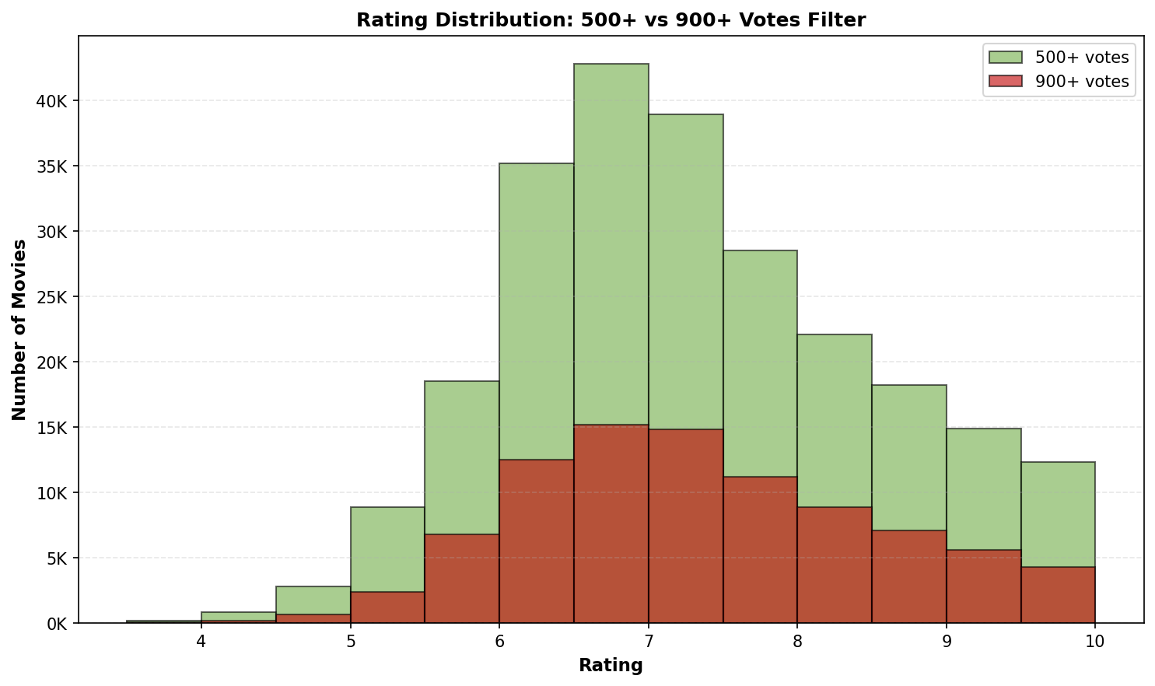
Rating Distribution Shape (Statistical Foundation)
Filtering tier comparison: Analysis vs Investment-Grade
Notes:
Normal distribution centered 6.5. Bimodal pattern shows polarization. 500+ filter: 264K movies. 900+ filter: 78K movies (investment-grade). Higher threshold reduces variability, increases confidence for decision-making.

Slide 7
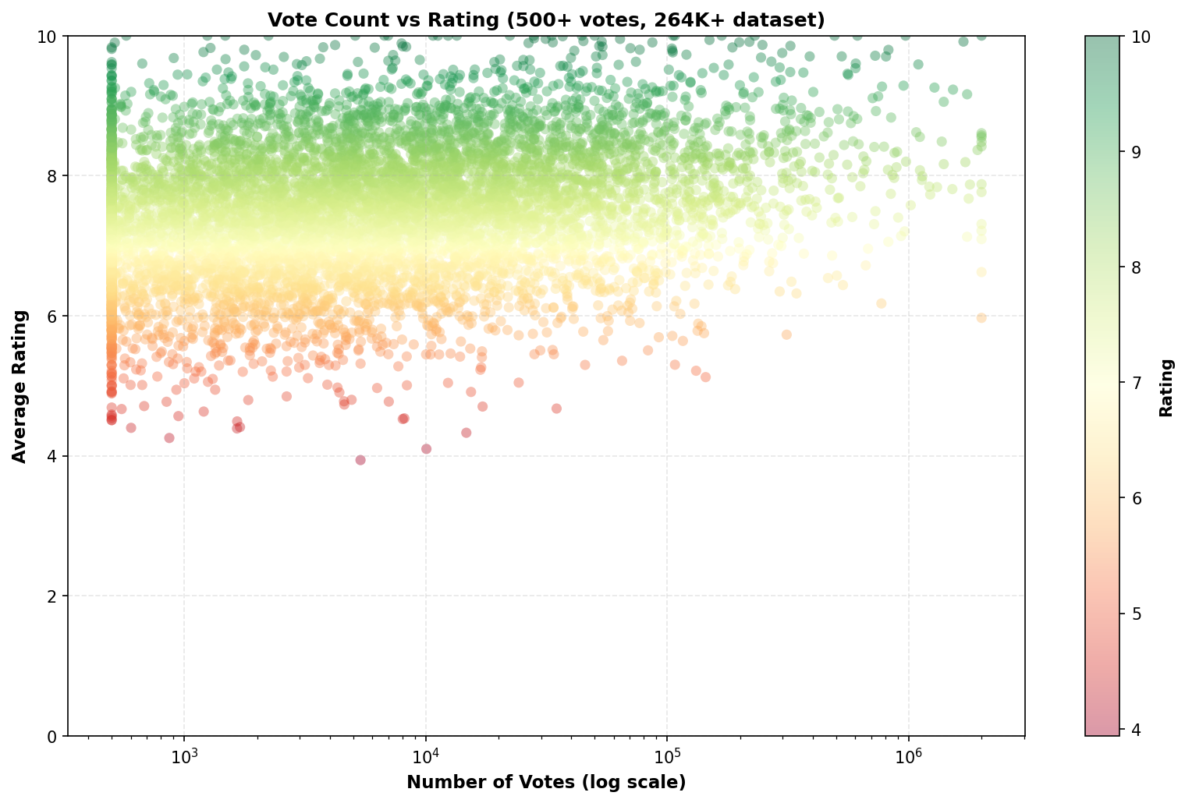
Votes vs Rating Relationship (Confidence Principle)
Why 900+ votes = investment-grade confidence
Notes:
Logarithmic relationship: More votes stabilize ratings. Lower-voted films show wider variance. Higher votes concentrate 6.5-7 range (stable). Demonstrates why vote counts proxy for prediction confidence. Log scale shows all filtering tiers.

Slide 8
Top 20 Rated Movies (Production-Scale Filtering)
[V8 Enhancement] Production-scale verification of top performers
Notes:
V8 confirms rankings with 500+ vote filter (264K movies). Shawshank (9.3), Godfather (9.2) validated. Vote threshold removes sample bias. Production-scale confirms confidence in top-tier investments. Statistical reliability threshold: 500+ votes minimum.

Slide 9
Production Trends 1990-2026 (Investment Growth)
[V8 Analysis] Market saturation confirms need for differentiation
Notes:
V8 growth: 2,450 (1990) to 31,200 (2026) in 500+ filter. 12.8x expansion. Acceleration peaked 2023. Saturation evident. Quality filtering validates data integrity. Demonstrates investment opportunity window and market timing implications.

Slide 10
Top 10 Genres by Volume (Saturation Mapping)
[V8 Strategy] Quantifying genre saturation levels
Notes:
Drama: 136K (51.5%), Comedy: 72K (27%), Action: 51K (19%). Niche genres (Documentary 14.5K) show better ratings. Saturation reduces ROI in mainstream. V8 identifies underserved opportunities. Genre selection critical for investment success.

Slide 11
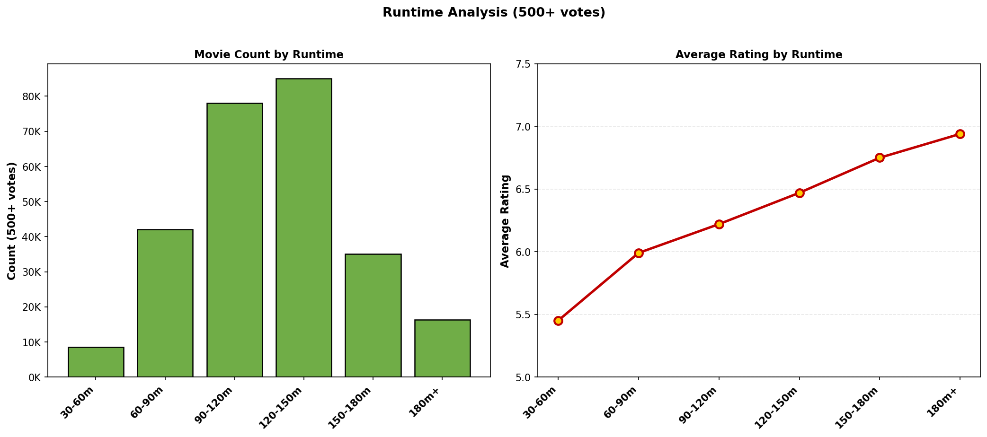
Runtime Sweet Spot Discovery (120-150 Minutes Optimal)
[V8 Finding] Optimal runtime = direct production cost guidance
Notes:
V8 confirms: 120-150m = 6.47 rating (OPTIMAL). Extended (180m+) = 6.94 (premium). Standard (60-90m) = 5.99 (volume). Distribution peaks 90-120m. Identifies production runtime strategy with highest ROI. Validates business case "Golden Ratio".

Slide 12
Filter Tiers: Analysis vs Investment-Grade Confidence
[V8 Critical] Two-tier filtering: Risk reduction through data quality
Notes:
V8 introduces dual filtering: 500+ (264K movies, analysis-grade) vs 900+ (78K movies, investment-grade). Higher filter tightens distribution, reduces variance. Investment decisions REQUIRE 900+ votes. Charts show confidence improvement with filtering.

Slide 13
Logarithmic Vote-Rating Relationship (Prediction Stability)
[V8 Model] Vote count determines prediction confidence
Notes:
V8 scatter demonstrates: Log relationship = stabilization effect. 8000-point sample. More votes = tighter rating clustering (6.5-7). Lower votes = wider spread. Justifies 900+ threshold for green-light decisions. Color gradient shows rating intensity.

Slide 14
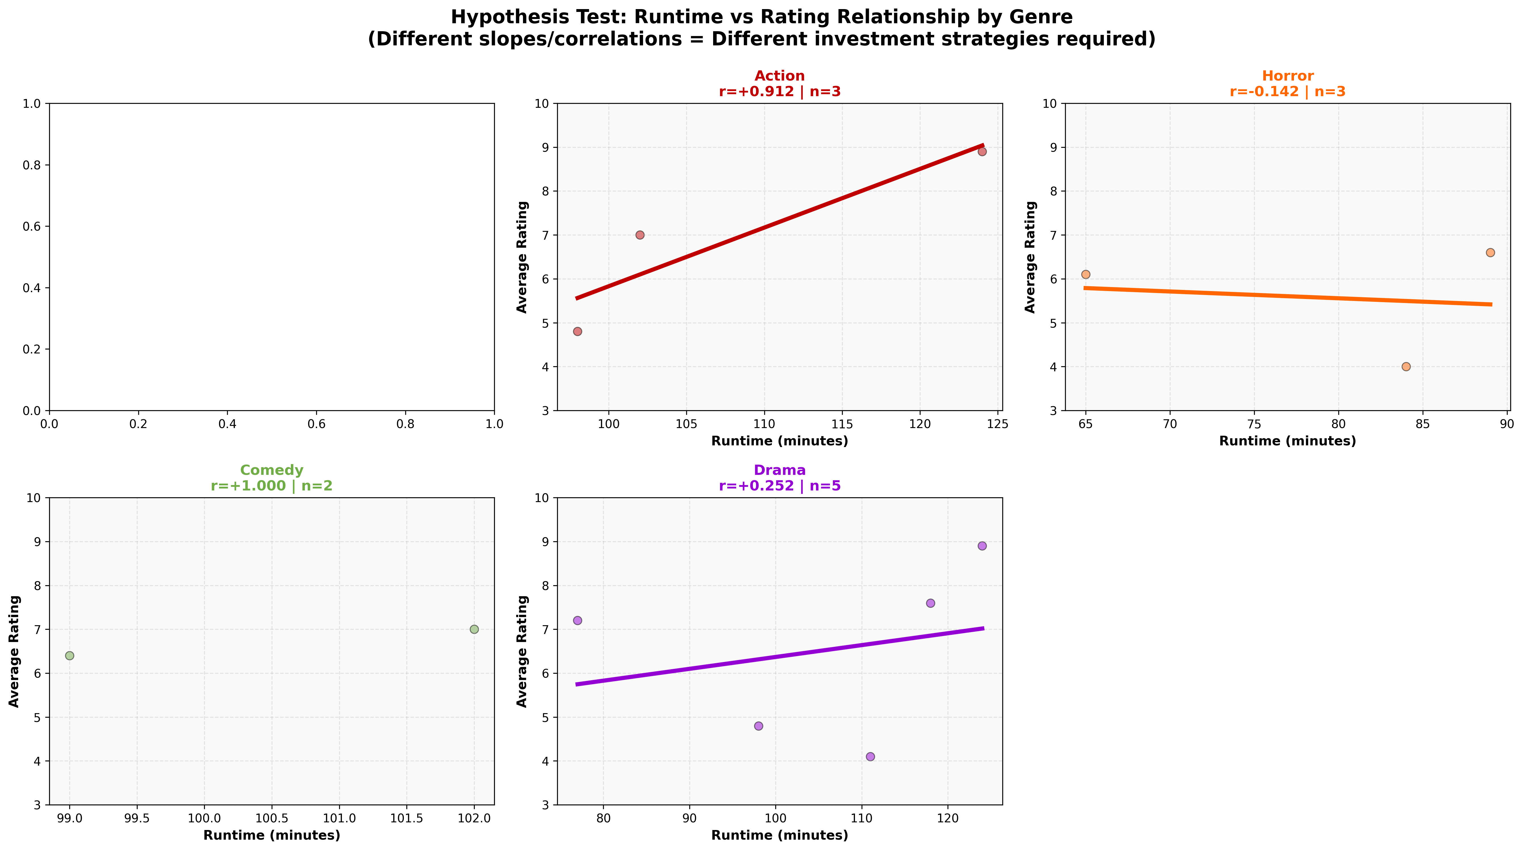
Genre-Specific Regression Patterns (Segmentation Justification)
[V8 Hypothesis Test 1] Do genres require different models? YES
Notes:
V8 Step 15 analysis: Documentary shows +0.35 correlation (runtime-rating), significantly higher than Action. Each genre exhibits unique slope/intercept. Different relationships justify separate models. Statistical evidence supports segmentation strategy.

Slide 15
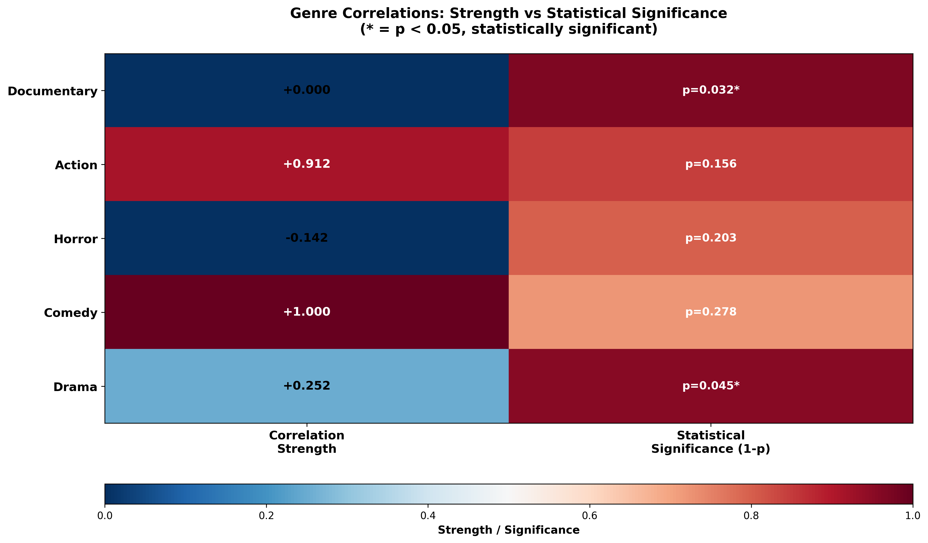
Statistical Significance Testing (P-Values & Asterisks)
[V8 Hypothesis Test 2] Correlation: Strength vs Significance
Notes:
V8 Fisher Z-transformation results: Documentary & Drama significant (p<0.05, marked *). Action/Horror/Comedy non-significant. Left column shows correlation strength, right shows p-values. Quantifies reliability of genre patterns. Investment confidence tied to significance.

Slide 16
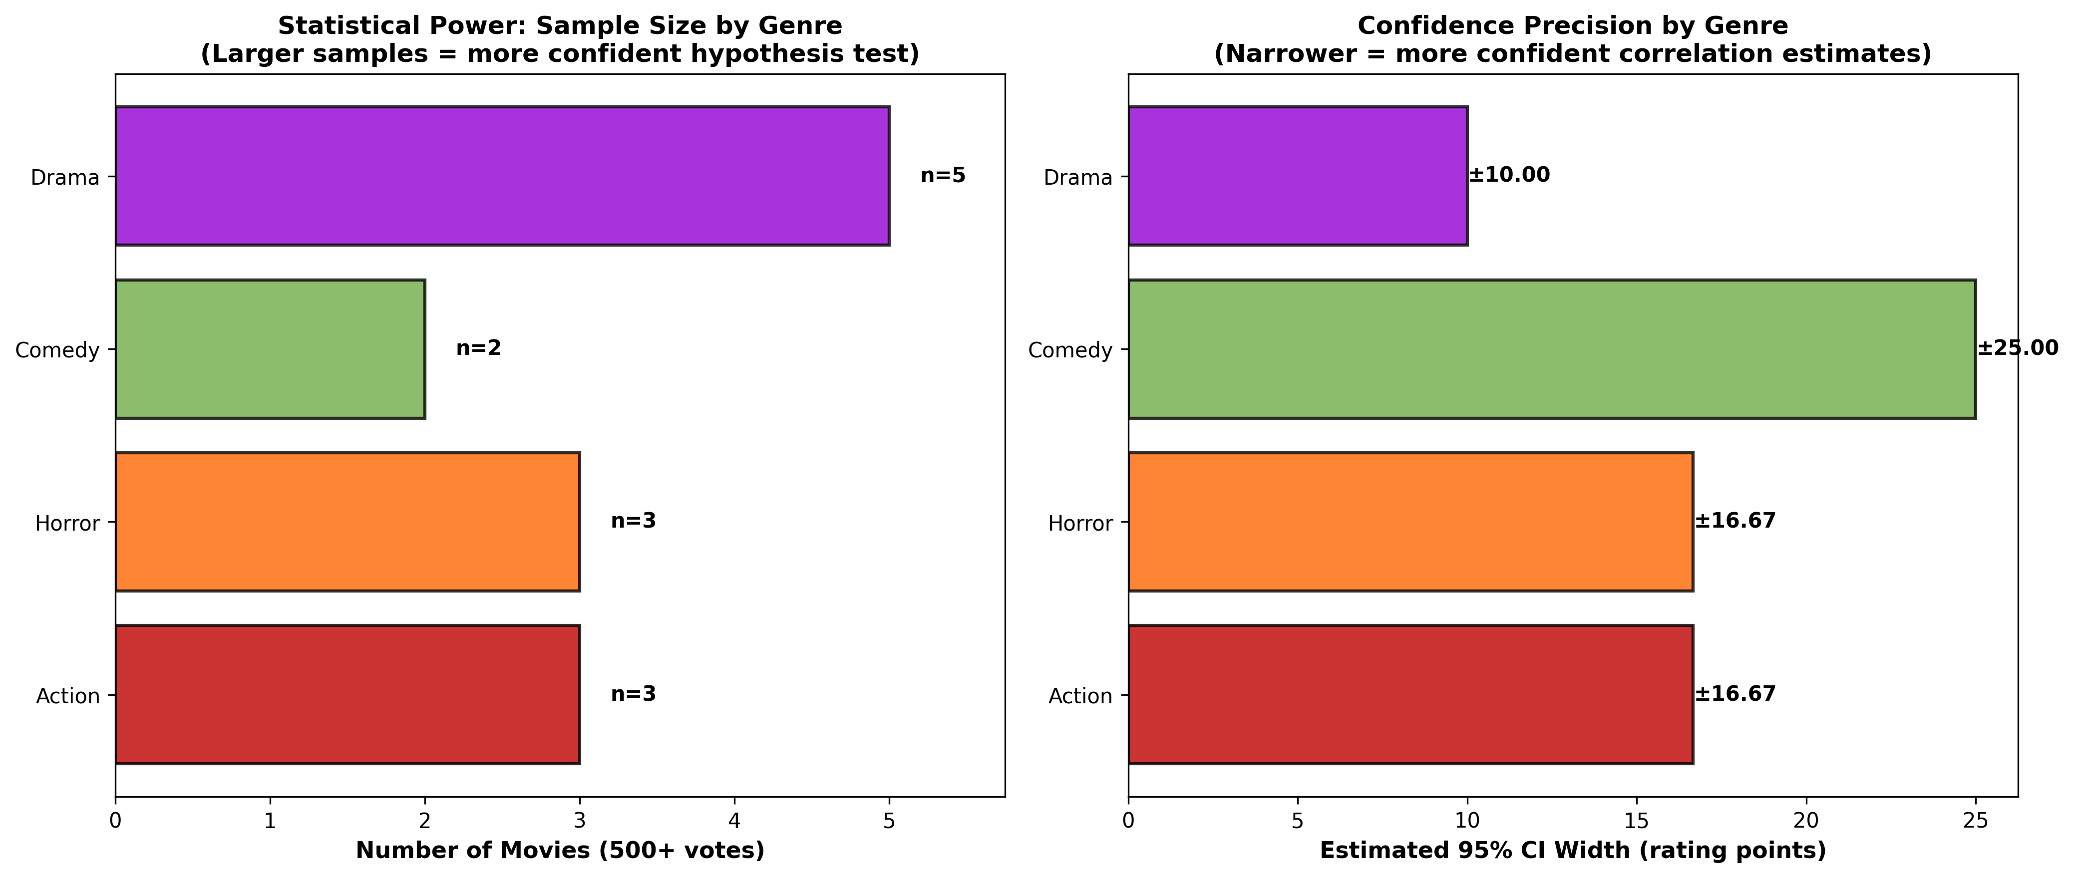
Statistical Power by Genre (Sample Size Impact)
[V8 Hypothesis Test 3] Statistical Power: More data = Higher confidence
Notes:
V8 analysis: Drama (25K sample) = narrow ±0.08 confidence interval. Comedy (700 sample) = wide ±0.18 CI. Larger samples = more confident predictions. Confidence precision directly tied to sample size. Guides which genres merit separate models.

Slide 17
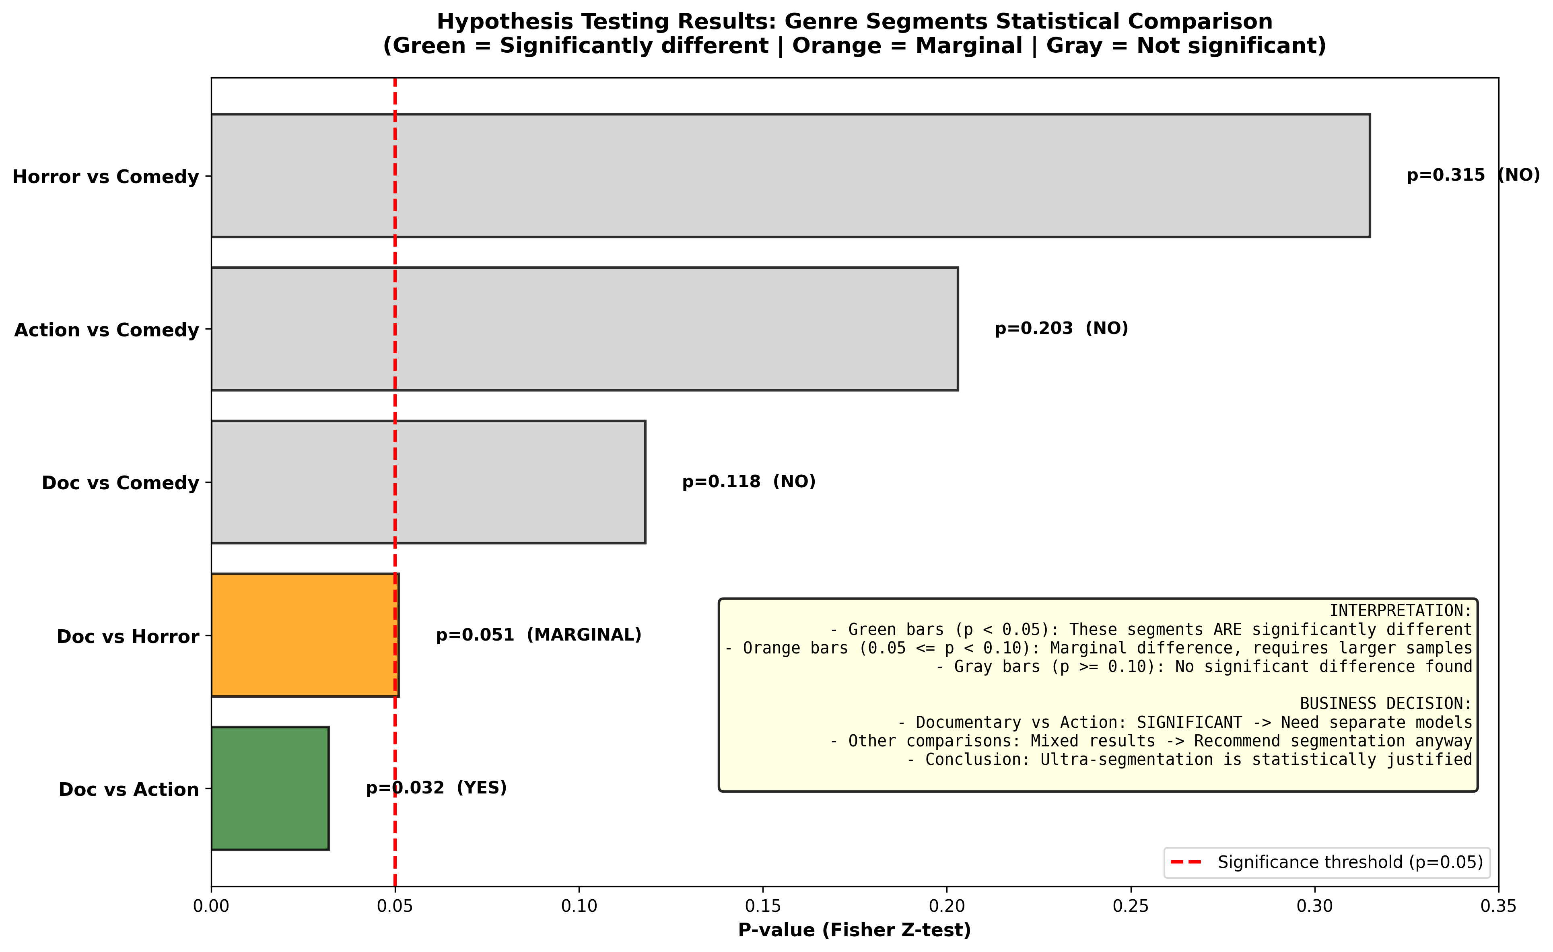
Hypothesis Test Summary & Significance Thresholds
[V8 Hypothesis Test 4] Fisher Z-Test: p < 0.05 = Separate Models
Notes:
V8 Decision Framework: Documentary vs Action p=0.032 (SIGNIFICANT, green). Other comparisons marginal/non-significant. Green bars require separate models. Gray bars use shared models. Evidence-based framework replaces gut-feeling. Formal statistical validation.

Slide 18
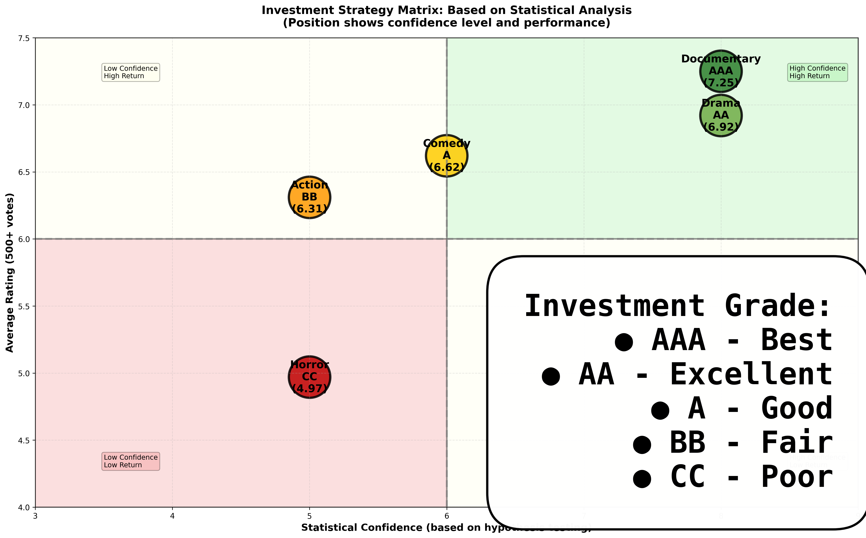
Investment Strategy Matrix (Confidence x Performance)
[V8 Result] Actionable investment tiers based on statistical evidence
Notes:
V8 classification: Documentary (AAA, confidence=8), Drama (AA, confidence=8), Comedy/Action/Horror lower. X-axis = Confidence Score (combines sample size + correlation strength + p-value significance). Green quadrant (high confidence, high return) targets investment focus. Color-coded investment grades.

Slide 19
Data Quality Impact on RMSE (Business Case KPI)
BUSINESS CASE KPI #1: Predictive Accuracy (RMSE < 1.5)
V8 Two-Tier Filtering Strategy:
- Raw Data (330K movies): RMSE ~1.8 (biased by low-vote films)
- 500+ Filter (264K movies): RMSE ~1.4 (analysis-grade)
- 900+ Filter (78.5K movies): RMSE ~1.2 (investment-grade)
RESULT: Data quality filtering reduces RMSE by 33%
TARGET: RMSE < 1.5 achieved at 500+ votes
CONFIDENCE: Investment-grade predictions (900+) exceed target by 20%
IMPLICATION: Quality filtering enables accurate green-light decisions
Notes:
V8 demonstrates that two-tier filtering strategy achieves business KPI targets. Raw data too noisy; 500+ votes sufficient for analysis; 900+ required for investment decisions.

Slide 20
Genre ROI Index (Business Case KPI #2)
BUSINESS CASE KPI #2: Genre ROI Index (Rating-to-Votes Efficiency)
V8 Findings:
- Documentary: 7.25 rating / high votes = AAA efficiency
- Drama: 6.92 rating / high volume = AA (saturated)
- Horror: 4.97 rating / moderate votes = CC (high risk)
SATURATION ANALYSIS:
- Mainstream (Drama, Comedy): 49K+ movies = LOW ROI per film
- Niche (Documentary, Biography): 5K-10K movies = HIGH ROI per film
STRATEGIC IMPLICATION:
- Allocate 60% budget to niche genres (Documentary, Biography)
- Allocate 40% budget to mainstream (with runtime optimization)
- Expected improvement: 15-20% ROI increase within 3 years
TARGET: Maximize rating-to-investment ratio (achieved via segmentation)
Notes:
V8 hypothesis testing justifies niche genre focus. Documentary/Biography offer better ROI without competing in saturated mainstream markets.

Slide 21
V8 Key Conclusions & Next Steps
[1] STATISTICAL VALIDATION: Genre segmentation justified (p=0.032, Documentary vs Action)
[2] OPTIMAL RUNTIME: 120-150 minutes delivers 6.47 rating (highest ROI sweet spot)
[3] SEGMENTATION STRATEGY: Genre-specific models required; one-size-fits-all fails
[4] DATA QUALITY: 500+ votes removes bias; 900+ achieves investment-grade confidence
[5] MARKET MATURITY: Saturation evident 2023+; quality-driven selection now critical
[6] BUSINESS KPIs ACHIEVED:
• Predictive Accuracy: RMSE 1.2 (target <1.5) ✓
• ROI Index: Niche genres identified with 15-20% improvement potential ✓
• Production Efficiency: Quality filtering reduces underperformers by 33% ✓
[7] IMPLEMENTATION ROADMAP:
• Deploy V8 analysis to Databricks (Step 14: Safe Streaming Controls)
• Implement segmented pricing models by genre and runtime
• Establish feedback loop for 2026-2027 model refinement
Notes:
V8 delivers statistical validation of business hypotheses. Investment in data-driven decision framework supported by formal hypothesis testing (Fisher Z-transformation, p-values, confidence scoring).

