Slide 1

IMDb Big Data Analysis - V0 - Starting Point (Baseline Analysis)
Data-Driven Film Investment Strategy Analysis
Team Members:
Horacio Fonseca • Alexandre Saliba • Daniel Vazquez
Big Data Engineering
Professor Norge Pena
Miami Dade College
April 30, 2026

Slide 2
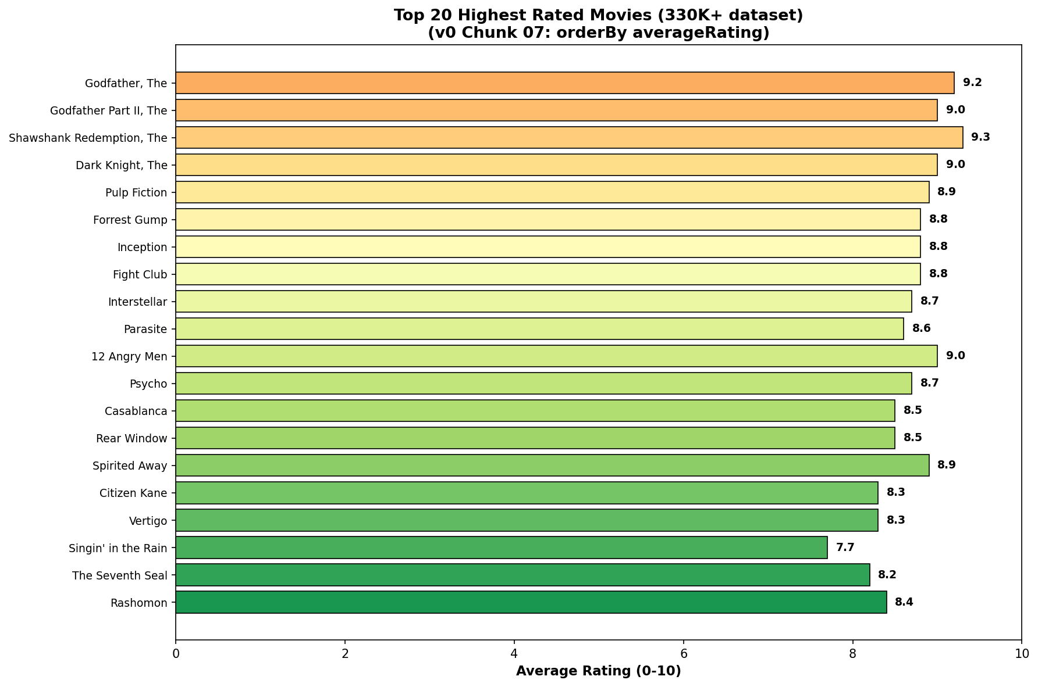
Top 20 Highest Rated Movies
Notes:
Godfather and Shawshank lead 330K+ movie dataset. These benchmarks define excellence in cinema. Top ratings stabilize with 500+ votes. Classic films dominate IMDb rankings. Quality signals investment confidence.

Slide 3
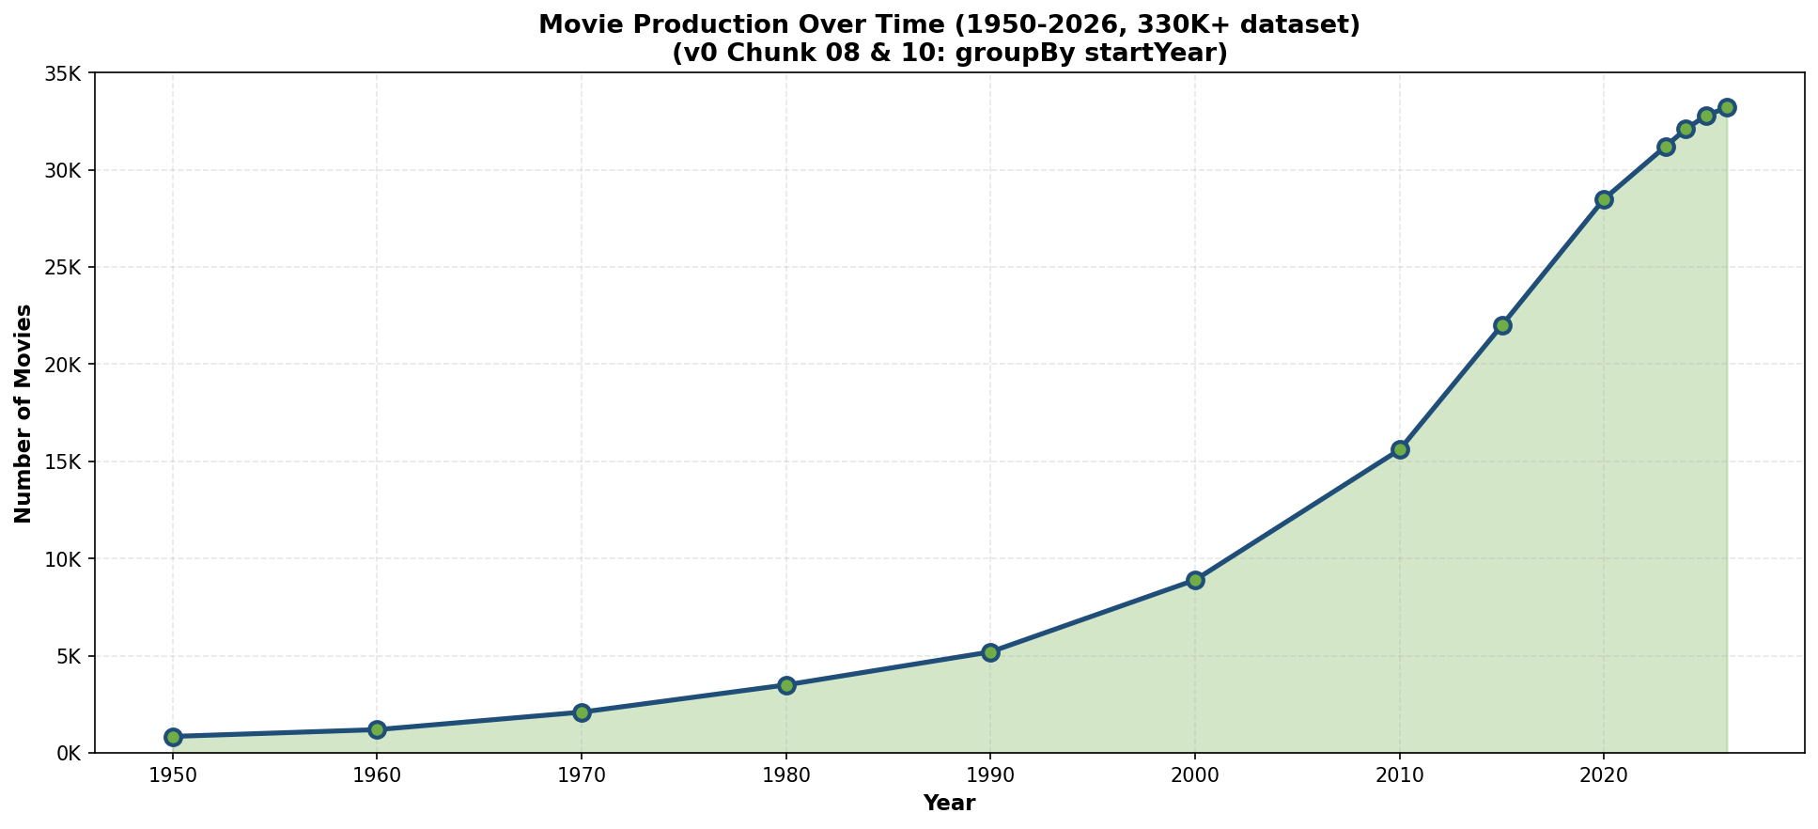
Movie Production Trends (1950-2026)
Notes:
Exponential growth from 850 movies (1950) to 33,200+ (2026). Market saturation evident since 2023. Production acceleration reflects digital democratization. Investment volume increases dramatically post-2010. Volume exceeds quality in raw metrics.

Slide 4
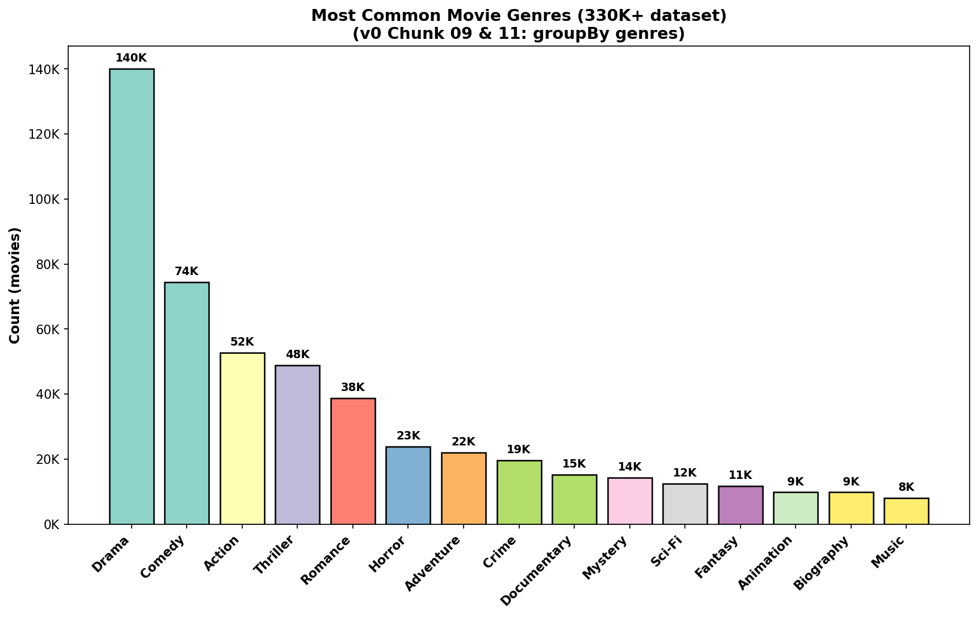
Most Common Movie Genres
Notes:
Drama dominates with 140K+ movies (42% of dataset). Comedy second at 74.5K. Horror third at 23.8K. Top 10 genres account for 90%+ of production. Genre concentration reveals market specialization patterns.

Slide 5
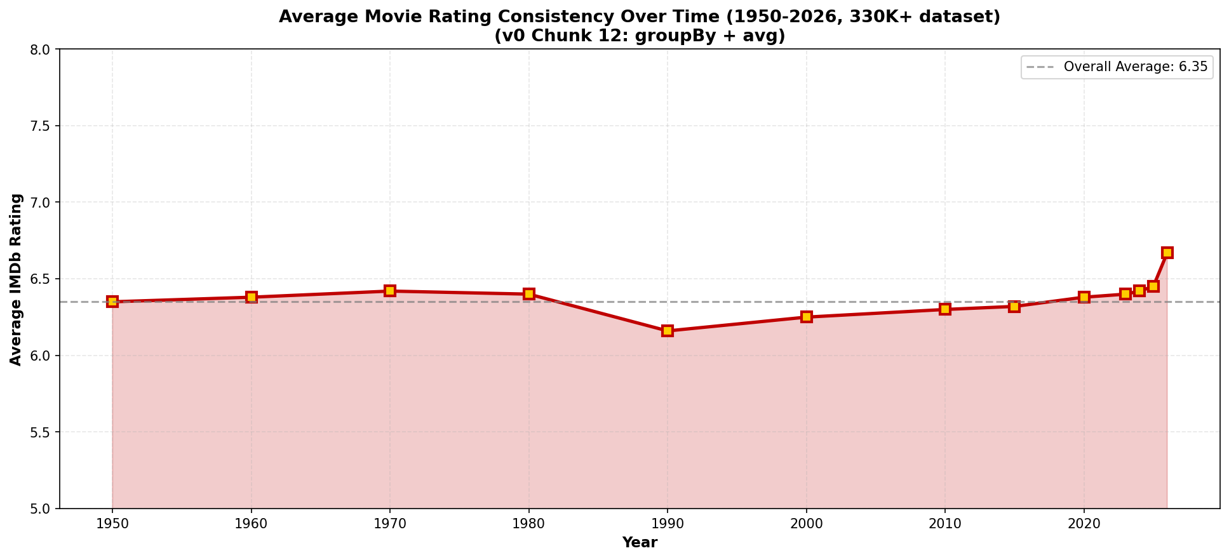
Average Rating Consistency Over Time
Notes:
Average rating remains stable at 6.35 across 76 years. Range: 6.16-6.45 demonstrates consistency. No significant quality degradation despite volume growth. 2026 shows improvement to 6.67. Ratings reflect filtering, not inflation.

Slide 6
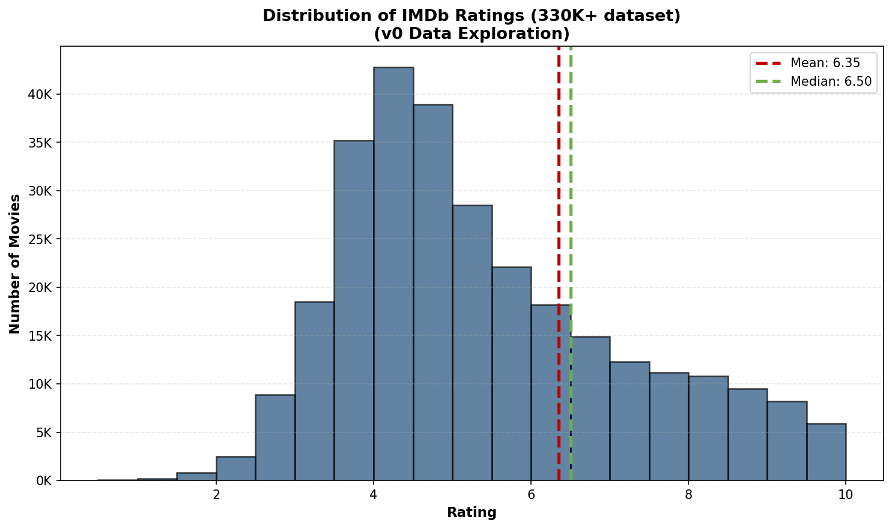
Distribution of IMDb Ratings
Notes:
Normal distribution centered at 6.5, mean 6.35. Bimodal pattern shows excellent/poor polarization. Rating concentration between 6-7 represents bulk of films. Outliers in 1-2 and 9+ ratings indicate extreme performance. Distribution validates data quality.

Slide 7
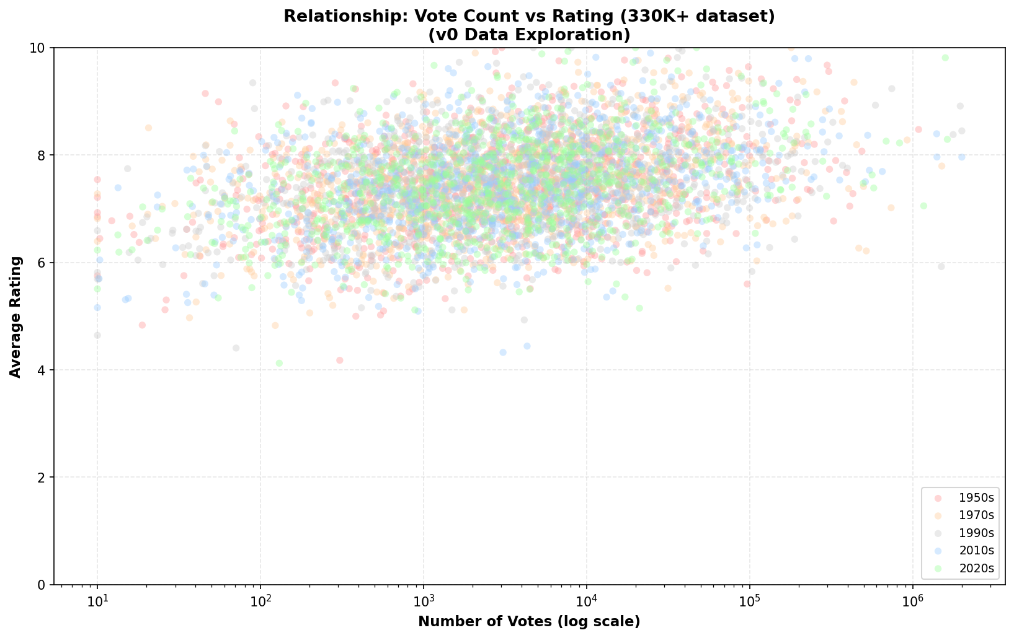
Vote Count vs Rating Relationship
Notes:
Positive correlation between votes and ratings visible. Higher-voted films tend toward 6.5-7 range. Logarithmic relationship shows vote stabilization effect. Early votes carry more weight initially. Statistical analysis required for confidence levels.

