Slide 1
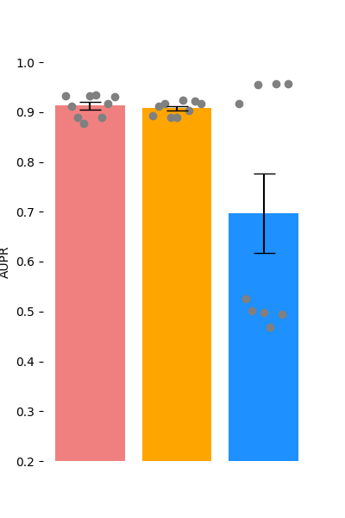
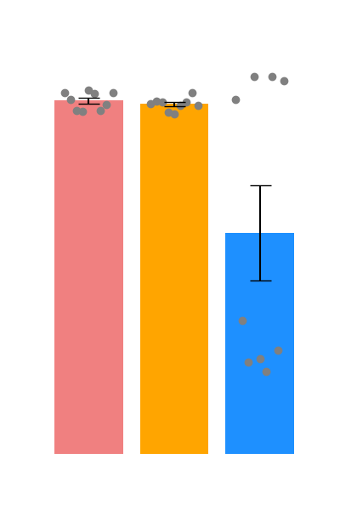
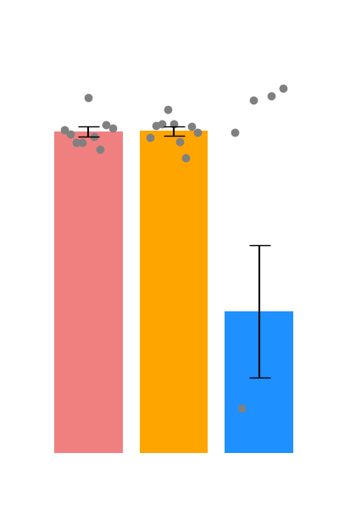
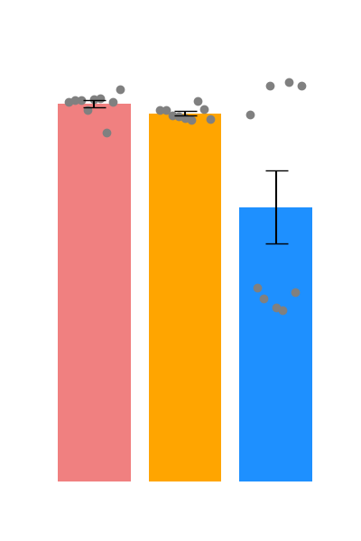
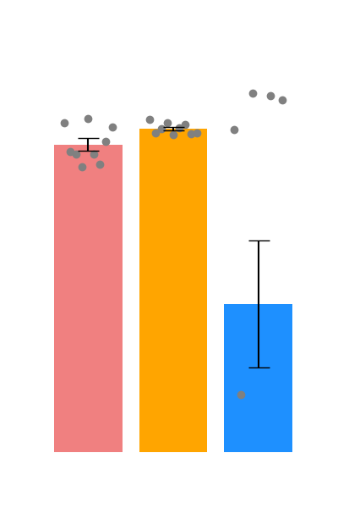



Binding(60.69%)
Reaction(55.03%)
Ptmod(7.33%)
Catalysis(45.64%)
Inhibition(4.11%)
HIGH-PPI
PIPR
GNN-PPI
Baselines
Baselines
Baselines
Baselines
Baselines

Slide 2
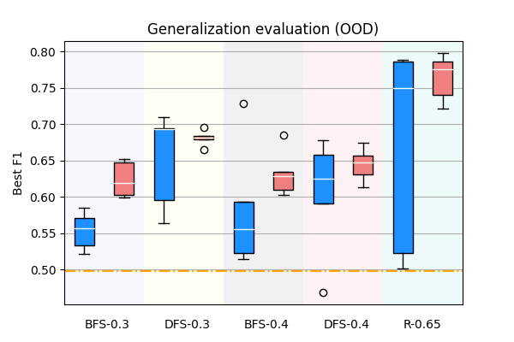
HIGH-PPI
GNN-PPI
-·-
PIPR

