Slide 1
Sharing-Bicycle System Prediction
Horace Wang
Mar.26 2019

Slide 2
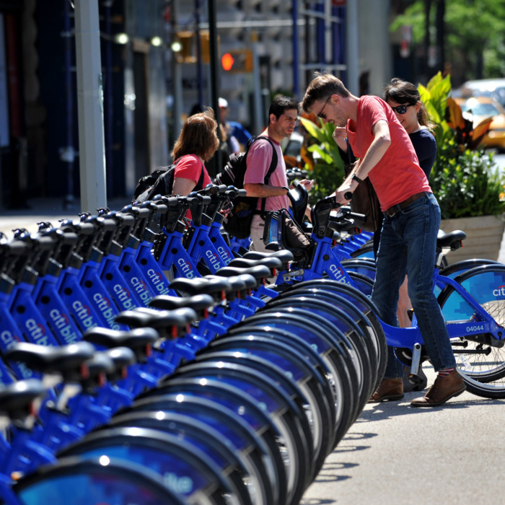

Introduction & Problem
Bicycle sharing service
Customer rent and return bicycle at designed locations
Availability at each station is not equal
Shortage becomes a big issue for the company
Need a method to predict the demand for each station

Slide 3
Data
Citibike official website provides JSON file
https://feeds.citibikenyc.com/stations/stations.json
Including following characteristics:
executionTime stationBeanList
stationName availableDocks
totalDocks latitude
longitude statusValue
statusKey availableBikes
stAddress1 stAddress2
city postalCode
location altitude
testStation lastCommunicationTime
landmark

Slide 4
Methodology
Different Analyzing Method:
Linear Regression
SVR
Decision Tree
Natural Network
Evaluation Standards:
R-square
Means Squared Error

Slide 5
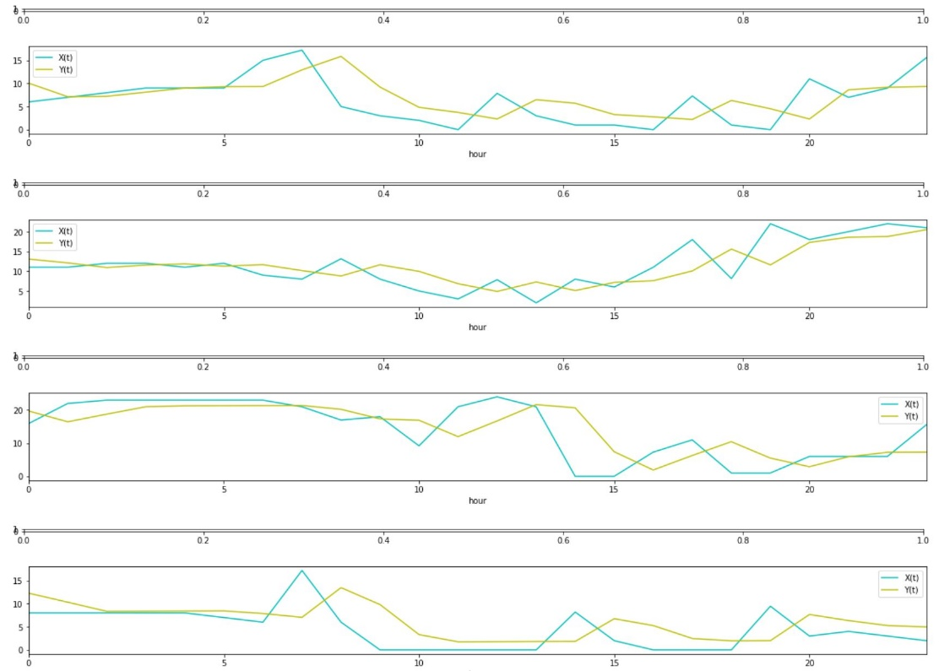
Discussion (1/5)
Linear Regression

Slide 6
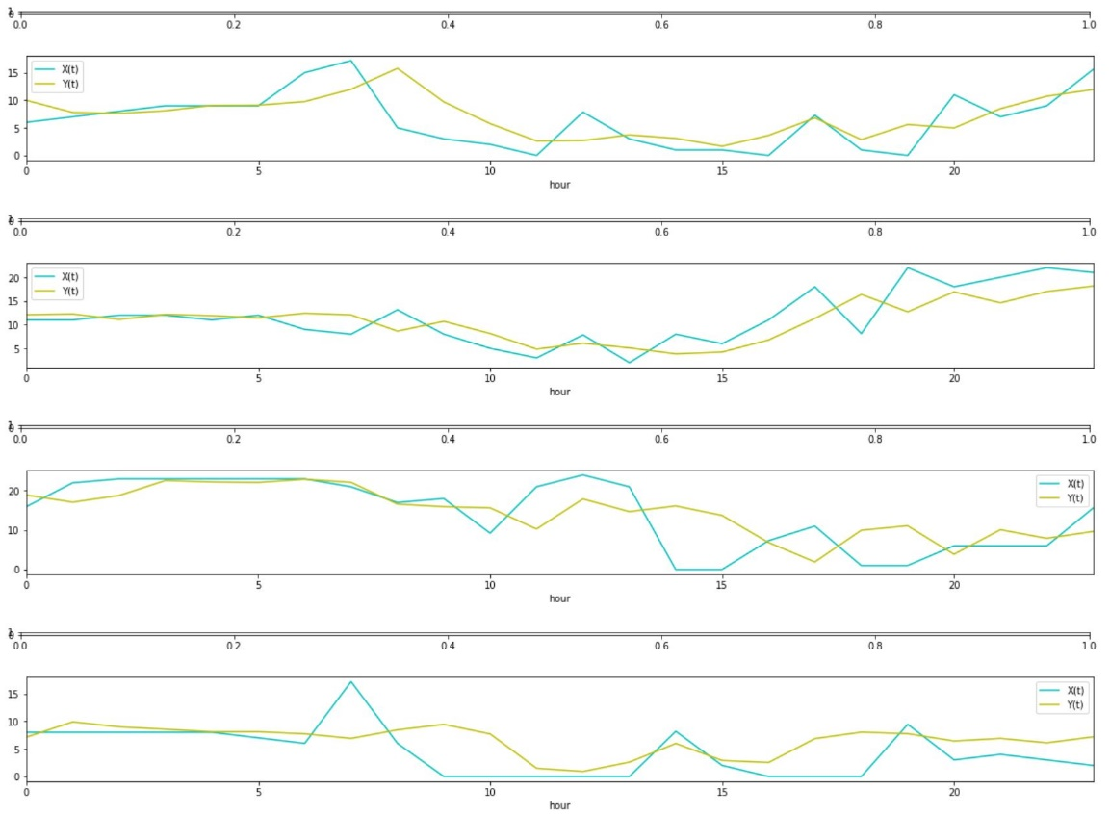
Discussion (2/5)
SVR

Slide 7
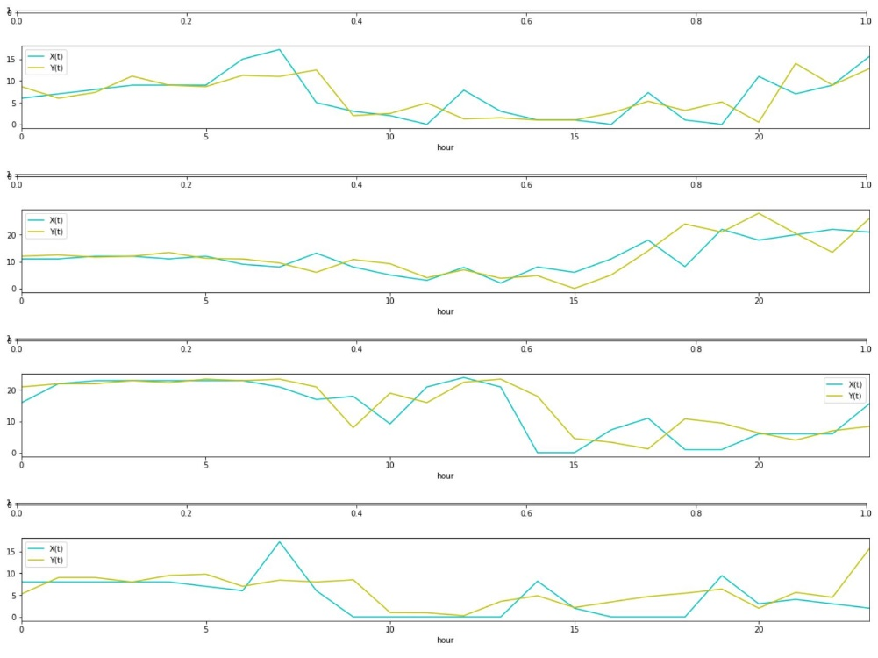
Discussion (3/5)
Decision Tree

Slide 8
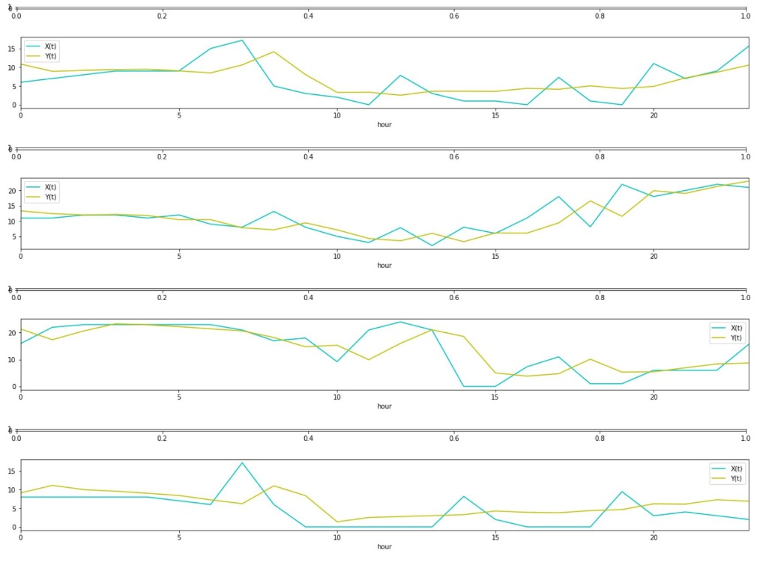
Discussion (4/5)
Natural Network

Slide 9
Discussion (5/5)
 | Linear Regression | SVR | Decision Tree | Neural Network
R-square | 0.547 | 0.556 | 0.485 | 0.622
MSR | 18.453 | 18.063 | 20.960 | 15.387
Neural Network has the highest R-square value and lowest Means Square Error. Thus, Neural Network is the best estimation model for Citibike’s business for each station.

Slide 10
Conclusion
Neural Network is the best model to estimate the demand of each station currently
Future Improvement:
More data needed to have more accurate result:
Customer’s behavior
The relation between different stations
The differences between each week, seasons or years need to be considered

Slide 11
Thanks

