Slide 1
Reproducing results of single pair of document representation and training algorithms

Slide 2
20NG 10% labeled data
DocRep. | Model | Precision | Recall | F1 | Accuracy
TFIDF | SVM | 0.66 | 0.66 | 0.65 | 0.66
 | MLP | 0.68 | 0.65 | 0.66 | 0.65
 | RF | 0.47 | 0.45 | 0.44 | 0.45
 | XGB | 0.28 | 0.27 | 0.27 | 0.27
Doc2Vec | SVM | 0.44 | 0.43 | 0.43 | 0.43
 | MLP | 0.52 | 0.50 | 0.50 | 0.50
 | RF | 0.35 | 0.35 | 0.34 | 0.35
 | XGB | 0.30 | 0.31 | 0.30 | 0.31
USE | SVM | 0.67 | 0.68 | 0.67 | 0.68
 | MLP | 0.69 | 0.69 | 0.68 | 0.69
 | RF | 0.64 | 0.64 | 0.63 | 0.64
 | XGB | 0.58 | 0.58 | 0.58 | 0.58
BERTP | SVM | 0.40 | 0.41 | 0.40 | 0.41
 | MLP | 0.27 | 0.26 | 0.22 | 0.26
 | RF | 0.20 | 0.20 | 0.20 | 0.20
 | XGB | 0.21 | 0.21 | 0.21 | 0.21
BERTS | CNN | 0.55 | 0.53 | 0.53 | 0.53
ELMOP | SVM
 | MLP
 | RF
 | XGB
ELMOS | CNN
Explanation:
I have reproduced the performance results of DocRep and Model pairs, except for ELMO embedding due to the lack of computation power of my PC.
The results were almost identical to the original work except for BERT, which my PC can only support the computation with maximum segment length of 16, which made the results far inferior compared to the original work.
I also restructured the code into Jupyter notebooks and made the code compatible with tensorflow 2.0.

Slide 3
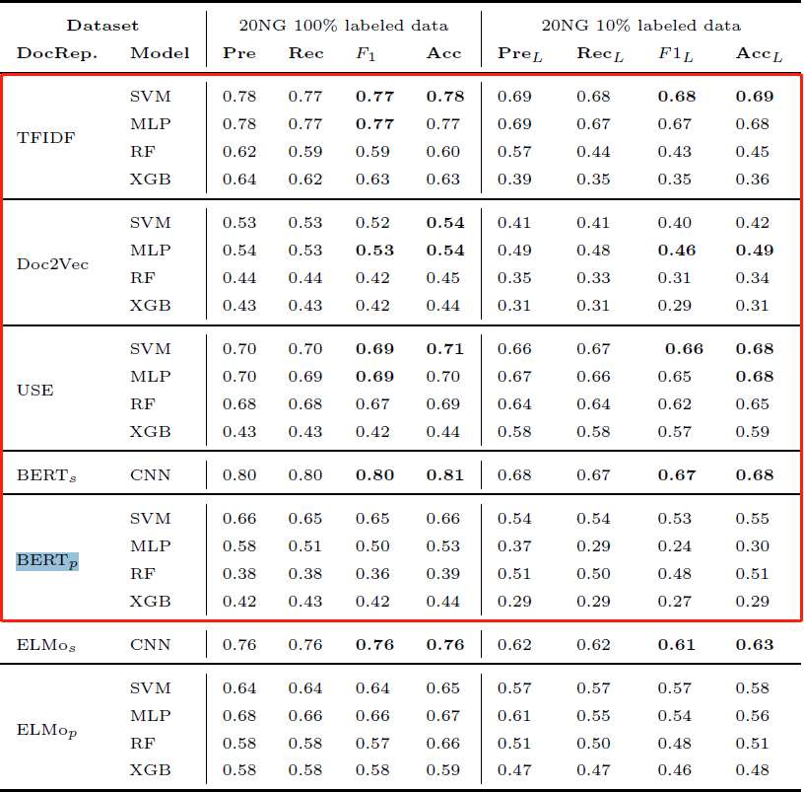
I wonder if I can proceed with implementing the tri-training model with doc representation that can be run by my PC?
I assume my efforts will be put in:
Implementing the basic tri-training algorithm with identical document representation.
Using the results on the left as the baseline, evaluate the performance of tri-training model with:
Identical document representation for 3 classifiers
Different document representation (neither pair of the three are identical) for 3 classifiers
Compare the differences in performances with (possibly) self-training or co-training models
Results in the red box have been reproduced

