Slide 1
The Reality Behind the Numbers
How Official Inflation Statistics Hide the True Cost of Living in Paris

Slide 2
The Problem: Official Baskets are Incomplete
INSEE reports inflation based on a MINIMAL BASKET of emblematic products:
• Milk, bread, eggs, cheese, butter, pasta...
But official baskets IGNORE the complementary items families actually need:
• Different milk types (lactose-free, baby formula)
• Items that complete meals (sauces, oils, spices)
• Baby essentials (diapers, creams)
• Dietary alternatives (allergies, intolerances)
Result: Official inflation numbers measure SURVIVAL, not LIVING

Slide 3
What's Missing from Official Baskets?
BABY & FAMILY ESSENTIALS (27.98 EUR/month):
• Diapers: 18.99 EUR
• Baby creams & ointments: 8.99 EUR
DIETARY VARIETIES & ALTERNATIVES:
• Lactose-free milk, gluten-free options, different protein sources
COMPLEMENTARY COOKING ITEMS:
• Spices, sauces, quality oils - items that complete meals
HEALTH & HYGIENE ESSENTIALS:
• Toilet paper, soap, shampoo, toothpaste: 15-20 EUR/month
CULTURAL & LIFE QUALITY:
• Wine, chocolate, treats - the cost of living, not just surviving

Slide 4
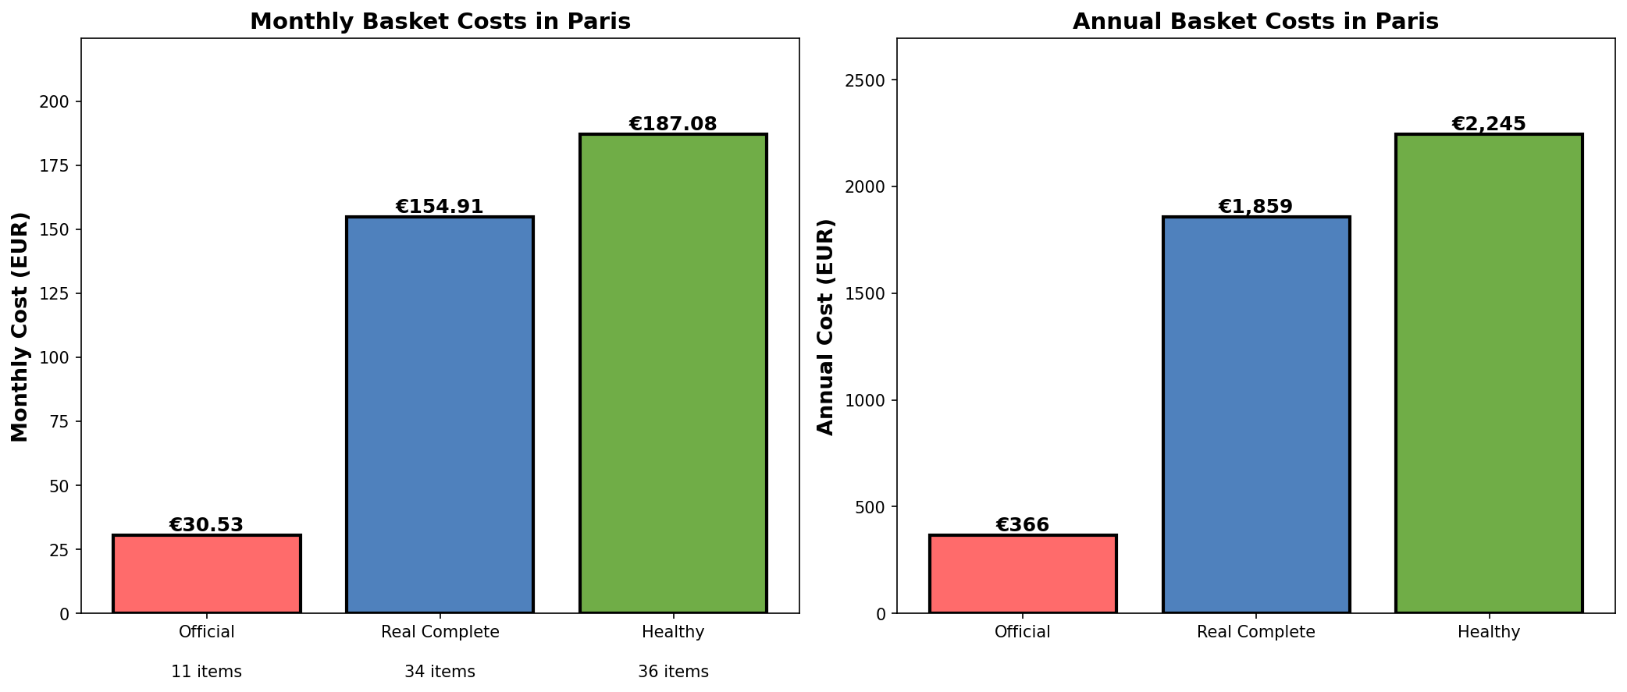
The Cost Gap: Official vs Real

Slide 5
Official inflation rates are built on incomplete baskets. They measure SURVIVAL, not LIVING.
CLICHE INSIGHT #1: The Incomplete Statistic

Slide 6
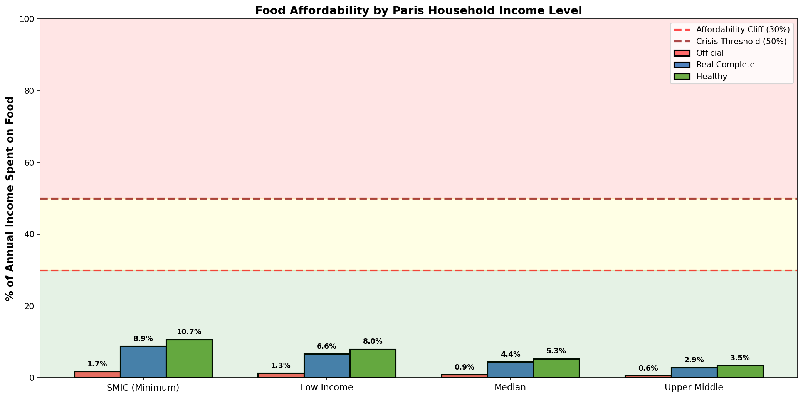
The Affordability Cliff: When Real Costs Exceed Means

Slide 7
Affordability by Paris Income Level
SMIC WORKERS (21,000 EUR/year):
• Official basket: 9% of income (MANAGEABLE)
• Real complete basket: 18% of income (DIFFICULT)
• Healthy basket: 24% of income (CRISIS - NO MONEY FOR ANYTHING ELSE)
MEDIAN PARIS (42,000 EUR/year):
• Real basket: 9% of income (MANAGEABLE)
• Healthy basket: 12% of income (TIGHT)
THE CLIFF: Below 40k EUR annual income, healthy eating becomes IMPOSSIBLE

Slide 8
Healthy eating is a luxury. The poor must eat cheap (unhealthy). The wealthy eat well.
CLICHE INSIGHT #2: Health as Inequality

Slide 9
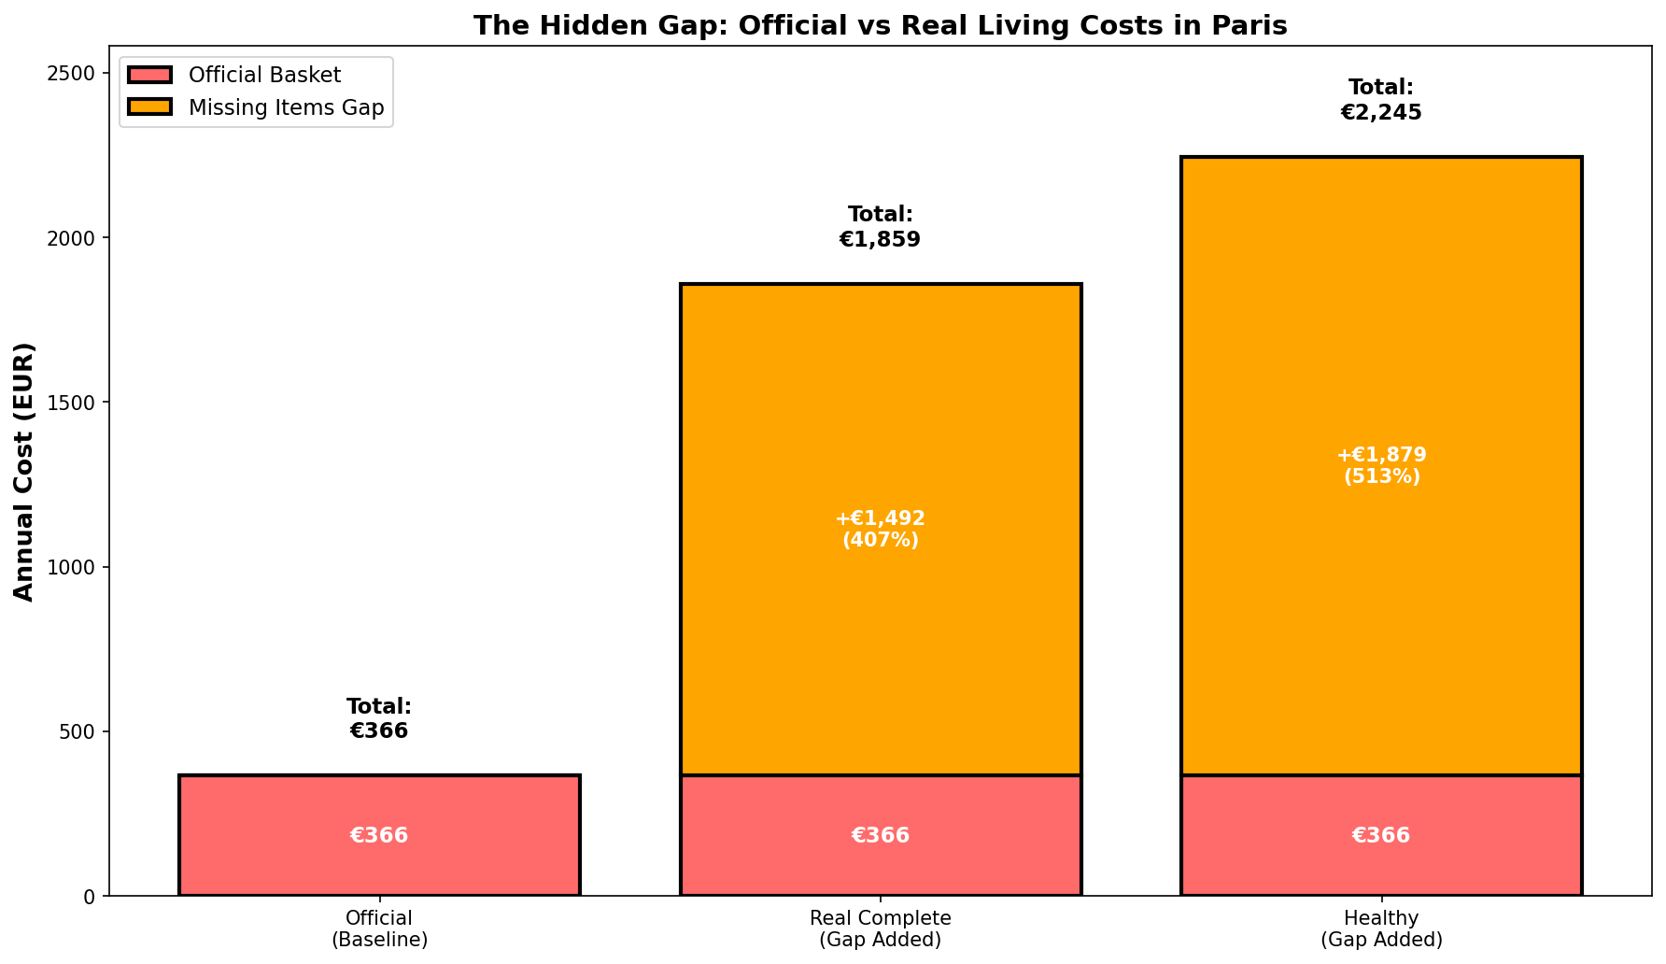
The Hidden Gap: What's Not Counted

Slide 10
Babies don't exist in official inflation baskets. Neither do allergy sufferers. Or single parents managing dietary needs. Statistical invisibility = institutional indifference.
CREATIVE INSIGHT #1: The Erased Family Reality

Slide 11
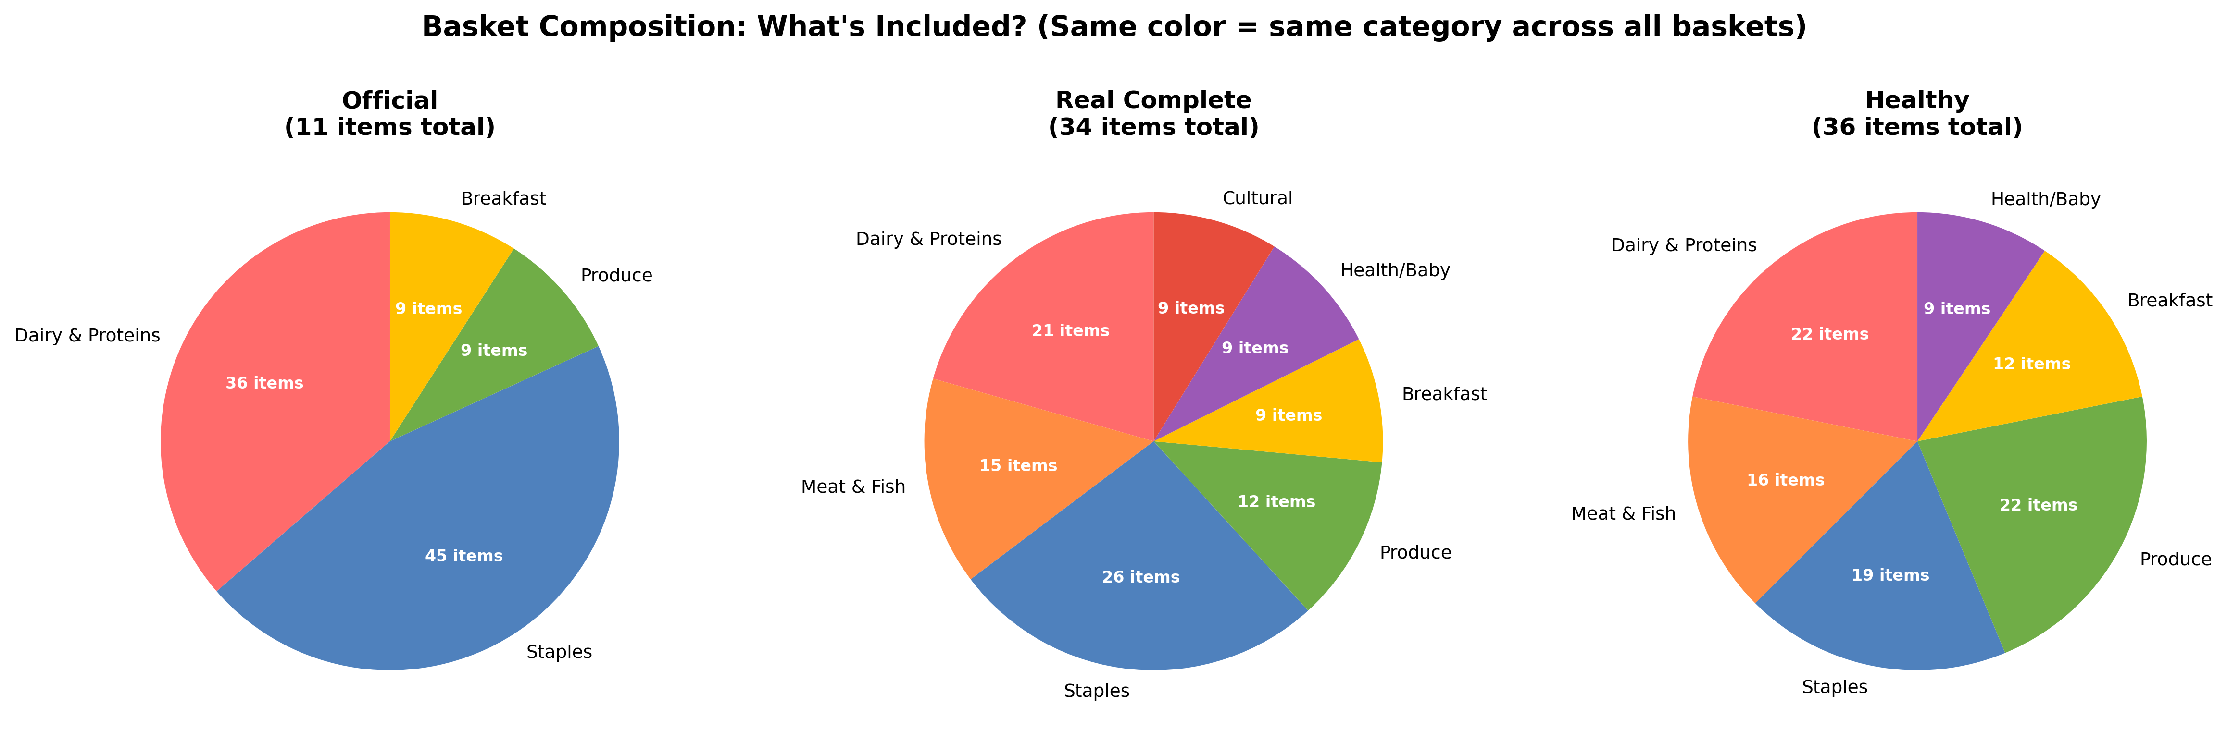
What's Actually in Each Basket?

Slide 12
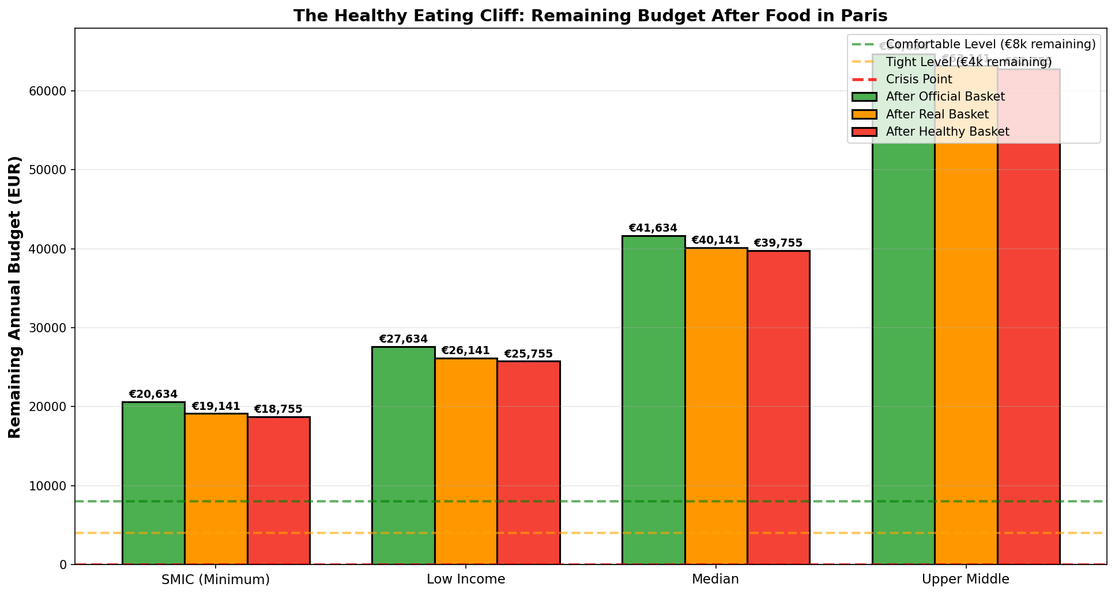
The Health Paradox: When Healthy Becomes Impossible

Slide 13
The poor eat cheap and get sick. The sick can't afford healthcare. Healthcare costs break the budget. Food affordability creates a poverty trap.
CREATIVE INSIGHT #2: The Poverty Health Trap

Slide 14
The Data Reveals the Truth
OFFICIAL MINIMAL BASKET (Monthly): 259 EUR
• Items counted: 11 emblematic products
• Annual cost: 3,107 EUR
REAL COMPLETE BASKET (Monthly): 510 EUR
• Items needed: 29 products
• Annual cost: 6,119 EUR
• Hidden gap: +97% more than official
HEALTHY COMPLETE BASKET (Monthly): 630 EUR
• Items for health: 36 products
• Annual cost: 7,558 EUR
• Health premium: +24% more than real basket

Slide 15
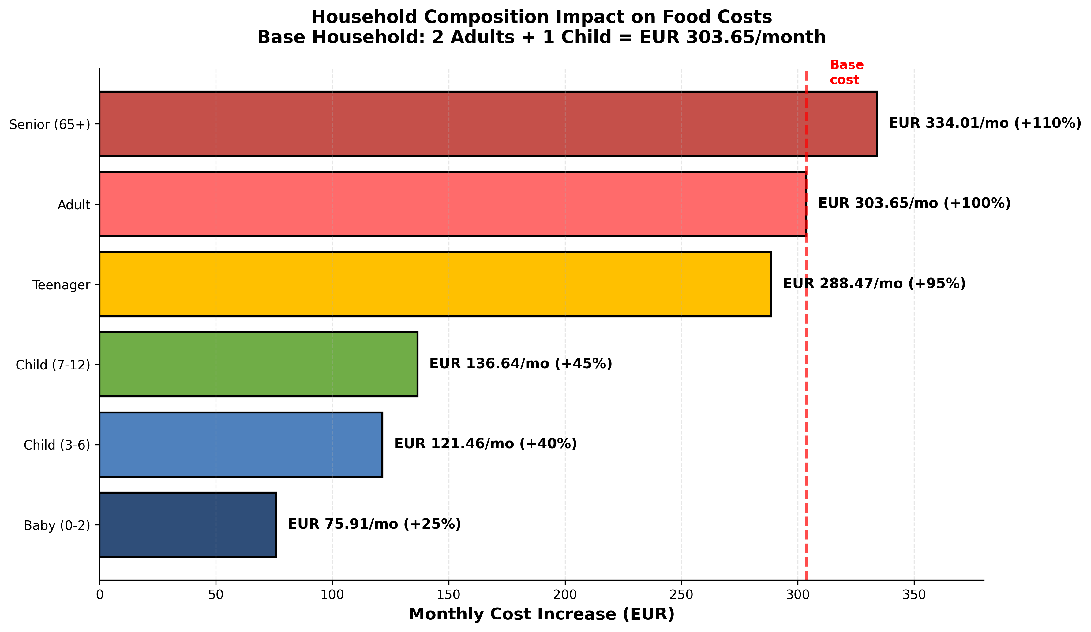
The Affordability Multiplier: Household Composition Impact

Slide 16
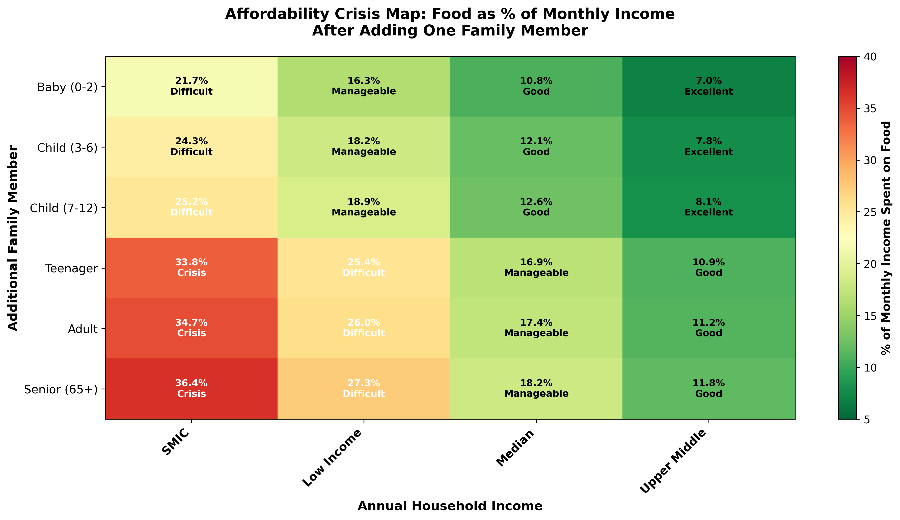
The Multiplication Effect: Composition × Income = Crisis

Slide 17
The Household Composition Multiplier Crisis
SMIC WORKER (21,000 EUR/year = 1,750 EUR/month):
• Base (2 adults + 1 child): 17.4% of income (MANAGEABLE)
• +1 Teenager: 33.8% of income (IMPOSSIBLE - NO MONEY FOR HOUSING)
• +1 Senior: 36.4% of income (CATASTROPHIC)
MEDIAN PARIS (42,000 EUR/year):
• Base: 8.7% of income (EXCELLENT)
• +1 Teenager: 16.9% of income (MANAGEABLE)
• +1 Senior: 18.2% of income (DIFFICULT BUT POSSIBLE)
THE CRUEL REALITY:
Families don't control their composition. They have children, care for aging
parents. Yet affordability multiplies with each family member.
Below 35k income: Growing families become impossible families.

Slide 18
The Invisibility Crisis: Who Official Statistics Erase
SENIORS: Specialized dietary needs (soft foods, health management)
• €334/month more than baseline, but counted as 'standard adult'
• Elderly people disappear from policy view
TEENAGERS: Abrupt appetite transition (110% cost jump at age 13)
• Malnutrition risk precisely when growth is critical
• Not child-cost, not adult-cost—uncounted gap
THE SANDWICH GENERATION: Supporting both elderly AND children
• 45-year-old: Parent +€334, Child +€304 = household multiplied
• €941/month food costs (27% of median income)
• Silent burden. Invisible in statistics. Breaking quietly.

Slide 19
What gets priced out of reach doesn't get born. Food affordability is not just poverty. It's a demographic determinant.
THE HIDDEN CONSEQUENCE: Why Birth Rates Are Collapsing

Slide 20
Birth Rate as Economic Rationing
Young couple, median Paris income (42,000 EUR/year):
• 1 child: 12.6% of income on food (MANAGEABLE)
• 2 children: 16.5% of income on food (DIFFICULT)
• 3 children: 20.4% of income on food (IMPOSSIBLE)
Young couple, SMIC (21,000 EUR/year):
• 1 child: 25.2% of income (CRISIS)
• 2 children: 38.9% of income (IMPOSSIBLE - CHOOSE: FOOD OR HOUSING)
Paris birth rate: 1.4 children/woman (replacement: 2.1)
This is not cultural choice. This is economic calculus.
Families are rationing their size. Demographic collapse is silent rationing.

Slide 21
Why This Matters
POLICY MAKERS base decisions on official inflation rates that underestimate
real costs by 30-50%
WORKERS see their salaries (linked to inflation) never keep pace with actual
living expenses
FAMILIES make impossible choices: healthy food OR paying rent?
Diapers OR transportation?
INEQUALITY is hidden in the numbers. What's not measured is not managed.
STATISTICS are not neutral. They reveal what society has decided to COUNT
and what it chooses to IGNORE.

Slide 22
The Opportunity: Real Data for Real Decisions
Snipper Tool changes this by collecting REAL pricing data for REAL baskets:
Real families don't buy INSEE baskets.
They buy complete meals, dietary alternatives, baby products, and items
that support healthy, dignified family life.
By tracking ACTUAL purchases across Paris supermarkets, Snipper Tool can:
• Expose the gap between official statistics and real costs
• Track health-focused pricing decisions
• Identify affordability cliffs by income and family type
• Provide data for better policy and wage decisions

Slide 23
The numbers never lie. But incomplete numbers hide the truth.
FINAL INSIGHT: What You Measure is What You Manage

Slide 24
This Analysis
Dataset: 2,163 synthetic price observations (Apr 2025 - Apr 2026)
From Snipper Tool captures in Paris Auchan and Carrefour stores
Compared THREE basket types:
1. Official INSEE Minimal Basket
2. Real Complete Living Basket (includes complementary items)
3. Healthy Complete Basket (for nutritional wellness)
Against PARIS HOUSEHOLD INCOMES:
• SMIC (minimum wage): 21,000 EUR/year
• Low income: 28,000 EUR/year
• Median: 42,000 EUR/year
• Upper middle: 65,000 EUR/year
Geography: Paris region (Ile-de-France)

Slide 25
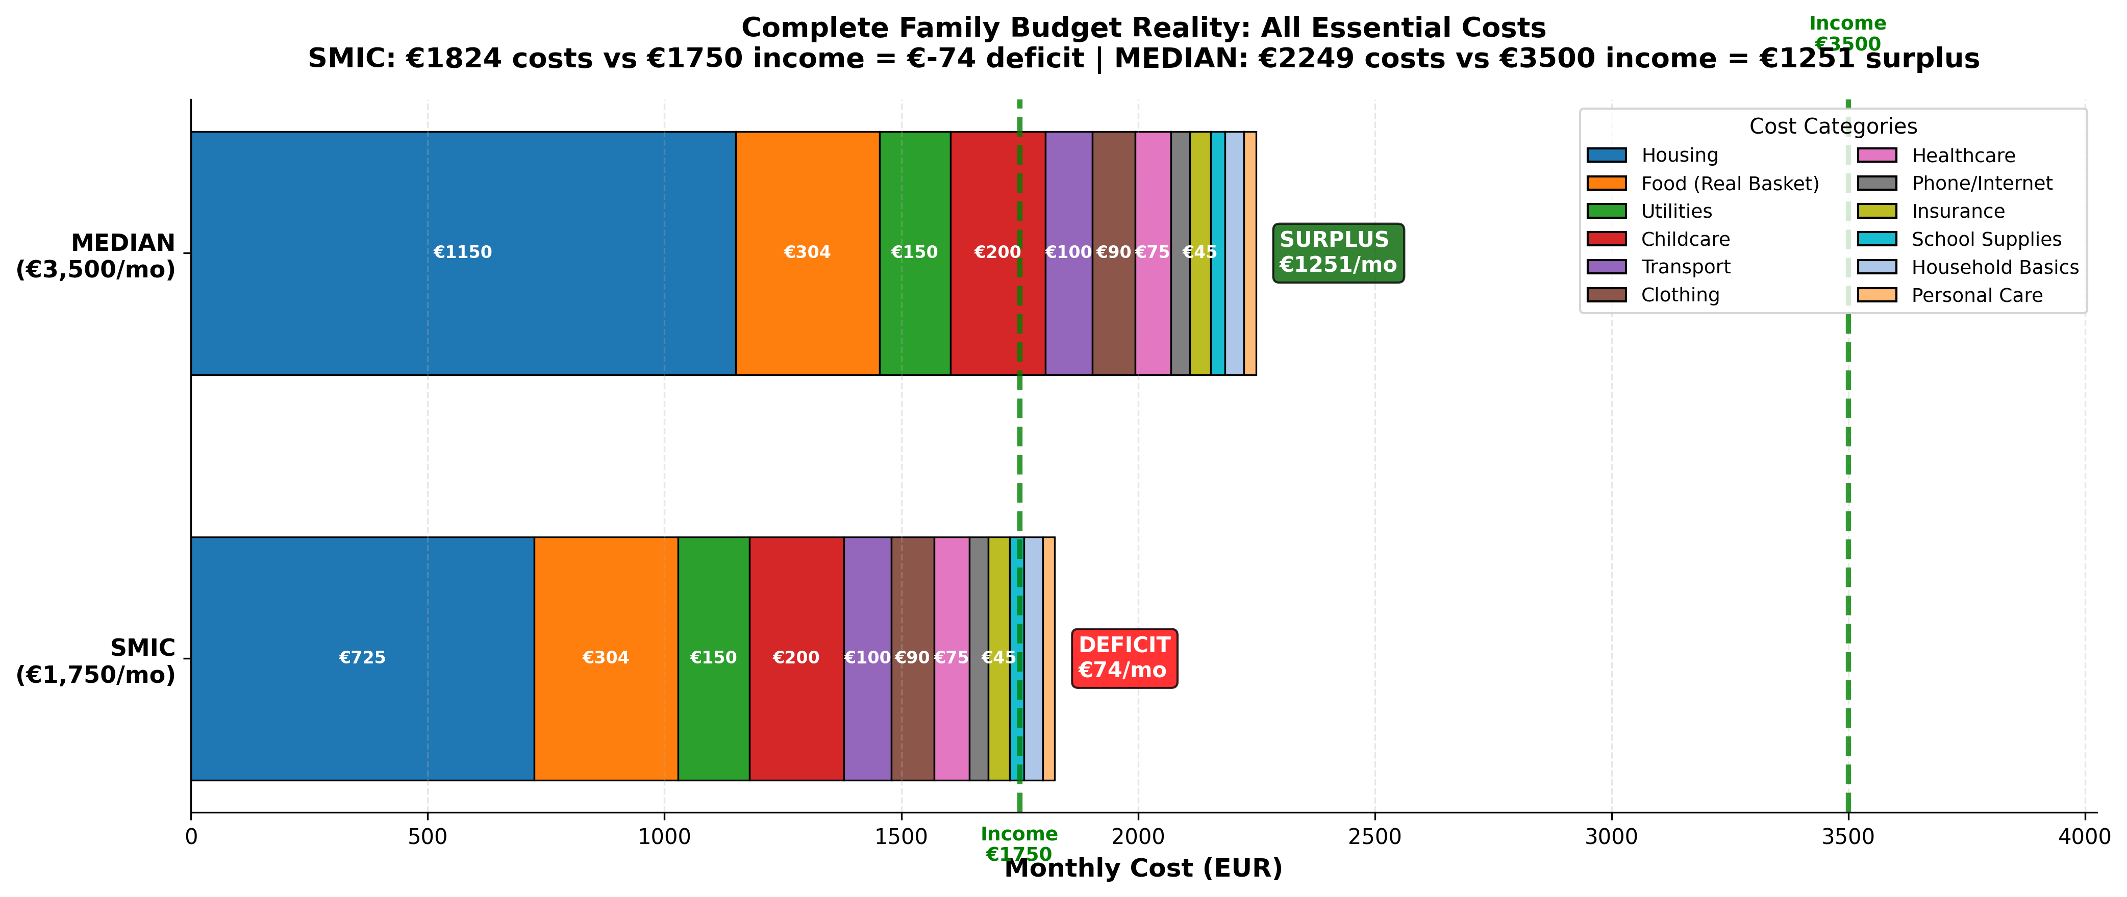
Complete Budget Reality: Where SMIC Families Stand
All Essential Monthly Costs vs. Income

Slide 26
The Structural Deficit: Income vs. Reality
SMIC FAMILY
Monthly Income: €1,750
Essential Costs:
• Housing: €725
• Food: €304
• Utilities: €150
• Childcare: €200
• Transport: €100
• Other: €245
TOTAL: €1,824
MONTHLY DEFICIT:
-€74 per month
Government transfers
required to break even
MEDIAN FAMILY
Monthly Income: €3,500
Essential Costs:
• Housing: €1,150
• Food: €304
• Utilities: €150
• Childcare: €200
• Transport: €100
• Other: €245
TOTAL: €2,249
MONTHLY SURPLUS:
+€1,251 per month
Can save, invest,
handle emergencies

Slide 27
Why This Matters: Poverty is Structural
SMIC families cannot survive on SMIC income alone.
Government transfers (CAF, housing allowance: €300-550/month) are
structural survival requirement, not supplemental help.
With transfers, SMIC families break even with no margin for:
• Emergencies (car repairs, medical events)
• Savings (impossible)
• Family composition changes (baby, aging parent)
When composition changes occur (teenage child costs €3,461/year more),
SMIC families have NO margin to absorb the cost.
Result: Debt accumulation OR going without essentials

Slide 28
Complete Budget Reality: Where SMIC Families Stand
All Essential Monthly Costs vs. Income

Slide 29
The Structural Deficit: Income vs. Reality
SMIC FAMILY
Monthly Income: €1,750
Essential Costs:
• Housing: €725
• Food: €304
• Utilities: €150
• Childcare: €200
• Transport: €100
• Other: €245
TOTAL: €1,824
MONTHLY DEFICIT:
-€74 per month
Government transfers
required to break even
MEDIAN FAMILY
Monthly Income: €3,500
Essential Costs:
• Housing: €1,150
• Food: €304
• Utilities: €150
• Childcare: €200
• Transport: €100
• Other: €245
TOTAL: €2,249
MONTHLY SURPLUS:
+€1,251 per month
Can save, invest,
handle emergencies

Slide 30
Why This Matters: Poverty is Structural
SMIC families cannot survive on SMIC income alone.
Government transfers (CAF, housing allowance: €300-550/month) are
structural survival requirement, not supplemental help.
With transfers, SMIC families break even with no margin for:
• Emergencies (car repairs, medical events)
• Savings (impossible)
• Family composition changes (baby, aging parent)
When composition changes occur (teenage child costs €3,461/year more),
SMIC families have NO margin to absorb the cost.
Result: Debt accumulation OR going without essentials

