Slide 1
The Battle of the Neighborhoods
John Horan
September 7, 2020

Slide 2
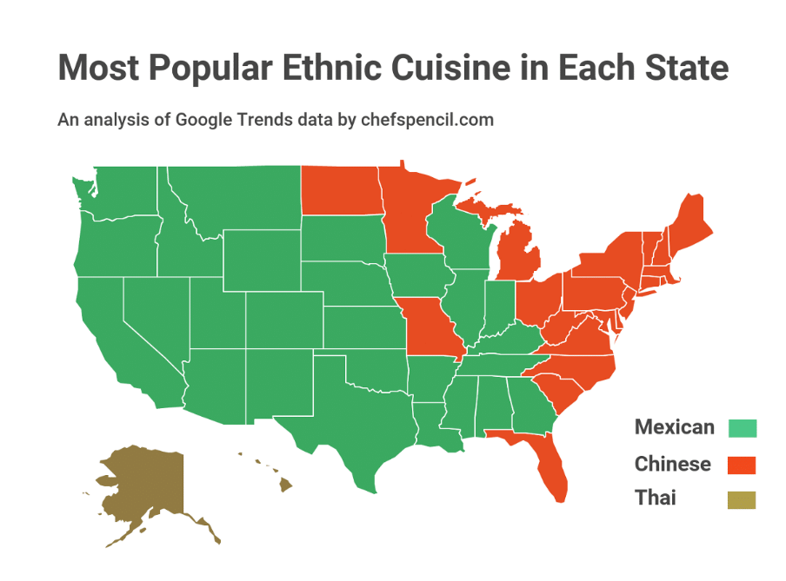
Introduction
6 million people visit the National Parks in the state of Utah every year
The number of visitors increased 17% between 2017 and 2018
Zion National Park is the most popular National Park in Utah with 4.3 million visitors in 2018.
This analysis is for stakeholders interested in opening a restaurant in and around Zion National Park
Mexican Cuisine is one of the most popular ethnic cuisines in the U.S.

Slide 3
Data
Cities and zip codes with latitude and longitude supplied from the website: https://www.unitedstateszipcodes.org/zip-code-database/
Visitor statistics were supplied from a State of Utah’s Travel and Tourism Industry study performed by the Kem C. Gardner Policy Institute of the University of Utah. https://travel.utah.gov/wp-content/uploads/2019-TTtrifold-Updated.pdf
Foursquare API was used to provide venue data for Washington County and Kent County, specifically “Food” venues.

Slide 4
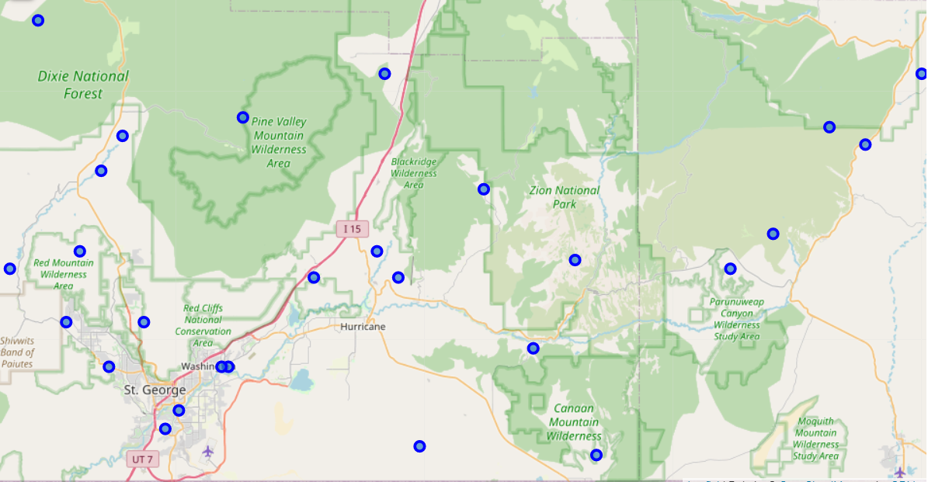
Methodology
Zip Code Data was scaled down to only include cities in Washington County and Kent County
Foursquare was used to acquire all “Food” venues within 5 miles of all cities within Washington County and Kent County
Python libraries and coding was used to analyze the data.

Slide 5
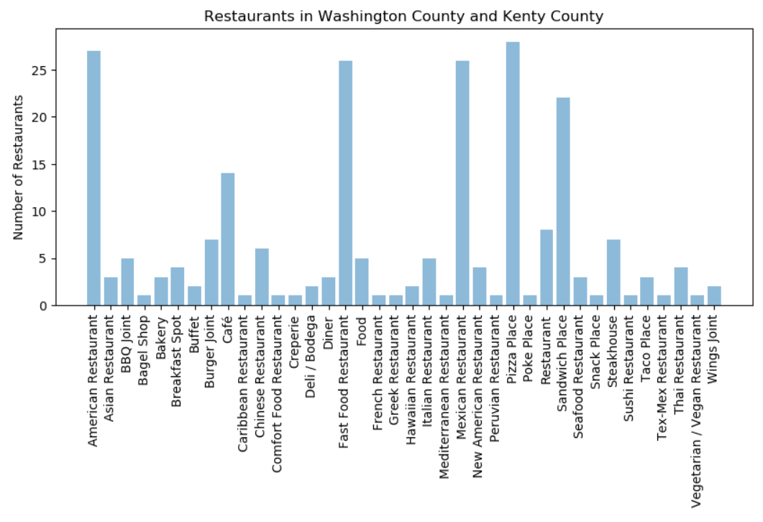
Analysis
Analysis of the data allowed us to visualize the number of restaurants within cities in Washington County and Kent County.

Slide 6
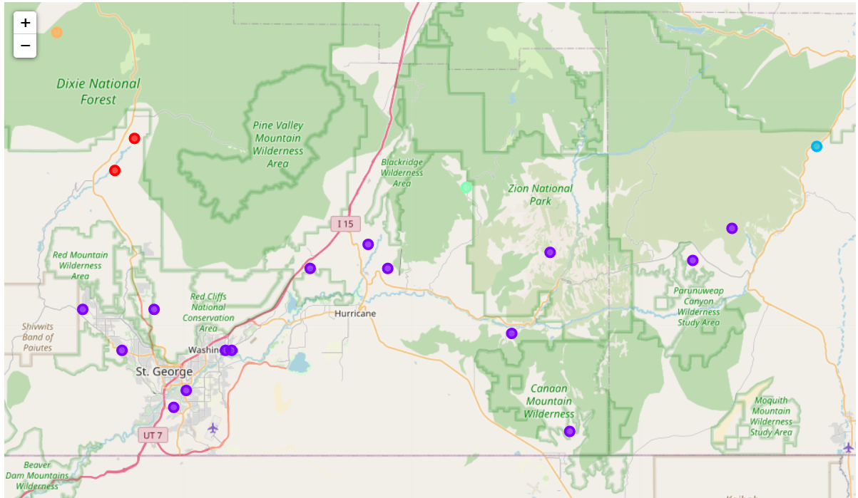
Analysis
Data Analysis and Machine Learning allowed us to group our cities into clusters based on commonality of restaurants available in each city

Slide 7
Results & Discussion
Results of Analysis show many Mexican Restaurants exist in the central location around Zion National Park
Best Location for a Mexican Restaurant would be in the Northwestern corner of Washington County or the northeastern corner of Kent County

Slide 8
Conclusion
Opening a Mexican Restaurant around Zion National Park may be redundant.
There is a shortage of Chinese food restaurants in the area of analysis
As Chinese Food is the 2nd most popular ethnic restaurant choice in the US, stakeholders may want to consider opening a Chinese food restaurant in the area of analysis.

