Slide 1
Course Orientation & General Discussion
Course Code: CSC 3115
Course Title: Object Oriented Programming 2
Dept. of Computer Science
Faculty of Science and Technology
Lecture No: |  | Week No: |  | Semester:
Lecturer:

Slide 2
The Course
Course Title: OBJECT ORIENTED PROGRAMMING 2
Course Code: CSC 3115
Credit Hour: 3/1
Prerequisite: (CSC 2209: Object Oriented Programming 1)

Slide 3
Objectives
At the end of the course, the following objectives should be achieved:
Develop classes and describe how to declare a class
Create .Net Technology applications that leverage the object-oriented features of the C# language, such as encapsulation, inheritance, polymorphism and abstraction.
Use .Net technology data types and expressions
Use arrays and other data collections
Use the concept of Assembly
Implement error-handling techniques using exception handling
Perform multiple operations on database tables, including creating, reading, updating and deleting using MSSQL.
Create an event-driven graphical user interface using Windows Form: panels, buttons, labels, text fields, and text areas.
Learn .Net Framework.

Slide 4
Importance of the course
This will allow you to understand and take full advantage of the upcoming courses like Advanced Programming with .NET etc

Slide 5
Topics to be covered
IDE OVERVIEW
.NET OVERVIEW
OOP OVERVIEW IN .NET
C# BASICS
SOFTWARE DESIGN PATTERN
LAYERED ARCHITECTURE DESIGN
SOFTWARE DEVELOPMENT

Slide 6
Books/References
1.C# 4.0 The Complete Reference; Herbert Schildt; McGraw-Hill Osborne Media; 2010
2. The C# Programming Language (Covering C# 4.0); Anders Hejlsberg, Mads Torgersen, Scott Wiltamuth, Peter Golde; Addison-WesleY; 2010
3. Headfirst C# by Andrew Stellman
4. Fundamentals of Computer Programming with CSharp – Nakov v2013
5. MSDN Library; URL: http://msdn.microsoft.com/library
6. C# Language Specification; URL: http://download.microsoft.com/download/0/B/D/0BDA894F-
2CCD-4C2C-B5A7-4EB1171962E5/CSharp%20Language%20Specixfication.doc

Slide 7
Course Requirements
These are the things need to be accomplished properly by the students during the term such as:
Attending at least 80% of the classes
Attending quizzes, presentation sessions and term exams
Submission of the assignments, lab tasks in due time, etc.

Slide 8
Final Project
You will be assigned a group project at the end of the course which will contribute 50-100% of the final grade
Group Members: Min :3 , Max : 4
*** Proposal Submission: Within 5th week of midterm
*** Prototype Submission: Within 9th week
*** Submission Deadline: week after the final term
(Exact dates will be announced later)

Slide 9
IMPORTANT!!
Never Come to my office with the request for an extra grade.
Never miss any deadline.
Marks will be deducted, even worse can happen if you copy assignment

Slide 10

WELCOME TO
OBJECT ORIENTED PROGRAMMING 2

Slide 11
Lecture Outline
Introduction and Overview of .NET Architecture and .Net Framework
Introduction to C#
Introduction to Visual Studio

Slide 12
Overview of .NET
.NET Architecture
What is .NET Framework
The .Net framework is a software development platform developed by Microsoft.
The framework was meant to create applications, which would run primarily on the Windows Platform.
The first version of the .Net framework was released in the year 2002.
The .Net framework can be used to create any kind of applications - Form based, Web based, Mobile applications

Slide 13
Overview of .NET
.NET Architecture
VB
C++
C#
JScript
…
Common Language Specification
Enormous platform
Over 10000++ types
Well-defined sub-systems and partitioning of responsibility
ASP.NET: Web Services
and Web Forms
Windows Forms
Visual Studio.NET
ADO.NET: Data and XML
Base Classes
Common Language Runtime

Slide 14
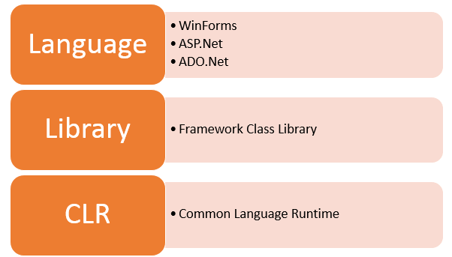
Overview of .NET
.NET Architecture
.Net Framework Architecture

Slide 15
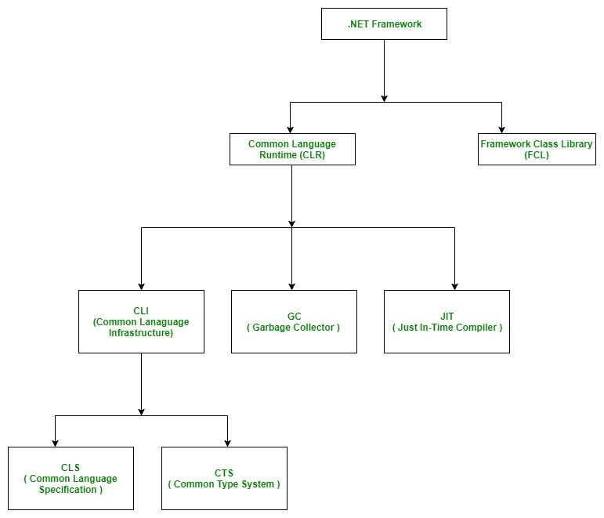
Overview of .NET
.NET Architecture

Slide 16
What is .NET platform?
C# is the language for .NET platform
Microsoft .NET is a platform for developing “managed” software
Traditional practice of compiling to an executable file that contains machine code and how that file is loaded and executed by the operating system.
This “unmanaged” compilation-to-execution process.
In the traditional compilation process, the executable file is binary and can be executed by the operating system immediately.

Slide 17
.NET platform
In the managed environment of .NET, the file produced by the compiler (the C# compiler in our case) is not an executable binary. Instead, it is an assembly, which contains metadata and intermediate language (IL) code.
An assembly contains intermediate language and metadata rather than binary code. This intermediate language is called Microsoft Intermediate Language (MSIL), which is commonly referred to as IL. IL is a high-level, component-based assembly language. IL supports a common type system and multiple languages in the same platform.

Slide 18
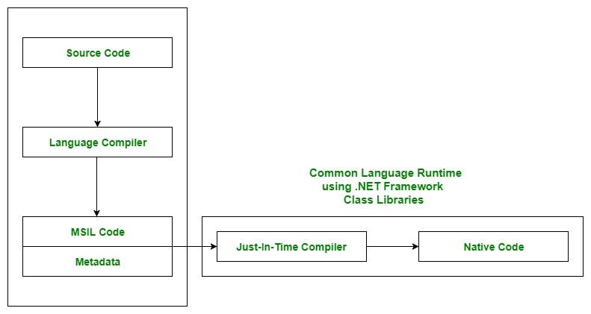

Slide 19
.NET Execution Model
Source code
Visual Basic
C#
C++
Unmanaged
Component
Compiler
Compiler
Compiler
Managed
code
Assembly
IL Code
Assembly
IL Code
Assembly
IL Code
Common Language Runtime
JIT Compiler
Native Code
Operating System Services

Slide 20
MSIL, IL & JIT
Microsoft Intermediate Language (MSIL), the intermediate code produced by the compiler after compiling the source code. This intermediate code is known as MSIL.
Intermediate Language (IL) is also known as MSIL (Microsoft Intermediate Language) or CIL (Common Intermediate Language).
Just In-Time Compiler (JIT), responsible for converting the CIL(Common Intermediate Language ) into machine code using the Common Language Runtime environment.
Common Language Runtime (CLR) provides an environment to execute .NET applications on target machines. The responsibilities of CLR are listed as follows:
Automatic memory management
Garbage Collection
Code Access Security
Code verification
JIT compilation of .NET code

Slide 21
Common Language Runtime (CLR)
Where is CLR on my machine?
C:\WINDOWS\Microsoft.NET\Framework\v2.0.50727\mscorlib.dll
(the path may vary for different framework versions)
The mscorlib.dll file is described as the Microsoft Common Language Runtime Class Library file integrated into the Microsoft Windows Operating System platform. The Common Language Runtime or CLR which is linked to the file mscorlib.resources.dll is the virtual machine constituent attributed to Microsoft's .NET enterprise.
The CLR where the mscorlib.resources.dll file is associated with is the Common Language Infrastructure or CLI standard implementation of Microsoft that identifies the program code's execution environment.

Slide 22
.NET Framework Class Library (FCL)
.NET has an extensive library, offering literally thousands of reusable types. Organized into namespaces, the FCL contains code supporting all the .NET technologies, such as
Windows Forms
Windows Presentation Foundation
ASP.NET
ADO.NET
Windows Workflow
Windows Communication Foundation.
In addition, the FCL has numerous cross-language technologies, including file I/O, networking, text management, and diagnostics. As mentioned earlier, the FCL has CLR support in the areas of built-in types, exception handling, security, and threading. Table below shows some common FCL libraries

Slide 23
.NET Framework Class Library (FCL)
Some Common .NET Framework Class Library Namespaces
System | System.Runtime
System.Collections | System.Security
System.Configuration | System.ServiceModel
System.Data | System.Text
System.Diagnostics | System.Threading
System.Drawing | System.Web
System.IO | System.Windows
System.Linq | System.Workflow.*
System.Net | System.Xml

Slide 24
According to Wiki…
In computer programming, a software framework is an abstraction in which software providing generic functionality can be selectively changed by additional user-written code, thus providing application-specific software. It provides a standard way to build and deploy applications and is a universal, reusable software environment that provides particular functionality as part of a larger software platform to facilitate development of software applications, products and solutions.

Slide 25
Introduction to .Net Framework
What is .NET Framework?
.NET is a platform for the developers made up of tools, programming languages and libraries. The framework is a complete environment that allows developers to develop, run and deploy applications such as:
Console applications.
Windows Forms applications.
Windows Presentation Foundation (WPF) applications.
Web applications (ASP.NET applications).
Web services.
Windows services and some more.

Slide 26
The main components of .NET Framework
.NET Framework Class Library
Common Language Runtime
Dynamic Language Runtimes (DLR)
Application Domains
Runtime Host
Common Type System
Metadata and Self-Describing Components
Cross-Language Interoperability
.NET Framework Security
Profiling
Side-by-Side Execution

Slide 27
A Tiny Bit of History
The C# language was originally developed by a small team led by two distinguished Microsoft engineers, Anders Hejlsberg and Scott Wiltamuth in 2001.
Anders Hejlsberg is also known for creating Turbo Pascal, a popular language for PC programming, and for leading the team that designed Borland Delphi, one of the first successful integrated development environments (IDEs) for client/server programming.

Slide 28

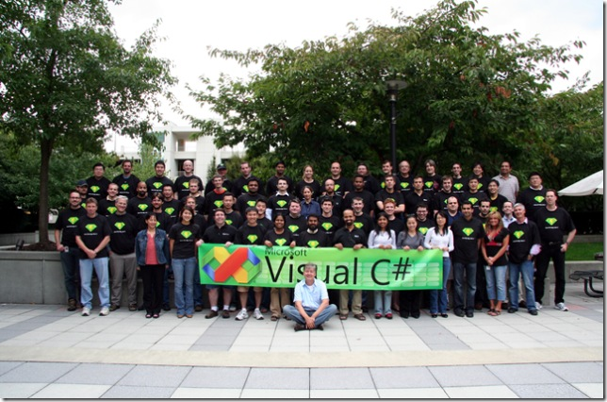
Anders Hejlsberg
Anders Hejlsberg
Since 2000, he has been the lead architect of the team developing the language C# and currently is a Microsoft Chief Architect

Slide 29
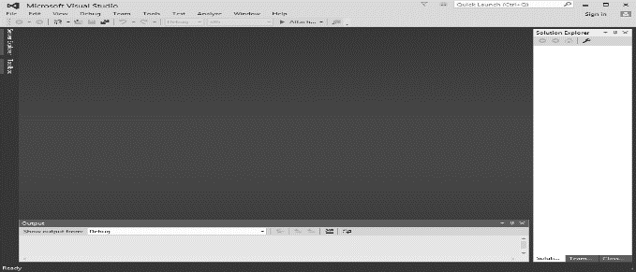
Introduction to Visual Studio
Visual Studio is an IDE (integrated development environment) for building apps. Similar to using Microsoft Word to write documents, you’ll use Visual Studio to create web apps.

Slide 30
Visual Studio
VS supports multiple languages (C#, C++, Visual Basic, J#) in one IDE.
VS manages features and content in a convenient way.
All Visual Studio .NET languages are object-oriented.
All programs have a similar structure.
All programs compiled into Common Intermediate Language (CIL)
For this course at least Visual Studio 2012

Slide 31
IDE’s and CLI Implementations
Visual C# http://www.microsoft.com/express/2012/
in MSDNAA
must be version 2012: we need C# 4.5
Mono: http://www.go-mono.com
Open Source for Linux
Rotor: http://msdn.microsoft.com/net/sscli
Shared Source for Windows
Use to work on BSD / OS X, too
Portable.NET: http://www.dotgnu.org
yet another open source implementation

Slide 32
First C# Program
using System;
namespace Test
{
class ExampleClass
{
static void Main()
{
System.Console.WriteLine("Hello, world!");
}
}
}

Slide 33
Books
Visual Studio from the Microsoft Developer Network (MSDN) https://msdn.microsoft.com/enus/library/dd831853(v=vs.120).aspx (particularly note the Visual Studio IDE User Guide and the Application Development in Visual Studio links).
C# 4.0 The Complete Reference; Herbert Schildt; McGraw-Hill Osborne Media; 2010

Slide 34
References
MSDN Library; URL: http://msdn.microsoft.com/library
C# Language Specification; URL: http://download.microsoft.com/download/0/B/D/0BDA894F-2CCD-4C2C-B5A7-4EB1171962E5/CSharp%20Language%20Specixfication.doc

Slide 35
Thank you!

