Slide 1
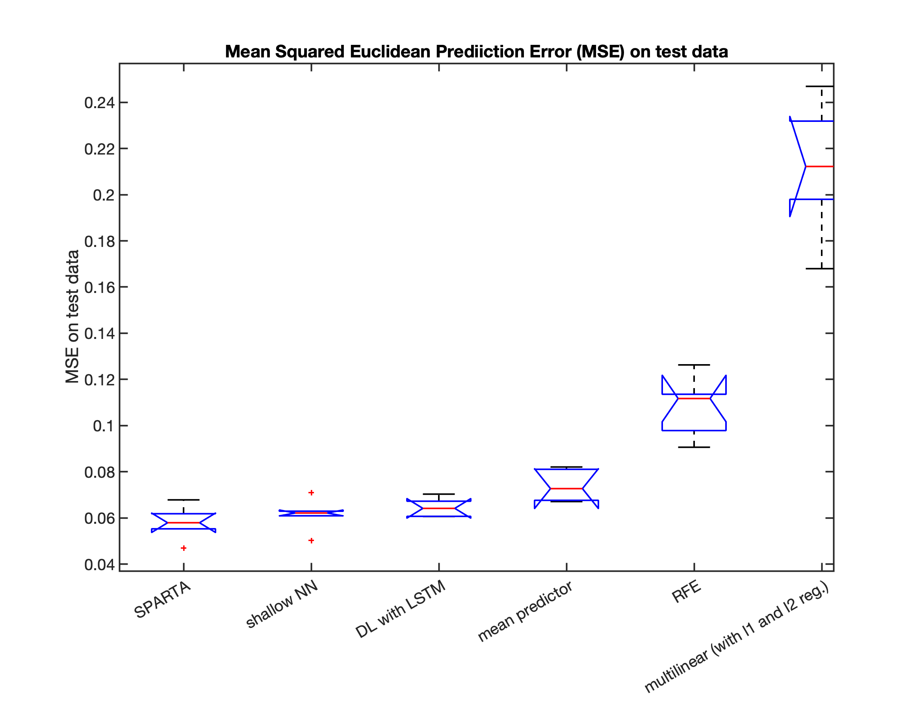
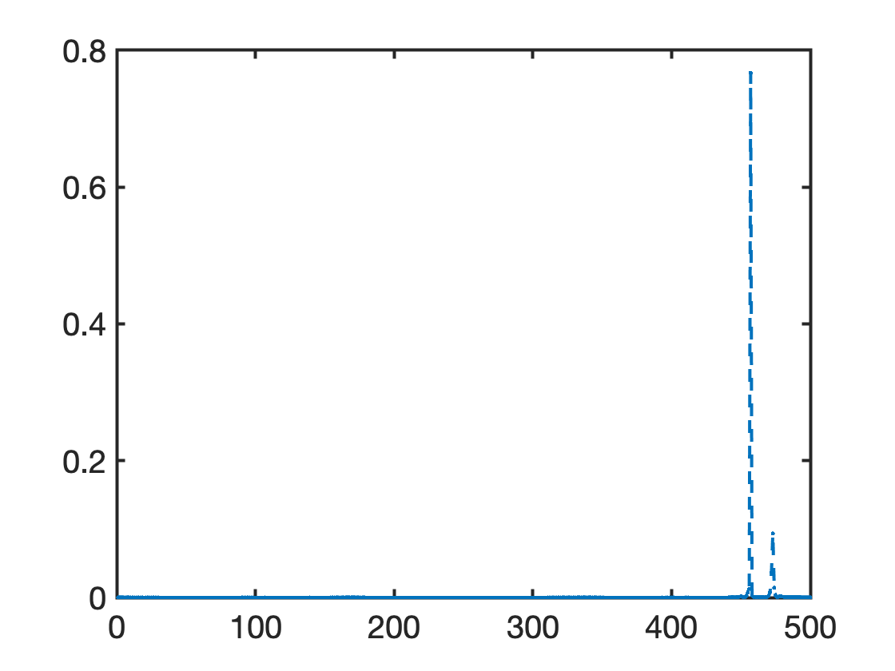
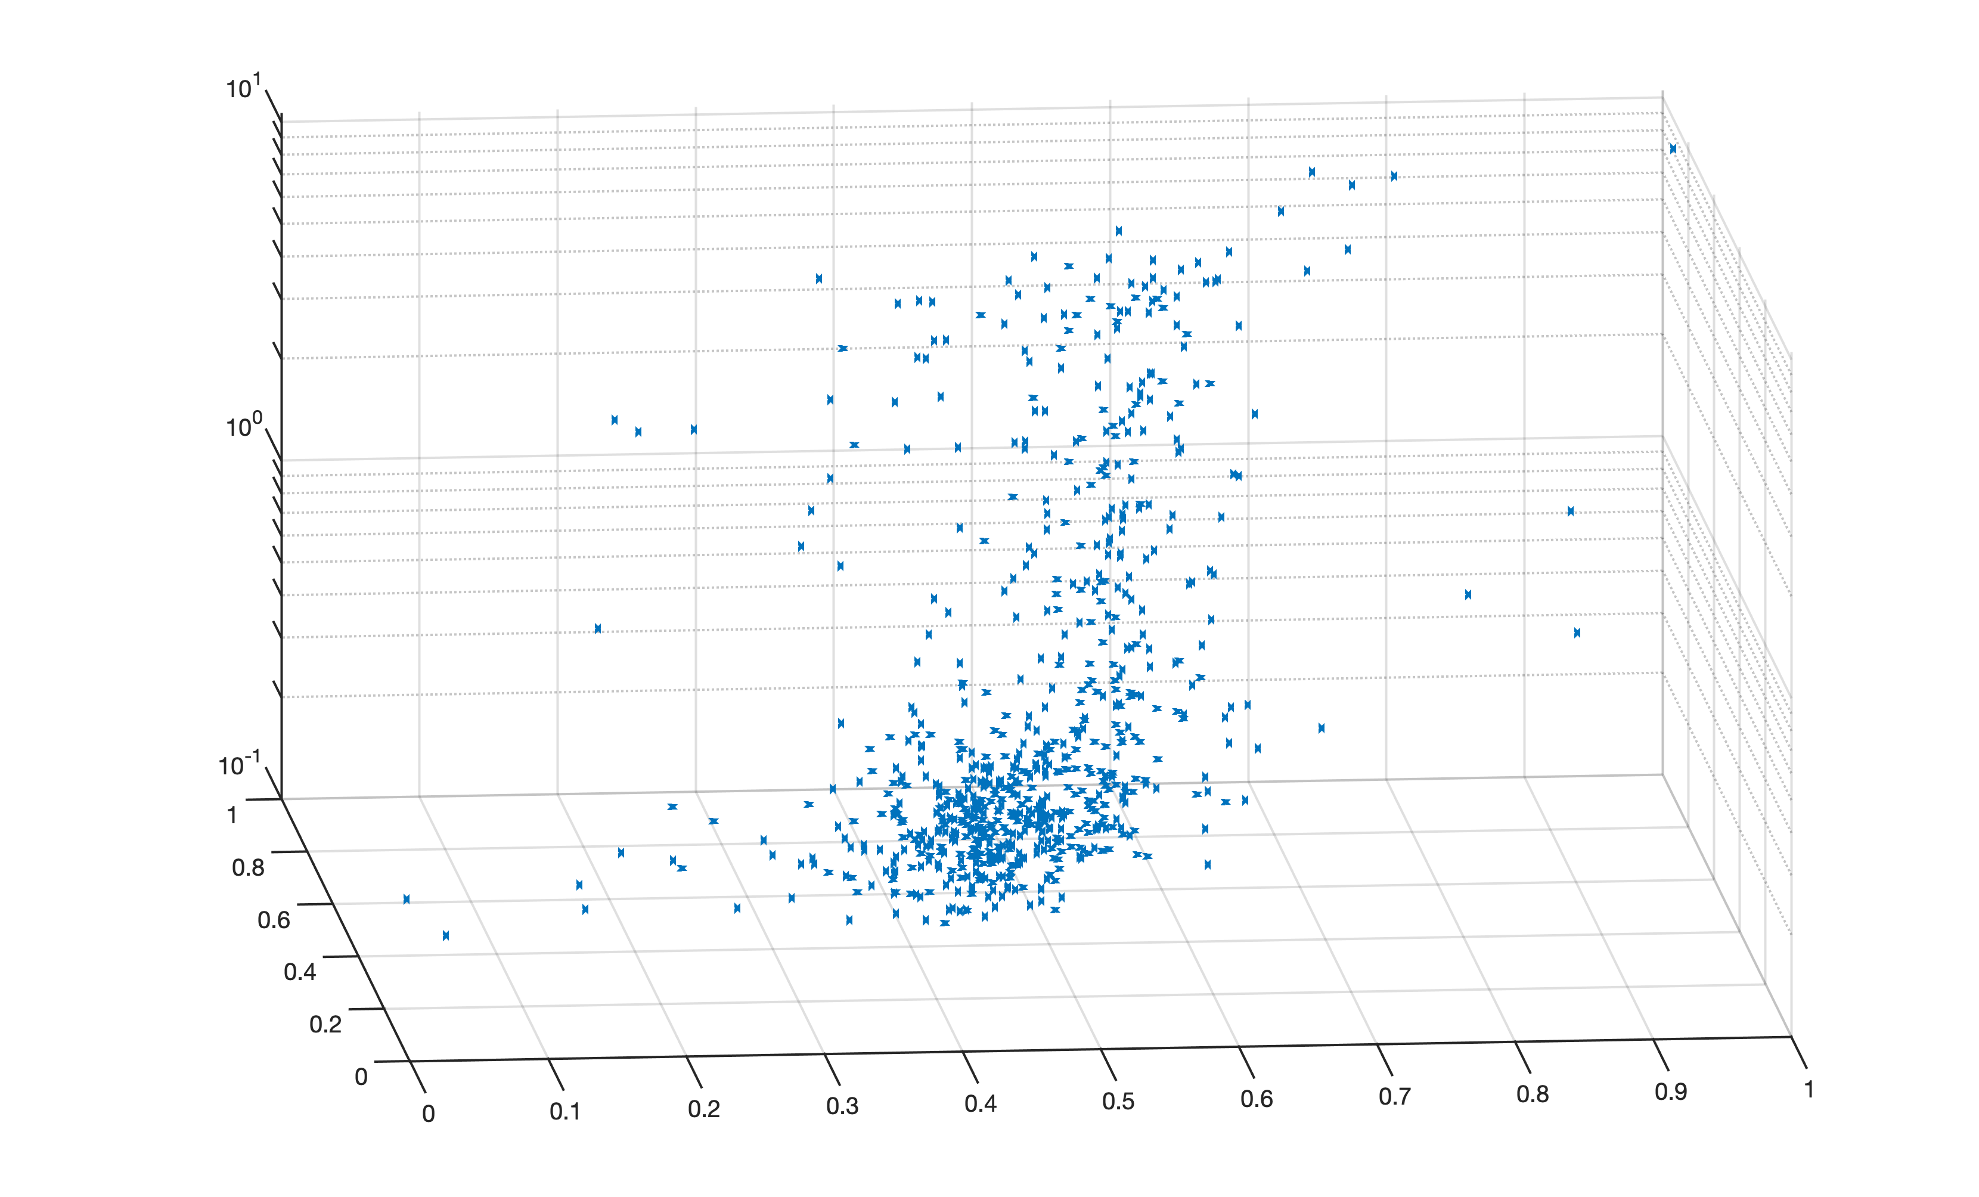
Feature 457
Feauture Weight
Feature 473
Feauture index (1-400 prestimulus, 401-500 peristimulus)
Response Time
Feature 473
Feature 457

