Slide 1

Maximize profitability in opening restaurant in New York City

Slide 2
Introduction to Business Problem
To provide business solution to ABC Company to open restaurants in New York City
This is done by maximizing profitability to suggest locations in neighborhood of Borough of New York City for Saturated Market, Untapped Market and popular cuisines in Borough of New York City

Slide 3
Data Collection and Cleaning
URL (https://cocl.us/new_york_dataset) was used to get location of each neighborhood in borough of New York City
Web Scrapping of Wikipedia Page (https://en.wikipedia.org/wiki/Cuisine_of_New_York_City) was used to get popular cuisine in neighborhood in borough of New York City

Slide 4
Methodology
Restaurants in the neighborhood of borough of New York City was explored.
Foursquare API was used to get Restaurant Venue and URL (https://cocl.us/new_york_dataset) was used to get location of each neighborhood.
Saturated Market and Untapped Market was checked in the neighborhood by doing clustering and visualizing the neighborhood in Map.
Popular cuisine in neighborhood of borough of New York City was explored by Web Scrapping of Wikipedia Page (https://en.wikipedia.org/wiki/Cuisine_of_New_York_City) visualizing
Popular cuisines was visualized by Word Cloud

Slide 5
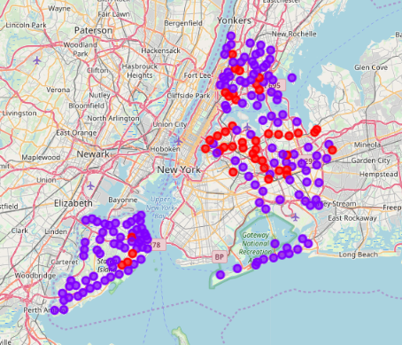
Results: Saturated and Untapped Location
In the map, purple points denote untapped location and red points denote saturated location for opening new restaurant in neighborhood of Boroughs viz. The Bronx, Queens and Staten Island in the New York City.

Slide 6
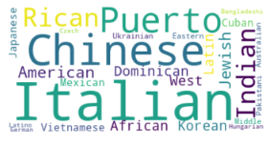
Results: Word Cloud of cuisines of Manhattan
By observing Word Cloud of cuisines of Manhattan, top 3 preferred cuisines of Manhattan:
Italian
Chinese
Puerto Rican

Slide 7
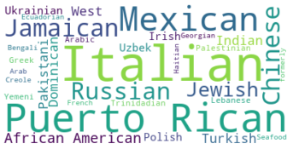
Results: Word Cloud of cuisines of Brooklyn
By observing Word Cloud of cuisines of Brooklyn, top 3 preferred cuisines of Brooklyn:
Italian
Puerto Rican
Mexican

Slide 8
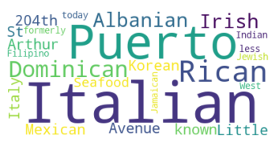
Results: Word Cloud of cuisines of The Bronx
By observing Word Cloud of cuisines of The Bronx, top 3 preferred cuisines of The Bronx:
Italian
Puerto Rican
Dominican

Slide 9
Discussion
We can provide solution by suggesting them to open restaurant in the neighborhood like 'Wakefield', 'Co-op City', 'Eastchester', 'Fieldston', 'Riverdale', 'Woodlawn', 'Norwood', 'Williamsbridge', 'Baychester', 'Pelham Parkway', 'City Island', 'Bedford Park', 'University Heights', 'Morris Heights', 'East Tremont', 'West Farms', 'High Bridge', 'Mott Haven', 'Port Morris', 'Hunts Point', 'Morrisania', 'Soundview', 'Clason Point', 'Throgs Neck', 'Country Club', 'Westchester Square', 'Van Nest', 'Spuyten Duyvil', 'North Riverdale', 'Pelham Bay', 'Schuylerville', 'Edgewater Park', 'Castle Hill', 'Olinville', 'Pelham Gardens', 'Concourse', 'Edenwald', 'Claremont Village', 'Mount Eden', 'Mount Hope', 'Bronxdale', 'Allerton', 'Kingsbridge Heights' instead of neighborhood like 'Kingsbridge', 'Fordham', 'Melrose', 'Longwood', 'Parkchester', 'Morris Park', 'Belmont', 'Unionport', 'Concourse Village' and to have Italian, Puerto Rican, Dominican as top cuisines in those restaurants.

Slide 10
Conclusion
With such observation we can provide solution to ABC Company to open restaurant in the given location of untapped market and have preferred cuisine in the restaurant accordingly

Slide 11
Thank You!!

