Slide 1

Confidence-Aware RAG Pipeline with Hallucination Detection
A chatbot that answers only when its documents back it up.
Shivam Gupta (BTCD24O1060)
Cornerstone Project · Project Expo 2026
Artificial Intelligence & Machine Learning Systems · July–Dec 2026
Notes:
One line: I built a document chatbot that checks its own answers twice and says "I don't know" instead of guessing when the documents don't support an answer.

Slide 2



The problem: chatbots make things up
Answers anyway
Adds details
Contradicts
The documents don't cover the question, so the model fills the gap from memory.
The right text is found, but the answer includes facts that aren't in it.
The answer says the opposite of what the documents say.
And it sounds just as confident either way. Users can't tell a right answer from a made-up one, and a confident wrong answer is worse than "I don't know".
Notes:
This is called hallucination. RAG (retrieval-augmented generation) gives the model relevant documents, which helps, but doesn't stop it. Give one quick example of each failure.

Slide 3


My idea: check twice, then decide
Gate A · before answering
Gate B · after answering
Are the retrieved passages actually about this question?
If not, stop. The language model never even runs.
Is every sentence of the answer backed by the passages?
If not, hold the answer back and show which sentence failed.
Pass both checks → answer, with the evidence. Fail either → "I don't know", with the reason. Runs fully offline on a laptop.
Notes:
Objectives in one breath: build the pipeline, add both checks, combine them into one decision, log everything to a dashboard, and measure it honestly against a normal chatbot. Gate A uses a reranker model, Gate B uses an NLI (natural language inference) model.

Slide 4
How it works: one question, step by step
1 · Find text
top 5 matching passages from the documents
2 · Gate A
are these passages relevant?
Relevant enough?
3 · Answer
local LLM writes an answer from the passages
LLM said it can't?
4 · Gate B
is each sentence backed by the passages?
Question
yes
no
no
yes
"I don't know"
nothing relevant found
"I don't know"
the LLM itself declined
Done once, offline
documents split into chunks and stored in a vector database
Answer
shown with its sources and evidence
Confident enough?
5 · Combine
one confidence score from both gates
Backed up?
yes
yes
no
no
Answer + warning
passed, but only just
"I don't know"
answer held back; shows why
Every decision is logged and shown on a monitoring dashboard.
Notes:
Details if asked: retrieval uses MiniLM embeddings in ChromaDB; Gate A is a cross-encoder reranker with threshold 0.45; the LLM is llama3.1 8B via Ollama; Gate B is a DeBERTa NLI model with threshold 0.25; the combined score is a weighted harmonic mean (0.4 / 0.6) with threshold 0.33.

Slide 5



Three choices that make it work
Two different models
One weak check fails all
One lie isn't averaged away
Gate A ranks passages by relevance. Gate B checks if a sentence follows from a passage. Different jobs, so different models.
If relevance is 0.95 but support is 0.05:
If any sentence contradicts the documents, the whole answer fails, even if every other sentence is true.
0.50 average: would pass
0.08 my score: correctly fails
Notes:
Middle card: the combined score is a weighted harmonic mean, which is pulled down by the weaker gate. Right card: a contradicted sentence caps Gate B at 0.15, a fixed number so tuning thresholds can never switch it off.

Slide 6

How I tested it
Two systems, same questions, same model
A normal RAG chatbot
always answers
My system
both checks switched on
150 test questions
From SQuAD 2.0. Half of them have no answer in the text: they are traps designed to look answerable.
What I counted
Made-up answers: answering a trap question (lower is better)
Missed answers: refusing a question it could have answered (lower is better)
Also tested on 150 harder multi-step questions (HotpotQA)
Notes:
Each question is searched among its own paragraph plus four unrelated ones, so retrieval has to work. Terms if asked: made-up answers = hallucination rate; missed answers = over-abstention.

Slide 7
The journey: five milestones
M1
M2
M3
M4
M5
Build
Test
Tune
Stress-test
Audit & fix
The pipeline, both checks, the app
150 questions vs a normal chatbot
Set the check thresholds from data
Harder multi-step questions
Re-checked everything, fixed Gate B
Working app, 31 tests
Made-up answers 75 → 3, but too cautious
Slightly less cautious
Gate B struggles
Missed answers 71% → 48%
Notes:
M2: it refused 84% of answerable questions. M3: calibration brought that to 72%. M4: on multi-step questions the evidence is split across passages and Gate B can't combine it. M5: the audit, next slide. Details for each milestone are in the backup slides.

Slide 8



What I found and fixed
A bug in my own scoring
Answers ending in a citation like "[1]" were marked wrong. When the system answered, it was actually right 20 of 21 times.
The real reason it was too cautious
Gate B rejected correct answers (35 of 36 rejections) because it read whole paragraphs at once.
The fix: Gate B v2
Check each sentence against short 3-sentence windows as well as the full passage.
17 more correct answers for 2 more mistakes, a statistically significant gain.
Notes:
The audit re-scored every saved answer. Viva details: missed answers fell from 70.7% to 48.0% (paired McNemar test, p < 0.001); the 2 extra made-up answers are not significant (p = 0.5). Gate B v2 takes about 0.4 s instead of 0.1 s.

Slide 9
Results
75 → 11
made-up answers to trap questions
3 in 4
of its answers are correct, versus under half for a normal chatbot
The cost
still says "I don't know" to about half of the answerable questions
Notes:
Exact figures if asked: correct share of all answers given is 76% vs 45%; 38 of the 39 answerable questions it chose to answer were right; missed answers 48%. The normal chatbot answers everything, so it gets more right in total but also answers all 75 traps.

Slide 10
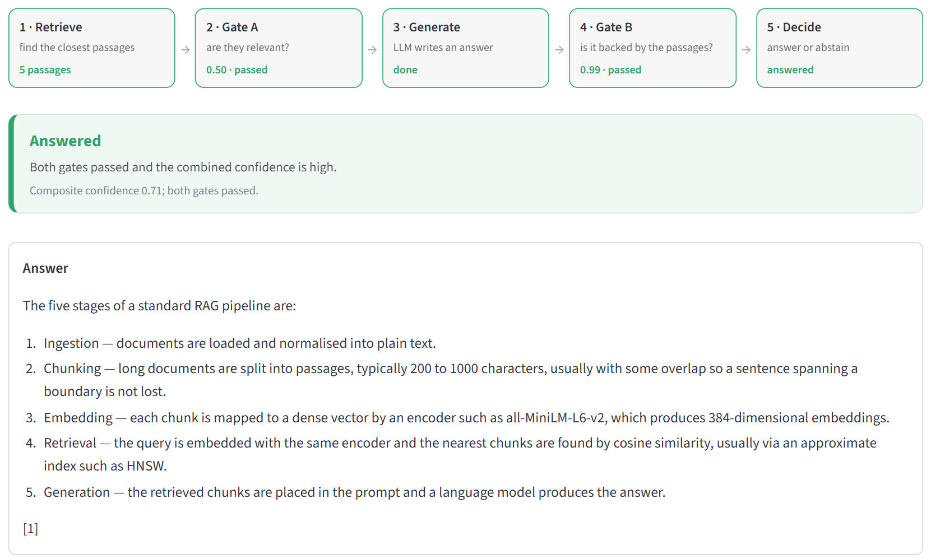
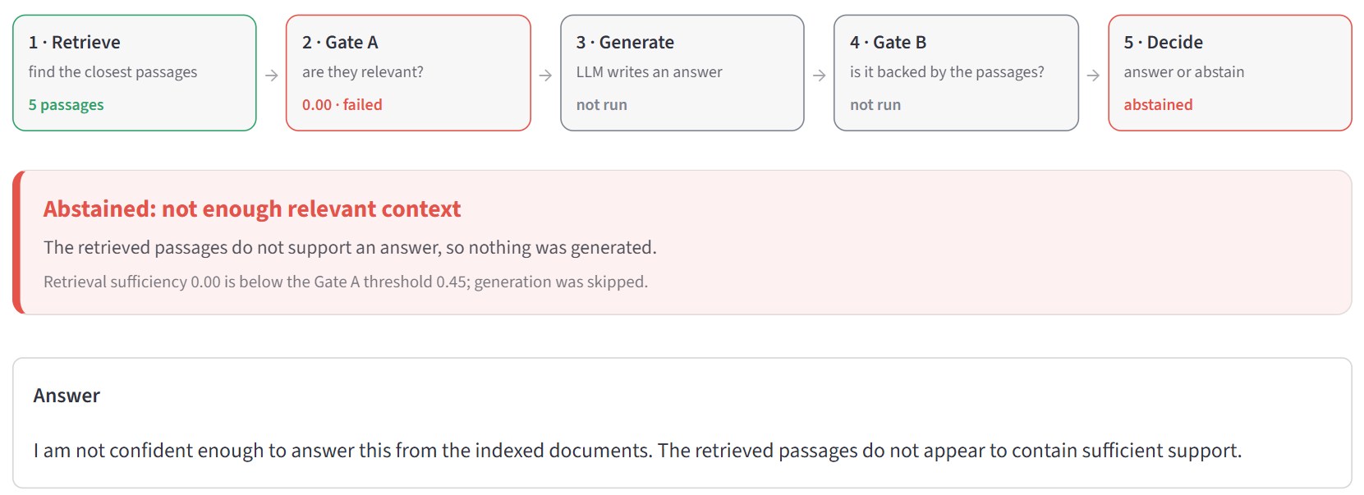
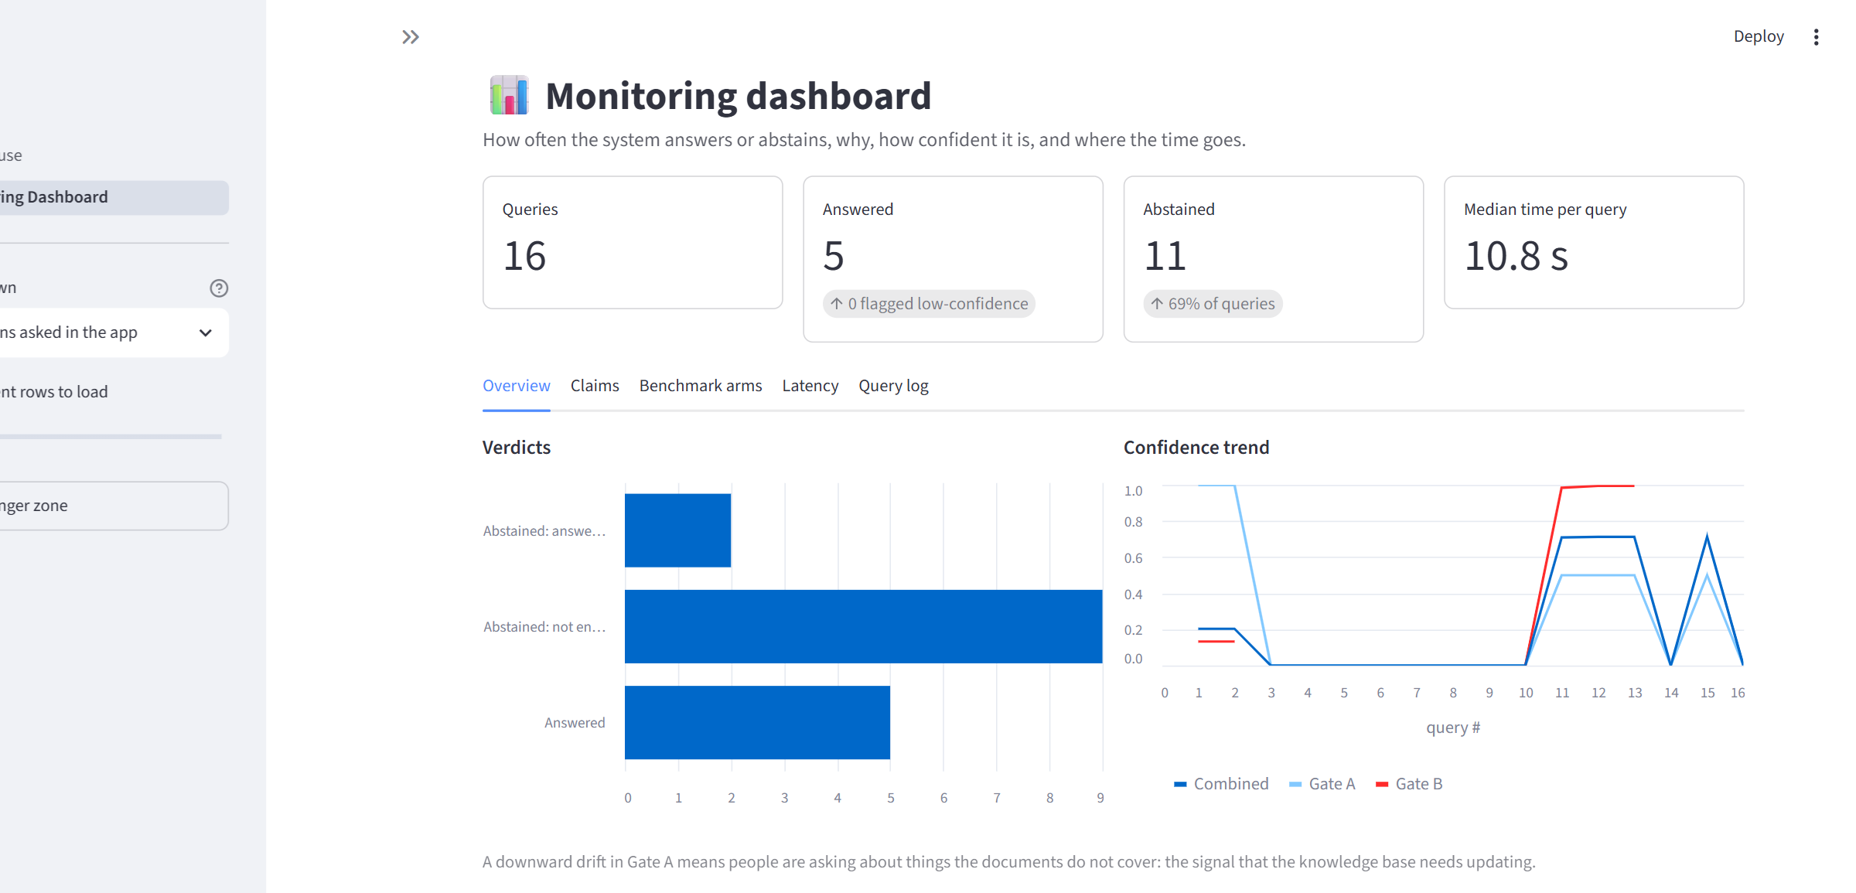
Live demo
Off-topic question: refused before the LLM runs
Answered: both checks pass, evidence shown
Dashboard: every decision logged
Notes:
Demo order: 1) the five-stages question, answered; 2) the Amazon rainfall question, refused at Gate A; 3) the same question in Baseline mode, which answers anyway; 4) the False alarm question, an honest limitation; 5) the dashboard. Warm up Ollama before presenting.

Slide 11


Limitations and what's next
Limitations
What's next
Still too cautious: refuses about half of the answerable questions
Gate B sometimes rejects a correct sentence
Weak on multi-step questions, where the evidence is split across passages
Tested on 150 questions, so the numbers have some uncertainty
A bigger checking model: already tried, it cut wrongly rejected answers from 41% to 10% on SQuAD, but needs a bigger GPU
Check multi-step answers against several passages together
Test on more questions
Notes:
The bigger model was DeBERTa-v3-large: AUROC 0.65 to 0.70 on SQuAD, but no gain on HotpotQA, and it doesn't fit next to the LLM on an 8 GB GPU without very small batches.

Slide 12
In short
1
It knows when to say "I don't know"
Made-up answers fell from 75 to 11 out of 75.
2
It shows its reasons
Every answer or refusal comes with the evidence behind it.
3
I tested it honestly
Compared against a normal chatbot, then audited and fixed my own mistakes.
Thank you · Questions?
Shivam Gupta (BTCD24O1060) · Cornerstone Project
Notes:
Stop here. The slides after this are backup, only for detailed questions.

Slide 13
Backup slides
Details for questions: implementation, calibration, multi-hop results, audit.

Slide 14
Backup · Implementation (Milestone 1)
Layer | Files | Role
Data layer | ingest.py · embeddings.py · retriever.py | parse, chunk, embed, search
Scorers | scorers.py | reranker (Gate A), NLI (Gate B), LLM judge
Confidence layer | confidence.py | gates, contradiction cap, composite, verdicts
Generation | generator.py · llm.py | grounded prompt; Ollama, Groq, Gemini
Orchestration | pipeline.py · store.py | runs the stages, logs one row per query
Interface | app.py · pages/ | app, guide, monitoring dashboard
Stack
Python · LangChain · ChromaDB
MiniLM embeddings + reranker
DeBERTa-v3 NLI
llama3.1 8B via Ollama
Streamlit · SQLite
92 unit tests · ruff

Slide 15
Backup · Calibration and judge study (Milestone 3)
Threshold | Before | Fitted | How
Gate A | 0.45 | 0.45 | Youden's J; AUC 0.65; chosen in 185 of 200 splits
Gate B | 0.60 | 0.25 | F1, kept above the 0.15 contradiction cap
Composite | 0.55 | 0.33 | just above both gates' corner
84% → 72%
3 → 8
κ ≈ 0.04
missed answers after calibration
made-up answers of 75; p = 0.06, not significant
NLI vs gemma2 LLM judge: chance-level agreement; judge ~860× slower

Slide 16
Backup · Multi-step questions (Milestone 4, HotpotQA)
43% → 59%
normal chatbot accuracy, sentence vs chunk indexing
41% → 24%
wrong answers among those given, with checks on (22% answered)
~2 in 3
correct multi-step answers that Gate B rejects

Slide 17
Backup · Audit details (Milestone 5)
Item | Finding | Result
Citation scoring | "1894 [1]" failed exact match | guarded answers right 20 of 21 times
Headline metric | aggregate EM rewards abstaining on SQuAD 2.0 | report answered / abstained breakdown
Prompt vs gates | guarded prompt also allows refusing | of 67 refusals: 40 gates, 27 the model
Gate B | 36 answerable answers rejected | 35 were correct; fixed in v2
Gate B v2 (fresh run) | missed answers 70.7% → 48.0% | McNemar p < 0.001; made-up +2, p = 0.5
DeBERTa-large (offline) | SQuAD AUROC 0.65 → 0.70 | no gain on HotpotQA; GPU memory limit

