Slide 1
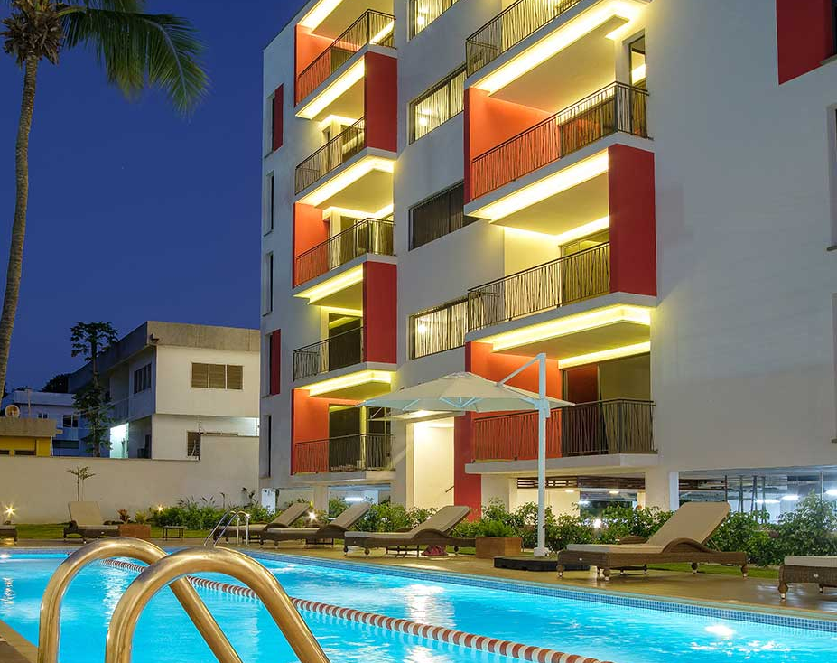
CAPSTONE PROJECT PART TWO
GIDEON AHIADZI

Slide 2
WHERE TO FIND BUDGET ACCOMMODATION IN ACCRA

Slide 3
PROJECT OUTLINE
Introduction
Data Exploration
Insights
Conclusion

Slide 4
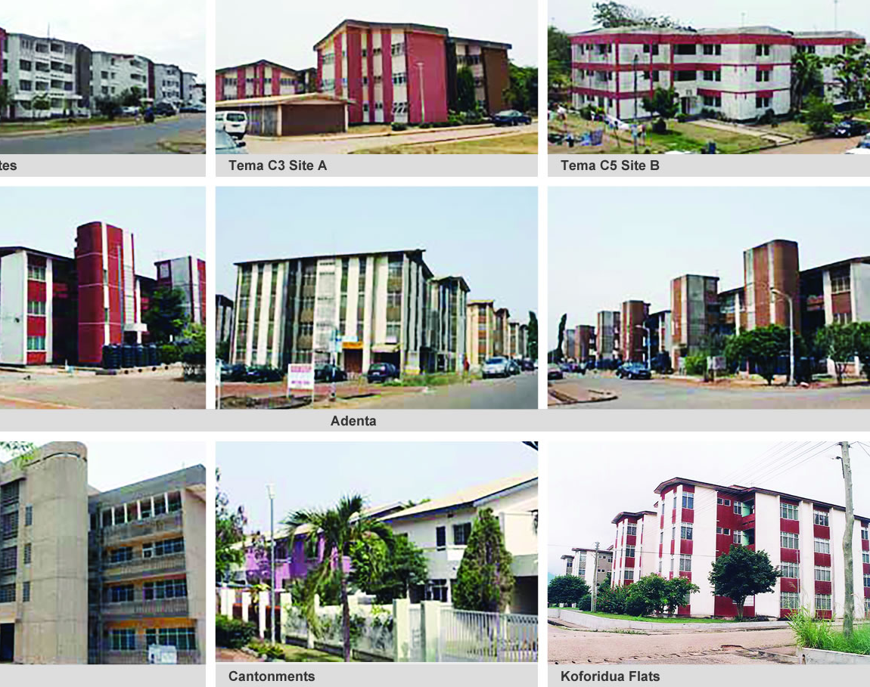
PROJECT GOAL The main goal of the project is to find the areas in the Greater Accra Region with the most affordable accommodation

Slide 5
DATA EXPLORATION
TOOLS USED
The exploration of the dataset was done mostly with the help of the Python Programming Language.
Some of the libraries used includes Pandas, NumPy, Matplotlib, Plotly and Seaborn,
DATA QUALITY ASSESSMENT
The dataset contain over two thousand observation and nine features. Its was assessed to account for missing values, uniqueness, inconsistent values, incorrect data and inconsistent datatype. Check appendix for data quality assessment report.

Slide 6
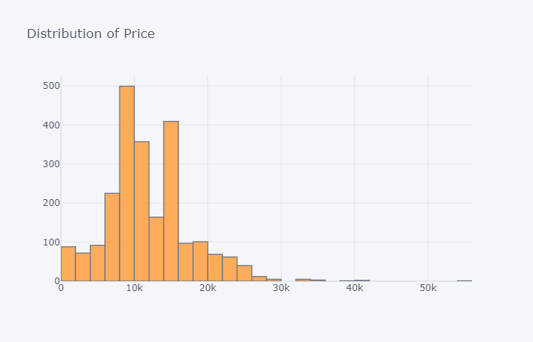
DISTRIBUTION OF PRICES OF ACCOMMODATION IN ACCRA Accommodation price in a range from about GH₵ 100 to about GH₵ 50,000 per month Most the prices are however concentrated within the GH₵ 500 to GH₵ 15,000 per month
INSIGHTS

Slide 7
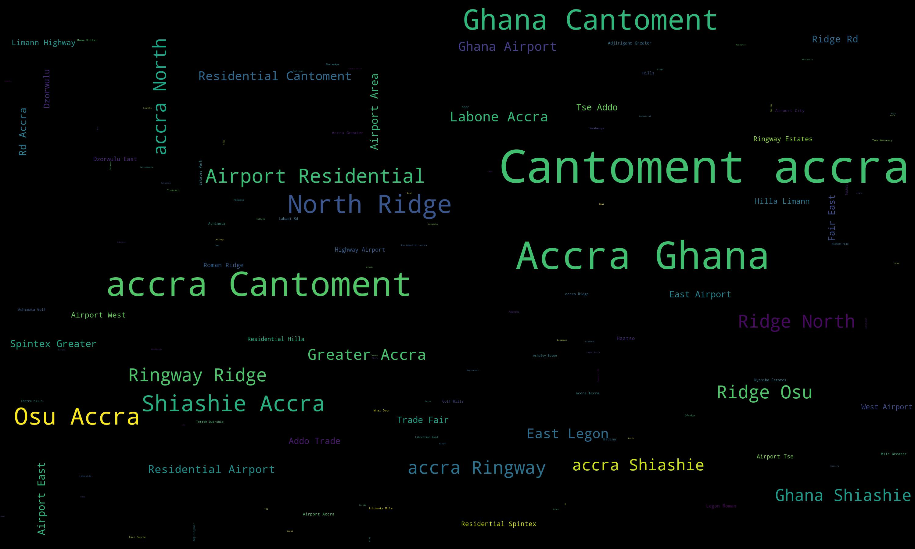
AREAS IN ACCRA WITH THE MOST ACCOMMODATION LISTINGS From the word cloud presented Cantoment has the most listing of Accommodation in Accra. Other noticeable areas include Osu, Airport Residential, Accra
INSIGHTS

Slide 8
VARIABLE THAT INFLUENCE THE PRICES OF ACCOMMODATION IN ACCRA Some of the variable that influence the prices of accommodation in Accra includes 1. Location of the accommodation 2. The availability of the amenities Other factors includes the following (in the following slides we see that these factors does not have a strong effect on the price as compared to the location and availability of amenities) 3. The number of Bedrooms 4. The floor area measured in meter squared 5. The Number of garages
INSIGHTS

Slide 9
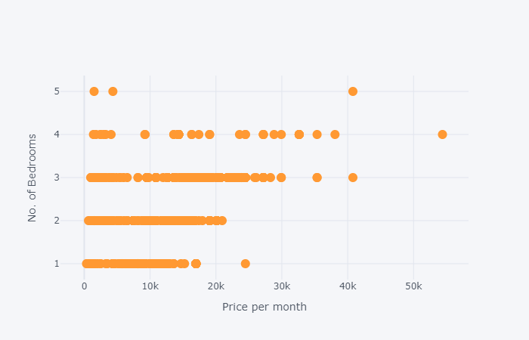
No. of Bedrooms vs Price With correlation coefficient of 0.565
INSIGHTS

Slide 10
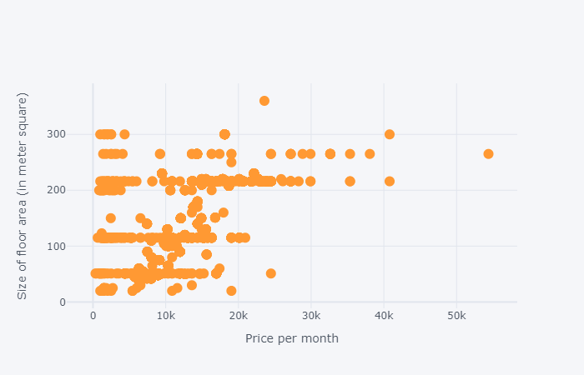
Floor Area vs Price With correlation coefficient of 0.574
INSIGHTS

Slide 11
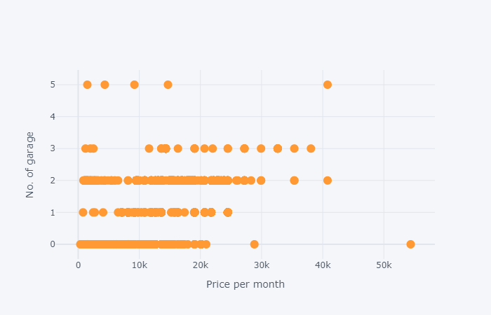
No. of Garage vs Price With correlation coefficient of 0.492
INSIGHTS

Slide 12
AREAS WITH THE MOST AFFORDABLE RENT PRICES IN ACCRA. The price of accommodation in Accra is highly dependent on the budget of the individual. It is also the individual decision to rent a house with a specific number of bedrooms in a specific location. Hence, I will show charts with location of every number of bedrooms ranging from 1 to 5 with respect to their prices. This will help an individual to decide based on their budget where to get an affordable apartment to rent.
INSIGHTS

Slide 13
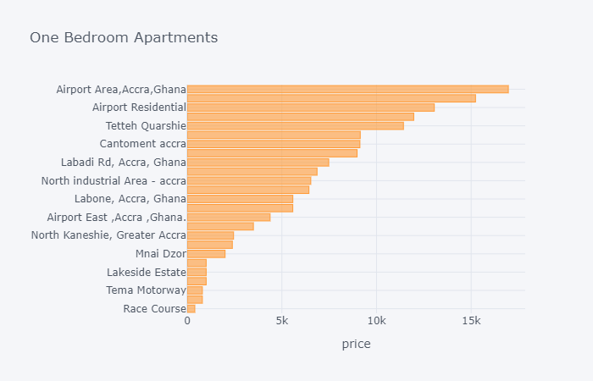
AREA TO FIND AFFORDABLE ONE-BEDROOMS ACCOMMODATIONS Race-Course has the cheapest one-bedroom accommodation in Accra. The average price of accommodation at this location is about GH₵ 200. Haasto, Tema Motoway, Lakeside estate, Pobiman also have affordable rent. It is worth noting that this accommodation are not fully furnished are may are likely to lack amenities such as reservoir, internet, Pools etc. To get such amenities an individual should consider the Airport and Cantoment areas
INSIGHTS

Slide 14
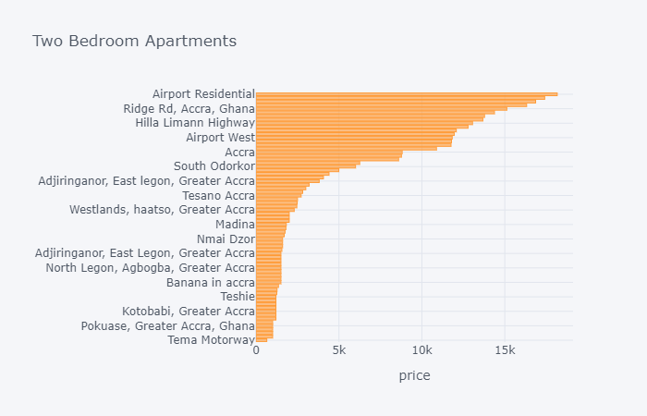
AREA TO FIND AFFORDABLE TWO- BEDROOMS ACCOMMODATIONS Two-bedrooms apartments ranges between GH₵ 350 and GH₵ 17,500. The cheapest one can be found around Awoshie, Tema motoway, Circle Odo Rice, Lapaz, Pokuase, Alajo etc. Whereas the expensive ones can be at Airport area, Roman ridge, Osu. Again, it is worth noting that the cheapest accommodation are not fully furnished are may are likely to lack amenities such as reservoir, internet, Pools etc. As opposed to the expensive ones where they are fully furnished and has relevant amenities.
INSIGHTS

Slide 15
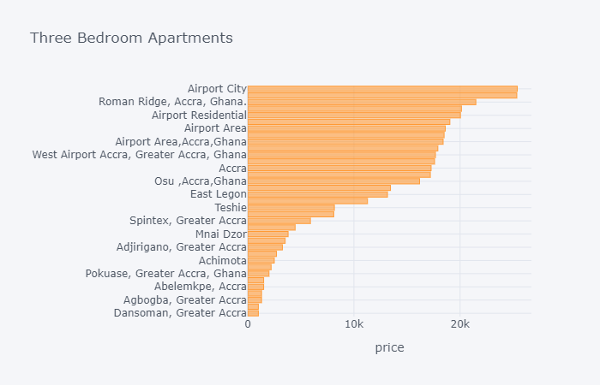
AREA TO FIND AFFORDABLE THREE-BEDROOMS ACCOMMODATIONS For affordable three-bedroom apartment, look no further than Dansoman, Ashaley Botwe, Agbogba, Ofankor, Pokuase, Pobiman and Abelemkpe. If you are feeling lucky you can again look around the Airport area if you care about luxury.
INSIGHTS

Slide 16
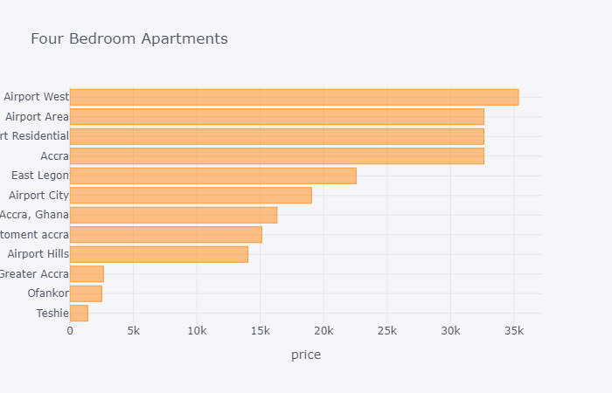
AREA TO FIND AFFORDABLE FOUR-BEDROOMS ACCOMMODATIONS Just like the previous cases, your choice to rent a four-bedroom house depends on your budget. For the cheapest one look around Teshie, Ofankor and also around Spintex. For luxury and fully-furnished apartment with amenities again start looking around Cantonment to Airport West area
INSIGHTS

Slide 17
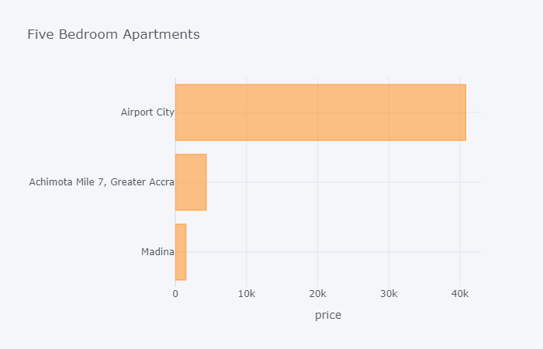
AREA TO FIND AFFORDABLE FIVE-BEDROOMS ACCOMMODATIONS For a cheaper 5 bedrooms apartment to rent, look around Madina, it will cost you around GH₵ 2000, per month. If you can afford about GH₵ 5000, look around Accra. Also, if Jeff Bezos is your friend, then look no further than Airport City.
INSIGHTS

Slide 18
From the analysis and insight generated, we have learnt that there are various options for you if you need to rent accommodation in Accra. Some of the main factors that influence the price of accommodation in Accra is the location, the availability of amenities. The number of bedrooms and the size floor area only has a mid positive effect the price of accommodation. It also goes without saying that at every price within the range of the dataset there is an available option except that you may have to sacrifice on some amenities and cater for furnishing the apartment. The location of the accommodation will also determine how much your pay per month.
CONCLUSION

